Slide 1
Low Cost SCADA for CyberSecurity Education
Tommy Morris
Professor, Electrical and Computer Engineering
Director, Center for Cybersecurity Research and Education
University of Alabama in Huntsville

Slide 2
TopICS
What is SCADA?
OpenPLC
Virtual SCADA w/ OpenPLC
Demo

Slide 3
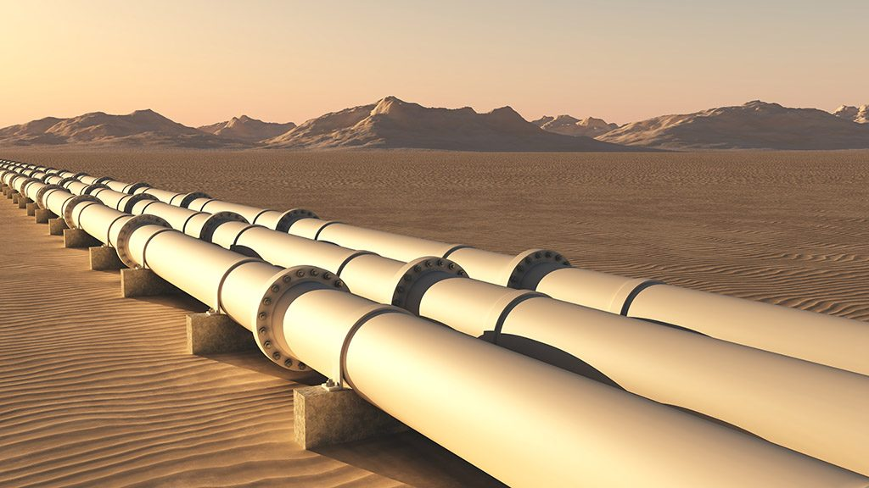
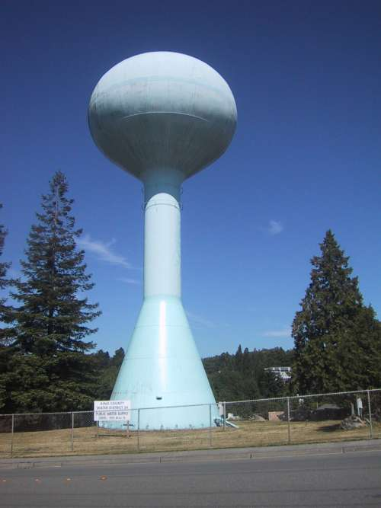
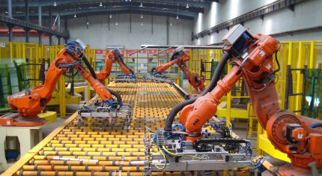
Oil/Gas Distribution
Flood Control
Petrochemical
Critical Infrastructure
Water Distribution
Factory
Automation
Electrification
Notes:
Are there computers here?
Hydraulic drives, gate controls, water level monitoring, etc

Slide 4
A Common Understanding
Cyber security staff must understand the system/product they are defending.
Product/design engineers must understand implications of poor cyber security.
Cyber security
staff
Product engineers

Slide 5
The set of computers, networked data communications and graphical user interfaces that monitors and control industrial processes is called SCADA

Slide 6
What Is SCADA?
Supervisory Control And Data Acquisition
Notes:
When controllers are applied to processes like shown before, the system is usually called SCADA

Slide 7
What Is SCADA?
Supervisory Control And Data Acquisition
Huh?!

Slide 8
What Is SCADA?
Supervisory Control And Data Acquisition
Supervisory | Control | Data Acquisition
Supervisor synonyms Manager Overseer Administrator | Change current state of process Open close breakers, switches, valves, etc. | Situational Awareness Monitoring

Slide 9
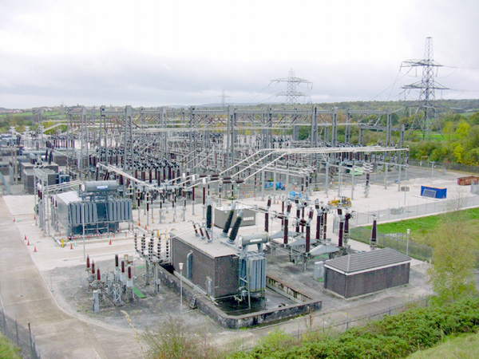
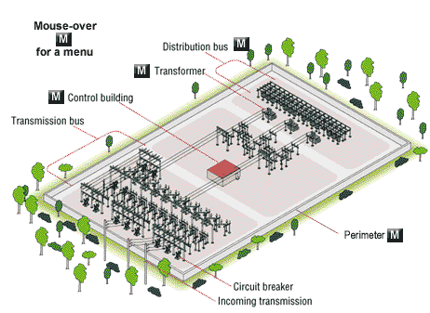
Substation
Situational Awareness
Control
Open/close breakers
Islanding

Slide 10
Water Distribution
Need to control water level in tower to keep steady water pressure.
Water is pumped in when level is low.

Slide 11
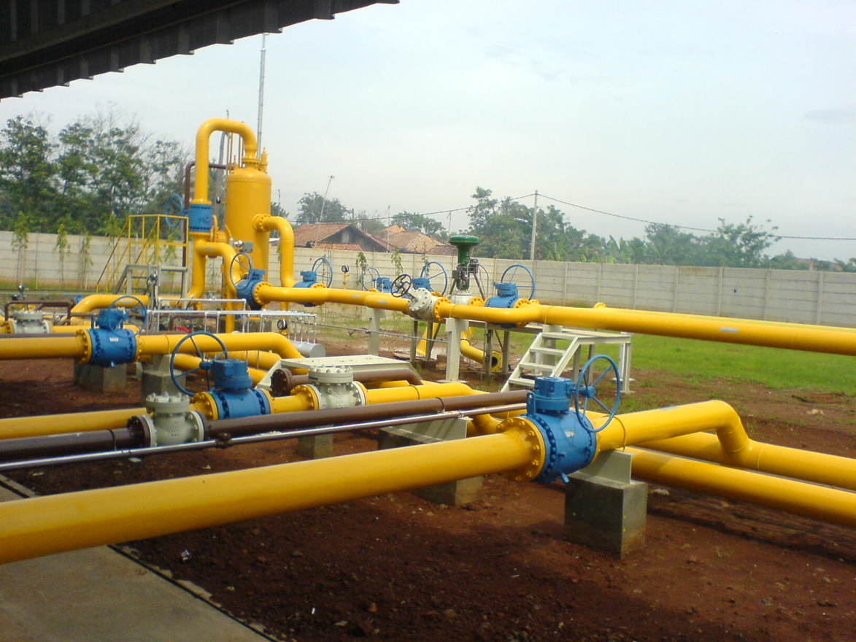
Oil/Gas Distribution
Monitor Pressure
Route Product
Billing

Slide 12
Electric Grid
Situational Awareness
Route Power
Billing

Slide 13
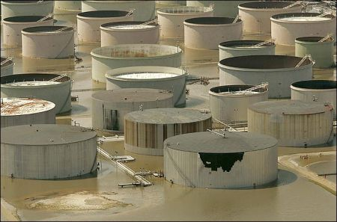
Petrochemical
Follow complex recipe to produce product
Safety
Storage

Slide 14
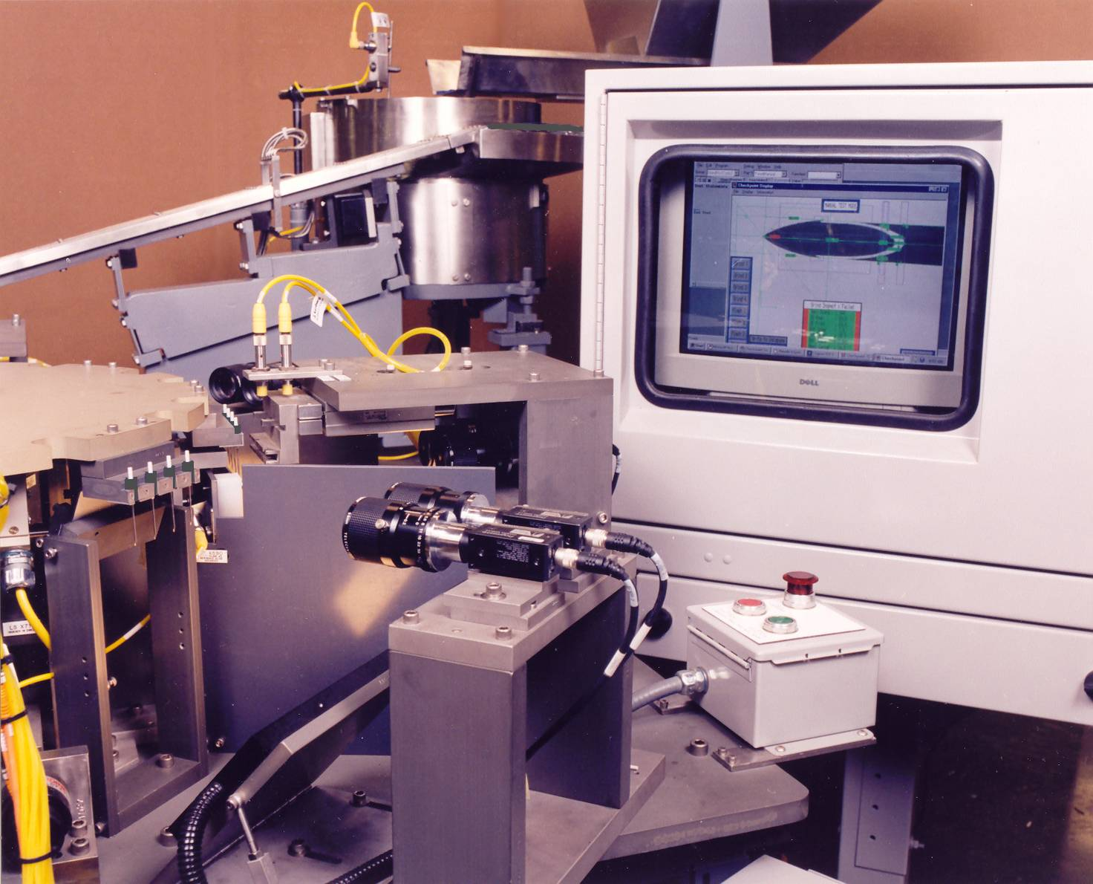
Factory: Donor Needle Machine
This machine captured donor needles off the grinder and feed them onto a turntable. Once on the turntable the needles were presented to a machine vision system four at a time for inspection. The system verified the angle of the needle to ensure it was within specification.
Slide from Drew Richey.

Slide 15
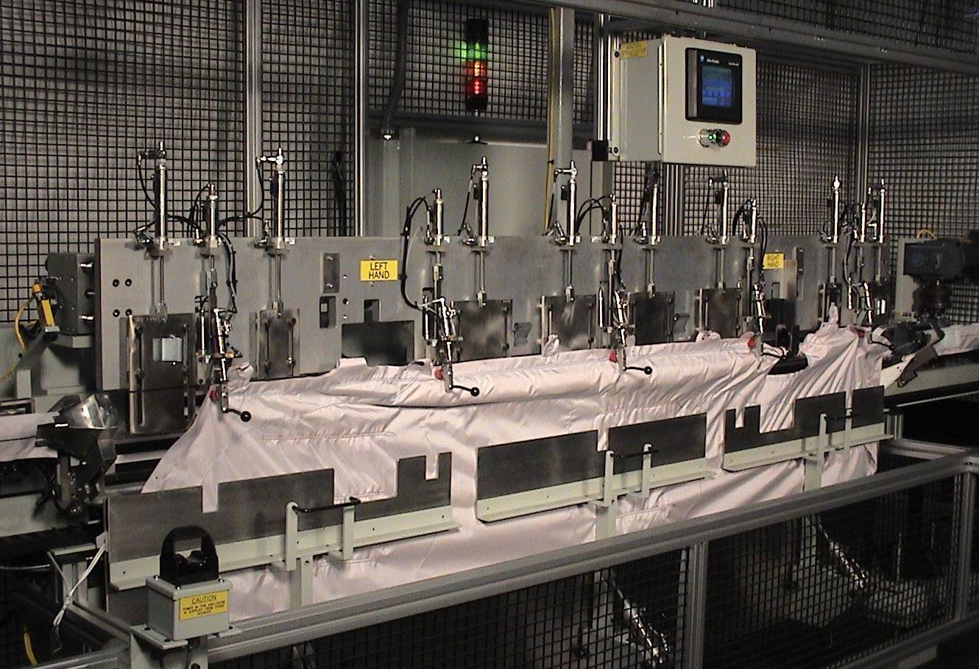
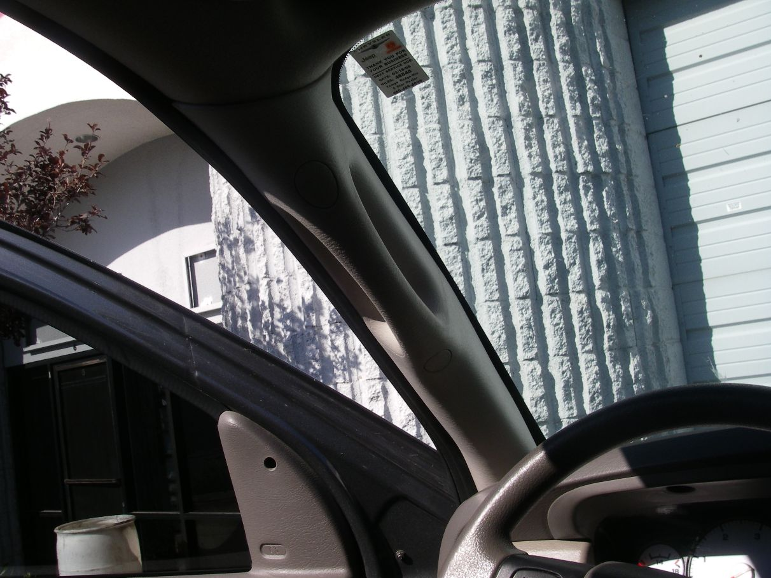
Factory: Airbag Assembly Machine
This machine takes an unfolded airbag cushion and folds it to the highly critical fold specs required for correct deployment. Once it is properly folded a slide advances a sock over the bag to help keep its form.
A-Pillar
Slide from Drew Richey.

Slide 16
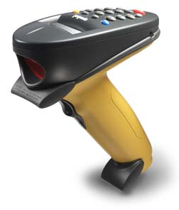
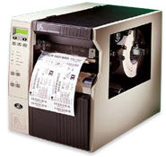
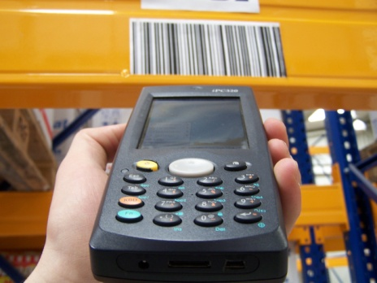
Factory: Traceability System
Auto manufacturing
JIT manufacturing
DOT Federal mandate (seven year history)
Each supplier followed same traceability requirement
Plant stopped if traceability system wasn’t on-line
Slide from Drew Richey.

Slide 17
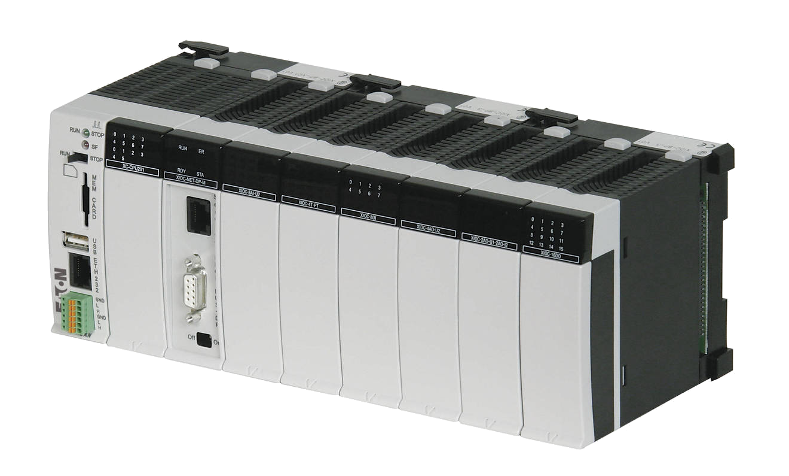
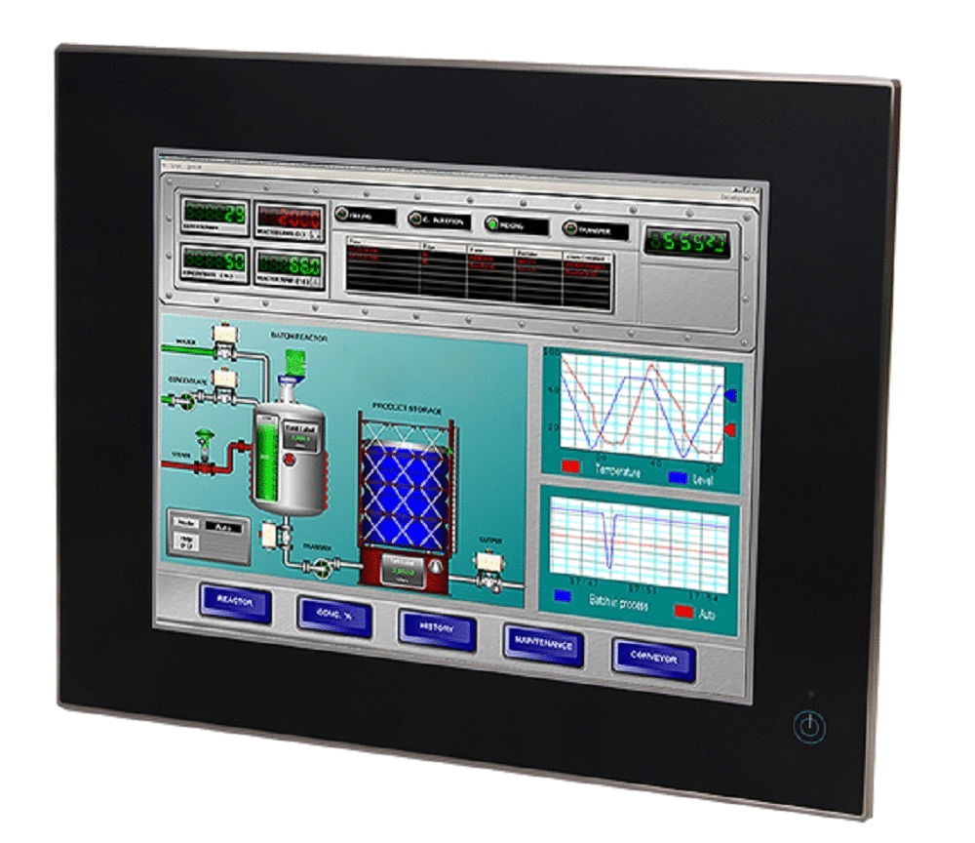
SCADA Architecture
Physical System
(sensors and actuators)
Wired or Wireless Connection
Programmable Logic Controller (PLC)
Network
Human-Machine Interface

Slide 18
Physical System
Physical structure for the process
Embedded sensors that measure quantities such as pressure, temperature, flow, or density
Embedded actuators to control mechanisms such as solenoids, valves, or gates

Slide 19
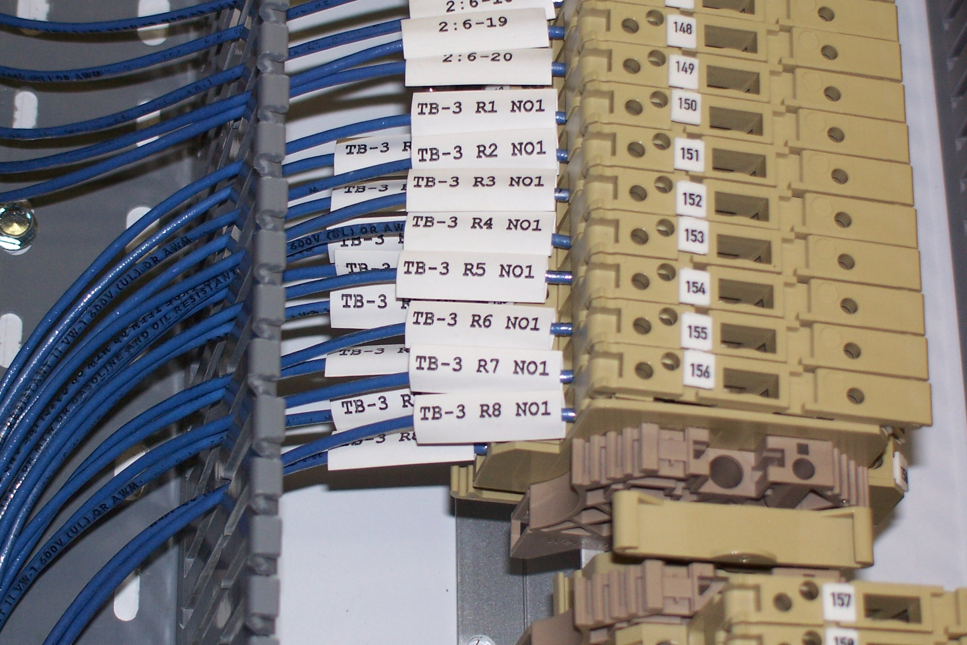
Wired (or wireless) Connection
Sends sensor signals to the controller
Sends controller commands to the actuators
Electrical communication between the controller and its physical interfaces

Slide 20
Programmable Logic Controller
Digital Computer used on Automation
Input modules read data from sensors
User program decides what to do based on the input data
Output modules control actuators on the physical system

Slide 21
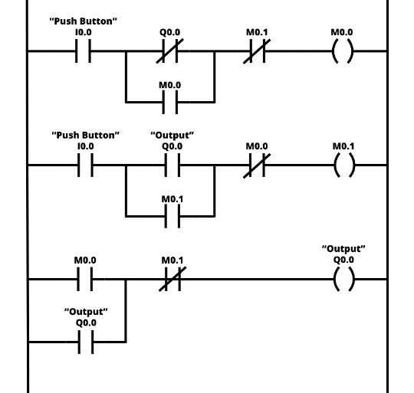
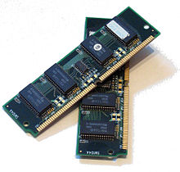
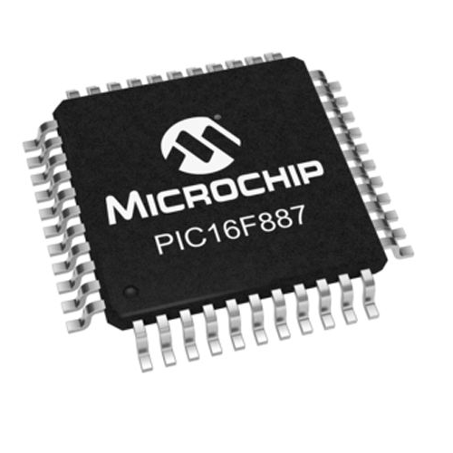
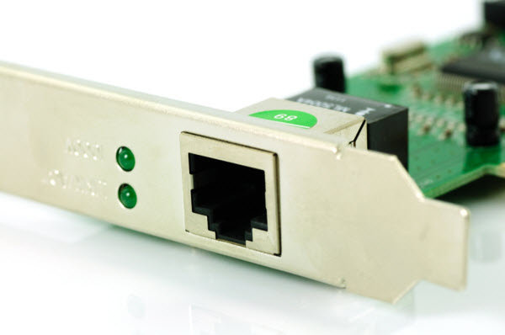
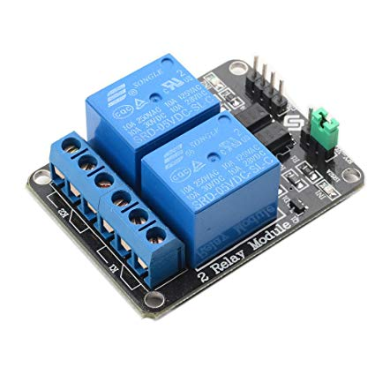
What is inside a PLC?
Program-
Ladder
logic
Memory
Microcontroller - often older technologies
Network I/F
Physical System I/F

Slide 22
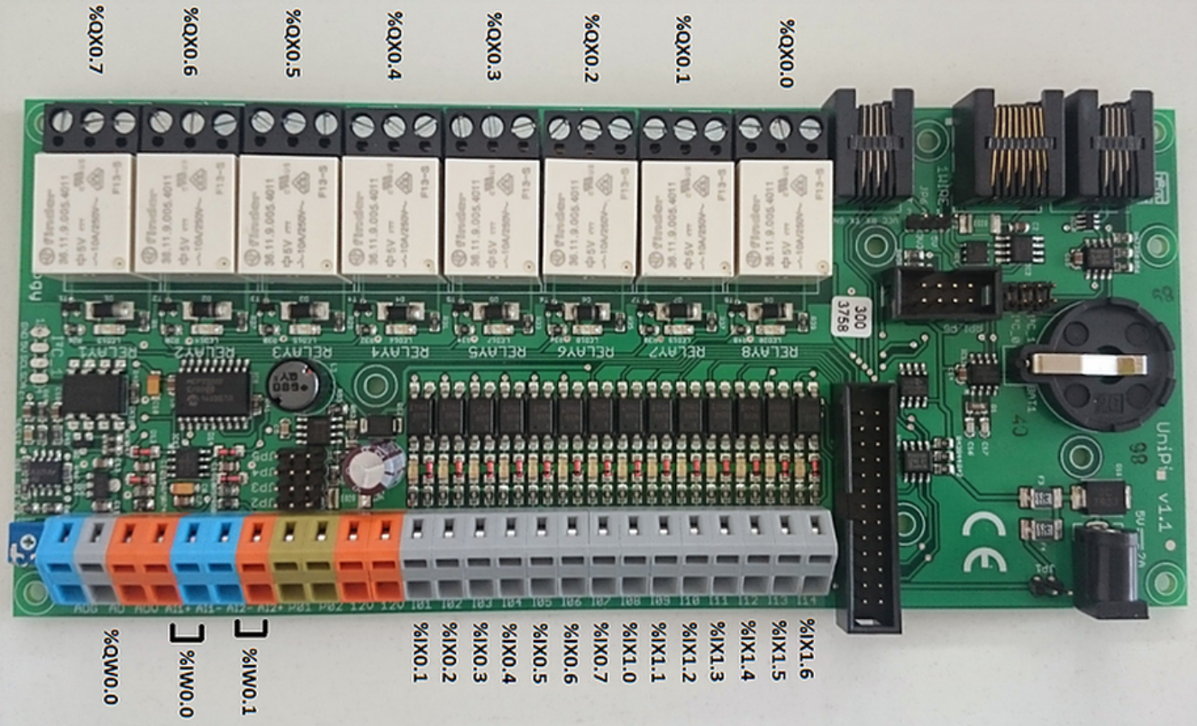
Inside a PLC
Relays- outputs to actuators
Battery- resilience
Wire bridge for inputs

Slide 23
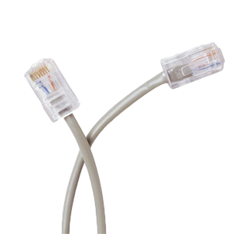
Enterprise Network / Internet
Allows data exchange between the Programmable Logic Controllers and other computers
Enables supervisory software to query information from the plant
Communication follows a set of rules called Protocol
Output modules control actuators on the physical system

Slide 24
Human Machine Interface
Graphical screens that consists of buttons, alarms, reports and trends about the process
Manages the physical process data
Provides a mechanism for user interaction and control

Slide 25
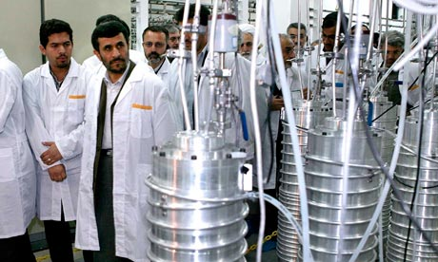
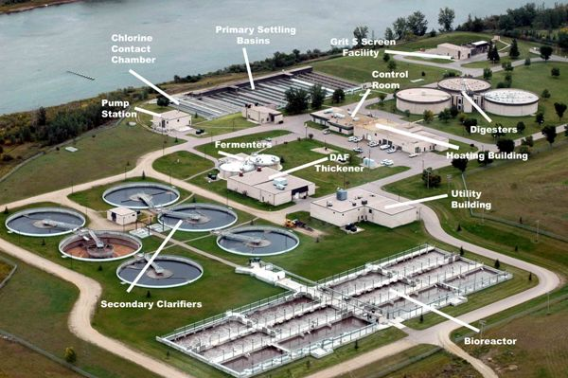
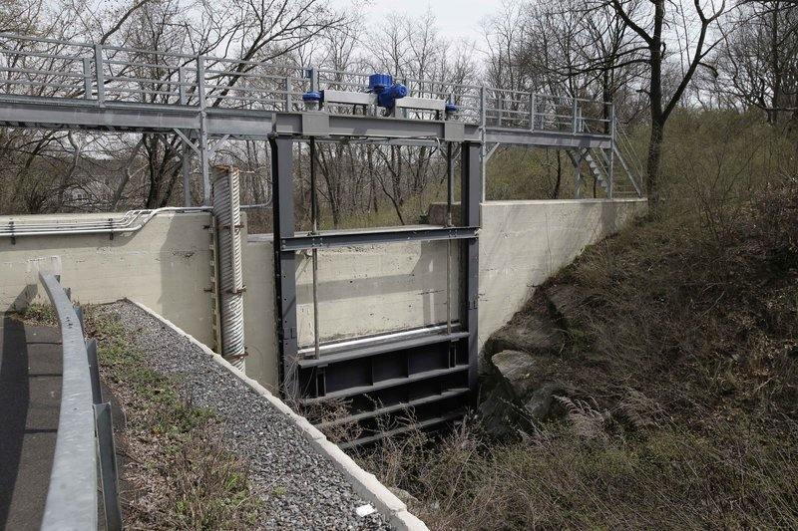
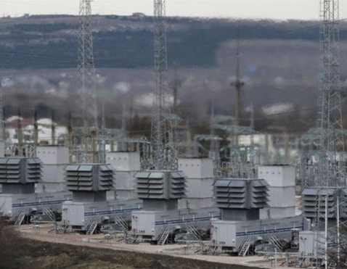
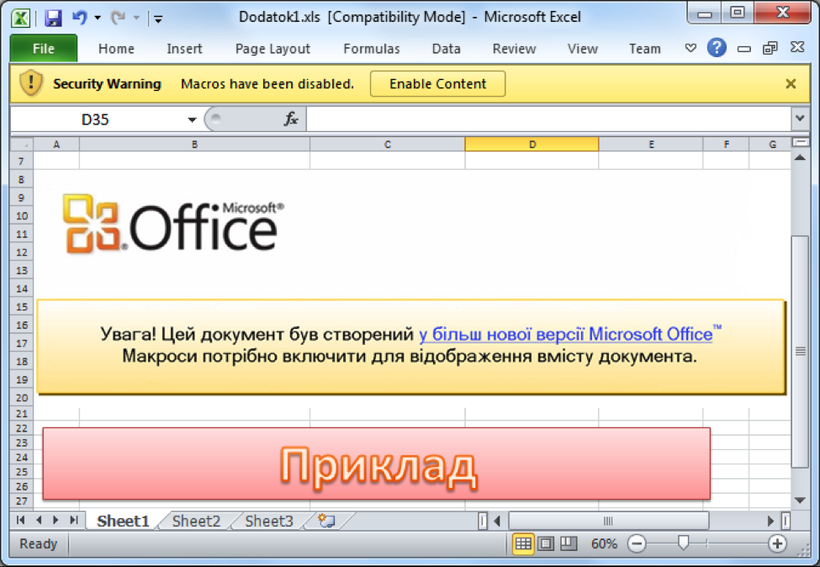
Threats To SCADA
STUXNET
Iranian nuclear program attacked by nation state actor.
Maroochy
Australian water treatment plant attacked by insider.
NY flood control dam attacked by Iranian hackers.
Ukraine
Large scale blackout attack.

Slide 26
How can we teach students to Defend these Systems?
First need to teach SCADA
Unique system components - Cyber Physical Systems
Unique programming - ladder logic
Unique network protocols - Modbus, DNP3, etc.
Legacy systems and components
Unique security requirements
Availability, Integrity, Confidentiality versus Confidentiality, Integrity, Availability

Slide 27
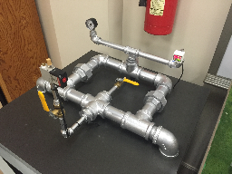
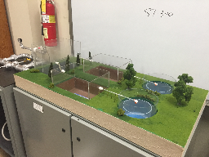
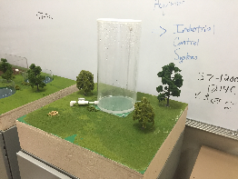
UAH SCADA Laboratory
Gas Pipeline
Water Treatment
Storage Tank
Physical systems
Real actuators and sensors
Commercial PLC’s
Commercial Human Machine Interface (HMI) Software
Standardize networks
Real cyber vulnerabilities
Real physical impacts

Slide 28
Lab Options
Type | Description | Pros/Cons | # Students Served | Cost
Access to real systems | Co-op/intern or tour | Limited availability Real systems, real problems | One at a time for co-op/intern model. | $
SCADA Lab | Working SCADA commercial hard- ware & software | Limited physical system complexity Expensive | One student at time/system or teams. UAH has 3 systems. | $$$
PLC Lab | Commercial hard- ware & software | Limited physical system complexity Limited to one brand PLC Closed source | One student at time/system or teams. 20 PLC to a lab. | $$
OpenPLC | Bread boards + Arduino + PC | Limited physical system complexity Open source | Students purchase own kit and pair with PC. | $
Virtual SCADA | Matlab Simulink + OpenPLC (soft) | Model larger physical systems No kinetic effects | Available on PC via cloud. | $

Slide 29
OpenPLC http://www.openplcproject.com
Runtime
multi-platform
soft PLC
Editor
PLC programation
Edit ladder logic (and 4 other languages)
Simulate and debug
GUI
build GUI’s
remote monitoring and control

Slide 30
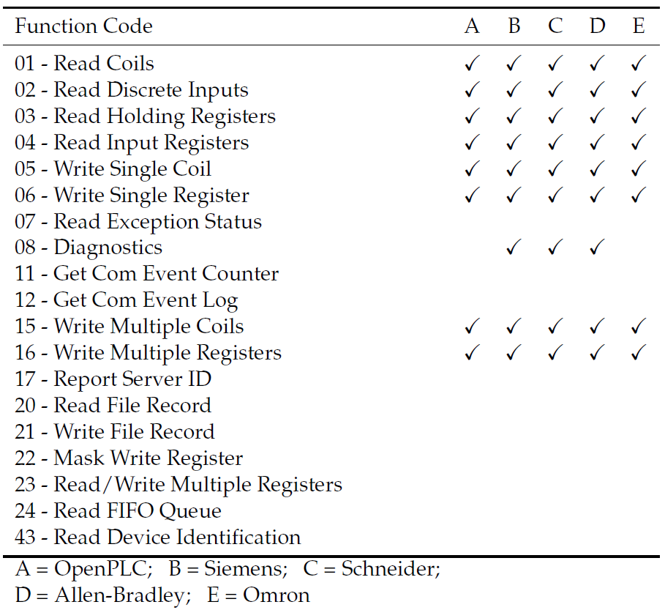
OPENPLC MODBUS Support Compared TO Commercial

Slide 31
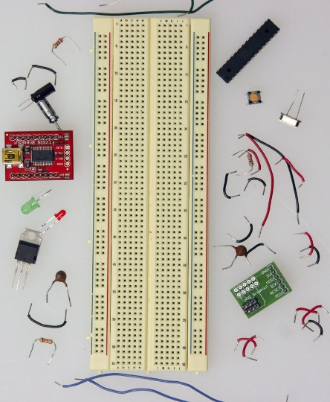
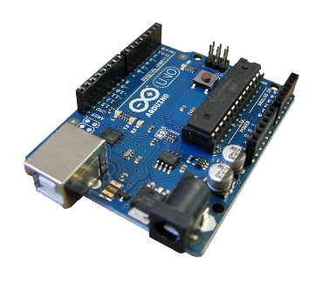
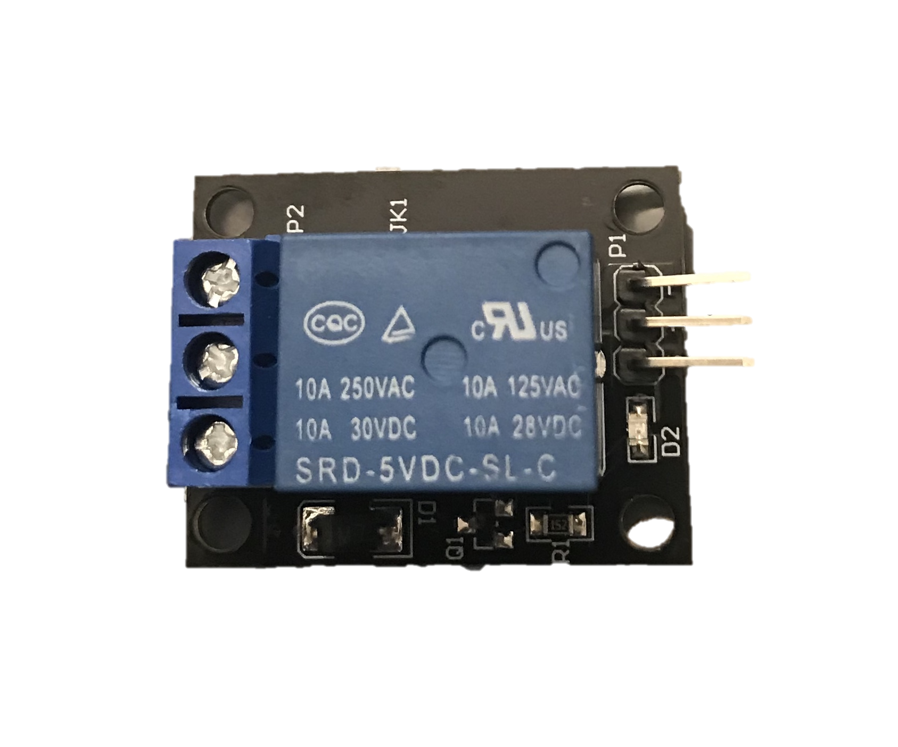
OpenPLC + ArDUINO+PC
OpenPLC runtime runs on PC.
Arduino provides Input/Output (IO): Analog and Digital
Inputs: buttons, sensors (various)
Outputs: LED, relays, speakers, etc.
Host only network from Virtual Box or lab network.

Slide 32
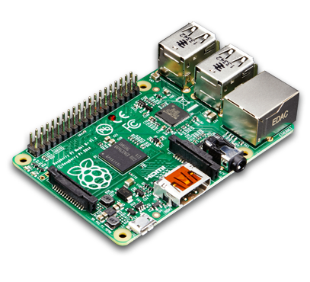
OpenPLC + Raspberry PI
OpenPLC runtime runs on Raspberry PI.
Raspberry PI provides Input/Output (IO): Analog (low quality) and Digital
Inputs: buttons, sensors (various)
Outputs: LED, relays, speakers, etc.
Need monitor, mouse, keyboard to program.
Need lab network.

Slide 33
Virtual SCADA Demo

Slide 34
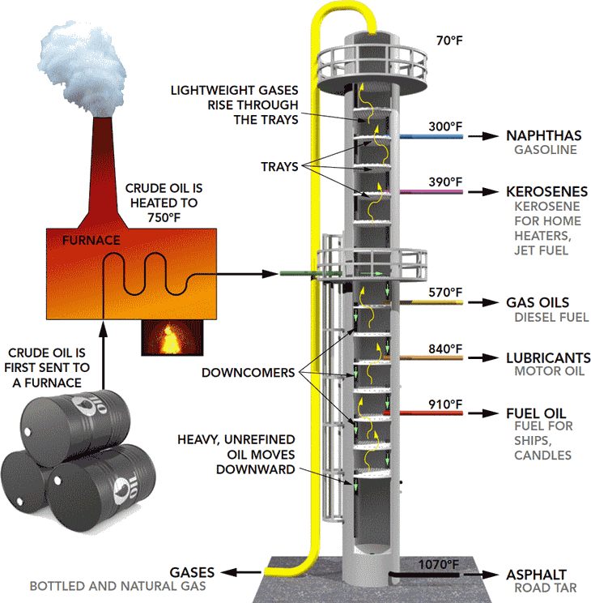
Refinery Distillation Column

Slide 35
OPENPLC + Arduino Demo

Slide 36
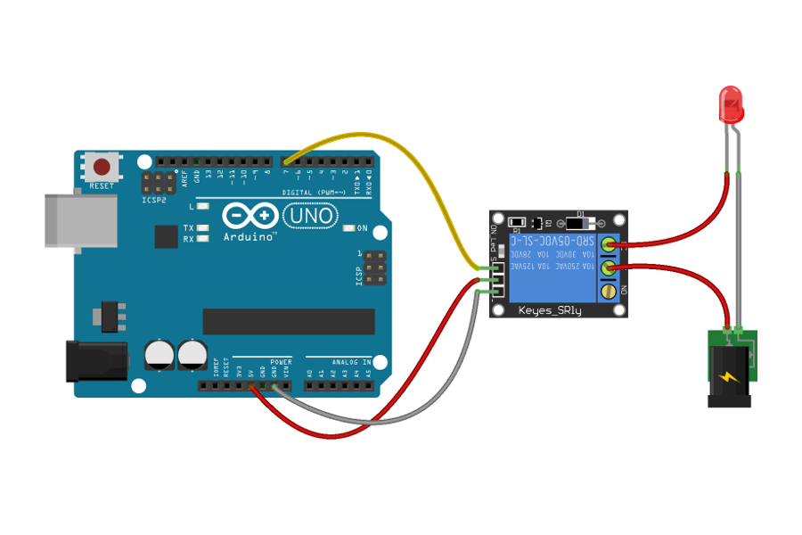
using a relay.
S = set (1) or not set (0)
Power (+)
Ground (-)
Use 5V for this relay.
Can connect to A/C or D/C on this side of relay.
https://blog.siliconstraits.vn/relay-what-is-it-and-how-to-use-it/

Slide 37
using a relay.
Move this wire to change behavior
Normally open, Set = close
Normally closed, Set = open
Don’t use both pins
https://blog.siliconstraits.vn/relay-what-is-it-and-how-to-use-it/

Slide 38
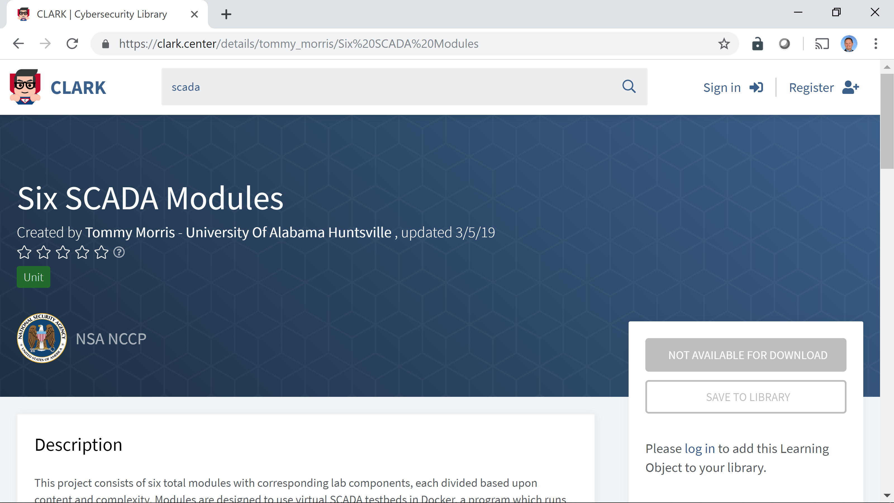
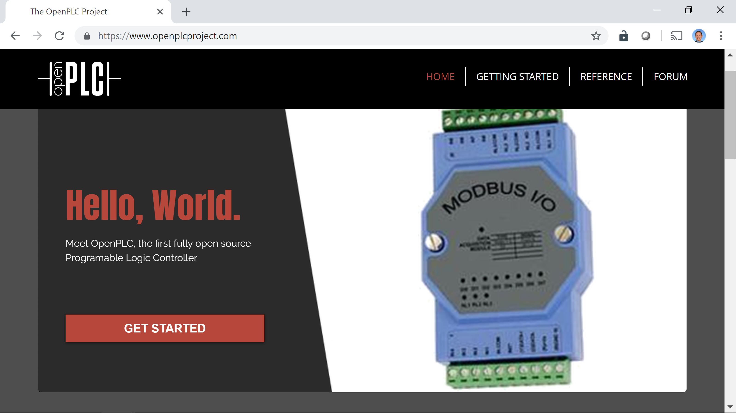
Where Can you get this Material?
http://clark.center
Search for SCADA
https://www.openplcproject.com/
Use Reference -> Creating your first project

