Slide 1
What is Security?
Software Exploitation

Slide 2
Hardware VS Software
What is the difference?
Hardware:
Physical components of a machine
Example: Systems without a secure boot process, malware can hi-jack BIOS code
Software:
Programs that run on the OS and the OS itself is software
The OS is a system software that manages programs and hardware
Attackers can hijack both hardware and software

Slide 3
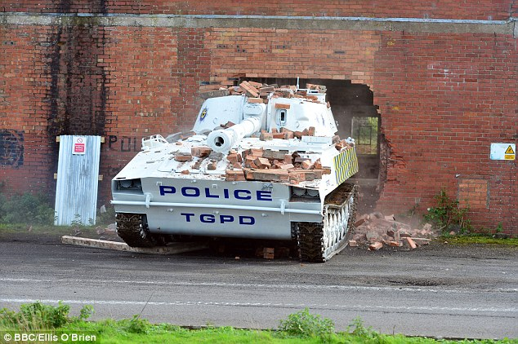
Exploit VS Vulnerability
A vulnerability is a “weak point” in a system
An exploit is the “weapon” that can do damage to a system through that “weak point”
A vulnerability can be found in any part of a system
An attacker crafts an exploit based on the nature of the vulnerability discovered

Slide 4
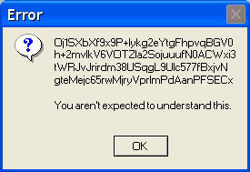
Bugs
A bug is a flaw in a program that leads to undesired behavior
Bugs typically come from human errors
Bugs can lead to vulnerabilities being discovered
They will always exist in code written by humans
Therefore there will always be vulnerabilities to find, although they become more difficult to exploit over time

Slide 5
Network Security
Securing a network isn’t just using a firewall
Update software and firmware on all components
Strong encryption and passwords
Good management of users and their assigned privileges
Restrict access as much as possible
Create separate networks for vital data
There are many steps that must be taken to create the most secure network possible
A crucial aspect of any business

Slide 6
What is Wrong Here?
Internal
DMZ
User Systems, Servers, etc
Web Server
Database

Slide 7
Interpreted Language Overview
Interpreted languages are not compiled before they are executed
Instead interpreted languages use an interpreter
This can yield a higher degree of code flexibility and is often easier to program with
Some examples of such languages are:
Python
Java/.NET
Ruby
Javascript
Perl
Lua

Slide 8
The Interpreter
As mentioned in the previous slide, the interpreter allows for the code to be run
The interpreter is essentially a program that reads and executes the program since interpreted language instructions aren’t executed directly by the host machine like compiled languages
As an example, and interpreter would see a “-” sign in the code and execute it’s own sub(x,y) function. This function would then call the SUB machine instruction

Slide 9
Security of Interpreted Languages
Since there’s no compiler, security issues can be skipped over and not displayed at compile time where security checks can be set with flags
Interpreters go through many more stages to execute the same instruction a compiled binary would, leaving more opportunities for attackers to manipulate a program
Most interpreted languages are loose and can lead to insecure programming habits
Some don’t have features like buffer-overflow protection that are common in compiled languages

Slide 10
Compiled Languages
These languages use a compiler to convert the human readable code written by the author into machine code
Unlike interpreters, the output of a compiler is a binary file that the host computer can execute directly, but this requires the code to be recompiled to test any changes made to the code
Compilation leads to more efficient execution, since there’s no interpreter overhead, and smaller space requirements
There are many compiled languages, but here are a few:
C/C++
COBOL
Go

Slide 11
Security of Compiled Languages
Compilers can detect issues at compile time and have much more features to increase flaw detection and verbose output
Compilers optimize code and add security features into the binary, such as security cookies and other protections
Compilers change code. For instance, if sensitive information needs to be overwritten in memory by a function, a compiler may optimize it out because it sees that function as useless (www.owasp.org/index.php/Insecure_Compiler_Optimization)
Developer is responsible for things like memory management, conversion types, variable initialization, variable scope
Compiler optimizations can also impact code written

Slide 12
How Do We Find Bugs?
Depends on the language/framework/environment
Overall, some major types of bug hunting
Fuzzing
Source code auditing
Reverse engineering
Code scanners
Bug bounty programs

Slide 13
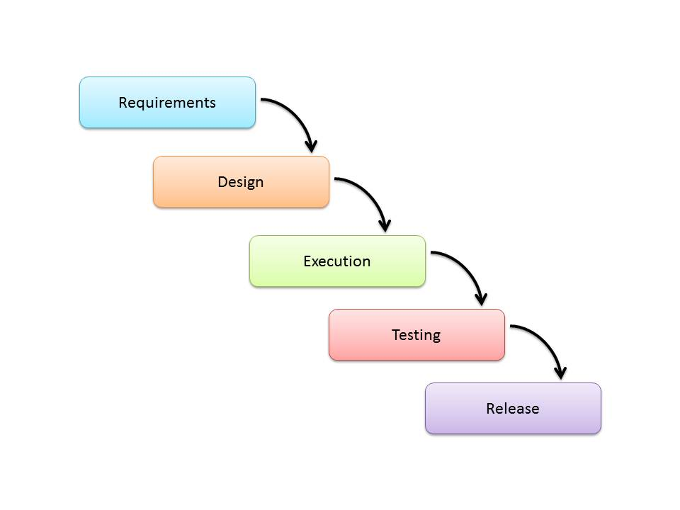
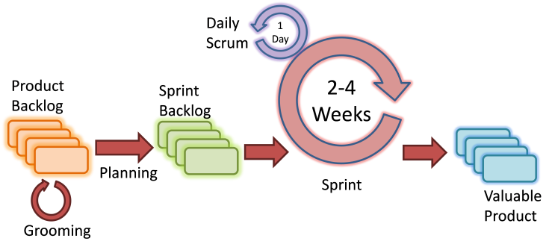
Software Development Lifecycle Refresher
A software development lifecycle describes the paths a piece of software will undergo while it’s in development
This is to create a more streamlined application because these methods have been tested and proven many times
There are many methods out there such as the waterfall and agile method each with their own advantages, but all of them can be modified to build security into an application
Waterfall: Agile:

Slide 14
Why Develop with Security In Mind?
This may be an obvious answer to some, but some software developers are not taught in depth security concepts
Security has mostly been implemented in the testing phases of development essentially as an afterthought. This often led to more holes left open than patched.
It’s much more effective to discover vulnerabilities through every stage of the process
Simply being constantly aware of secure concepts during development can lead to more secure applications
The need for more secure software led to the creation of the Secure SDLC (Software Development Lifecycle)

Slide 15
Benefits of the Secure SDLC
Some of these were mentioned before, but this is a clearer list:
Security being a constant part of development leads to more secure software
Vulnerabilities can be caught early and consistently
Friendlier on the budget due to early detection making maintenance and bug fixing shorter and easier
Less cost to resolve damages later on
More secure software is far less risky for a business to release

Slide 16
How is this done?
Existing models can be used with security principals listed in the requirement creation phase or…
A new model can be used. Below are a few:
OWASP’s CLASP – CLASP was built to integrate with existing processes, and focuses on easy integration to the existing workflow of all departments (https://www.owasp.org/index.php/CLASP_Concepts)
Microsoft’s SDL – Keeps the same steps of typical lifecycles, but describes what can be done at each stage to increase security. (https://www.microsoft.com/en-us/sdl/default.aspx)
US-CERT’s Secure SDLC Process Survey – This is a paper produced by the U.S. Computer Emergency Readiness Team (A division of Homeland Security). Although it may not be a “model” it dives into many different methodologies and will help in choosing the processes best for the team and project at hand.

Slide 17
Where to Begin
Most places have established their own process, so there are a few steps to maintain that but increase the level of security.
Here are some points for developers and testers:
Education is key, training developers more secure coding practices and secure frameworks should be the first step
Use code scanning tools (see the module on “open-source code scanning tools”)
Security should be included in test cases
Extending past the coders to administration and management:
To get things started quickly, help from specialized security companies can be handy
An effectiveness assessment of existing processes within the organization can help determine where work needs to be done to amplify the impact of secure practices

