Slide 1
Windows: Processes & Virtual Memory
Module 17

Slide 2
Objectives
Understand the difference between a program, process and thread
Understand how a program utilizes virtual memory
Understand how the OS loader parses the PE file to load an EXE into memory and begin execution
Notes:
Use notes for additional resources, etc

Slide 3
Programs
Programs and processes are often thought of as synonymous but are in fact very different
Program: static, contains program instructions and data
Process: container that provides all resources for a program as it executes

Slide 4
Processes
Processes typically contain (Windows OS):
A virtual address space (more on this later)
An executable program loaded in memory
Open handles
Access Token - defines security context for the process
Process ID
At least one thread of execution - this is what is executing the program’s code

Slide 5
Viewing Processes using Process Explorer
Notes:
Process Explorer comes from Sysinternals: https://technet.microsoft.com/en-us/sysinternals/processexplorer.aspx
Discuss the hierarchical nature of processes - everything running in your desktop has a parent of EXPLORER.exe.
If you look under WININT.exe you’ll see several instances of SVCHOST, this runs the services for the OS. If you notice an instance of SVCHOST running under EXPLORER and not WININIT than something is amiss with the system.

Slide 6
Programs On Disk
Notes:
Refresher on the PE file format, this information is parsed by the OS loader to map the image into memory before executing the program. We can parse this information on disk, as we’re doing here with the 010 editor, but it’s not quite the same. Here we use offsets in a file, when in memory we use virtual addresses and relative virtual addresses (RVAs) to locate the same information.

Slide 7
Programs On Disk
When a program is executed (double-clicked by the user, for example)
The OS determines the type of the file
The loader parses the PE file format to determine where the program should be loaded in memory and the initial entry point for execution
Maps in any necessary libraries
Executes the program
Notes:
An over-simplification, but with out getting into all of the technical aspects this is roughly what happens. The primary goal here is to understand the difference between the program on disk and in memory when it’s executing.

Slide 8
Threads
OS schedules the thread for execution
Threads typically include:
Register contents, this represents the state of the CPU
Stacks - one for kernel-mode/ one for user-mode
Thread Local Storage (TLS)
Thread ID
May have it’s own security context different from the process

Slide 9
Virtual Memory (Virtual Address Space)
Linear address space
32-bit: 0x0 - 0xFFFFFFFF (2 GB range)
64-bit: 0x000'00000000 through 0x7FF'FFFFFFFF (8 terabyte range)
Processor translates VA to physical address
Programmer does not need to take this into account
Benefits
Program can use contiguous range of addresses - even if not contiguous in physical memory
Allows for programs to access more memory that is physically available
Virtual addresses for each process are isolated

Slide 10
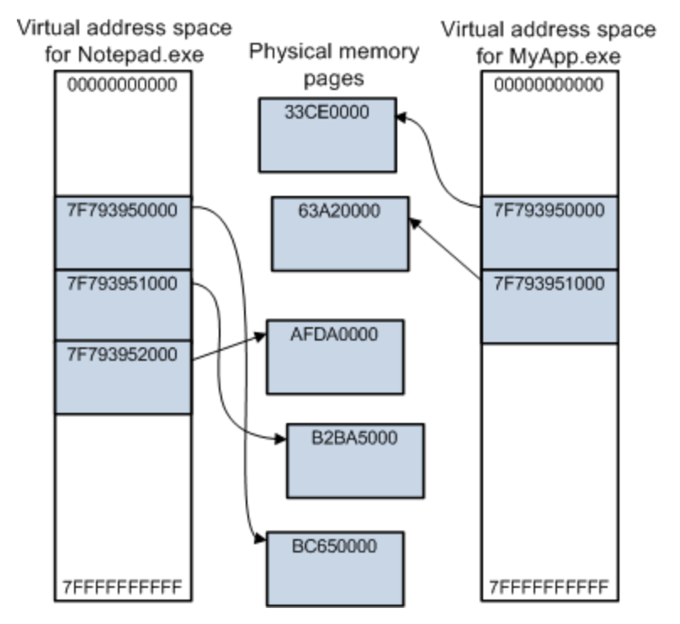
Virtual Memory
Notes:
Source: https://docs.microsoft.com/en-us/windows-hardware/drivers/gettingstarted/virtual-address-spaces

Slide 11
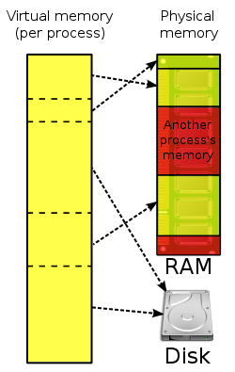
Virtual Memory
Maps virtual addresses in memory to physical addresses in memory
OS segments RAM into pages
Loads pages into and out of RAM on demand
Reduces
load time
amount of RAM used by program
Slows
access to RAM may require page faults
delays (lazily) when pages are loaded

Slide 12
Virtual Memory
When process accesses memory, consults a page table
Tells process which physical address to use
Don’t map each byte, instead use pages
Processor can enforce rules on how memory is accessed
We have sections in the PE because processor needs to treat modules differently
At load time, memory manager sets access rights: r, w, x
Permissions come from settings in section header
Sections typically start on a fresh page

Slide 13
Paging
Memory management scheme
Allows for retrieval of data from secondary storage (HDD) for use in primary storage (RAM)
OS retrieves data from secondary storage in same-size blocks – pages
This allows for contiguous virtual address space and non-contiguous physical address space
Page Faults
Program attempts to access page not in RAM
OS takes over and loads the desired page – expensive
May need to write a page to secondary storage

Slide 14
Executing a Program
By understanding the PE file format, we can identify where the program should be loaded in memory and where it’s execution point will be
IMAGE_NT_HEADERS -> IMAGE_OPTIONAL_HEADER32:
AddressOfEntryPoint - DWORD that defines START (not necessarily main though)
RVA
ImageBase - DWORD that defines where the program should be loaded into memory
By default most compilers use 0x400000. ASLR will randomize this value during run-time

Slide 15
Executing a Program
To find entry point on disk, you have to:
Find the section that the entry point falls in - this is typically .text
View SECTION_HEADER -> VirtualAddress

Slide 16
Executing a Program
The AddressOfEntry is an RVA from the ImageBase
Subtract the VirtualAddress from the section from AddressOfEntry to get a raw offset
0xBAC34 - 0x1000 = 0xB9C34
Now, from the SECTION_HEADER add the PointerToRawData value
0xB9C34 + 0x400 = 0xBA034
Notes:
Some hex editors, such as the 010 Editor, will calculate this for you. The screenshot to the right is 010’s calculation of the file offset (versus virtual address)

Slide 17
Executing a Program
You can locate in a hex editor

Slide 18
Process Memory (Viewing w/ Process Hacker)
In memory, use virtual addresses and relative virtual addresses
Use the VirtualAddress value from the SECTION_HEADER, subtract from AddressOfEntry to get the raw offset in the section
0xBAC34 - 0x1000 = 0xB9C34
Locate that section in memory and go to that offset
Notes:
I use Process Hacker to view processes, if you double-click the process you’ll get a dialog with multiple tabs. Use the MEMORY tab to see these details.
Here we can see ASLR in action - the imagebase is 0x40000 but it’s loaded at 0xed0000. We know its our program because the last column shows the path to what’s loaded there.
And we can see that the bytes line-up - YAY!

Slide 19
A Quick Aside
IDA does the same thing to start disassembly
But signature detection usually puts you in main
Keep in mind when using other disassembly engines, PE file helps you find START
Notes:
This is just to show how IDA emulates virtual addresses instead of file offsets and to provide better insight into how IDA knows where to start disassembly. It’s also important to note that if you parse a PE and disassemble with another frameworks as Capstone or Radare, you may have to manually identify main.

Slide 20
VAs in IDA Pro
IDA shows disassembly output with a corresponding virtual address
This makes it easier to correlate the static disassembly with the runtime disassembly (ie disassembly by the debugger)
Remember, you may have to adjust your IMAGE_BASE due to ASLR
Notes:
This is the beginning of main in IDA and in WinDbg during program execution. For this example, ProcessHacker had an IMAGE_BASE of 0xED0000.

Slide 21
Summary
Understand the difference between a program, process and thread
Understand how a program utilizes virtual memory
Understand how the OS loader parses the PE file to load an EXE into memory and begin execution

