Slide 1
WinDbg

Slide 2
Why Do You Care?
Debugging is a critical reverse engineering skill
WinDbg is supported by Microsoft
WinDbg allows for Kernel debugging

Slide 3
Objectives
How to load a program for debugging
Understand the different windows available
Explore basic commands and interact with target program
Notes:
Use notes for additional resources, etc

Slide 4
WinDbg Setup
Where to download?
Windows Development Kit
https://www.microsoft.com/en-us/download/details.aspx?id=8279
You can install as a stand-alone option
Notes:
This is just an FYI - I recommend having WinDbg already installed and setup in whatever VM/Lab environment you provide.

Slide 5
Loading a Program
Notes:
Review how to debug a program - open or attach and then point out specifically how to do it with WinDbg

Slide 6
Accessing Windows
Notes:
Once WinDbg is open the windows are considered part of the workspace - you can add more windows under this menu then arrange automatically or manually, need to dock each window to do that, windows do not need to be a part of the primary window. This can be difficult to get all windows laid out as desired.

Slide 7
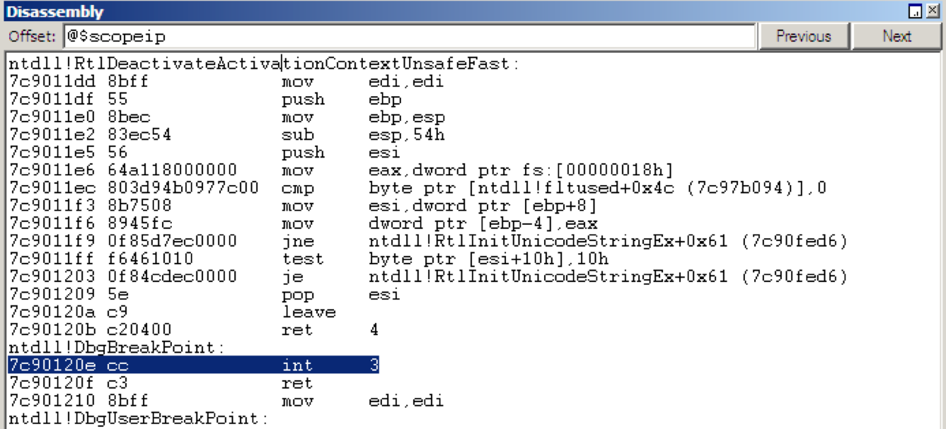
Important Windows
Disassembly Window
Current instruction pointer w/ instructions before/after

Slide 8
Important Windows
Command Window
Allows you to enter commands to interact with debugger/software

Slide 9
Important Windows
Command:
a: assembles 32-bit instruction mnemonics
Puts resulting code into memory
Notes:
the first image shows use at a breakpoint at 0x3e1000, where the instruction is ’push ebp’. The next image (animated in the slides) shows what happens when we enter assembly mode by typing ‘a’ -> enter, entering two NOPs, then pressing enter again to exit and write the assembly to the program. This allows us to patch the program during runtime, amongst other things.

Slide 10
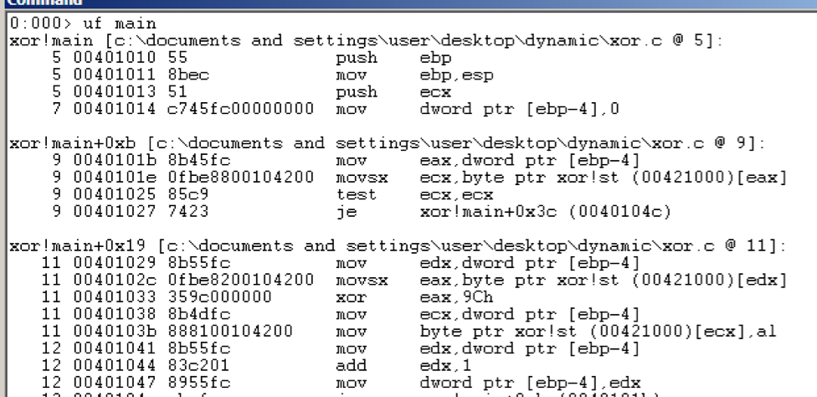
Important Windows
Command:
u [address]: disassemble from address
u [range]: disassemble range
ub: disassemble backwards
uf: disassemble entire function

Slide 11
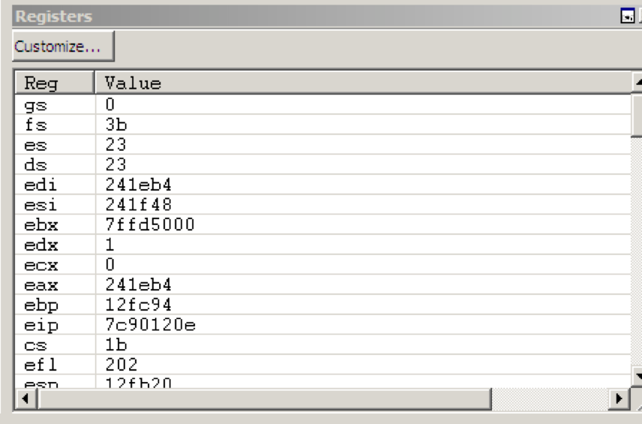
Important Windows
Registers Window
Current state of the registers
Register turns red if previous instruction modified it
You can edit registers by clicking on them

Slide 12
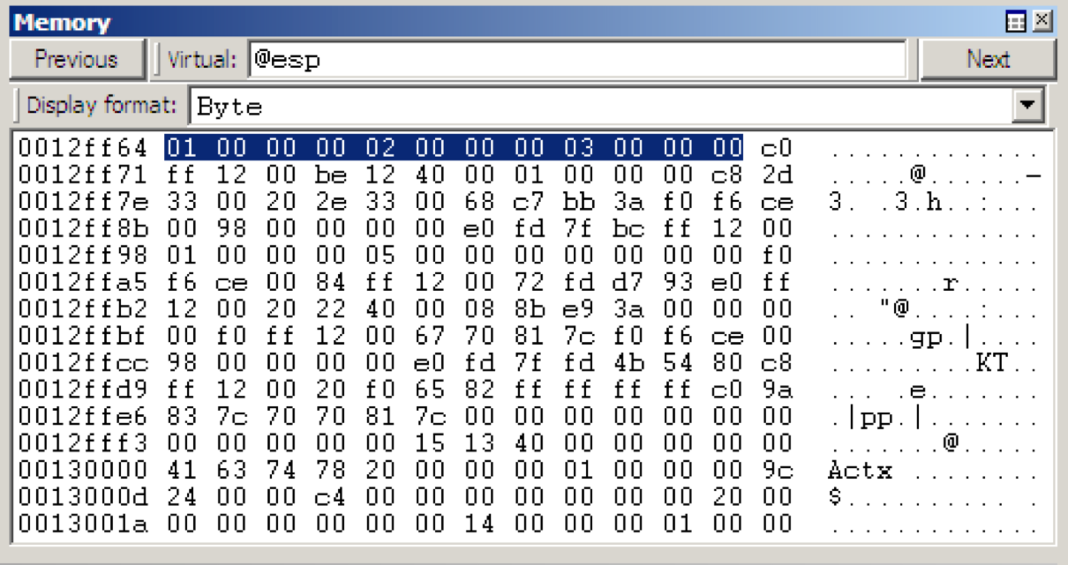
Important Windows
Memory Window
Dump of live memory – you can enter an address or use registers (esp, eip, ebp)

Slide 13
Important Windows
Stack Information
Can use the Memory window - @esp
May need to adjust display format

Slide 14
Important Windows
Stack information
Can use the Calls window

Slide 15
Important Windows
Command window w/ k* commands

Slide 16
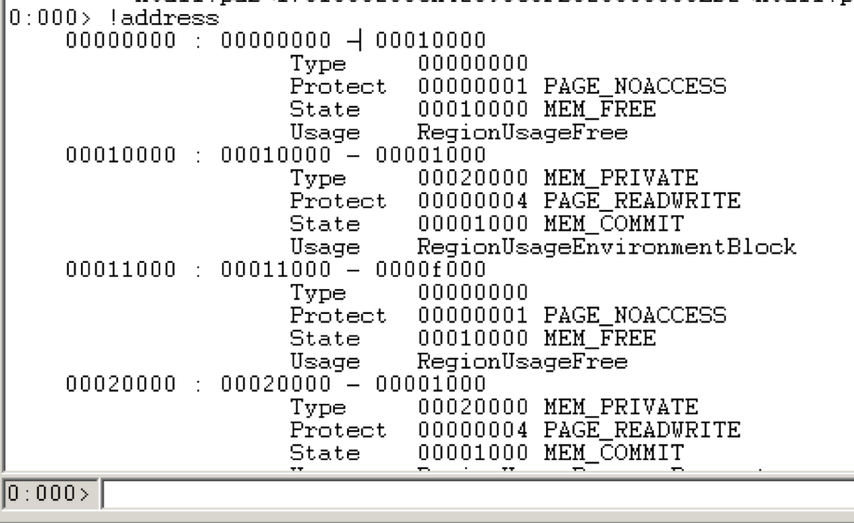
Commands
Memory Map
You can view all memory blocks allocated by the debugged program
From the command prompt: !address

Slide 17
Rebasing
PE files in Windows have a preferred base address – image base
Most EXEs will use 0x00400000
Executables that support ASLR will often be relocated
Common for DLLs to be relocated
Single app may import many DLLs, each with a preferred base address
If two have preferred base of 0x10000000, can’t both be loaded there
Windows will relocate the other one
Notes:
Also important to understand that each time you load a program using ASLR, it will have a different address. If the student is trying to match breakpoints/etc from IDA Pro w/ the debugger may need to adjust for this (or disable). You can rebase in IDA but is usually either easier to disable ASLR (use the linker or EDITBIN on Windows) or just make the calculation from the new image base.

Slide 18
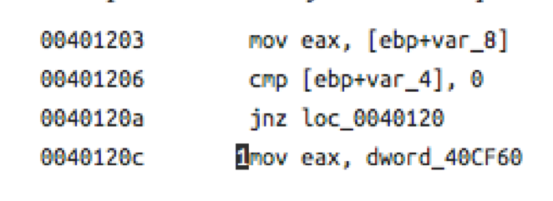
Absolute vs Relative Address
Instructions may refer to relative or absolute memory addresses
Instruction at 1 will fail if relocated
DLLs/EXEs come with .reloc section for fix-up locations
This adjusts addresses for the new image base

Slide 19
Symbols
When building a program, linker can generate a PDB file
Program Database
Contains the symbols of the image
Usually a stand-alone file
PDB Contains – Private Symbols:
Mappings between function names and addresses
Static and global variables
Types declared in the image
Source-line information
Function parameters, local variables
Public Symbols: You can strip a PDB file
Non-static functions and global variables

Slide 20
WinDbg Help
From the command window: .hh
Online:
http://windbg.info/doc/1-common-cmds.html

Slide 21
Summary
How to load a program for debugging
Understand the different windows available
Explore basic commands and interact with target program

