Slide 1
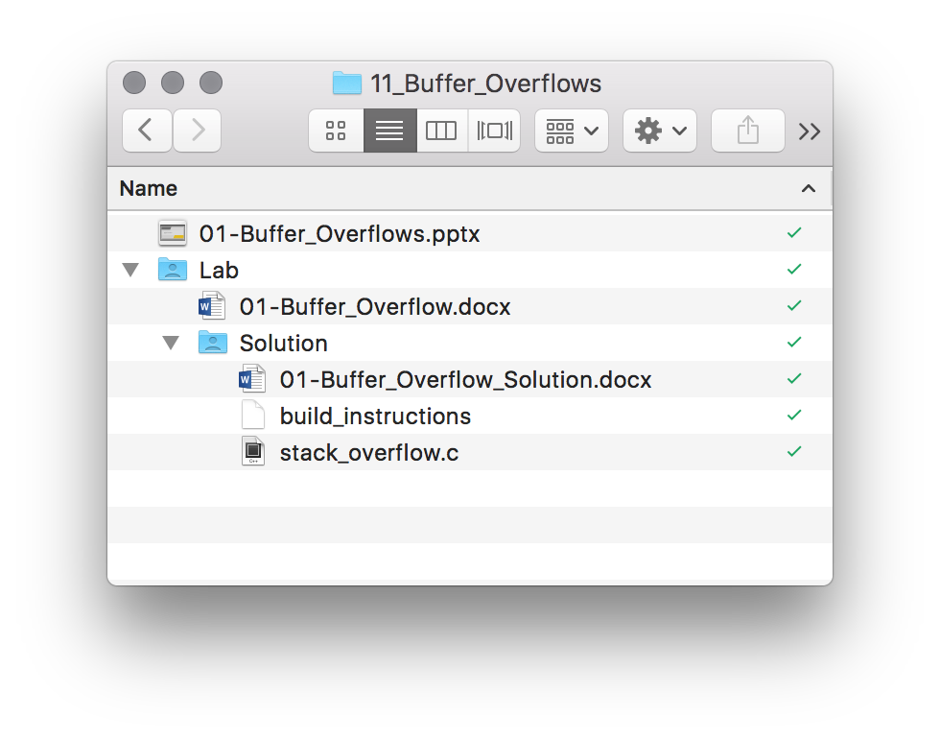

Slide 2
Buffer Overflows

Slide 3
Why Do You Care?
Buffer overflows allow one to study the foundation of modern-day exploitation techniques
And the series of mitigations/bypasses that lead to the current state-of-the-art
Begin to understand defensive coding techniques
Use the process of reverse engineering to identify and abuse program vulnerabilities

Slide 4
Objectives
Reviewed the stack / stack frame
Understand how memory is corrupted during a buffer overflow
The tools and techniques for determining a buffer overflow and how to get control of EIP
How to exploit a buffer overflow
Notes:
Use notes for additional resources, etc

Slide 5
Function Calls – Stack Based
When call is executed:
Address of next instruction is pushed onto the stack
EIP is set to the address of the function
Function is entered and stack frame built - commonly referred to as function prologue
When return is executed:
Address of next instruction is popped off the stack
EIP returns to the previous instruction
Commonly referred to as function epilogue

Slide 6
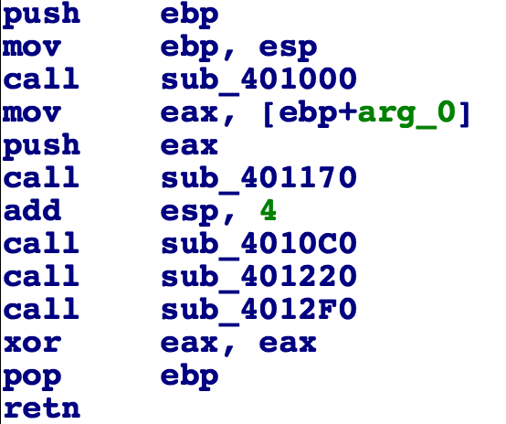
Function Calls – Stack Based
use EBP as the base pointer
beginning of function (prologue)
push ebp
mov ebp, esp
End of function (epilogue)
mov esp, ebp
pop ebp
ret
prologue
epilogue

Slide 7
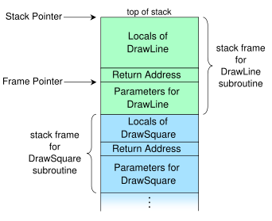
Stack Frames
Stack Frame: when a function is called, structure called the stack frame is pushed onto the stack
EIP jumps to first instruction of the function
Stack frame contains:
Local variables
Return address
Arguments
Lower Addresses
Higher Addresses

Slide 8
EBP
Used in the function to base the stack frame
ESP
Virtual Address Space
EIP
The Stack
HIGHER Addresses
Used for current
stack frame
1
0x401145: push 1
0x401147: push 2
0x401149: call sub_X
0x40114E: add esp, 8
2
0x40114E
Stack Frame Built
Used by function
Function Returns
LOWER Addresses
Notes:
This slide is animated, as it makes it easier to walk through a dynamic stack representation when recording. An alternative would be to use a blank slide and draw on it using a touch enabled interface. This will likely not print well if desired as handout material.

Slide 9
EBP
Restored to previous value
Virtual Address Space
The Stack
HIGHER Addresses
1
2
0x407461: push ebp
0x401147: mov ebp, esp
0x401149: sub esp, 8
…...... 0x4074D2: mov esp, ebp 0x4074D4: pop ebp 0x4074D5: ret
EIP
ebp
ESP
0x40114E
Used for local variables
LOWER Addresses
Notes:
This slide is animated, as it makes it easier to walk through a dynamic stack representation when recording the session. An alternative would be to use a blank slide and draw on it using a touch enabled interface. This will likely not print well if desired as handout material.

Slide 10
Exploitation
Programs are setup to follow a set of instructions that tell the CPU what to do and define how the program should behave
Exploitation is designed to get the computer/program to do what you want it to do – even if it was designed to prevent that action
Still, programs don’t always behave as the programmer intended
Common errors include off-by-one errors, memory corruption, etc

Slide 11
Buffer Overflows
Move more data into a buffer than the buffer was allocated for
Example: we have an 8 byte buffer, move 10 bytes of data into that buffer – what happens?
Overrun buffer’s boundary and overwrite adjacent memory locations
Action may be allowed, may change behavior of the program, may cause program to crash
What about stack cookies?
/GS & /GS- with Visual Studio
Detects stack corruption, terminates the program
Notes:
buffer overflow, buffer overrrun, stack overflow stack overrun - it goes by many names.

Slide 12
Stack-Based Buffer Overflows
An overrun that allows for writes to a memory address on the program’s call stack outside of the intended data structure
Usually involves a fixed-length buffer
Typically involves corruption of adjacent data
More likely to cause changes to program execution than heap-based overflows
Due to return address being on the stack

Slide 13
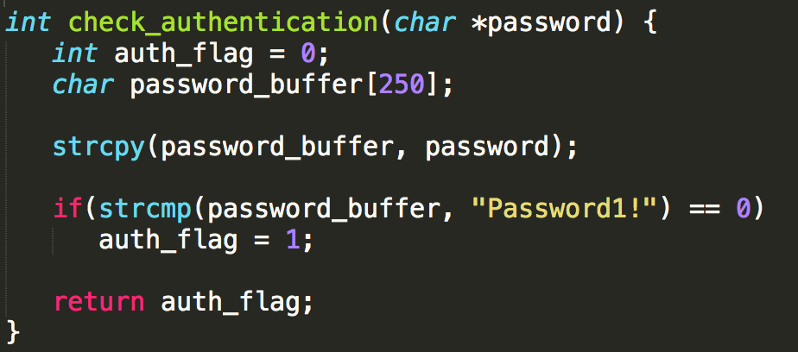
Sample Program
Can you spot the bug?
Notes:
The main bug is the unrestricted copy using strcpy, this is the classic buffer overflow. This can lead to EIP overwrite (via return address). The attacker could stop short of EIP corruption and just overwrite the auth_flag variable, this could cause the program to always return true. If stack guard is enabled both scenarios are protected as the stack guard will re-order variables so that the buffers are adjacent to the canary.

Slide 14
Virtual Address Space
The Stack
HIGHER Addresses
Return Address
If password is <= 250
Old EBP
EBP
If password is > 250
auth_flag - [EBP-4]
What if password > 250 && < 260?
If EIP (return address) is corrupt
attack controls EIP
epilogue takes whatever
ESP points to, places in
EIP
Write content in space for buffer
Corrupt the stack
Corrupt auth_flag
ESP
JMP ESP (to shellcode)
Buffer - [EBP-256]
LOWER Addresses
Notes:
This slide is animated, as it makes it easier to walk through a dynamic stack representation when recording the session. An alternative would be to use a blank slide and draw on it using a touch enabled interface. This will likely not print well if desired as handout material.

Slide 15
Detecting a Crash
When EIP becomes corrupt, the program will likely crash
Without a debugger attached it is difficult to see details of the crash
Requires precision to take advantage of a buffer overflow
Run target program under a debugger
Look for access violations (first chance exceptions)

Slide 16
Getting More Control
If you can overwrite the return address of the stack frame, you can control the flow of execution
Program may crash – stack clean-up may be skipped
How can you determine how to overwrite the return address?
Determine the distance from your input to the return address
Calculate using debugger/IDA Pro
Send specially crafted input (ie a pattern) to determine the offset needed

Slide 17
Calculating Stack Size w/ IDA Pro
The Stack
How much data to overwrite the return address of this function?
RETURN ADDRESS
4 bytes
Old EBP
4 bytes
auth_flag
4 bytes
2 bytes buffer
2 bytes padding
4 bytes
password_buffer
4 bytes
Total: 20 bytes to begin overwrite of EIP

Slide 18
Calculating Stack Size w/ IDA Pro
Double-click stack variable - takes you to stack view of function (new tab)
Calculate size based on layout

Slide 19
Fuzz the Application
Monitor application crashes with a debugger
Send variable length input until you can write a precise 4-byte value in EIP
“A” * 400 + “B” * 4 --> Too Small
“A” * 800 + “B” * 4 --> Too Big
“A” *600 + “B” * 4 --> Too Small
“A” * 700 + “B” * 4 - Crash! EIP = 0x424242
Notes:
You can manually fuzz - this is usually very time consuming. Fuzzing can be automated through a variety of frameworks or scripting.

Slide 20
Metasploit Can Help
Ruby scripts:
Pattern_create
Generates a non-repeating pattern
When program crashes, get unique value in EIP
Pattern_offset
Calculates the offset from the unique pattern
Tells you how large your payload has to be to corrupt EIP
Notes:
These scripts are a part of the metasploit framework and installed in Kali. In an RE course I prefer to have students determine stack layout using IDA so this is usually just for reference and I don’t demo it.

Slide 21
You Have EIP - Now What?
Need to perform a stack-pivot
In a classic attack, shellcode is staged on the stack
Control EIP to execute this code
However, modern OSes and application defenses make this difficult
DEP - prevents code exec on the stack
ASLR - makes it difficult to find stack pivot instructions in memory
Stack Guard - prevents stack corruption

Slide 22
Adding Shellcode
The Stack
Return Address - Instruction to JMP to Stack
Attacker Payload:
NOPS + SHELLCODE + PADDING + EIP Overwrite
NOPS
SHELLCODE
PADDING
EIP Overwrite
The overwrite is an address to an instruction
that allows you to pivot EIP onto the stack
NOPs (or NOP Sled) allows for less precision
You can search for instructions w/ IDA or a debugger
Need to avoid modules that use ASLR

Slide 23
Summary
Reviewed the stack / stack frame
Understand how memory is corrupted during a buffer overflow
The tools and techniques for determining a buffer overflow and how to get control of EIP
How to exploit a buffer overflow

