Slide 1
Stack cookies
CSC 444
Josh Stroschein

Slide 2
Stack Cookies
Buffers allocated on the stack
Can be overrun by a buffer overflow
To stop these overflows cookies have been introduced
Also known as:
Canary
Stack Guard

Slide 3
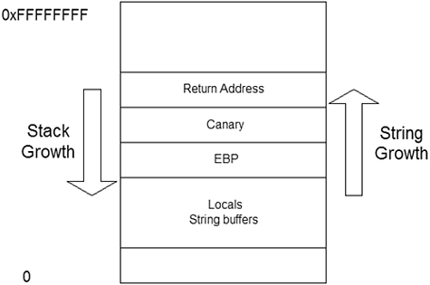
Stack Cookies – How do they work?

Slide 4
Microsoft
A string buffer is defined as an array whose element size is one or two bytes, and where the size of the whole array is at least five bytes, or, any buffer allocated with _alloca.
Cookie is static value at runtime
4 bytes DWORD
Stored in .data section when module loads
XORed with the current value of EBP
That value is placed on the stack:

Slide 5
Microsoft
When the function returns
XOR current value of EBP
Compare the value in ECX to the random cookie value
If they are equal, continue

Slide 6
Another Example

Slide 7
Checking the value

Slide 8
Stack Cookie
HIGHER
Args….
PROLOG:
push ebp
mov ebp, esp
RETURN ADDY (EIP)
OLD EBP
EBP – 4 Cookie
…
EBP - 18h Buffer
EBP – 1C Local
LOWER

Slide 9
Variable Reordering

Slide 10
Variable Reordering

Slide 11
GCC
-fstack-protector
Emit extra code to check for buffer overflows, such as stack smashing attacks. This is done by adding a guard variable to functions with vulnerable objects. This includes functions that call alloca, and functions with buffers larger than 8 bytes. The guards are initialized when a function is entered and then checked when the function exits. If a guard check fails, an error message is printed and the program exits.
-fstack-protector-all
Like -fstack-protector except that all functions are protected.

Slide 12
References
http://en.wikipedia.org/wiki/Buffer_overflow_protection
Microsoft stack guard
https://msdn.microsoft.com/en-us/library/8dbf701c(VS.80).aspx
https://gcc.gnu.org/onlinedocs/gcc-4.4.2/gcc/Optimize-Options.html

