Slide 1
American Fuzzy Lop
CSC 748
Josh Stroschein

Slide 2
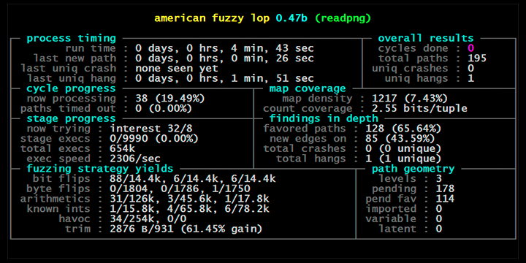
What is AFL?

Slide 3
What is AFL?
Employs a novel type of compile-time instrumentation & genetic algorithms
Uses this to automatically discover new test cases that trigger new internal states in the targeted binary
This improves functional coverage of the fuzzed code
Coverage guiding fuzzing – program execution paths are used to guide the generation of more effective input data for test cases

Slide 4
Static Analysis VS DBI
Dynamic Binary Instrumentation – analyzing binary application at runtime through injection of instrumentation code
Instrumentation code – code that is designed to monitor or measure
Typically transparent to the target application
Runtime instrumentation allows fuzzer to gain insight into behavior and state of an application
Static analysis leaves us to speculate what may occur, DBI allows to observe what does occur

Slide 5
Benefits of AFL
Fairly easy to setup and begin using
Minimal configuration
Discovers interesting code paths for you
Generates relevant test cases
You don’t need to spend time writing rules to generate test cases
Don’t have to worry (as much) about samples code coverage

Slide 6
AFL Modes of Operation
Compile from source
Modify existing code to target specific functionality
Black-box using QEMU (Linux)

Slide 7
Let’s Fuzz Binutils
Find software you want to fuzz
binutils
Configure build to use the AFL-Compiler
cd binutils
./configure CC=afl-gcc
make
Create test case(s)
Consider afl-tmin and afl-cmin
Fuzz!
afl-fuzz –i inputs/ -o outputs/ pat/to/target/binary <arguments>

Slide 8
The GUI

Slide 9
Status Screen
Process timing
* paths = test cases that trigger new execution patterns
If AFL does not start finding new paths right away, there is likely a configuration issue – target binary is not parsing the input file
Anything in RED needs your attention

Slide 10
Status Screen
Cycles done – queue passes
Number of times fuzzer covered all interesting test cases, fuzzed them and looped back to the beginning
Each fuzz session should be allowed to complete at least one cycle
Total paths = number of test cases
Crashes and hangs can be viewed in output dir

Slide 11
Status Screen
Cycle Progress
How far along the fuzzer is with current queue cycle
Map Coverage

Slide 12
Corpus Minimization
afl-cmin
afl-tmin

