Slide 1
Fuzzing
CSC 748
Josh Stroschein

Slide 2
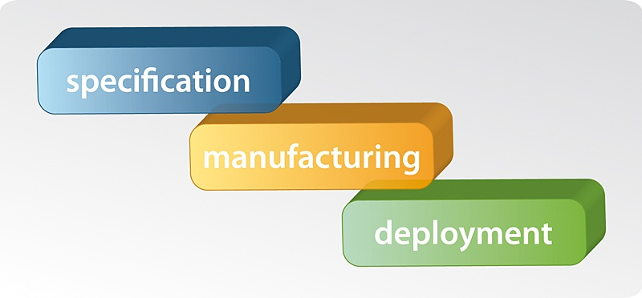
What Is Fuzzing?
70% of modern security vulnerabilities are programming flaws
10% being configuration issues
20% being design issues
“Over 80% of communication software implementations today are vulnerable to implementation-level security flaws. For example, 25 out of 30 Bluetooth implementations crashed when they were tested with Bluetooth fuzzing tools.” (2007-8)

Slide 3
Security Testing
Traditional faults
Actual software functionality
Intended functionality
Missing defenses
Poor defenses
Extra “functionality”
No authentication
Weak authentication
Buffer overflow in authentication

Slide 4
Costs of Fixing Bugs

Slide 5
Post-Release Bug Fixes

Slide 6
What Is Fuzzing?
“Fuzz testing or Fuzzing is a Black Box software testing technique, which basically consists in finding implementation bugs using malformed/semi-malformed data injection in an automated fashion.” [1]
Automated testing technique to find bugs in software
Focus on the attack surface, which are the areas of code used to access or interface between systems
Files, APIs, Network interfaces, Reg keys, etc.
Also, focus on boundary conditions (data and other)
Integer types, and privilege types, etc
Notes:
[1] https://www.owasp.org/index.php/Fuzzing
[2] The Shellcoder’s Handbook, 2nd Edition - Anley

Slide 7
What is Fuzzing?
Two main types of fuzzing
Mutation and Generation
Also called dumb and intelligent
Dumb is not necessarily less effective
“Most” of the data needs to be delivered correctly for fuzzing to work well
So it’s not really dumb is it?

Slide 8
When Is Fuzzing Most Effective?
Very effective on languages like C/C++ where memory is unmanaged
I.e. programmer can manually define the size of static buffers as in ‘char buf[100]’, etc
Don’t forget languages like python/ruby are built with C/C++ and can call directly to it
Even .NET code sometimes calls to unmanaged code
Could be used elsewhere like web, etc
Looking for different exceptions typically though
Still very effective in PC world
Even more so in hardware/teleco/SCADA

Slide 9
MS Six Stages of Fuzzing [1]
Stage 1: Prerequisites
Identify Targets
Prioritize Efforts
Stage 2: Creation of fuzzed data
Will it be format aware? Context-aware?
Use existing data or generate from scratch?
How will malformations be applied?
Will restrictions on malformations be enforced? Deterministic, random or both
Notes:
[1] https://blogs.microsoft.com/microsoftsecure/2007/09/20/fuzz-testing-at-microsoft-and-the-triage-process/

Slide 10
MS Six Stages of Fuzzing [1]
Stage 3: Delivery of Fuzzed Data
Get application under test to consume fuzzed data
cmd-line, gui, API hooking, MITM proxies, DLL redirection, in-memory, etc
Stage 4: Monitoring of application under test for signs of failure
What to look for? What should you see?
Stage 5: Triaging Results
How to classify and analyze issues found
Stage 6: Identify root cause, fix bugs, rerun tests, analyze coverage data
Notes:
[1] https://blogs.microsoft.com/microsoftsecure/2007/09/20/fuzz-testing-at-microsoft-and-the-triage-process/

Slide 11
Test Cases
Creating good test cases is hard
“Complete” software testing is an NP-Hard problem
Not to mention in practice testers aren’t given the budget and often training to attack low level security issues
Imagine a program that can parse a file 1 megabyte in size
How many possible files is this if you created a file for every possible combination of bytes (or bits!)?
Wayyyyyyyyyyyy too many… thus fuzzing
Fuzzing hits many cases, quickly, and comes up with combinations a tester might not manually consider important
New research is looking at novel ways to get good CODE COVERAGE (CC) via auto path discovery, etc

Slide 12
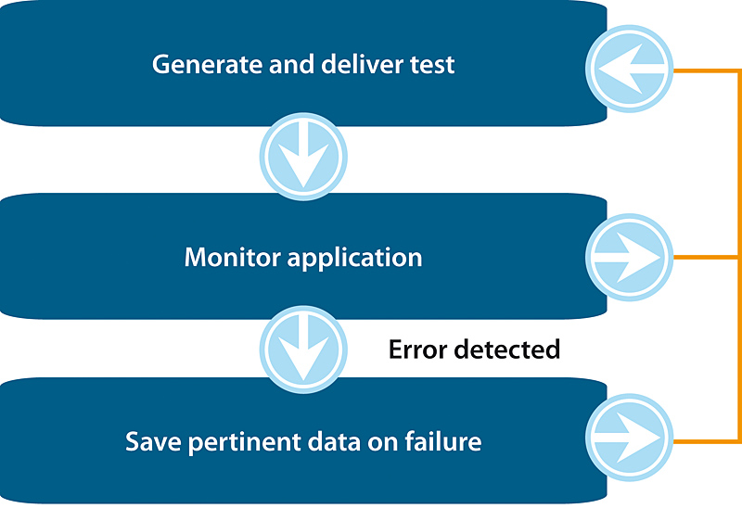
High-Level Overview

Slide 13
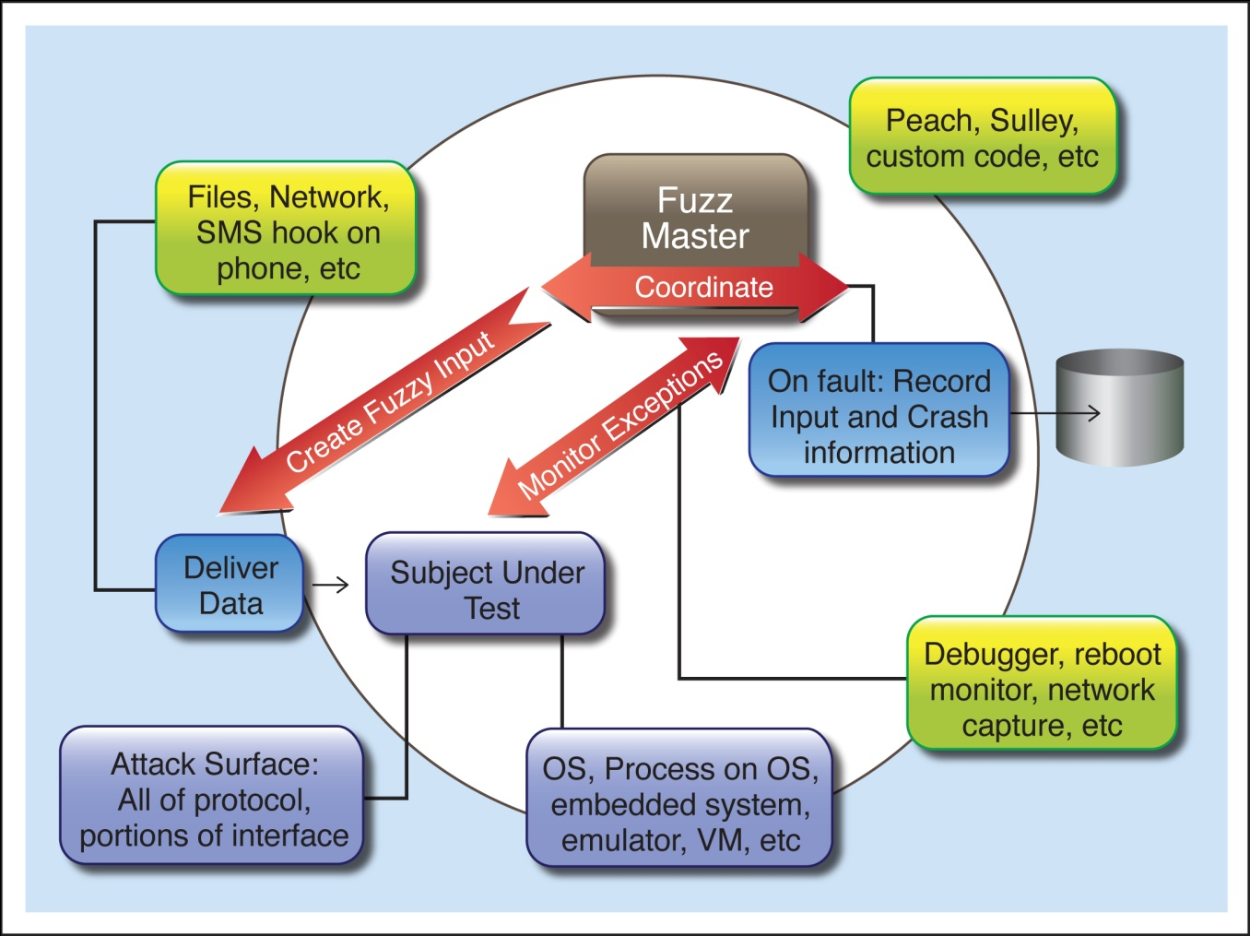
Overview Refined

Slide 14
A Smart Fuzzer
Data Model + AnomalyLib + Delivery Harness + Monitoring + Reporting == Good Fuzzer

Slide 15
Traditional String Anomaly Library
"/.:/" + "A"*5000 + "\x00\x00",
"/.../" + "A"*5000 + "\x00\x00",
"/.../.../.../.../.../.../.../.../.../.../",
"/../../../../../../../../../../../../etc/passwd",
"/../../../../../../../../../../../../boot.ini",
"..:..:..:..:..:..:..:..:..:..:..:..:..:",
"\\\\*",
"\\\\?\\",
"/\\" * 5000,
"/." * 5000,
"!@#$%%^#$%#$@#$%$$@#$%^^**(()",
"%01%02%03%04%0a%0d%0aADSF",
"%01%02%03@%04%0a%0d%0aADSF",
"/%00/",
"%00/",
"%00",
"%u0000",
# format strings.
"%n" * 100,
"%n" * 500,
"\"%n\"" * 500,
"%s" * 100,
"%s" * 500,
"\"%s\"" * 500,
# command injection.
"|touch /tmp/SULLEY",
";touch /tmp/SULLEY;",
"|notepad",
";notepad;",
"\nnotepad\n",
# SQL injection.
"1;SELECT%20*",
“'sqlattempt1",
"(sqlattempt2)",
"OR%201=1",
# some binary strings.
"\xde\xad\xbe\xef",
"\xde\xad\xbe\xef" * 10,
"\xde\xad\xbe\xef" * 100,
"\xde\xad\xbe\xef" * 1000,
"\xde\xad\xbe\xef" * 10000,
"\x00" * 1000,
# miscellaneous.
"\r\n" * 100,
"<>" * 500, # sendmail crackaddr

Slide 16
Intelligently Fuzzing Different Types
The key to intelligent fuzzing is understanding the timing, state, and format of data
How is it going to be parsed?
If we’re fuzzing a binary protocol of [Type][Len][Variable]
The length should “usually” be correct
The type should be as many as possible
The variable string could be valid if required
But more likely from the anomaly library
Also, can calculate runtime
Elements * Anomalies * Time/Run = Total Run Time
20 * 1000 * 10sec = 55.5hrs
How to decrease that?

Slide 17
Monitoring
How will we detect faults?
Always start by manually causing a fault in the application under test if possible.
This shows you what a fault will look like
Fuzzing is pointless if you’re not sure how to detect errors
Debuggers, OS or application logs, network sniffs, crash files, etc.
Some fuzzing tools can “bin” crashes
5000 crashes could be the result of one bug

Slide 18
Gen 1: Attach with a debugger
Attach to the process with debugger
Run attack
Wait for exceptions
Might not work well for two reasons:
Doesn’t scale/requires constant manual work
Catches too many 1st chance exceptions
IE is the king of exceptions that are “OK”
Exception types can of course be ignored

Slide 19
Gen 2: Monitoring Application
C:\Program Files\FileFuzz>crash.exe "C:\Program Files\QuickTime\QuickTimePlayer.exe" 5000 C:\bad-1.m4v
[*] crash.exe "C:\Program Files\QuickTime\QuickTimePlayer.exe" 5000 C:\bad.m4v
[*] Access Violation
[*] Exception caught at 6828e4fe mov edx,[edx+0x4]
[*] EAX:00005af4 EBX:00000000 ECX:00000004 EDX:00142ffc
[*] ESI:00142ffc EDI:00116704 ESP:001160fc EBP:00000000
When wrapped by another program, can be effective
The filefuzz program wraps crash

Slide 20
Gen 3: Scriptable Debugger
import sys
from pydbg import *
from pydbg.defines import *
def handler_crash (pydbg):
print pydbg.dump_context()
return DBG_EXCEPTION_NOT_HANDLED
dbg = pydbg()
for (pid, name) in dbg.enumerate_processes():
if name == sys.argv[1]:
break
dbg.attach(pid)
dbg.set_callback(EXCEPTION_ACCESS_VIOLATION, handler_crash)
dbg.debug_event_loop()
Notes:
Pydbg is a program created by Pedram, as part of the PaiMei suite of tools. Good for custom debugging apps like fuzzers. Wraps Windows debugging API.
Supply name of process to attach to. If an access violation occurs, the context will be printed out.

Slide 21
Peach Fuzzer
Fuzzing platform
Separates out modeling of data and state systems being fuzzed w/ the actual fuzzing engine
Provides robust agent/monitoring system
Pluggable and extensible!

Slide 22
Peach Fuzzer - Components [1]
Modeling: peach applies fuzzing to models of data and state
Focus on data and state modeling
This differentiates between a dumb/smart fuzz
Publisher: I/O interfaces, convert abstract state models and apply actual transport implementation
write files, TCP, UDP, COM objects, HTTP requests, etc
Fuzzing Strategy: How to generate/mutate the data.
How to transition state - does not produce data at this point
Mutators: used to produce data.
Notes:
[1] http://community.peachfuzzer.com/v3/PeachPit.html

Slide 23
Peach Fuzzer - Components
Agents: run locally or remotely, monitor fuzzing activities
Monitors: run inside of an agent, do tasks like capturing network traffic or attaching to a debugger
Logger: save crash and fuzzing run information
File system logger by default
Steps to Fuzzing:
Create models
Select/configure publisher
Configure agents/monitors
Configure logging

Slide 24
Working with Peach
Peach Fuzzer Framework
Actively maintained
Commercial version available
Peach Community Edition available too
Peach training is available
There is a bit of a learning curve, we’re just looking for an intro on this topic

Slide 25
Peach Components
Peach Pit
Peach
Peach Agent
Data Model
UI
UI
Mutators
Monitors
State Model
Agent Config
Publisher
Engine
Remote
Publisher
Test Config
Logging
Agent
Manager

Slide 26
File Fuzzing w/ Peach
File
Peach
Create
Publisher
Run
Target
Application
Engine
Logger
Agent
Manager
Monitor
Peach Agent
Debugger

