Slide 1
Cyber Operations
Unit 01 Intro to Ethical Hacking

Slide 2
Learning Outcomes
Upon completion of this unit, students will be able to identify different types of offensive security engagements and understand ethical considerations surrounding them
Students will be able to identify laws governing computer security as they relate to cyber operations.

Slide 3
General Terms: Setting the stage
Penetration test / “ethical” hack
Legal attempt to break into a company’s network to find its weakest link
Tester reports findings
Vulnerability Assessment (VA)
PT vs VA
confusion in the market place…
Red Teaming / Security test
how is this diff than a PT or VA?
Penetration Testers / Ethical Hackers / Sec Researchers
The players!
Notes:
PT / Ethical Hack
Legal / authorized attempt to break in order to: assess, identify AND provide POC
Expose security issues
Report the findings so the company can address BEFORE a malicious attacker finds the same thing
VA vs PT:
Consider the difference between vulnerability assessments and penetration tests.
Think of a vulnerability assessment as the first step to a penetration test (sometimes called an “overt” PT)
The information gleaned from the assessment will be used in the testing.
Whereas, the assessment is checking for holes and potential vulnerabilities, the penetration testing actually attempts to exploit the findings.
Red Teaming: / Security Test
More than an attempt to break in; also includes analyzing company’s security policy and procedures
Tester offers solutions to secure or protect the network
The players:
Employed by companies to perform penetration tests
Security Researchers (independent, salaried, academic)

Slide 4
The many names for a “hacker”
Hacker vs Hacker
Hackers vs Cracker
Crackers vs Script Kiddie vs Packet Money vs Elite
White Hat Hacker vs Black Hat Hackers vs Gray Hat Hackers
Ethical Hacker vs Malicious Attacker
Hactivist vs…
Notes:
in one form or another you could look at any of these names and substitute the word “hacker” but there is a difference here…
and you should know it even if you don’t use it
I think it’s more useful to “classify” people via skill level and intent…
skill level == how “good they are at gaining access” and “intent” == what they are going to do when they have access
let’s look at the first example “hacker vs hacker”. --- the term is VERY ambiguous…good to some people bad to others…
in the 60’s and 70’s “hacker” was a GOOD word --- someone good with code
in the 80’s when Wargames came out…the media latched on to the buzz word and it has been bad ever since
still in the community “some people” will use the word hacker with a positive spin
hacker vs cracker == a little more sinister because cracker is someone who is intentionally breaking laws / cracking / etc…
Access computer system or network without authorization
Breaks the law; can go to prison
Break into systems to steal or destroy data
U.S. Department of Justice calls ANYONE who employees these techniques a “hacker”
Penetration Tester / Ethical hacker
Performs most of the same activities but with owner’s permission
Ethical Hacker:
Even if you don’t know (or believe) that there are “ethichal hackers” YOU ARE WRONG
BUT---let’s just say for this second---”ethical hackers ALWAYS have permission”.
Other than permission and intent (motivation and intent) EVERYTHING is the same...no difference in tools, techniques,

Slide 5
Common Question:
How do I move from “script kiddie” to elite?
Programming
“Eventually everything is software!”
“The lower level the better”…(think Assembly)
the lower you go the more doors you open
Assembly, C, C++, Python, Perl
Notes:
Programming:
the ability to program is a good differentiator between a script kiddie and an elite
BECAUSE…script kiddies will ALWAYS have to rely on other peoples tools. Programmers will write their own (tools and exploits!)
the lower the better…(assembly is good for malware, good for exploit dev
but that doesn’t mean that scripting languages are bad (just the opposite…)
Programming languages used by experienced penetration testers
Assembly
C
Python
Perl
Among other things…programming is useful for reversing and automation!
Lets say for example: you’re doing a pen test…during info gathering you get a “free legit copy of their software”…how much MORE valuable is your skill set to that company if you can take the free software / demo & reverse it & patch it and show them a fully functional copy of their demo??? Trust me---you WILL get a call back from that company.
Script = Automation
Set of instructions that runs in sequence
Bat files
It’s also good to point out that simply knowing how to program doesn’t make you a good hacker.
it’s just a good toolset to have --- like the ability to social engineer --- some people are good others are not…learn to use your strengths

Slide 6
Tools needed:
Dedicated machine == good!
(sometimes called a Tiger box)
Collection of OSs and hacking tools
Helps penetration testers and security testers conduct vulnerabilities assessments and attacks
What if you can’t afford a dedicated machine?
Old cheap laptops / desktops
VMs
Notes:
Tigerbox can be helpful to keep all of your files / tools separate
Why do this on a separate machine?
* AV Software doesn’t like a lot of the tools we use, it will delete, or throw a hissy fit when it sees them or tries to use them
* most tools use root exclusively (log in as root, run as root, etc...) that’s great for our tools but a BAD idea for our own personal security...
In this class:
If you are on on campus or following along in the videos. HAVE A LOCAL COPY RUNNING IN A VM!!!
Also be sure to have access to the IA Lab

Slide 7
<< BT & Kali Linux
Defacto pen testing distro
General Info:
http://kali.org
http://www.backtrack-linux.org/
Downloads:
http://www.kali.org/downloads/
Install options:
Physical (local), vm, live disc, USB persistent
Community Forums:
http://forums.kali.org
Notes:
There are lots of other distros---but this one is among the best
Well supported, (community) and underlying distro
Downloads == lots of options (even one to install it on your Xoom android tablet)
64bit for native install
KDE / Gnome
32 bit
VM
.iso for live booting (lack of forensic evidence)
Install Options:
Lots of “how tos” on the internet
Send me an email if you’re unsure
We’ll use VM --- if you’re not sure how to use a VM send me an email
Forums == have thick skin, but good place to learn and get help
NOTE---you do NOT have to use BT---but using a different distro == no support from me!

Slide 8
<<Kali (or BT) Linux: running in a VM
Download the VM from Kali (or OffSec)
Extract (7z)
Open VM player → Open a Virtual Machine
Navigate to the .vmx and open
Logging in
User / Pass == root / toor
BT ONLY: need to start GUI
startx
Wireless (in a VM)
Notes:
Demo this (start the VM, log in, startx)
Show the terminal (where we’ll do most work)
Check networking (ifconfig) --- check networking on the host (VM Player settings!!)
Warn students about checking these settings (especially if things aren’t working…ping == your friend)

Slide 9
Overt Penetration Tests
Overt PT or White box model
Tester is told everything about the network topology and technology
Tester is authorized to interview IT personnel and company employees
What is the goal?
What is the benefit?
What is the drawback?
Notes:
So now we have our tool---what are we going to do with it???
Conduct Security TESTS!!
Overt PT or White box model
Tester is told everything about the network topology and technology
Tester is authorized to interview IT personnel and company employees
Makes tester job easier
GOAL == Thoroughly test a system (or network) very comprehensive
BENEFIT == makes the tester’s job easier if they don’t have to worry about stealth
DRAWBACK == not really testing your CERT / Incident Response teams and “defenses”
Benefit = without worrying about being stealthy you can REALLY dig in…
often times in covert you will only scan for known “weak services” to keep your footprint small…like look for a misconfigured SQL Server…
But with an overt you can scan all 65,535 ports. TCP AND UDP!
can also be good for simulating “insider threats”---from the standpoint of “the attacker knows ALL about your network” (not from a “stealthy” standpoint

Slide 10
Covert Penetration Test
Covert or Black box model
Company staff does not know about the test
Tester is not given details about the network
Burden is on the tester to find these details
What is the goal?
What is the benefit?
What is the drawback?
Notes:
Black box model
Company staff does not know about the test
Tester is not given details about the network
Burden is on the tester to find these details
Tests if security personnel are able to detect an attack
GOAL == gain access anyway possible & remain undetected (PoC)
BENEFIT == wake up call, PoC that it CAN happen…sony wasn’t just unlucky
DRAWBACK == probably not as “comprehensive”…because you’re only looking for 1 way in…
won’t port scan all 65535 ports, rather just a few on a few Ips…
these require much more skill than a OVERT test (skilled PT’er) cause you’re not just “running tools”.
typically cost more, take longer,

Slide 11
Middle ground?
Gray box model
Hybrid of the white and black box models
How to choose (what to sell)
Personal philosophy (warning soap box)
Formal methodologies a little later
Notes:
Grey box: Company gives tester partial information
“Here is a list of our IP addy’s”, “This webserver is running Linux Redhad version xx.xx w/ Apache version xx.xx.”
How to choose:
soapbox == I tend to rail against Overt…
NOT BECAUSE IT’S BAD --- BUT BECAUSE PEOPLE BUY OVERT WITHOUT KNOWING THEY’RE BUYING IT…
typically preferred by most PT’ers because these simulate “real world attacks”.
THE MAIN DIFF HERE:
Covert PT’ing is about finding the EASIEST way to gain access to a system (undetected) NOT about finding a LARGE # of vulnerabilities (Overt)

Slide 12
Security based certifications
Entry Level
Security+
Certified Ethical Hacker (CEH)
Certified Penetration Tester (CPT)
Applied
OSSTM Professional Security Tester (OPST)
www.isecom.org/projects/opst.shtml
Cisco Certified Security Professional
Offensive Security: OSCP / OSCE
Offensive Security Certified Professional
Offensive Security Certified Expert
Certified Expert Penetration Tester (CEPT)
Notes:
Lot’s of students are interested in certs…so the next couple of slides provide a brief overview
A good place to see what’s hot is to browse “ClearanceJobs.com” to get a bead on the hottest security certifications job hunters need
Certified Ethical Hacker (CEH)
Developed by the International Council of Electronic Commerce Consultants (EC-Council)
Based on 21 domains (subject areas)
Web site == www.eccouncil.org
Recently been upgraded…from v5 to v6…
OPST
Open Source Security Testing Methodology Manual
http://www.isecom.org/projects/opst.shtml
The OPST actually requires you test against test servers *which are located at La Salle University, Barcelona.
No tricks to the tests- you can either do it or you can't (use scripting and tools and programming)
it is not about what you know but if you can apply what you know
Off-Sec (OSCP / OSCE)
MY PERSONAL FAVS!!!
OSCP
The OSCP, or Offensive Security Certified Professional, is one of the world's first completely hands on information security certifications.
the OSCP challenges the students to prove they have a clear understanding the concepts of the Pentesting With BackTrack material,
as well as a depth of knowledge in penetration testing.
OSCE
The OSCE, or Offensive Security Certified Expert, takes security certification to a level never even considered today's market.
After the student completes the very challenging Cracking the Perimeter class the core of their understanding and knowledge is challenged to the limits in the special OSCE certification labs.
The OSCE labs are set up with a limited amount of machines and very specific "hacks" must be performed in order to pass this amazingly challenging 48-hour exam.
The student must submit their completed exploits and the steps they took to obtain the proof.txt files on the servers they are challenged with.

Slide 13
Professional Level
Certified Information Systems Security Professional (CISSP)
Certified Information Systems Auditor (CISA)
Many others at all levels
Notes:
CISSP
Issued by the International Information Systems Security Certifications Consortium (ISC²)
Usually more concerned with policies and procedures
Consists of 10 domains
Web site == www.isc2.org
CISA
Candidates for a CISA certification must pass a test,
adhere to the Information Systems Audit and Control Association's Code of Professional Ethics,
provide proof of a minimum of five years of professional IS auditing, control, or security work
follow a program of continuing professional education.
There are certainly many many other types of tests/certs that can be had (LPT) / (Certified Pen Tester), etc…etc…etc…but

Slide 14
A big part of Ethical hacking = Ethics
What are ethics?
Once you understand the meaning of ethics you can understand / tackle / take on ethical hacking (white hat)
Teaching Ethics
The great debate
Notes:
Ethics
(from the Ancient Greek word ēthos (E-thauce) meaning "custom, habit”
The study of values and customs of a person or group.
Covering the concepts such as right and wrong, good and evil, and responsibility.
The process of determining how one should hold the interests of various stakeholders, simultaneously taking into account moral values and principles
A system defining right and wrong behaviors
Teaching Ethics:
the great debate…can “ethics” be taught?
some recent research says … YES! With repeated examples…some disagree.

Slide 15
Ethical Hacking
Ethical hacking is an activity where a computer and network expert attacks a security system on behalf of its owners,
Utilize the same tools and techniques as malicious hackers
Seek the same vulnerabilities that a malicious hacker could exploit
BUT report problems instead of taking advantage of them
Notes:
Heard me say this:
Very slippery slope from .99 song → $9.99 album → $19.99 dvd / movie → $59.00 game → $250 Operating System → $2400 piece of software…
DO NOT START ON THE PATH!!
If you never start down the path you’ll never end up where you don’t want to be
If you’ve started down the path STOP!!!
Music for example---I’m not a spokesman for the RIAA---but there are GOOD alternatives to illegally downloading music.
Never download music or use illegal software you’ll never have to question
FOLLOW YOUR GUT!!!
Most people have a good sense of right or wrong
If you’re not sure ASK SOMEONE BEFORE PROCEDING!!
CIA Prezi this summer:
Don’t steal music. We’ll know. Amnesty for lots of things…but this one is tripping up lots of potential employees
with 100,000 job aps a year you have to be better than the best

Slide 16
Legal issues
Laws involving technology are “behind the times” but do change quickly and geographically
Find what is legal for you locally
Get the specifics on ALL COMPOUNDED LAWS!
Just like real estate it’s all about:
location, location, location
Notes:
1st off understand---there are ALWAYS legal issues with what we do…and I’m NOT A LAWYER
2nd you will always be the target of any investigation involving a computer crime
3rd I’m NOT A LAWYER
4th you have to decide your threshold for pain
Laws involving technology change as rapidly as technology itself
Find what is legal for you locally (local laws can affect you)
Laws change from place to place
Be aware of the specifics of what is allowed and what is not allowed
what tools, what activities, etc…
real estate Be aware of location!
Internet & virtualization make it difficult to tell where the computer is located
Be aware of location!!
Beyond your local state borders?
Jurisdiction questions?
Now you have to know MORE then just your laws?
What if your “route” passes through other States??? Do you have to abide by those laws too???

Slide 17
Metasploit (and other tools) ARE weapons
Failure to understand this point can result in you going to federal prison
Governments are getting more serious about punishment for cybercrimes
German law: 202(c)
Notes:
Hacking tools and guns == “hacking tools are like guns” not illegal to have unless you shoot someone
Tools on your computer might be illegal to possess
Written words are open to interpretation
YOU ARE RESPONSIBLE TO KNOW THE LAWS!
YOU CAN GO TO JAIL!
German Law: August 2007,
a strict reading appears to make illegal the distribution, sale and possession of any security tools which could be used to commit a crime.
In January of 2008 UK said it was considering adopting a similar law
DSU = DO NOT DO NOT DO NOT RUN THESE TOOLS OUTSIDE THE LAB!!!

Slide 18
US Federal Laws
Federal computer crime laws are getting more specific
Cover cybercrimes and intellectual property issues
Computer Hacking and Intellectual Property (CHIP)
New government branch to address cybercrimes and intellectual property issues
Notes:
About 75 Attorneys working closely around the US---they bring in other people
Computer Crime & Intellectual Property Section http://www.cybercrime.gov/
* don’t go here until AFTER the contest!!

Slide 19
The Laws and You
http://www.sans.org/reading_room/whitepapers/legal/federal-computer-crime-laws_1446
Federal Laws
Computer Fraud and Abuse Act
Electronic Communications Privacy Act
Computer Security Enhancement Act
Patriot Act: Section 217
Notes:
sans paper google: “sans federal computer crime laws”
CFAA (computer fraud and abuse act)
goes back to 1984 (oldest one on the books) modified in 1986
CFAA is the most important computer crime statute in the U.S. because almost every other statute that deals with computer crime modifies the CFAA.
In its current incarnation CFAA criminalizes seven types of computer activities:
The first 4 are “unauthorized access” (for whatever reason), the others are “intentional damage to a computer system, trafficing passwords, threatening computers with the intent of extorting money
(1) the unauthorized access of a computer to obtain national security information with an intent to harm the United States or for the benefit of a foreign nation; (2) the unauthorized access of a computer to obtain protected financial or credit information; (3) the unauthorized access of a computer used by the federal government; (4) unauthorized access to a protected computer with the intent to defraud; (5) intentionally damaging a protected computer; (6) the fraudulent trafficking in computer passwords and any other information which can be used to gain access to a protected computer; and (7) threatening a protected computer with the intent of extorting money or something else of value.
ECPA:
Passed in 1986, Electronic Communications Privacy Act (ECPA) was an amendment to the federal wiretap law,
the Act made it illegal to intercept stored or transmitted electronic communication without authorization.
ECPA defines the provisions for access, use, disclosure, interception and privacy protections of electronic communications
Cyber Security Enhancement Act
Cyber Security Enhancement Act (CSEA) was passed together with the Homeland Security Act in 2002,
it granted sweeping powers to the law enforcement organizations and increased penalties that were set out in the Computer Fraud and Abuse Act.
Patriot Act
Lots of legal implications about who has authority to do what and collect what and look at what
217 specifically deals with communication interception

Slide 20
State Laws
Make sure you understand the state laws in EVERY state you’re doing business in
http://www.ncsl.org/default.aspx?tabid=13494
http://sdlegislature.gov/statutes/DisplayStatute.aspx?Statute=43-43B&Type=Statute
Hands-On Ethical Hacking and Network Defense

Slide 21
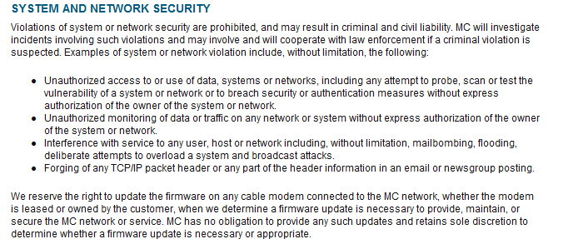
Local Laws (including ISP!)
Notes:
What’s your ISP?
Let’s find their AUP
How do you pen test through your ISP? Will they find you? Have you ever been on the receiving end of a call from your ISP? (Dana?)
remember---the ISP might not have the authority to do anything to you…but they are probably recording your traffic…and THAT can be used against you (think Patriot Act)
https://www.midco.com/Legal/acceptable-use-policy-aup/

Slide 22
It’s law so It’s not always clear…
A simple example
is port scanning legal?
is password cracking?
is there a federal law?
is there a state law?
local law?
Notes:
Some states deem it legal
Not always the case
Federal Government does not see it as a violation
Allows each state to address it separately
Read your ISP’s “Acceptable Use Policy”

Slide 23
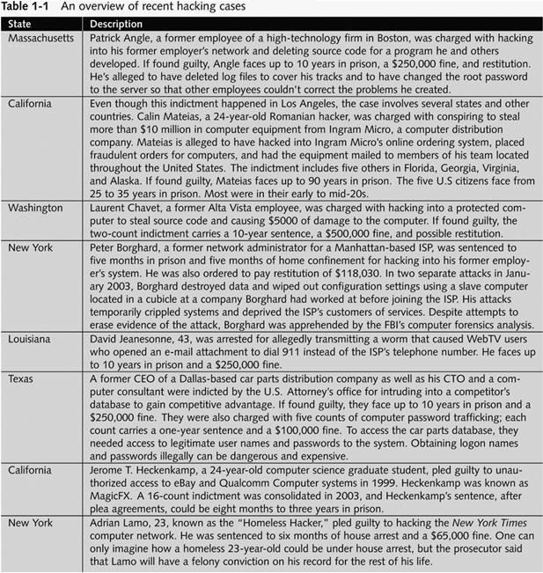
http://www.cybercrime.gov/cc.html
Notes:
http://www.darknet.org.uk/2009/01/tjx-tj-maxx-and-marshall%e2%80%99s-hacker-jailed-for-30-years/
been showing this slide for a while JUST TO HAMMER HOME THE ISSUE!!!

Slide 24
What You Cannot Do Legally
Accessing a computer without permission is illegal
Other illegal actions
Installing worms or viruses
What if they’re fixers?
http://www.securityfocus.com/brief/887
Denial of Service attacks
Denying users access to network resources
Be careful your actions do not prevent customers from doing their jobs
Notes:
Remember it’s always the most restrictive
Fixers: http://www.securityfocus.com/brief/887?ref=rss

Slide 25
Get It in Writing
Using a contract is just good business
Contracts may be useful in court
Internet can also be a useful resource
Have an attorney read over your contract before sending or signing it
Notes:
ANYTIME ANYTIME ANYTIME!!
* even if it’s your grandma’s (ESPECIALLY if it’s family!)

Slide 26
Ethical Hacking in a Nutshell
What it takes to be a security tester
Knowledge of network and computer technology
Ability to communicate with management and IT personnel
Ability to write
Understanding of the laws
Ability to use necessary tools
Notes:
You have to be trustworthy…
You have to be able to write…
Translate from technical details to something a common person could read
Any packet monkey can push a button…can you READ the results?
Can you exploit??? If not you’re really just doing a “vuln assessment”…

Slide 27
The Internet and You
Practice good OPSEC
For your safety, security, and wellbeing
What do you want the world to know about you?
Where you work
Where you live
What new expensive toy you got
When you’re on vacation (and not home)
Went to that party before you were 21

Slide 29
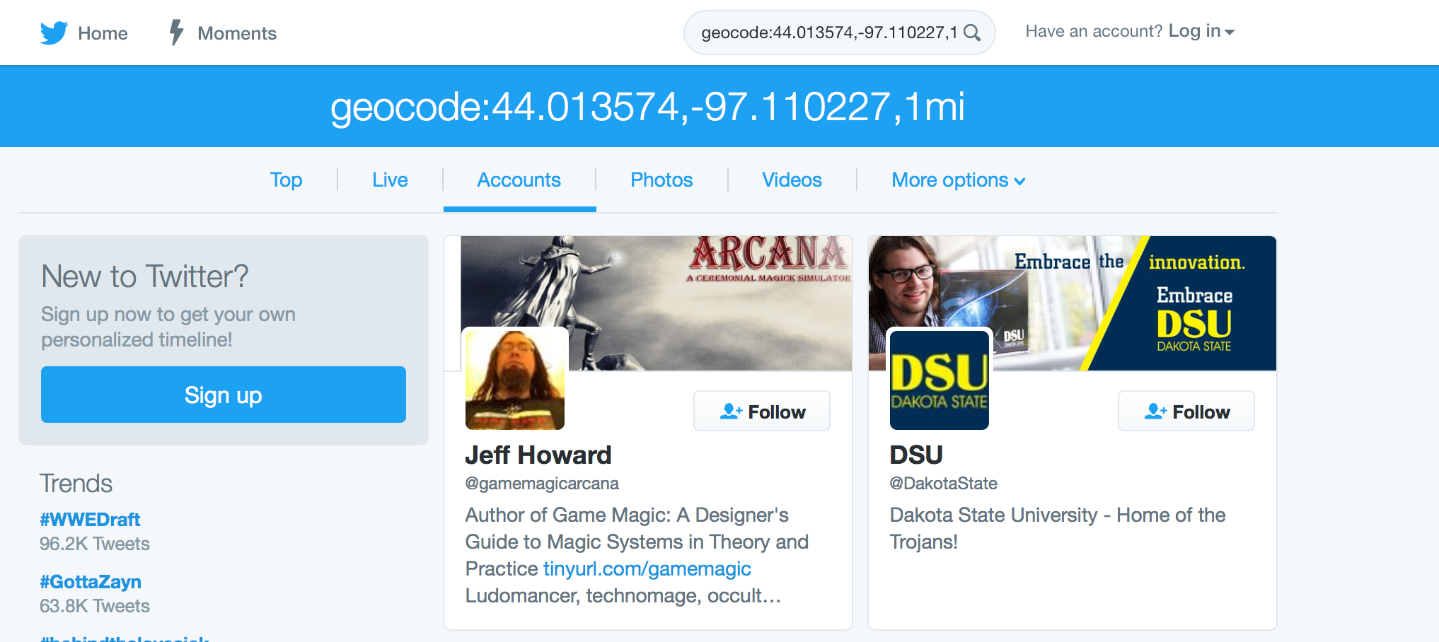

Slide 30
www.homepages.dsu.edu/pengebretson/ssn.doc

Slide 31
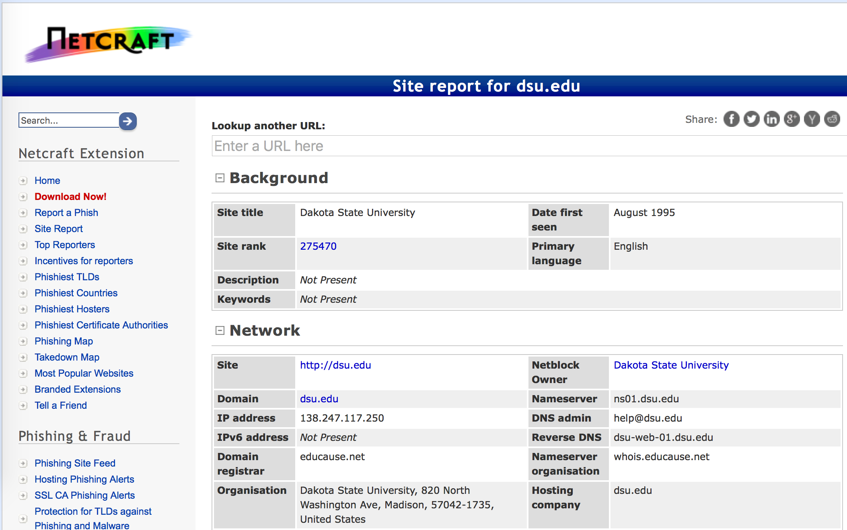
http://searchdns.netcraft.com

Slide 32
Summary
Several meanings for the word “hacker”
Several different words to describe Pen Testing
Several different types of security tests
PTs vs VAs vs Red Teaming
Different Penetration test models:
Overt / White box
Covert / Black box
Hybrid / Gray box model

Slide 33
Summary (continued)
Security Certs: depends on your goals
Legal issues:
Be aware of what you are legally allowed or not allowed to do
Compounding (most restrictive) of
Federal → state → Local → Other
ISPs might not have “legal teeth” but don’t underestimate
YOU HAVE TO UNDERSTAND ALL LAWS before conducting a security test

Slide 34
Summary (continued)
Get it in writing!!!
Use a contract
Have an attorney read the contract

