Slide 1
Cyber Operations
Unit 02 – Organizing and Managing the Operation

Slide 2
Learning Outcomes
Upon completion of this unit, students will be able to:
Install and setup Kali
Install and use Leo
Create a structured system of notes to organize and plan a cyber operation.
Identify the phases of penetration testing as reconnaissance, scanning, exploitation, post exploitation & maintaining access, and reporting.
Configure a virtual machine with software such as Metasploit and other tools as necessary to carry out a cyber operation.

Slide 3
Setting Up Kali Linux
https://github.com/cheetz/thp2 from the author of The Hacker Playbook if you want some additional software
Log in with default username/password (root/toor)
Change your password (optional for this particular class)
Update the image
Setup postgresql
Setup Metasploit database
Notes:
Update the image: apt-get update && apt-get upgrade -y && apt-get dist-upgrade
Start postgresql - service postgresql start
Start on boot: update-rc.d postgresql enable
Setup Metasploit database msfdb init

Slide 4
Setting Up Kali Linux
Change the hostname
Enable Metasploit logging (optional)
Logs are stored at /root/msf_console.log
Change the SSH keys
There is a big security risk if you don’t!
Notes:
Change the hostname
gedit /etc/hostname
gedit /etc/hosts
reboot
Enable Logging – optional since it takes up some space. Clients amy want a list of every command you ran
echo “spool /root/msf_console.log” > /root/.msf4/msfconsole.rc
Logs are stored at /root/msf_console.log
SSH Keys
cd /etc/ssh/
mkdir default_kali_keys
mv ssh_host_* default_kali_keys/
dpkg-reconfigure openssh-server

Slide 5
More of the Essentials…
Sublime Text
Turning off screen lock ← should you do this?
How to use Git
https://github.com/cheetz/Easy-P
Hexedit
Libc6-dev-i386
Notes:
Sublime
cd ~
wget https://download.sublimetext.com/sublime-text_build-3114_amd64.deb
dpkg –I sublime*

Slide 6
Windows
Sublime
HxD
IDA/Binary Ninja
Firefox Add-ons
Web Developer
Tamper Data
Foxy Proxy
User Agent Switcher

Slide 7
KeepNote
Note taking application that works on Windows, Linux, and MacOS X
Simple notebook hierarchy with rich-text formatting, images
Full-text search
”I think I found something with telnet open…”
root@kali:~# keepnote

Slide 8
Intro to Leo
Organization is key
Included in older versions of BT
Not included in Kali
Not included in BT 5 and >
Lots of other good tools
Down side to Leo
Pre-reqs:
install python on your system (>2.6)
Notes:
Organization is the key to a detailed PT (or VA)
Even if you only have a single target---if you’re going to spend HOURS examining a target—you’re going to come across a lot of different pieces of info
Management becomes key….
You will probably want to make money doing this job and nobody has “infinite” hours to spend on a project
The ability to quickly and accurately recall information will be KEY to your success…
Things change quickly and your threat landscape changes quickly (new targets, new services)
Need the ability to quickly add / edit / update / change AND more importantly search and sort through that info
This is all about management (managing the PT)
There are lots of tools out there that you can use. I’ll show you LEO because it’s my tool of choice.
Leo’s great because it’s light weight, supported by all major (OS’s), easy to use, and has tons of keyboard shortcuts.
When you first start it’s tempting NOT to use Leo (or another tool) BUT…trust me, get into the habit---it’s like learning cmd line, you’ll thank me latter
There are Lots of other good tools
One downside / bad thing about Leo is the fact that you can’t paste screenshots…that bothers me---

Slide 9
Leo Basics: Installing
Download the install package from Leo’s homepage link or SourceForge:
http://sourceforge.net/projects/leo/files/Leo/
From the home page, locate the link that says “Download Leo”
Choose the latest version
Unzip (“unzip” from the terminal)
For Kali
Run using Python (must be in the Leo directory)
# python launchLeo.py
Alternately: create a new launcher on desktop
Notes:
obviously the 1st thing we have to do is install it…
we have to install it before we can use it.
NOTE!! THIS IS THE PRE-COMPILED VERSION!!! (.deb file) --- you can also install from source
to install a deb file (on a deb system) --- dpkg –i Leo4.xxx
hint: you’re going to use it a lot, send a shortcut to the desktop

Slide 10
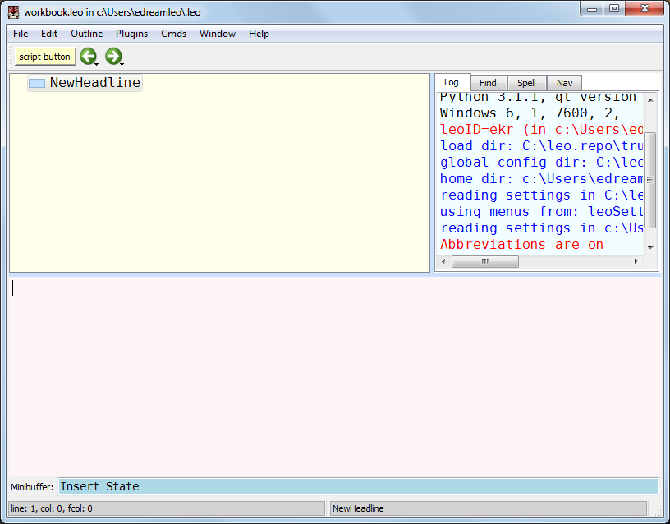
Overview of Leo: The main window
Start From the menu or python launchleo.py
Notes:
Starting Leo opens a workbook file…
there are 4 basic parts to a leo window:
Outline (contains Nodes) == overview
Body (lower part of window) == contains notes and details contained within each node
Log windows == I totally ignore
Mini buffer == enter commands (search, save, import, export, etc…)
The body has focus–it is colored a pale pink, and contains a blinking cursor.
Note: on some monitors the colors will be almost invisible. You can choose such colors to suit your taste.

Slide 11
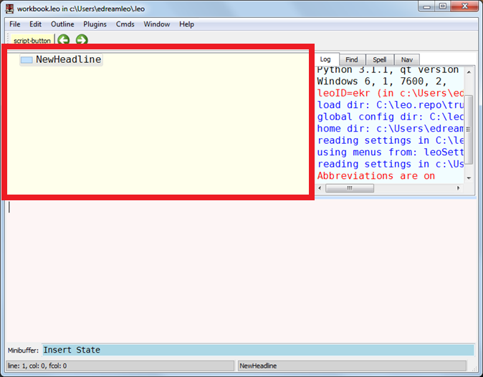
Outline Pane and Nodes
Notes:
The outline pane shows your project as an outline (or a series of “headings”) The outline contains all your project’s data.
An outline consists of nodes.
Each node has a “heading” or title and an ICON box (small blue rectangle next to the heading)
The icon box will indicate the status of the node
The border of the icon box is black if the node has been changed.
Smaller icons within the icon box indicate the status of the node:
A small blue box: the node has body text.
A red vertical bar: the node is marked.
A circular arrow: the node is cloned.
If a node contains children, a smaller icon appears to the left of the icon box. This icon contains a ‘+’ or ‘-‘ symbol. Clicking this expansion box expands or contracts the node.
Node
Each outline node has two two parts, a headline and body text.
The outline pane shows headlines. Selecting a headline selects the entire node; the node’s body text appears in the body pane.
Leo uses standard terminology to describe the relationships of nodes in an outline. We speak of parent nodes, child nodes, ancestor nodes and descendant nodes.

Slide 12
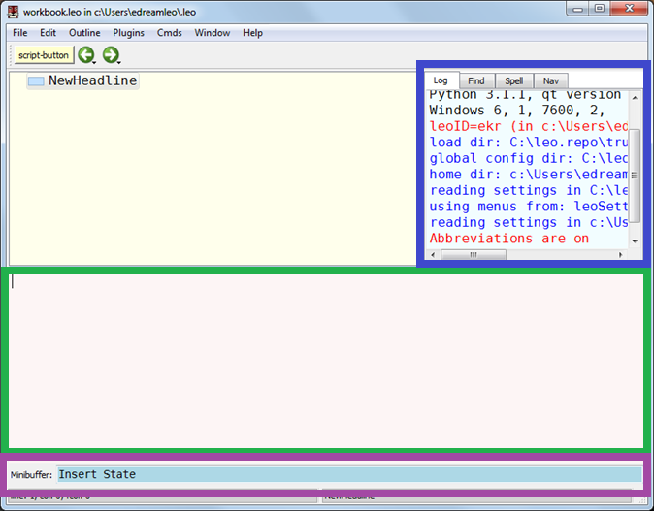
Body, Log, and Mini Buffer Panes
Notes:
Body pane
Highlighted in Green
The body pane contains the body text of the node selected in the outline pane.
All the information you want associated with the Node…detailed notes! (found an open port, running these services, has this vulnerability, etc…)
Log pane
Highlighted in blue
The log pane contains informational messages from Leo or your scripts.
Minibuffer
Highlighted in purple
You can type command and search strings in the minibuffer. It works much like the Emacs mini-buffer.
To enter a command, type <Alt-x> followed by the command name and then <return>.
To type a search string, type <ctrl-f> followed by the search string and then <return>.
For full details, see Using Leo’s Commands. http://webpages.charter.net/edreamleo/commands.html
NOTE!!! Always search fromm the top

Slide 13
A Note on Views
Personal preference:
Hide log pane
Window menu → Toggle Split Direction
Notes:
To me this just makes more sense---allows me to view more information more quickly

Slide 14
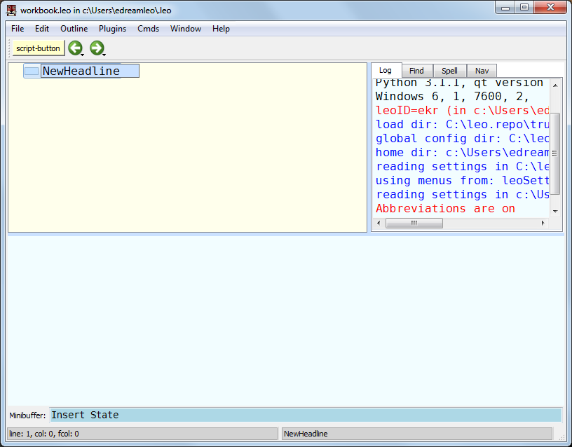
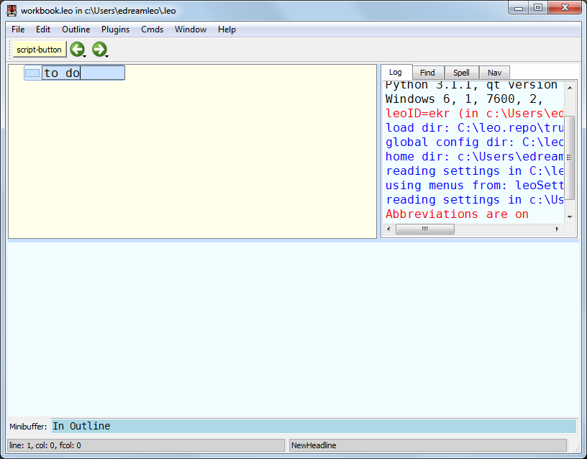
Ctrl-H edits the presently selected headline
Notes:
When you first create a new node it will be highlighted in blue and allow you to edit the heading
You can double click on the node OR…
To edit an existing heading use Ctrl-H
edits the presently selected headline.
You can type Ctrl-H at any time, regardless of where the focus is.
Typing the <return> key ends editing of the headline and puts focus back in the body pane.

Slide 15
Switching the Focus
You can use Leo without ever using the mouse.
Select any Leo pane by using keystrokes instead of clicking the pane:
Switch between Body and Outline with CTRL-T
Regardless of where the focus is,
Alt-D puts focus in the body pane
Alt-T puts focus in the outline pane.
With the focus in the outline pane:
hitting the return key puts the focus in the body pane.
Notes:
Again…this might seem clumsy at first…but in the end you’ll be more efficient if you learn to master the keyboard shortcuts

Slide 16
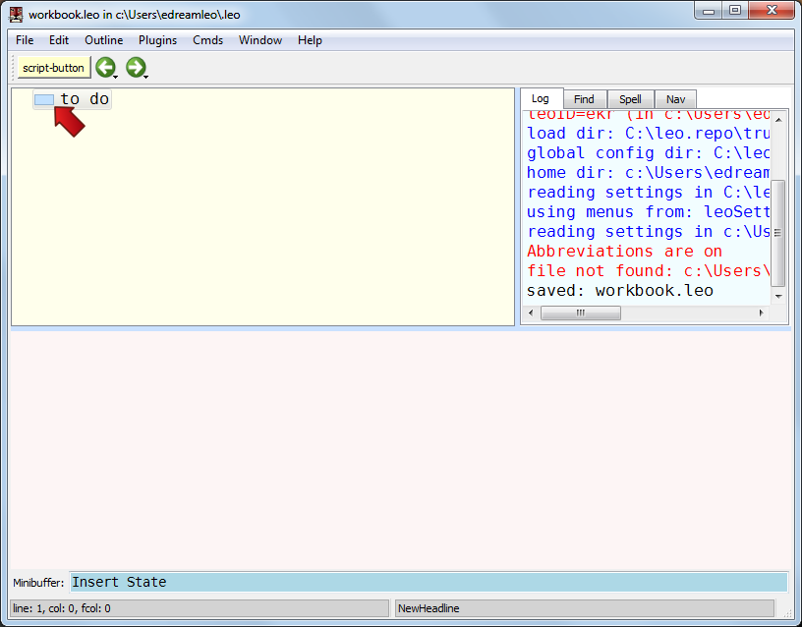
Save early. Save often
Ctrl-S saves the outline
Dark black border disappears indicating it has been saved
It’s a good idea to use “save as” the 1st time so you know where your file is!
Notes:
Leo is flexible. You can save as nearly any file type:
By default it saves a “.leo” file. Look up the “@files command to export your file to python, txt, etc…
For this class, I’ll have you submit a .leo

Slide 17
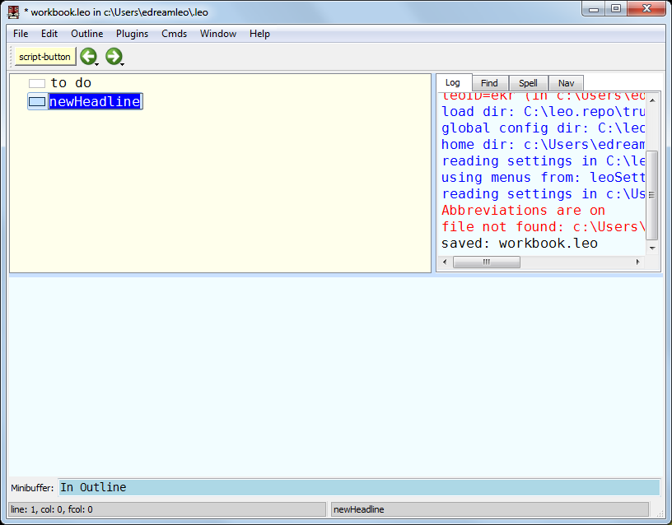
Adding Nodes
Ctrl-i inserts a new node.
Notes:
Create a new node. It will appear under the currently selected Node
Remember the fastest way to rename is directly after you’ve created the node (highlighted in blue)
Hitting return will drop you into the body of the node and allow you to enter info
Remember once you hit enter it will drop you into the body text where you start adding information about your target (focus is in the body pane)

Slide 18
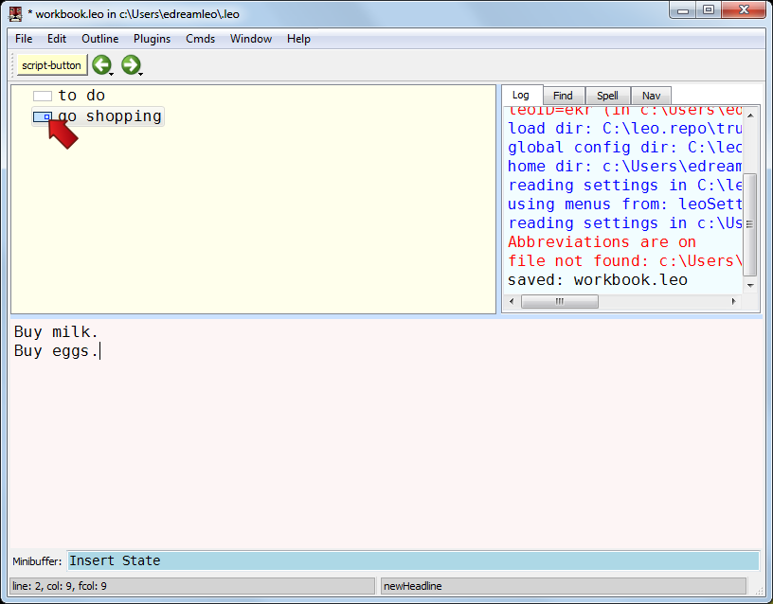
Populating the Body of a Node
Whatever I type will appear in the body pane.
Remember to keep detailed notes!
Anything and everything
Good idea to put “thoughts, hints, hunches” along with detailed tool output
The blue square in the icon area indicates that the body pane contains text.
Notes:
This is where you’ll keep pertainent notes about a subject (probably output from scans or other interesting bits of info

Slide 19
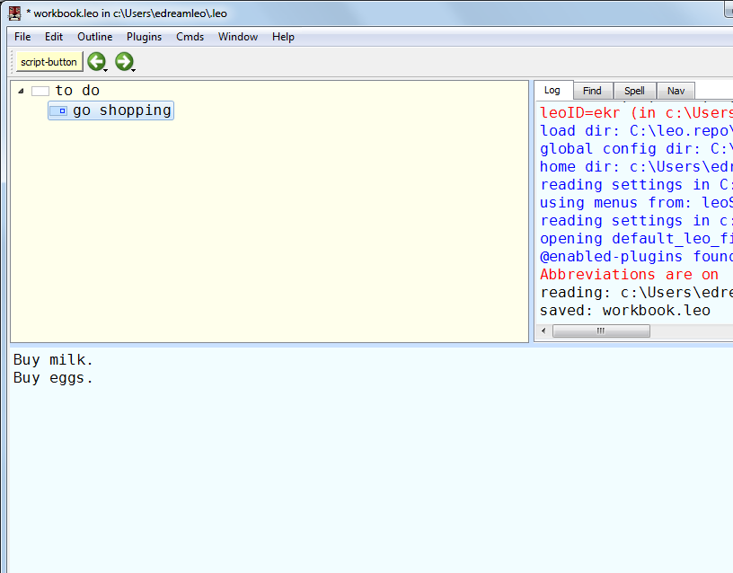
Making Children Nodes
CTRL-R moves a node right (makes it a child).
The “go shopping” node becomes a child of the “to do” node.
The “to do” node is the parent node.

Slide 20
Promoting the Child Node
CTRL-L moves the “go shopping” node left.
The “go shopping” node becomes a sibling of the “to do” node.
Don’t worry…it only SEEMS to delete all children above it
This is to help you see the level your placing the node

Slide 21
Make a Mistake?
Leo has unlimited undo/redo capabilities.
Use CTRL-Z to undo the previous move..
Note: CTRL-Shift-Z redoes a previous undo.

Slide 22
Changing Priority / Modifying the Layout
Use CTRL-U to move a node up
Use CTRL-D to move a node down
You can also “sort” from the outline menu
Alt+A will also sort children nodes
Notes:
To sort from the menu:
Outline → Sort Children (or Sort Siblings)
I create a new child node….“fix car” followed by the <return> key.
I decide that new node should have first priority.
I type Ctrl-U to move the node up.
It becomes the first child of the “to do” node.

Slide 23
Changing the Viewable Nodes
Hide nodes by collapsing them
Could click the black arrow > or (“-”) to the left of the parent node.
Use the arrow key to move the level you want to collapse
Use the left arrow key to collapse all child nodes
To expand the node, hit the Right-Arrow key.
We can now see all child nodes
Notes:
Hide the children nodes… can click the “+” or “-” but there are easier ways (keyboard shortcut)

Slide 24
One more useful feature
Piping output from terminal directly into a node
Set up a new node (I typically call it Exec)
Copy the py script into the Exec node body
Click the “script-button”
Move to the node-body where you want output from a command saved
Enter command in Mini-buffer
Output will be displayed / saved in node body
Notes:
Remember---one of the best things about Leo is that it is HIGHLY flexible…
Copying and pasting output isn’t always the most fun…but what if you could execute commands directly from the mini-buffer?
YOU CAN!
To use it, simply create a new node (I named mine "exec") and insert the python script (into the body)
With the node selected, click the "script-button" at the top
should create a new button titled whatever the node is named.
Then, go to the desired node --- put the cursor where you body and place the cursor where you want the output to go
Click the Exec button
The minibuffer will change and prompt for "Command:" at which type you insert the command you want to run. Type in whatever you want and press enter.
The command will execute and the output will be added to the body of the node with a header describing the command used and the time it was executed.
WARNING!!! LONG OUTPUT COMMANDS CAN TAKE A LONG TIME TO EXECUTE
import subprocess import datetime def getInput (event=None): stateName = 'get-input' k = c.k state = k.getState(stateName) if state == 0: k.setLabelBlue('Command: ',protect=True) k.getArg(event,stateName,1,getInput) else: cmd = k.arg body = c.frame.body.bodyCtrl loc = body.getInsertPoint() header = "Output of command: {0}\nExecuted On {1}\n----------------\n".format(cmd, datetime.datetime.now().isoformat()) command = subprocess.Popen(k.arg, shell=True, stdout=subprocess.PIPE) stdout = command.communicate()[0] body.insert(loc,header + stdout) k.clearState() getInput()

Slide 25
Summary
We covered the very basics of Leo
Why it’s important
How to create new nodes.
How to edit the headline and body text of any node.
Reorganizing nodes.
Changing node views (expand and contract nodes)
Make sure to force yourself to use the keyboard shortcuts…Mastering these skills is essential to using Leo effectively

