Slide 1
Cyber Operations
Unit 05 – Intro to Scanning

Slide 2
Learning Outcomes
Upon completion of this unit, students will be able to:
Perform basic scans with NMAP
Understand how a 3 way handshake works
Determine the best scan options to use on a target
Implement additional tools such as GitRob, HTTPscreenshot, and fping.

Slide 3
Post Recon
A collection of info:
Telephone numbers, domain names, IP addresses, contact information
The advantage
Attackers only have to be right once!
Scanning
Attacker actively pursues a foothold into your network
Network traffic flows in and out of your network
Notes:
Collection: now you’ve gathered info & mapped IP’s and networks
* further refinement of this process / focusing on specific targets
* what hosts we didn’t know about before & what services are running!
In phase 1 we mapped “real world targets to Ips”
In Phase 2 we’ll map IP addresses to open ports!
Disadvantage: you have to support users (who are a problem), keep dynamic systems need to be upgraded, updated and patched.
* you have to rush through your day, an attacker (a GOOD one) will take time to plan the attack
You can’t keep out what you have to let in.

Slide 4
Scanning vs Port Scanning
Scanning
Network Mapping
Determine live systems
Port Scanning
Discover the purpose of the system
Determine entry way into system

Slide 5
Perimeter Scanning Goal?
Attackers begin with the IP’s gained from Reconnaissance
Find a way through the perimeter
Internet Gateway, Firewall, Router, FTP Server, Web Server, DNS!
Break through and create a network map!
Discover the critical infrastructure:
pc’s, servers, routers, firewalls, etc…
Same inside the network or out
Stepping stones from ip to ip to get your final target
Notes:
Wireless: (skip until end of semester) begin on Counter Hack pg 261
WE BEGIN BY SCANNING THE PERIMETER…
Stepping stones =
if you need a file off a webserver that is publically facing…
if you need a file off an internal FPT server (might have to get past firewall)
if you need a schematic off a tightly controlled pc in the engineering dept…firewall, ids, router, software firewall

Slide 6
Sweeps
Use Ping sweeps to build an inventory of hosts / targets
If a reply comes back the host is definitely up
If not, either closed or down
IMCP or TCP or UDP?
What to do if ICMP is blocked?
Traceroute
Value of trace route to good guys / bad guys?
Notes:
One good tool for Scanning = Sweeps to save time
ICMP is blocked? OTHER OPTIONS!! (maybe even better options)
Value of Traceroute???
Learn the network topology
Can be used to create a map
Traceroute: decrements the TTL field and sends are reply at every network hop
* you tracert, it starts with a TTL of 30, passes through a router and drops to 29…
* you know what sits between you and your target!!!

Slide 7
EXAMPLE!
Traceroute:
tracert
traceroute
tracert “google.com”
Linux vs Windows
Notes:
Linux uses UDP (beginning at port 33434) while Windows uses ICMP
* example w/ windows firewall w/ File and Print Sharing Exception Enabled (will work from Windows machine)
* tracert from Windows to 192.168.100.208
* traceroute from Linux
* example w/ Comodo firewall w/ ICMP blocked
Traceroute: show some graphical trace route stuff from Sree’s PPT (in network ppt)

Slide 8
Defend Against Scanning (network mapping)
USE GOOD FILTER RULES!!
Properly configure firewall rules
Make use of packet filtering on routers
Block ICMP at your Internet Gateway
Should the general public be able to ping your web server?
Email server in the DMZ?
Internal Hosts?

Slide 9
MOAPS (mother of all port scanners) = NMAP
Nmap:
Freely available at: https://nmap.org
Widely used by both underground and security professionals
Multi-platform (Windows, unix, linux)
Nmapfe (zenmap) = GUI
Good place to start but begin but don’t let it become a crutch!
After you learn a little force yourself to use the command line.
Notes:
Written by Fyodor: A
Why do I STRESS the importance of command line?!!?!? You won’t always have access to a GUI (rarely actually)

Slide 10
Port Scanning
Send a packet to each designated port
What kind of packet?
What kind of response?
YOU COULD GO TO JAIL WARNING!!!!
CRASH WARNING!!!
Scans could cause the target system to become flooded or crash under the load / traffic
Printers, VoIP phones, embedded devices, sometimes servers…

Slide 11
Port Scanning Continued:
Good summary and quick reference for Nmap
Google or use the man pages!
The Basics:
3 way handshake
Think of a phone call
Notes:
3 way handshake: the basis for ALL good communication *=*http, ssh, ftp, etc…)
* good communication includes info that allows send & re assemble packets & request packets…etc..

Slide 12
3 Way Handshake
Notes:
Syn (A, ISN-A)
SYN-ACK (A, ISN-A+1) (B, ISN-B)
ACK (B, ISN-B+1)
Connection established!! Let’s DO THIS!! (talk)
ISN = Initial Sequence Number
* value of ISN is to allow for request / resending of lost packets
* allow systems to reassemble packets

Slide 13
TCP Connect Scan
The “polite” scan
Attempts to complete a 3 way handshake with each port on target
Ends w/ FIN Packet
Benefits:
Little chance of DoS / network flood / victim crash
Drawback:
VERY NOISY!!
Notes:
So now we know how communication begins let’s talk about scanning…
TCP Scan aka “Plain vanilla” scan

Slide 14
TCP Connect Scan
Responses:
Host is Down
No response
Target is turned off, target is tightly firewalled
Port is Closed
No SYN-ACK (is this the same as No Response?)
RESET, ICMP Port Unreachable, Nothing (depending on the system)
Port is Up
SYN-ACK Response
Notes:
Type of response you get from a scan
Responses you get depend on the state of the machine.
No SYN-ACK (is this the same as No Response?)
*Depending on the type of scan the responses will mean different things:
*this is why it’s SO important to try different scans
Port is closed??
* but you get a reset from the computer---what does this say???
Look @ nmapFE 1st

Slide 15
TCP Connect Scan: Review
-sT = TCP Connect Scan
nmap –sT 192.168.7.x
Results?
What does nmap report back?
Remember the drawback to Connect Scans?
Notes:
Just watch me first…
Turn the firewall on…Issue the Ping command to show difference between nmap & PING
When you turn on the firewall and ping…results??? What about when you nmap???
Drawback = connect scans are noisy---let’s look at the firewall (clear and re-run)

Slide 16
Review:
Demo of TCP Connect scan using nmap
Notes:
nmap will scan 1000 “well known ports” (not 1-1024 but oft-used ports)
nmap –sT 192.168.7.x

Slide 17
Hang on, what if my host doesn’t ping or uses goofy ports?
If a system does not respond to ping, nmap will try some additional discovery with methods such as ARP and reverse DNS scanning
Nmap sends an ICMP echo request, a TCP SYN packet to port 443, a TCP ACK packet to port 80, and an ICMP timestamp request and ARP requests
If you need to disable this entirely and treat all hosts as if they were alive, use the –Pn switch
How about nonstandard ports?
If you have time, you should scan all 65,535 ports, not just the top 1000
Pass in the -p- switch
Example:
nmap –sT –Pn -p- 192.168.7.0/24

Slide 18
Other Ways to Specify Hosts
-iL is for input list (use your fping.txt document)
This is my typical way of doing things
Most tools we use have a switch to allow for a text file to be passed in
Lessens your chance of fat fingering an IP address and scanning something you shouldn’t
192.168.1.0/24 can also be represented as:
192.168.1.0-255

Slide 19
TCP SYN Scan
Benefits:
Basic stealth, most end systems record ONLY completed connections
NOTE: FIREWALLS / IDS / PACKET SNIFFERS LOG THE SYN PACKETS!!!
This is an exception, not a rule
Speed
Drawback:
Target system could become flooded w/ outstanding SYN’s
Nmap sends a RESET to close connection
Notes:
Default scan in nmap it’s so popular
BENEFITS: Check IIS Log---see if difference between Connect & SYN
REMEMBER: Even though the Host doesn’t log it could still be recorded
SPEED: Demo a –sT vs –sS for speed results

Slide 20
TCP SYN Scan
A slightly Stealthier Scan
Completes 2/3 of 3 way handshake
SYN→ SYN / ACK→RESET
Aborts connection before it’s completed
Remember the phone call example?
Response:
Same as Connect Scans
Notes:
Aka “half open” scan
RST packet tells the target to disregard any previous packets and close the connection
Fewer packets = less network traffic, a little goes a long way
PHONE CALL: Call a person, wait for them to say “hello” and hang up
RESPONSE:
* CLOSED = RESET, ICMP Port Unreachable, Nothing

Slide 21
TCP SYNScan: Review
-sS = TCP SYN Scan
nmap –sS 192.168.7.x
Results?
What does nmap report back?
Remember the drawback to SYN Scans?
Notes:
Again --- watch me first.
Issue the Ping command to show difference between nmap & PING
Drawback = syn scans are noisy---let’s look at the firewall (clear and re-run)

Slide 22
Review:
Demo of Syn Scan using Nmap
Notes:
nmap –sS 192.168.7.x

Slide 23
Performing UDP Scans
Most new pen testers seem to overlook UDP
Forgetting to scan UDP is like reading the Cliff Notes version of the network
UDP is connectionless (unreliable)
Drop a letter in the mailbox and hope that it gets there eventually
Used for DNS, SNMP, TFTP, etc.
nmap –sU 192.168.7.0/24

Slide 24
Note about UDP
Since it doesn’t require a response from the receiver, how do you know if it got there and a port is open/closed?
It’s really tough, nmap will just mark the port as Open | Filtered if a response is not sent back form the target
Some services will send a response back, but it’s rare
Add in the –sV switch for a little bit more accuracy
nmap –sUV 192.168.7.0/24

Slide 25
Violating the Protocol Spec: TCP FIN
FIN Scan breaks the specification by sending unexpected packets
FIN Packets instruct the target that the connection should be torn down
In a FIN scan no connection is set up!
Target still plays by the rules:
If port is closed target will responds w/ RESET
If port is open (or actively blocked) target will respond w/ nothing
Notes:
Connect scans follow TCP specification perfectly, SYN is close (still well behaved)
Fin scan = like someone (who you are NOT talking to) coming up to you and saying “it was nice talking to you, goodbye”
NO CONNECTION SET UP?
Target system sees a bunch of packets saying to tear down “non-existent” connections
WHAT IS AN RFC???
An RFC (Request For Comment) is a mechanism used to formally describe communications standards for the Internet and systems (like USENET) that are closely tied to it.
Important to remember!! Windows does not follow the RFC for packet responses so the following may not work against Windows
Out of class competition 1: perform each scan against BOTH a linux & windows machine…what is the result?
The key to these next scans is that they can sneak through non-stateful firewall
The firewall says “if you don’t have a syn or an ack set…you can’t come in…

Slide 26
TCP FIN Scan: Review
-sF = TCP FIN Scan
nmap –sF 192.168.7.x
Results?
What does nmap report back?
FIN scans can be stealthy but also lead to false positives
Notes:
Issue the Ping command to show difference between nmap & PING
* Ping 192.168.100.217
* nmap –sF 192.168.100.217
Are Fin scans noisy??? let’s look at the firewall (clear and re-run)
FIN scans can be used to find out which ports are open and which are closed

Slide 27
Review:
Demo of Fin scan using Nmap
Notes:
nmap –sF 192.168.7.x

Slide 28
More Violation Fun: Xmas Tree Scan
Xmas tree scan sends a packet to the target port with:
URG, ACK, PSH, RST, SYN, FIN
Benefit of xmas tree:
RFC says a packet without SN/ACK/RST and is a closed port, it should respond with a RST packet on its own. If it’s open, it should ignore the goofy packet
If a filter (firewall, acl, etc…) is looking for a control bit before allowing packet to pass.
Some older IDS’s will ignore
Results:
If port is closed target will responds w/ RESET
If port is open (or actively blocked) target will respond w/ nothing
Notes:
Why Xmas? Because all control bits are “lit up” like a Christmas tree.
Benefit of xmas tree scan?
bypass filter? Because all control bits are set to 1!

Slide 29
TCP Xmas Tree Scan: Review
-sX = TCP Xmas Tree Scan
nmap –sX 192.168.7.x
Results?
What does nmap report back?
Xmas Tree scans are NOT stealthy but can bypass some filters
Notes:
Remember---xmas Tree scans are NOT stealthy AT ALL but they can be used to bypass some filters.

Slide 30
Review:
Demo of Xmas Tree scan using Nmap
Notes:
nmap –sX 192.168.7.x

Slide 31
Continuing to Violate: TCP Null Scan
Null scans send TCP packets with no control bits set
Benefit of Null Scans:
Very stealthy!
Among the very minimalist port scans nmap can do
Results:
If port is closed target will responds w/ RESET
If port is open (or actively blocked) target will respond w/ nothing
Notes:
Stealthy:
The advantage of doing a NULL Scan are no TCP sessions are created for this scan
These scans are also some of the most minimal port-level scans that nmap can do. For a closed port, only two packets are transferred. This is all that is needed to find an open port!
it is normally quiet from the perspective of the remote target’s applications. Therefore, none of these scans should appear in any of the application logs.
This is a huge advantage when scanning a firewall or router that is facing the internet on a target network.
Remember only 2 packets are sent (at most)

Slide 32
TCP Null Scan: Review
-sN = TCP NULL Scan
nmap –sN 192.168.7.x
Results?
What does nmap report back?
NULL scans are stealthy and can aid in OS footprinting
Notes:
The Disadvantages of doing this type of scan are,
Some implementations of the TCP stack will render this scan useless.
For instance with Microsoft this scan will show all ports as closed regardless of their actual state.
But even this can work to your advantage, since any device showing open ports must not be a Windows-based device!
There is another caveat to the above, Software based firewalls can override this rule, as shown in the first scan.

Slide 33
Review:
Demo of Null Scan using Nmap
Notes:
nmap –sN 192.168.7.x

Slide 34
Another Violation: ACK Scan
ACK Scans can bypass some filters
Common network config allows internal network users to access external network & filters incoming traffic (packet filter)
How to handle response traffic?
All traffic to come through?
Think of 3 way handshake
Common solution for:
DMZ’s, boarder routers, and internal routers
Notes:
ACK scans can bypass some filters because traditional & unsophisticated filters (non-stateful) will only check the control bits of the packet!
If the ACK flag is NOT set filter can drop it!
This way NO sessions from the external network can be initiated because they would start w/ SYN control bit

Slide 35
TCP ACK Scan: Review
nmap –sScan_TYPE IP_Addy_of_Victim
-sA = TCP ACK Scan
nmap –sA 192.168.7.x
Results?
What does nmap report back?
ACK scans can aid in filter bypass & firewall / ACL testing.
Not useful in determining port state
Notes:
IMPORTANT!!
Different OS’s respond differently to ACK Packets---some report back ports are open others report back ports are closed…so NOT useful in determining port state BUT is useful in measuring filtering capabilities.

Slide 36
Review:
Demo of ACK scan using Nmap
Notes:
nmap –sA 192.168.7.x

Slide 37
Obscure Scanning: FTP Bounce
Nmap feature that allows for use of FTP File Forwarding
Some File Forwarding FTP servers still exist
Actively traded in the underground
Some printers have this turned on by default
Notes:
Purpose = attacker avoids having his IP show up in the victims logs
FTP File Forwarding = old feature of FTP that allows a remote user to connect to an FTP server and make a file transfer from 1 server to another
Purpose of this was to allow dialup / slow connections to move large files between FTP servers w/out having to download it locally first
w/ adoption of broadband this “needed” feature has largely disappeared

Slide 38
FTP Bounce
Attacker connects to FTP Server
Attacker requests that the FTP server forward a file to a given port on the target system
Target system responds:
If port is closed: “Port Closed” is returned
If port is open: “Port Open But Unable to Communicate with listener using FTP”
Notes:
Either way the attacker knows if they system is up and if the port is open or closed.
RECORD ON THE FTP SERVER?!?!?!
Yes---but if the FTP admin is dumb enough to leave forwarding on, they probably don’t keep good logs
US Cert issued a guidance on this issue in 1997 (how to config a FTP server to disable bounce) AND as recently as 6 month ago I witnessed bartering for this type of information

Slide 39
Idle Scan
Even better way to hide your source addy
Let someone else do your dirty work!
IP header includes: IP ID
Used in fragmentation
MANY SYSTEMS SIMPLY INCREMENT IPID BY 1 TO GENERATE A NEW / UNIQUE IPID
2 requirements:
Blamed machine must have a predictable IPID Increment
Blamed machine must have a low traffic
Notes:
As packet is sent out is given a unique IP ID. That way if packet gets fragmented it can be properly re-assembled.
IP ID is used to regroup packet fragments
What machines fit these 2 requirements???
1) Most Windows machines fit these requirements nicely!
2) Home / broadband users!

Slide 40
Idle Scan Continued
Pick a machine to blame
Could be any machine which fits pre-reqs
Send blamed machine a SYN, wait for SYN/ACK
Remember the IPID from SYN/ACK
Decide which port to scan on target machine
Send a SYN to target machine w/ spoofed addy belonging to blamed machine
Notes:
Web server, FTP, home machine on a cable modem (probably one of the best!)
Might go through step 1-3 10-20 times to be sure that traffic is predictable (pre-reqs)

Slide 41
Idle Scan
6. IF PORT IS OPEN:
Target machine sends a response (SYN/ACK) to spoofed source addy (blamed machine)
Blamed machine receives an unexpected SYN/ACK and responds w/ a RESET packet
Reset packet from blamed machine causes the IPID to increment (+1)
IF PORT IS CLOSED:
Target machine will drop traffic:
Result? NO traffic is sent from blamed machine

Slide 42
Idle Scan
Attacker needs to re-measure the IPID field on the blamed machine
Send a SYN packet to blamed machine
Blamed machine responds with a SYN/ACK (and IPID#)
Analyze the original IPID # in step 1 w/ IPID from step 8
If original value is IPID + 2 attacker knows it was incremented by someone OTHER THAN HIM (or her)
IPID + 2 = OPEN PORT!!!
If original value is IPID + 1 attacker know he was the only traffic on blamed machine
IPID + 1 = CLOSED PORT!!!
Notes:
NOTE: Idle scans are strictly TCP because UDP doesn’t have the needed RESET flag (to increment IPID +1)
9.2 = NO TRAFFIC BUT OURS ON THE BLAMED SYSTEM MEANS THE TARGET NEVER RESPONED SO PORT MUST BE CLOSED!!!
From the target’s standpoint the entire scan appears to be coming from the blamed machine.
Potential problems if the blamed machine is NOT truly idle → Might lead you to conclude that a port is open when it is actually closed! (false positive)
to combat this ---always run the idle scan several times and compare results

Slide 43
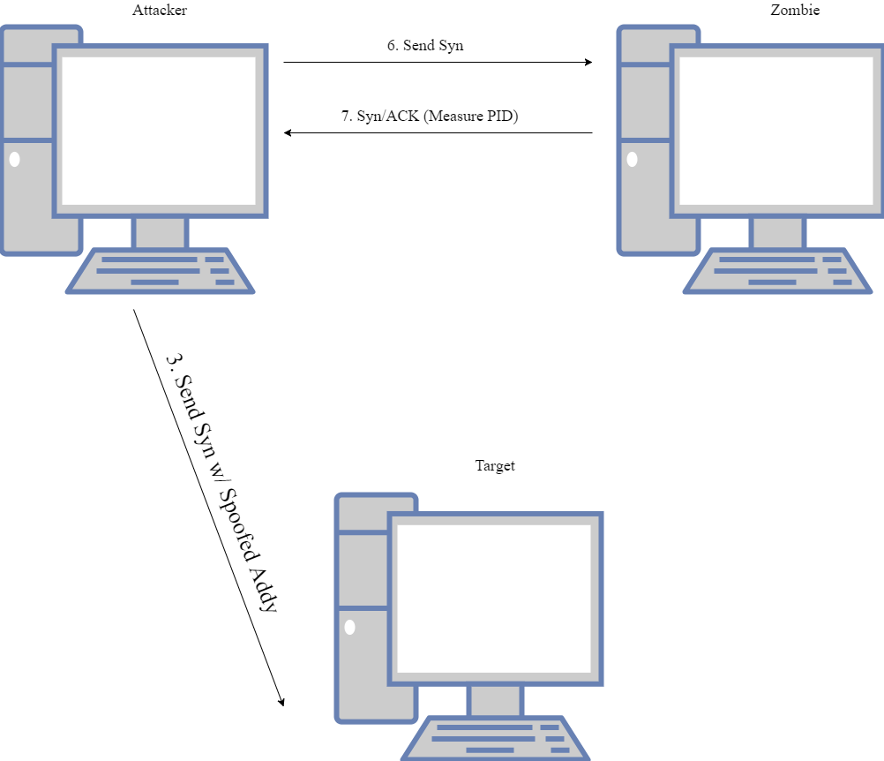
Idle Scan: Part 1

Slide 44
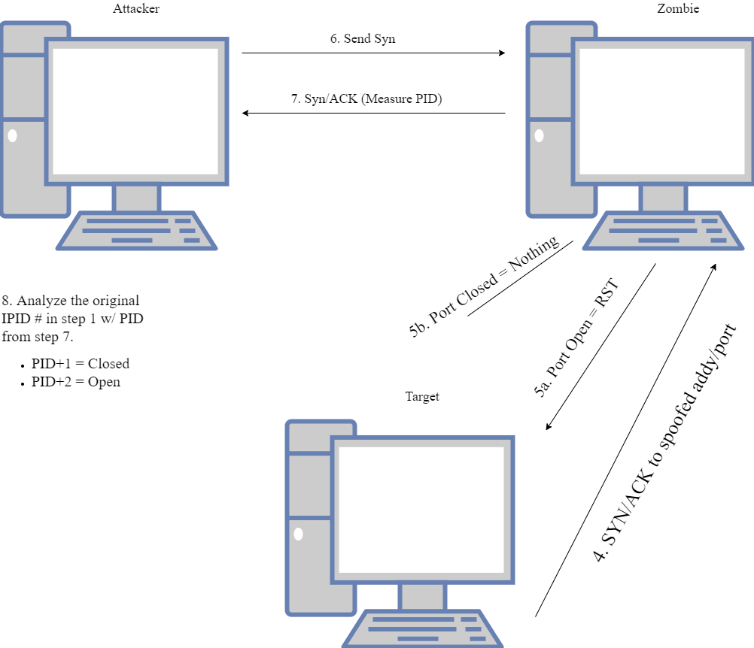
Idle Scan: Part 2

Slide 45
TCP Idle Scan: Review
-sI = Idle Scan
nmap –sI 192.168.7.x 192.168.7.x
Results?
What does nmap report back?
CHECK YOUR FIREWALL LOGS!!
-pN can be a useful flag
Notes:
IMPORTANT!!
Different OS’s respond differently to ACK Packets---some report back ports are open others report back ports are closed…so NOT useful in determining port state BUT is useful in measuring filtering capabilities.
-pN = no pings first (packets sent to target) --- can be more stealthy but allowing pings (not ICMP) can provide more accurate results

Slide 46
Review:
Demo of Idle Scan using nmap
Notes:
nmap –sI 192.168.7.x 192.168.7.x

Slide 47
Practice Makes Perfect…
Use the script I gave you to hide your host.
RUN ALL SCANS MANY MANY TIMES!!
Learn the output
Remember Windows v Linux
Notes:
I expect you to know them all.

