Slide 1
Cyber Operations
Unit 05 – Intro to Scanning

Slide 2
Learning Outcomes
Upon completion of this unit, students will be able to:
Describe port scanning
Explain what ping sweeps are used for
Compare and choose amongst various port scanning tools for a given situation

Slide 3
Scanning
Recon vs Scanning
Recon = Information gathering
Scanning = testing PC’s for responses
Find out which machines are turned on and what their purpose is
YOU CAN GO TO JAIL WARNING!!!
Notes:
Recon = “casing the joint”
Scanning = “knocking on the doors and windows”
Very load, very noisy, very easy to track. You can go to jail PERIOD.
IF YOU ARE DOING THIS ON YOUR LOCAL MACHINE---to host only

Slide 4
Gitrob
Information gathering happens in so many places
Search through Github for customer and any potentially sensitive files
Secret HTTP endpoints, session IDs, user information, passwords, API keys
Gathering emails and learning about what a company may be developing
git clone https://github.com/michenriksen/gitrob /opt/gitrob

Slide 5
Setting Up Gitrob
apt-get install libpq-dev
cd /opt/gitrob
gem update --system
sudo su postgres
createuser -s gitrob --pwprompt
createdb -O gitrob gitrob
gem install gitrob
gem uninstall github_api
gem install github_api -v 0.13
gitrob configure
gitrob analyze acme,johndoe,janedoe

Slide 6
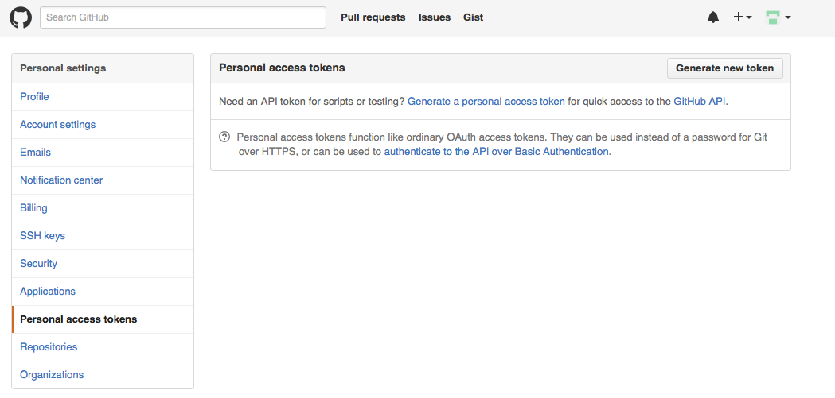
Github Tokens

Slide 7
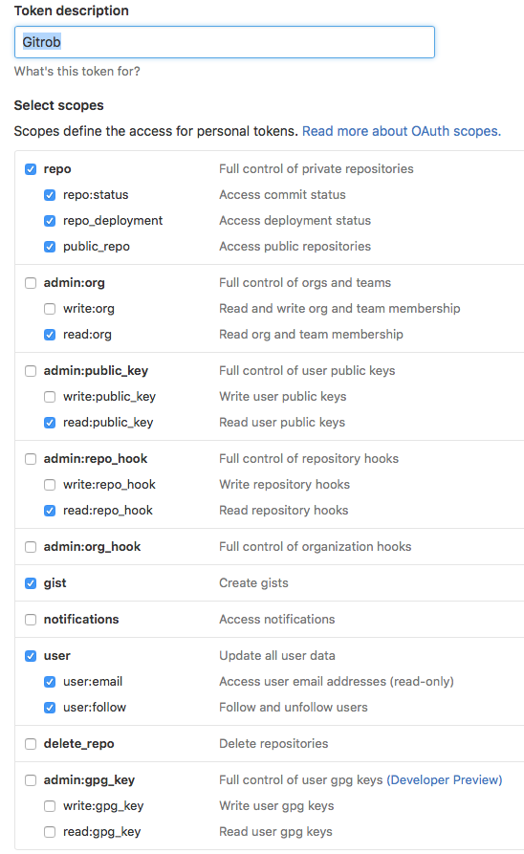
Github Tokens

Slide 8
Setting up Gitrob

Slide 9
HTTP Screenshot
When starting to actively scan a network, the sooner you can figure out the systems’ purpose the better
Tons of flaws in web applications that can be your ticket in
Default passwords, simple misconfiguration, web app flaws
Not enough time to visit each web page by hand, need to weed out the uninteresting ones for the sake of time
Combine the powers of Nmap and HTTP Screenshot

Slide 10
HTTP Screenshot
git clone https://github.com/breenmachine/httpscreenshot /opt/httpscreenshot
cd /opt/httpscreenshot
./install-dependencies.sh
firefox clusters.html

Slide 11
HTTP Screenshot
Tons of benefits to HTTP Screenshot such as resolving certificate hostnames for virtual/shared hosting and threading
Correlates web pages together
Groups those that have http basic auth for example
Groups printers
http://exploit-db.com/webapps
Easier to report on and weed through
Alternative tools: Eyewitness, WMAP Network Scanning

Slide 12
A helpful script
Can you find the hosts in this range?
172.16.45.1-254
#/bin/bash
echo "Setting up the victim machine, this will take just a moment..."
ifconfig eth2 down
sleep 2
ifconfig eth2 172.16.45.$((( $RANDOM %254)+1)) up sleep 2
# uncomment the following lines to set up services on your victim
# please note, distro specific paths apply
#/etc/init.d/ssh start
#/etc/init.d/apache start
#/etc/init.d/ftp start
echo "This victim machine is now setup."
Notes:
You can create a script and run it (add clear if you don’t want to see it) OR…put in /etc/rc.local if you want it to run on startup
Gives you the ability to practice!
Nothing set up---so we’ll skip this on this time and I’ll do a ping demo
How to practice:
#/bin/bash
echo "Setting up the victim machine, this will take just a moment..."
ifconfig eth2 down
sleep 2
ifconfig eth2 172.16.45.$((( $RANDOM %253)+1)) up sleep 2
# uncomment the following lines to set up servics on your victim # please note, you may need to change the location / path depending on your distro
/etc/init.d/ssh start
sleep 2
#/etc/init.d/apache start
#sleep 2
#/etc/init.d/ftp start
#sleep 2
echo "This victim machine is now setup."
echo "The IP address is somewhere in the 172.16.45.0/24 network."
echo "You may now close this window and begin your attack...Good luck!"

Slide 13
Conducting Ping Sweeps
Ping sweeps
Identify which IP addresses belong to active hosts
Ping a range of IP addresses
Problems
Computers that are shut down cannot respond
Networks may be configured to block ICMP Echo Requests
Firewalls may filter out ICMP traffic
WARNING!
Ping sweeps are loud and logged!
Notes:
Remember we’re starting simple…and it doesn’t get any more simple than PINGS!
Uses a special packet called an IMCP packet
Here is an example of 1 ping…ping google
What if we wanted to quickly determine which hosts were alive in a GROUP (range) of IP’s?
192.168.1.1-192.168.1.254
192.168.1.1-192.168.200.254
Ping is one of the most useful network debugging tools available. The first ping
program was written by Mike Muuss in December 1983 for use on Unix machines. Muuss
named his program after the sonar sounds used for echolocation by submarines,
although some say ping stands for "Packet InterNet Grouper".
Ping sends a small packet of information containing an ICMP ECHO_REQUEST to a specified computer,
which then sends an ECHO_REPLY packet in return. The ping program then evaluates
Packet Internet Groper
A program for determining if another computer is presently connected to the Internet
A diagnostic utility program that indicates whether a remote host is actually connected to the network
this reply, and a report is shown.
You can check several things with the ping program:
can you reach another computer,
how long does it take to bounce a packet off of another site, ...
You can ping either a domain name, or an IP address (*DNS troubleshooting)

Slide 14
fping
Ping multiple IP addresses simultaneously
Command-line tool
fping switches Input: multiple IP addresses
Demo 1: fping range & save output to file
fping -g 172.16.2.1 172.16.2.254 > results
Demo 2: fping range (show only alive hosts)
fping -g 172.16.2.1 172.16.2.254 –a > results
-a = show only hosts that are alive
Demo 3: fping range (and trip results)
fping -g 172.16.2.1 172.16.2.254 -as > results.txt
-s = print the final stats on screen
Notes:
Fping = “fast ping” tool to ping ranges!
Switch
Option to change the way a program functions
View man or help to review switches
Help in linux = man fping
Results.txt will be created in your “tools” directory (or where ever fping is installed)
-l switch: limit results to errors and results IN WINDOWS ONLY! -- in Linux this will cause a continuous loop
Use –g to generate a target list:
-g gives us the option to either use CIDR or manually specify a range
So to sweep an entire class c range you would use: -g 192.168.7.0/24
Or we can sweep specifying the range
Must specify first IP and last IP sperated by a space
DO THIS!! Ping sweep our network---what responds?
In windows fping -g 192.168.7.1-254 -a > results.txt
* -a = show only hosts that are alive
* -s = print the final stats
* -q = quiet (don’t show per ping / per target results)
* -r = set number of retries 3 by default
* by default fping sends several requests to target before giving up…and it waits a little longer on each successive request
* by default it waits 1.5 times longer
* -f = read targets from a list (fping < target_list)

Slide 15
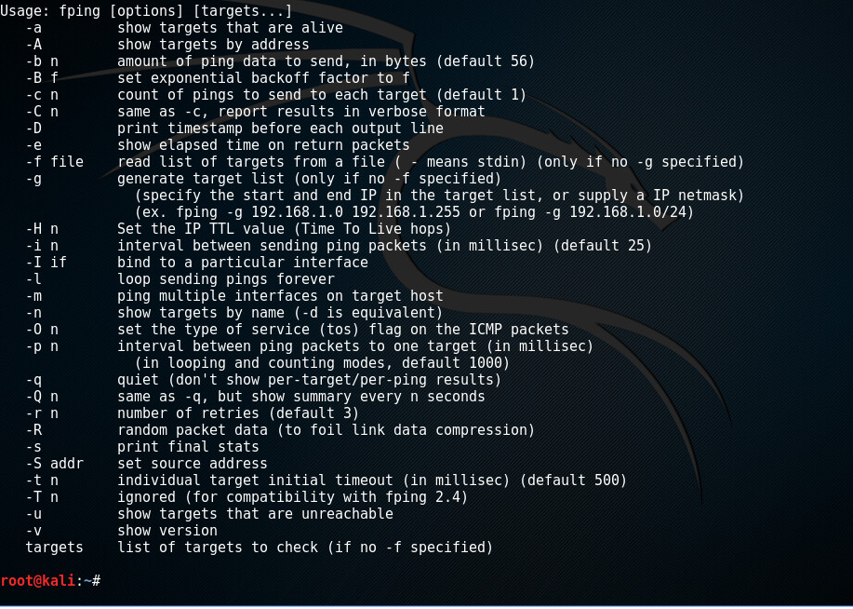
Notes:
Nice list of switches / parameters you should get

Slide 16
Now What?
You have a list of “available” targets now what?
What is a port?
PORT SCANNING!
Autoscan
nmap
Unicorn
Notes:
We’ll look at simple port scanning with an automated tool --- Autoscan…more on this in a minute..
Then we’ll move to the KING of scanners--- nmap!
Then we’ll look at Unicorn

Slide 17
What is a Port?
Similar with the extension number in telephone system
Example :
For hotel service,
Housekeeping service :555-1414 ext 123
Dining service :555-1414 ext 128
For network service,
Web service :192.168.0.1 port 80
E-mail service :192.168.0.1 port 25
Notes:
A numerically designated / access point for TCP/IP network communications
Allow for simultaneous communication w/o interference
Like a phone number with extensions…
Like a city with paths into the city
The city is your computer
The paths in (roads, interstates, county roads, bike paths, walking trails, railroads, etc…)
Paths are the ports

Slide 18
Introduction to Port Scanning
Port Scanning
Finds out which services are offered by a host
Identifies vulnerabilities
Sometimes Identifies OS
Service
Specific job that the computer performs (mail, ftp, printing, web)
Open services can be used on attacks
Identify a vulnerable port
Launch an exploit
Notes:
TOTAL PORTS ON A PC = 65,535
Port #’s 1024 and below are “well known ports” = reserved
Scan all ports when testing
Not just well-known ports

Slide 19
Port Scanning
65,535 ports available on every pc
Ports can be “Open” or “Closed” or “Filtered”
We can scan computers to see what ports are being used
Gives us a better picture of what the purpose of the box is
Gives us a better idea of how to attack the box
Notes:
Who answers the door = what service is running! (sometimes we just know who will answer the door by the port number!)
Always start with some very simple attacks…you’ll be surprised at what you’ll find…like default user names and passwords

Slide 20
Why Would Good Guys Use a Scanning?
Purpose of scanners
Identify unused / unauthorized services in the network
E.g. unauthorized ftp service, Trojan software
Discover unused / rogue devices in the network
E.g. unauthorized notebook computer
Notes:
You SHOULD be scanning EVERYTHING on your network. OFTEN!

Slide 21
Review Port Scanning
Port scanning programs report
Open ports
Closed ports
Best-guess assessment of which OS is running
Different OS’s respond differently
Connect Scan
Sends packets, asks for a response
Three way handshake
Notes:
Respond differently?
* how do they implement the tcp/ip stack
What’s a 3 way handshake?
* syn
* syn – ack
* ack
Like a phone call…
* I dial YOU (syn)
* You answer by saying “hello?” (syn-ack)
* I say “hello this is pat (ack)

Slide 22
Using Port-Scanning Tool
Autoscan
Lots of automation!
OS detection
Open port dection
Service detection
And more!
To Install on Kali: Search SourceForge for: AutoScan-Network
Download → untar (tar –xf) → run the “.sh” file
This is great! (right?)
Not always…
Why?
Notes:
Nmap
Unicornscan
NetScanTools Pro 2004
Nessus
→ssh → startd
Automation is ok for starters…it’s great for beginners…but not because you’re “leet” if you know command line…
BECAUSE YOU’RE LEET IF YOU KNOW HOW TO CONTROL A TOOL!...automation makes things easy BUT often REMOVES your control

Slide 23
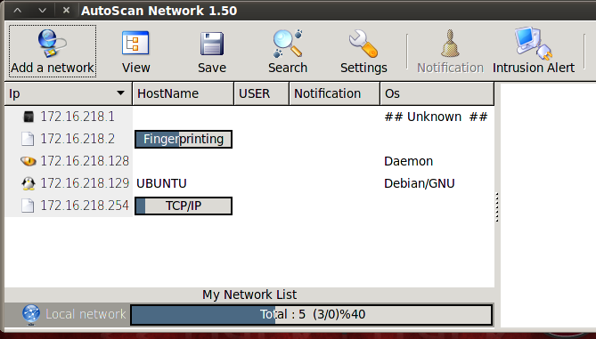
Autoscan: Automated Port Scanning
Walk through wizard...
Notes:
Walk through wizard…
Honestly…can be flakey…but still worth checking out
Demo simple scan…
Scan winxp -→ browse service →

Slide 24
Using Autoscan to interact with the target
Notes:
Autoscan allows you to interrogate the target
Check the summary --- and services (see left and lower left panes)
Use the dropdown box to interact
Click on the service to get more info…use “Nautilus” browser to interact / browse shares

Slide 25
Autoscan: Intruder Alert
Notes:
Great feature!
Remember not EVERY device is an intruder…but this is SURE handy…
Easy to set up---just run a scan and click the button…
Now if you have a TON of devices…and a “transient” work force---maybe not so much---but with a small network==AWESOME!!

Slide 26
Summary
Ping
Ping Sweeps
Ports
Port scanning
Also referred as service scanning
Process of scanning a range of IP address
Determines what services are running

Slide 27
PIAT: Intro to Port Scanning with Autoscan
Create a copy of Kali or BT
One as attacker
One as target
REMEMBER HOST MODE!!!
On the target machine
Use the bash script to change IP
Use fping to gather a list of targets which are up and running
Use Autoscan to find targets and systems
Use Autoscan to look for intruders
Notes:
Host mode---WHEN you use this remember you’ll need to set your IP’s manually as there is no DHCP server running

