Slide 1
Cyber Operations
Unit 06 – Advanced Scanning

Slide 2
Learning Outcomes
Upon completion of this unit, students will be able to:
Use NMAP for more advanced scanning
Use the NMAP scripting engine to determine vulnerabilities
Understand and describe what firewalking is

Slide 3
Don’t Forget UDP!
How is UDP different from TCP?
Nmap generates a UPD packet destined for each target port
If system returns an ICMP Port Unreachable message: Port = Closed
If target port responds with a UDP packet: Port = Open
THIS ONLY HAPPENS IF A UDP PACKET IS SENT BACK!!
Notes:
Sent back only happens when specific payloads are delivered
Scanning UDP is more difficult as it is a connectionless protocol and does not use a handshake like TCP
Instead (with UDP) the following sequence is used:
Source sends UDP packet to target\
Target checks to see if the port / protocol is active then takes action accordingly
This makes UDP scanning especially challenging → if you receive a response it will be 1 of three:
And ICMP type 3 message if the port is closed and the firewall allows traffic
A dissallowed message from the firewall
Or a response from the service itself
BUT the worst is…no response could mean that the port is open – but it could ALSO be that the traffic was blocked or simply didn’t make it to the target
In all honesty---it’s typically faster (and more reliable) to perform TCP BUT if you have time…it’s STILL worth your time / energy to scan UDP as well.
Admins tend to focus on securing TCP but fail to address UDP in their security policies

Slide 4
UDP Scanning
If no response:
Nmap labels as open|filtered
Sign that nmap doesn’t know what’s going on
No response could come from:
UDP missing a specific payload
Closed port & blocking ICMP response packets
Firewall filtering response
Lost packet
Golden ticket = response back
Notes:
UDP response on p53 = what? DNS!
* what tools

Slide 5
UDP Example
UDP response back on port 53
What is this machine?
What tools would you use to further interact with this machine?
nmap –sU [target_ip]
UDP scanning demo
nmap –sU 172.16.218.132
Notes:
Further interact = Dig & NSLookup
Another example == scan xp_sp3_inf (with tftp started & MAKE SURE TO TURN WINDOW FW OFF!!!)
Then connect to tfpt and upload: connect = # tftp 172.16.218.132 69 / upload = # put [file_name] / disconnect = quit
Tftp:
TFTP is designed to be small and easy to implement, therefore, lacks most of the features of a regular FTP. TFTP only reads and writes files (or mail) from/to a remote server. It cannot list directories, and currently has no provisions for user authentication

Slide 6
Nmap: Version Scanning
Version scanning allows attacker to see open ports AND the particular software / service listening on the port
Remember security through obscurity?
How?
Nmap completes 3 way handshake and grabs the banner
Matches banner against internal db
Example:
nmap –sT –sV 192.168.100.208
Notes:
Sec through Obscurity = run webserver on port 45623 in hopes of obscuring the purpose of the sever…
Matches a banner….BUT what if no banner is retrieved? If no banner present, nmap sends more probing packets to elicit a response

Slide 7
Nmap Source Port
Specifies which port your scans originate from
Can increase likelihood that scan is allowed in
why?
Goal is to set the source port so packets appear like normal traffic
20, 25, 53, 80, etc…
nmap –sS –g 80 192.168.100.80
Notes:
(Spoof source port number)
Why specify source port? IDS / FIREWALL EVASION!
One surprisingly common misconfiguration is to trust traffic based only on the source port number.
It is easy to understand how this comes about. An administrator will set up a new firewall, then gets flooded with complaints from users whose applications stopped working.
In particular, DNS may be broken because the UDP DNS replies from external servers can no longer enter the network.
Or FTP---with active FTP transfers, the remote server tries to establish a connection back to the client to transfer the requested file.
Secure solutions to these problems exist, often in the form of application-level proxies or protocol-parsing firewall modules.
But the problem is there are also easier, insecure solutions. For example: Noting that DNS replies come from port 53 and active FTP from port 20, many administrators have fallen into the trap of simply allowing incoming traffic from those ports
.
They often assume that no attacker would notice and exploit such firewall holes. In other cases, administrators consider this a short-term stop-gap measure until they can implement a more secure solution. Then they forget the security upgrade.
Overworked network administrators are not the only ones to fall into this trap. A number of products have shipped with these insecure rules. Even Microsoft has been guilty. The IPsec filters that shipped with Windows 2000 and Windows XP contain an implicit rule that allows all TCP or UDP traffic from port 88 (Kerberos).
In another well-known case, versions of the Zone Alarm personal firewall up to 2.1.25 allowed any incoming UDP packets with the source port 53 (DNS) or 67 (DHCP).

Slide 8
Don’t forget the Timing Options!
How often are you sending packets to the target?
-TO = Paranoid = 1 packet every 5 minutes
-T1 = Sneaky = 1 packet every 15 seconds
-T2 = Polite = 1 packet every .4 seconds
-T3 = Normal = quickly as possible w/out missing ports
-T4 = Aggressive = Wait no more then 1.25 seconds for a response
-T5 = Insane = waits maximum of .3 seconds for a response
Notes:
T0 = paranoid == used for IDS evasion, one port at a time with 5 minutes in between probes

Slide 9
Additional Functionality
nmap –sn
Ping sweep (report hosts up but not port scan hosts)
nmap –Pn
Old versions: -PO (zero) and –PN
Can take a LONG time
Output Options
Use the: -oA flag to output the scan results in 3 different formates
.nmap == plaintext
.gmnmap == greppable nmap (NEEDED TO RESUME!)
.xml == xml
Notes:
-sn = ping sweep
Skips port scan after host discovery
Uses ICMP echo and timestamp packets---BUT also uses TCP Syn and ACK packets
Using SYN and ACK scans can be useful for scanning past a firewall
-Pn = scan all ports regardless of whether host is up or not (don’t ping first)
May be better to explore the “-P” options---and find some balance between default scan and –Pn (scan everything)
See the man pages or Internet for –P options
Output options:
Obviously capturing the results of the scan is vital --- you’ll come back through these results dozens of times per test
“needed to resume” == if you stop the scan / kill it / you’ll need this format to “resume”
You can resume using the: “-resume” switch

Slide 10
More Functionality
-p
Specify port(s) to scan
-p 80 or –p-
-iL
Used to feed a list of Ips
Very good idea
Easily generated from our ping sweep tool
Using nmap to scan a range of Ips
nmap starting_ip-ending_octect(s)
nmap 172.16.218.1-254
nmap 172.16.218.0/24
Notes:
Specifying the port to use is VITAL for a covert test
Specifying ALL ports is VITAL for a overt test
--resume will take in the .nmap or .gnmap files for resuming. At least one host must be completed by then

Slide 11
Nmap Scripting Engine: NSE
Can be run as:
Categories
All checks in the category will be run against the target
Individual Checks
Only the specified scripts run
Categories include:
auth, broadcast, brute, default, discovery, dos, exploit, external, fuzzer, intrusive, malware, safe, version, vuln
Details on each: http://nmap.org/nsedoc/ (visit often!)

Slide 12
NSE: Individual Checks
To use the :
nmap --script <category> <target>
nmap --script <script-name> <target>
Script | Description
banner | A simple banner grabber which connects to an open TCP port and prints out anything sent by the listening service within five seconds.
broadcast-wake-on-lan | Wakes a remote system up from sleep by sending a Wake-On-Lan packet.
dhcp-discover | Sends a DHCPINFORM request to a host on UDP port 67 to obtain all the local configuration parameters without allocating a new address.
dns-blacklist | Checks target IP addresses against multiple DNS anti-spam and open proxy blacklists and returns a list of services for which an IP has been flagged. Checks may be limited by service category (eg: SPAM, PROXY) or to a specific service name.
Notes:
NSE ROCKS! --- check the website / documentation often! http://nmap.org/nsedoc/

Slide 13
NSE Continued
Script | Description
dns-brute | Attempts to enumerate DNS hostnames by brute force guessing of common subdomains.
dns-check-zone | Checks DNS zone configuration against best practices, including RFC 1912. The configuration checks are divided into categories that each have a number of different tests.
dns-zone-transfer | Requests a zone transfer (AXFR) from a DNS server.
firewalk | Tries to discover firewall rules using an IP TTL expiration technique known as firewalking.
ftp-anon | Checks if an FTP server allows anonymous logins.
ftp-brute | Performs brute force password auditing against FTP servers.
hostmap-robtex | Discovers hostnames that resolve to the target's IP address by querying the Robtex service at http://www.robtex.com/dns/.
http-auth-finder | Spiders a web site to find web pages requiring form-based or HTTP-based authentication. The results are returned in a table with each url and the detected method.

Slide 14
NSE Continued
Script | Description
http-brute | Performs brute force password auditing against http basic authentication.
http-default-accounts | Tests for access with default credentials used by a variety of web applications and devices.
http-email-harvest | Spiders a web site and collects e-mail addresses.
http-google-malware | Checks if hosts are on Google's blacklist of suspected malware and phishing servers. These lists are constantly updated and are part of Google's Safe Browsing service.
http-robots.txt | Checks for disallowed entries in /robots.txt on a web server.
ip-geolocation-geoplugin | Tries to identify the physical location of an IP address using the Geoplugin geolocation web service (http://www.geoplugin.com/). There is no limit on lookups using this service.
smb-check-vulns | Checks for vulnerabilities: MS08-067, a Windows RPC vulnerability Conficker, an infection by the Conficker worm Unnamed regsvc DoS, a denial-of-service vulnerability I accidentally found in Windows 2000 SMBv2 exploit (CVE-2009-3103, Microsoft Security Advisory 975497) MS06-025, a Windows Ras RPC service vulnerability MS07-029, a Windows Dns Server RPC service vulnerability
Notes:
Ip-geolocation-geoplugin (there are several geolocation plugins)

Slide 15
NSE Continued
Script | Description
smtp-brute | Performs brute force password auditing against SMTP servers using either LOGIN, PLAIN, CRAM-MD5, DIGEST-MD5 or NTLM authentication.
smtp-commands | Attempts to use EHLO and HELP to gather the Extended commands supported by an SMTP server.
smtp-open-relay | Attempts to relay mail by issuing a predefined combination of SMTP commands. The goal of this script is to tell if a SMTP server is vulnerable to mail relaying.
snmp-brute | Attempts to find an SNMP community string by brute force guessing.
telnet-brute | Tries to get Telnet login credentials by guessing usernames and passwords.
vnc-brute | Performs brute force password auditing against VNC servers.

Slide 16
Unicornscan
Basic Usage:
unicornscan target
“target can be a name , ip addy, or range
Notes:
Basic: In this example, all that was specified is the name of a server we wanted to scan.
The hostname server was resolved to the address of 192.168.0.2.
By default runs a TCP SYN (-mTS, which is the default scan mode)
Live Demo:
# unicornscan 172.16.218.129
Or … #unicornscan 172.16.218.0/24
If you get a geoip.dat error message--- you can download that data…and it will attempt to tell you where the scan is from (location of IP!)

Slide 17
TCP Scanning w/ Unicorn
unicornscan -r500 -mT www.yahoo.com/29:80,443
Notes:
This command resolves the name www.yahoo.com to 87.248.113.14 and sends packets to the IP range of 87.248.113.14/29 (87.248.113.8-16) on TCP ports 80 and 443

Slide 18
UDP Scanning w / Unicorn
unicornscan -r200 -mU -I 192.168.0.0/24:53
Notes:
This command scans the 192.168.0.0/24 range for DNS servers.
Note---the payloads.conf in BT is located in /pentest/scanners/unicornscan/etc/payloads.conf
In this case it sends DNS protocol specific queries as defined by the payloads.conf file to UDP port 53 for every IP in the range. The IP’s that respond return as open.

Slide 19
Nmap to Unicorn Switch Chart
Notes:
Take a look at the unicorn site / documentation for this (unicornscan.org)
Maybe very helpful for you to learn these!

Slide 20
Firewalk
Allows an attacker to determine which packets are allowed through a packet-filtering device
How is this different from nmap?
Nmap sends packets to an end system
Nmap attempts to find out what ports are OPEN on the target (firewall)
Nmap tries to get TO the firewall
If you scan PAST a firewall you don’t know what is being firewalled and what ports are being blocked by the target system
Install as stand alone OR use NSE --script firewalk
Notes:
Firewalk is a network-auditing tool that employs various techniques to determine what is allowed THROUGH a firewall.
It attempts determines what transport protocols a given gateway will let through.

Slide 21
Firewalk Continued
Firewalk attempts to send packets through a firewall (or router)
Gateway TTL + 1
If there is a firewall between you and your target
Nmap can not differentiate who is filtering the port (firewall or target)
What about ACK scans?
Through a firewall or filter?
Can you set up a connection?
Firewalk scans the firewall AND machine beyond to test for allowed EXTERNAL connections!
Notes:
Again---
So first firewalk finds the gateway device / ip addy…
THEN
The firewalk sends a 2nd scan and works by sending out TCP or UDP packets with an IP TTL one greater then the targeted gateway.
If the gateway allows the traffic, it will forward the packets to the next hop where they will expire and elicit a TTL exceeded in transit message.
If the gateway host does not allow the traffic, it will likely drop the packets on the floor and we will see no response.
By sending probes in a successive manner and recording which ones answer and which ones don’t, the access list on the gateway can be determined.

Slide 22
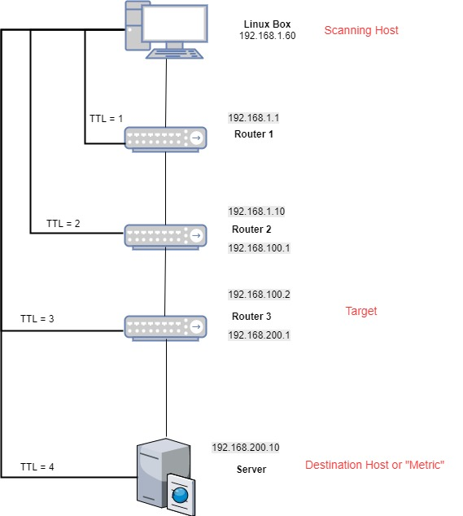
Notes:
Traceroute-style IP expiry scan is initiated and TTL increased until gateway is reached.
Gatway + 1 on TTL binds the scan.
A specific TTL number can indicate the maximum range for a packet. For example, zero restricts it to the same host, one to the same subnet, 32 to the same site, 64 to the same region and 128 to the same continent; 255 is unrestricted.

Slide 23
Firewalk:
Usage :
./firewalk [options] target_gateway target
Common switches:
-n - do not resolve IP addresses into hostnames
-S port range to scan
-p TCP | UDP - firewalk protocol
target gateway = firewall
Target = ip of target (or name)

Slide 24
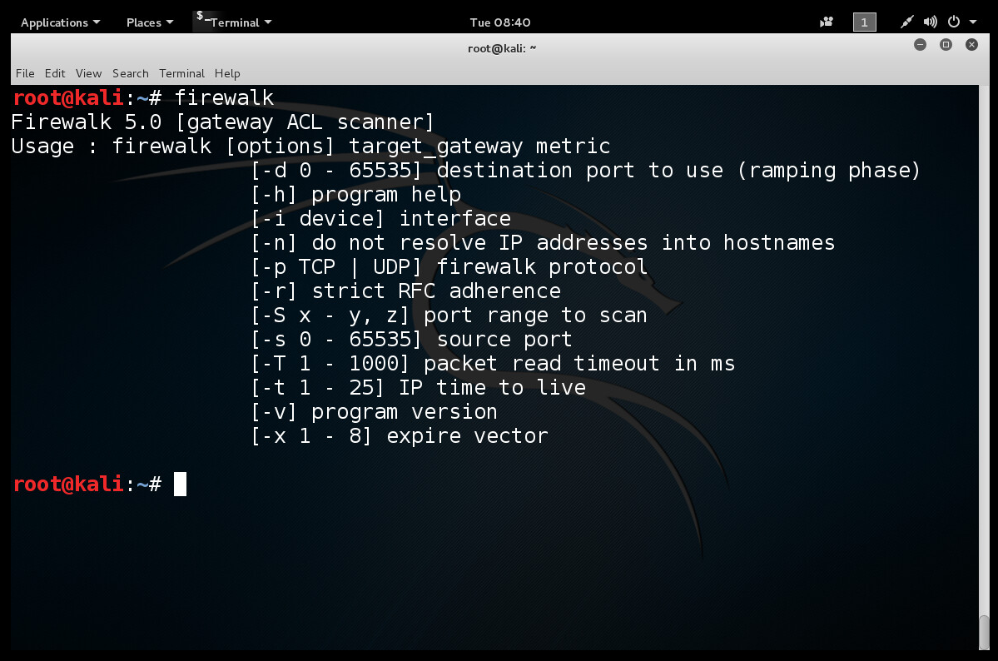

Slide 25
Firewalk Example
firewalk -n -S21,22,23,25,53,80 -pTCP gw.test.org www.test.org
Notes:
Usage : ./firewalk [options] target_gateway target
In this particular scan we’re using:
[-n] do not resolve IP addresses into hostnames
[-S] ports to scan
[-p TCP] scan using TCP protocol
target gateway (firewall)
target
Subtle but interesting tool…
Example used above: firewalk -n -S21,22,23,25,53,80 -pTCP gw.test.org www.test.org

Slide 26
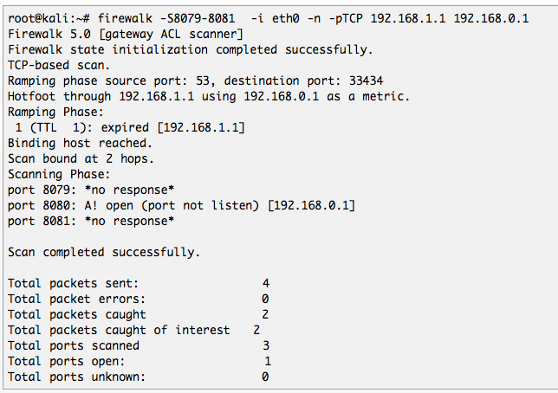

Slide 27
Firewalk Defenses
Use a proxy firewall!
Proxies remove original TTL information
Down side to Proxy Firewall is performance
Book suggests that you simply accept this is possible
Keep good logs!!
Be vigilant in your log reviews!
Notes:
The easiest solution to this problem is to disallow ICMP TTL Exceeded messages from leaving an internal network.

Slide 28
Summary:
Port scanning is your friend
ID Hosts / targets
Interrogate Services
Find access to systems
Nmap is the king
NSE rocks. Learn to use it.
Contribute if you can
There are lots of other good port scanning tools (beyond nmap)
Nmap Cheat Sheet

