Slide 1
Cyber Operations
Unit 07 – Vulnerability Scanning

Slide 2
Learning Outcomes
Upon completion of this unit, students will be able to:
  Install and activate OpenVAS
  Run various scans with OpenVAS
  Decide upon what exploits are available from the OpenVAS output

Slide 3
Step(s) – Prior Versions
To use OpenVAS:
  1) Run the setup
1. Setup a user. (This will be needed to access O-VAS)
2. Setup the Certificate.
3. Update the database.
4. Start the Scanner.
5. Configure the client.

Slide 4
Run The Setup – Prior Versions
From your terminal, run:
openvas-setup
Save your password!!!
openvas-scapdata-sync
openvas-certdata-sync
openvasmd --user=admin --new-password=Password1!
Notes:
Use the menu---run the OpenVAS setup (let it do it’s thing)
The default username is “Admin”
This will install several services (and processes) it will download plugins, etc…then it will prompt you for a password.
When it’s done you’ll get a message saying it’s been successfully installed

Slide 5
Installing
apt-get update & apt-get dist-upgrade –y
apt-get install openvas –y
openvas-setup
openvas-start

Slide 6
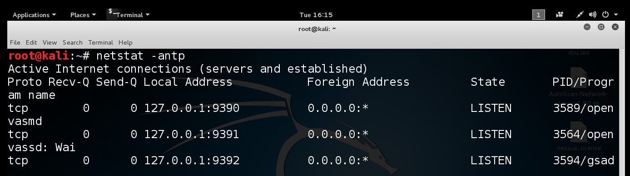
Check Your Services

Slide 7
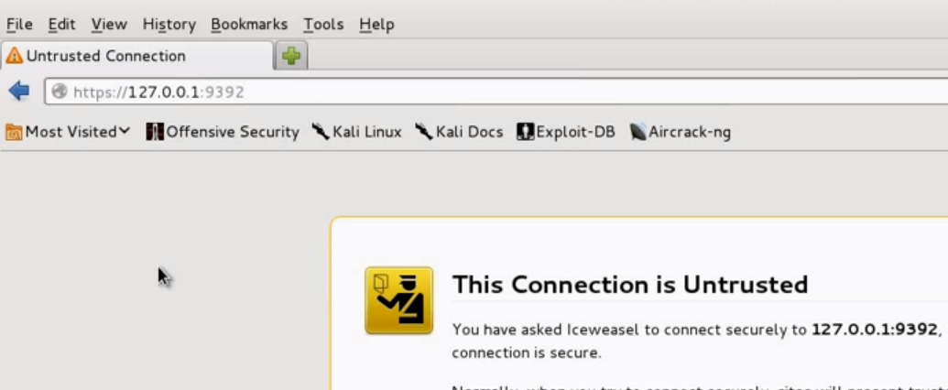
Open a Browser
Navigate to localhost:9392

Slide 8
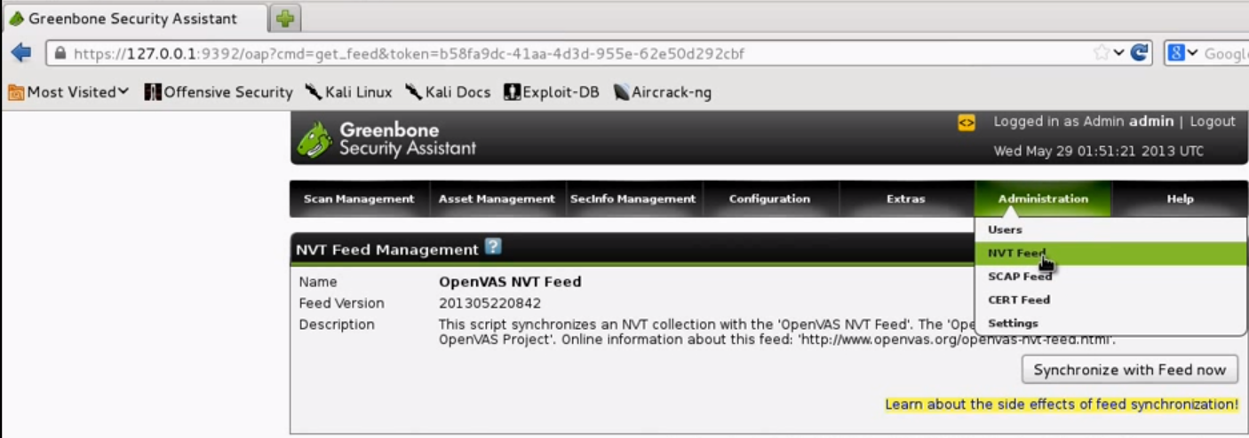
Update The NVT Feed
Add Users If Necessary

Slide 9
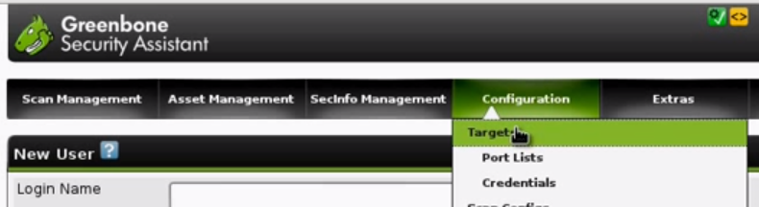
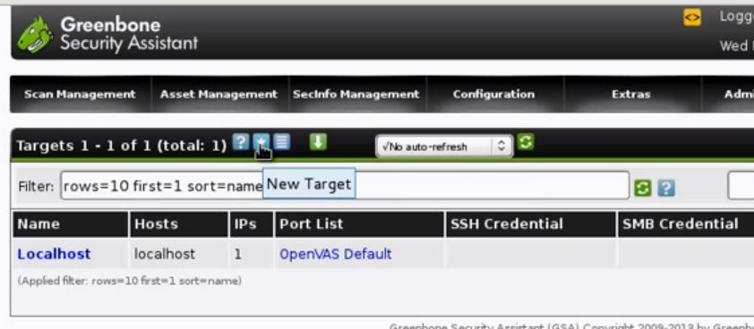
Begin Scan
Identify and Enter Target
Locate Star to Add a New Target

Slide 10

Complete Target Info
Add Host, IP, Target List, Comments
Choose the ports to scan
Set Credentials (SSH / SMB) if desired
Click “Create Target” button

Slide 11
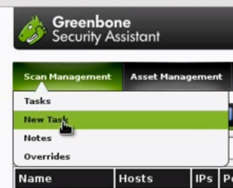
Set Up A New Task
Under “Scan Management” select “New Task”

Slide 12
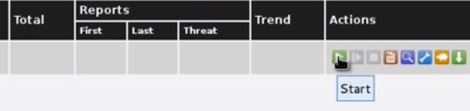
Start Your Scan
Look for the “Play” button

Slide 13
Set up a New Alert
Email or notify when the scan completes
Enter an email address and choose a format (HTML, PDF, etc…)

Slide 14
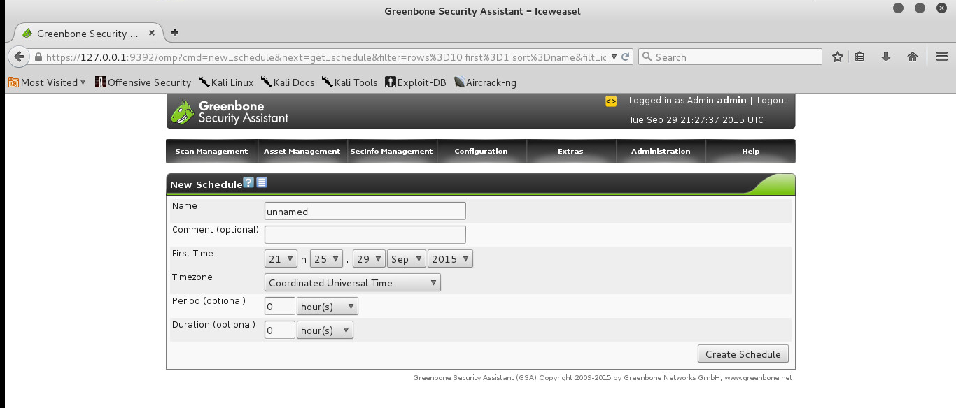
Configure Scheduled Scans

Slide 15
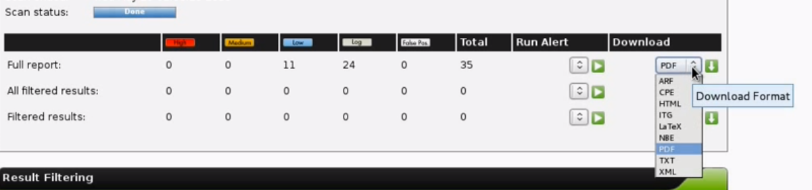
Review Report
Locate Scan under “Scan Managerment”
Find appropriate name and click on report date
Select the report format and download

Slide 16
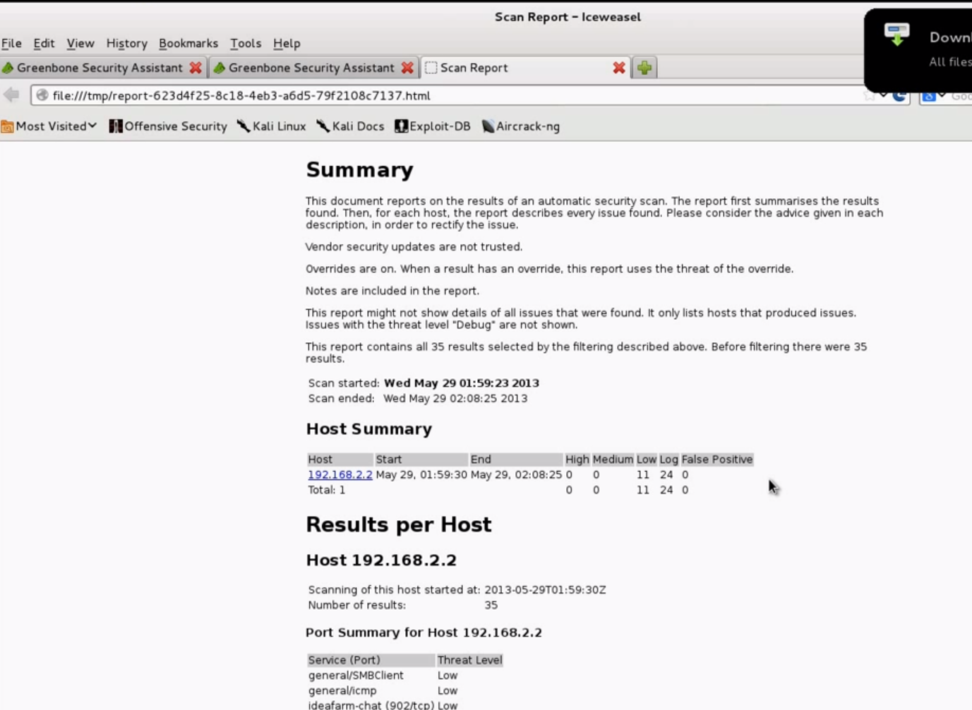
Review Report

