Slide 1
Cyber Operations
Unit 07 Vulnerability Scanning

Slide 2
Learning Outcomes
Upon completion of this unit, students will be able to:
Install and activate Nessus
Run various scans with Nessus
Determine what exploits are available from Nessus output and are exploitable/applicable minding the mission objectives.
Conduct network discovery using active methods.

Slide 3
Review of Information Learned…
Translation of real world / domains into cyber targets
List of address’s on host network
General network Topology
List of open ports on hosts
List of services & versions running on the ports
OS types of live hosts
List of ports open on firewall (acl re-creation)
Notes:
Translation = www
List of address’s = ping / sweep
Network Topo = traceroute / nmap / ping sweep
List of open ports = nmap
Versions = nmap –sV
OS = nmap –O
ACL = firewalk

Slide 4
Vulnerability
What is a vulnerability?
3 main types:
Common Configuration Errors
Default Configurations
Well-known System Vulnerabilities
Notes:
What’s the difference between a vulnerability and an exploit?
* vulnerability = POTENTIAL!
* exploit = weaponized / actualization of the vulnerability
As security experts we should treat all vulnerabilities as exploits (PATCH PATCH PATCH!!!)
Worm:Win32/Conficker.A, was first reported Nov. 21, 2008
The flaw was patched by Microsoft in October. The MS08-067 (October 23rd patch was released = almost a MONTH!)
Example of Common Config Errors = “allow ANY port 53 to DNS_Server_IP” (vuln to zone transfer)
Example of Default Configurations = “ms sql (older versions) used blank or weak SA password” (what if you don’t change)?
Example of “Well-know System Vulns” = ID software blatantly put a backdoor in Quake 1/2 and QuakeWorld including both the Linux/Solaris Quake2. RCON commands sent from the subnet 192.246.40.0/24 and containing the password "tms" are automatically executed on the server without being logged.
RCON, or Remote Console, is a way of allowing an administrator to interface directly to their server and send commands straight to the command line that drives the game server. RCON is used by many games and not just counter strike source although the commands that each will accept are different from game to game.

Slide 5
Vulnerability Scanner
Automates the process of looking for vulnerabilities!
Many include port scanners
Most Vul Scanners include the following:
Vulnerability DB
User configuration tool
Scanning Engine
Knowledge Base of Current Scan
Results Repository
Notes:
How do we find Vuls??? How do the BAD GUYS find vuls?
WE USE A SCANNER!
You should use one because you can be sure the bad guys are!
“Never trust a single scanner” → Make sure you use multiple scanners
Just to clear up…this is not exploit CREATION this is vulnerability scanning (BIG Difference)
Someone has to find the vuln & create a POC
That person has to disclose the vuln
Your scanner has to write code to “check” for the vuln

Slide 6
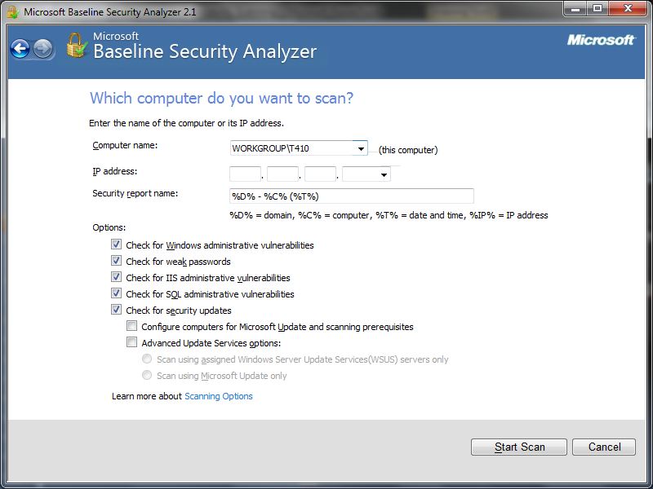
Microsoft Baseline Security Analyzer
Free patch scanner for MS (and limited other) products
Available for download @ Microsoft
scriptable
Notes:
Scriptable = set it as a background task and script it to alert you when something is missing a patch…or whatever…
It’s important to understand---mbsa will ONLY scan for missing security updates, missing rollups, and service packs FROM Microsoft update
It will NOT report on non-security updates, tools, or drivers
Installing is very easy --- pick your OS (32 or 64bit) and language---then next, next, next through the install prompts and finally open and fill out the appropriate information to scan

Slide 7
MBSA Report:
Notes:
Demo MBSA in class against a VM

Slide 8
MOAVS (mother of all vuln scanners): Nessus
First released in 1998
Open source tool
Uses a client/server technology
Conducts testing from different locations
Can use different OSs for client and network
Notes:
MOAVS (mother of all Vul Scanners)
Two of the most commonly used are Nessus and Nexpose (Rapid 7)
Not one of them provides the perfect solution in every scenario possible
Best idea given time and money is to run multiple tools, but if you can’t, you need to pick one.
If you had to pick one, Nessus is LEGIT. Cheap, unlimited IPs, picks up odd vulns like SCADA.

Slide 9
Nessus Plug-ins
Plug-ins:
Modular architecture
Each vulnerability check is based on a small program called a plug-in
Each plug-in conducts one check on a target system
Thousands of plug-ins are available
Collectively Plug-ins make up the Nessus Vulnerability Database
Downloadable from Nessus web site
Notes:
What is a plugin? “it extends the functionality”
Each vulnerability is cataloged / recorded as a plugin. If you find a new vul you can write a plugin!

Slide 10
Nessus Plug-Ins
Plug-ins are divided into the following categories:
Backdoors -Remote Shell
CGI Abuses -Gain Root Remotely
Cisco -General
Default Unix Accounts -Miscellaneous
DoS -Netware
Finger Abuses -P2P Filesharing
Firewalls -RPC
FTP -SMTP
Windows / Linux -Useless Services
* Some plugins are considered dangerous!

Slide 11
Nessus Architecture
Server
Can be *NIX or Windows platform
Client
Can be UNIX or Windows
Both can be on same machine!
Functions much like a database server
Ability to update security checks plug-ins
Notes:
Server = holds the plugins, completes the scans, accepts connections (directions from client)
Client = allows you to customize the scans, interact with the server
Both are on the same machine (start the server)
Professional vs Home Feeds (pro = $1200 / year)

Slide 12
Nessus Scripts
Write your own plug-ins!
Publish for others ☺ or keep yourself ☹
Use C or the Nessus Attack Scripting Language (NASL)
Nessus Plugins: Home vs Professional
Reporting:
Includes a built in reporting tool
Search the web for terms Nessus, output, perl script
Notes:
Home vs professional: the EULA changes OFTEN!
Used to be home got the new plugins 7 days AFTER the pro’s --- now they limit the number of PCs you can scan…next year might be different…

Slide 13
Nessus: Install
Available @ https://www.tenable.com/products/nessus-home Download your install
OS Specific
Register for a key
Home / Work
Check your email
Notes:
www.nessus.org/download → select your flavor (win, linux, etc..)
On BT #apt-get install nessus
Register a user
Install the key
Fetch new updates
Start nessus server
Log in

Slide 14
Install and Register / Activate Key:
Start the Nessus Service
/etc/init.d/nessusd start
Fire it open with a browser: https://kali:8834
You will get an SSL error, add it to your exceptions.
Notes:
This will activate your product key and allow you to get updates from Tennable with future plugins

Slide 15
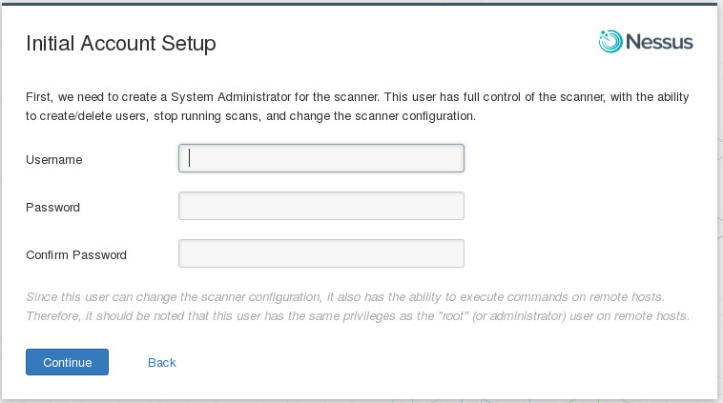
Create a Username

Slide 16
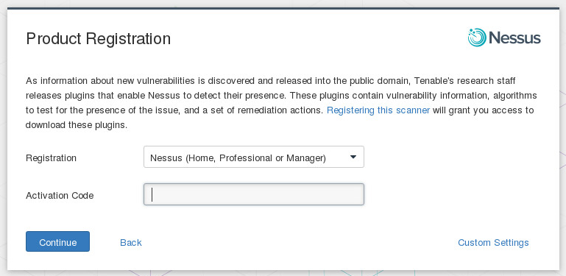
Register Plugin Feed

Slide 17
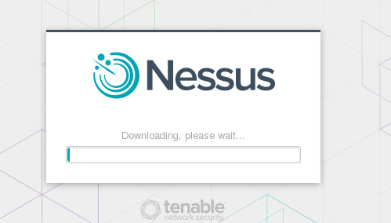
And now we wait…
This next part may take a while

Slide 18
Read the Manual!
There are things you may need to do through the command line in Nessus
The CLI has changed since the newer releases, so have this link handy
http://static.tenable.com/documentation/nessus_v6_command_line_reference.pdf

Slide 19
Common CLI Commands
List Users
/opt/nessus/sbin/nessuscli lsuser
Reset Password
/opt/nessus/sbin/nessuscli chpasswd
Add a user
/opt/nessus/sbin/nessuscli adduser
Running the default update
/opt/nessus/sbin/nessuscli update
Forcing the plugin and core components update
/opt/nessus/sbin/nessuscli update -all
Updating Plugins Only
/opt/nessus/sbin/nessuscli update --plugins-only
Notes:
Default update gets UI software options and plugins

Slide 20
Plugin Updates
If you’re using an older version be sure to update your plugins REGULARLY!
Newer versions will update automatically
Notes:
Last spring there were 20,000 this fall there are 35,000!! (that is an average of 41 new checks per day)
I suggest you do this every day---write a startup script (or check the box to update every 24 hours)

Slide 21
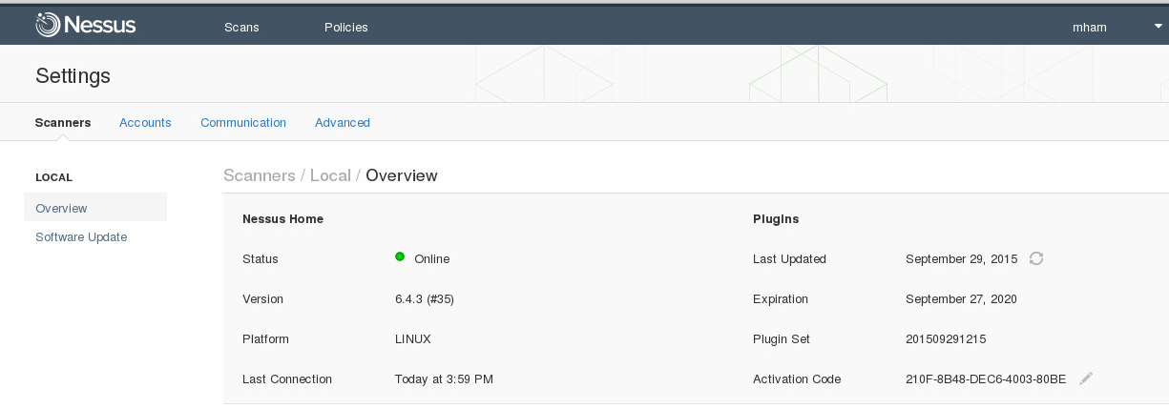
Logging In and First Checks
Validate that your plugin feeds have been successfully updated before scanning
You want the latest greatest, what if there was a vuln disclosed this AM?

Slide 22
Setup a Scan Policy
Notes:
By default nessus includes some scans…but take the time to go through this and customize a little!
Make sure you “NEXT” through all pages and click “SUBMIT”!! Or your scan won’t save.
PLEASE NOTE!!! IN THE LAB YOU MAY NEED TO CHANGE YOUR SCREEN RES TO SEE THE SUBMIT BUTTON!!

Slide 23
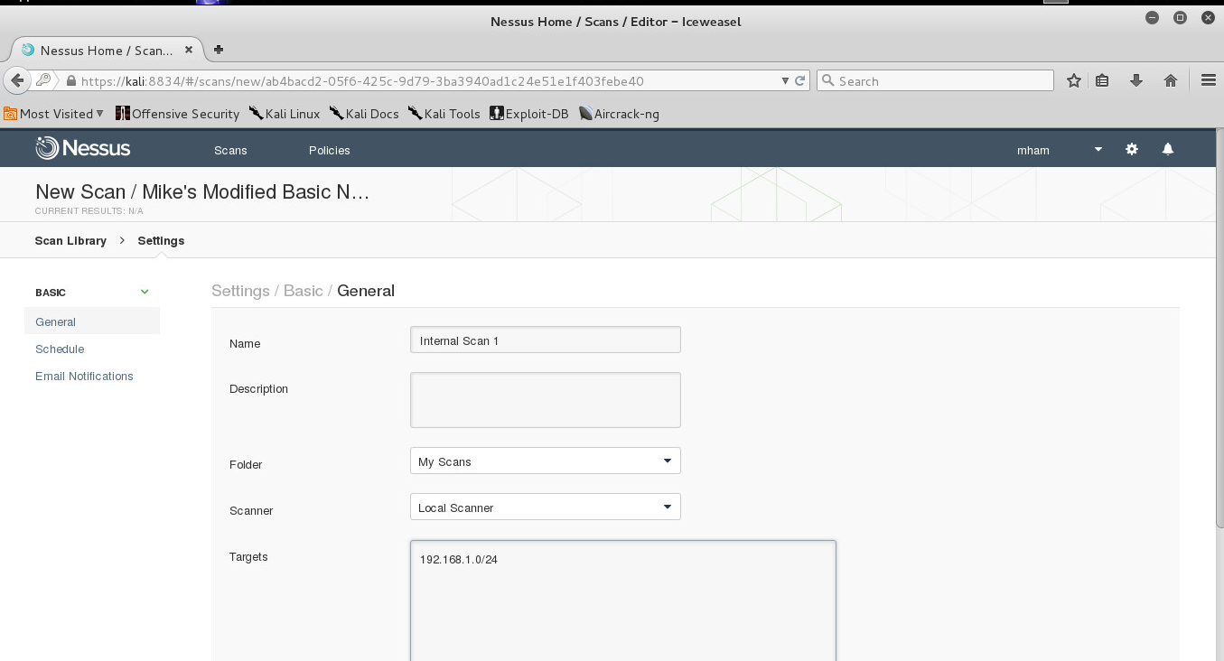
Setup a Scan (use the Policy)
Notes:
In the previous slide we set up a scan POLICY---now we’re going to set up a SCAN and launch it
NOTE: if you can’t see the “launch scan” button it is 4 tabs from “Scan targets” box

Slide 24
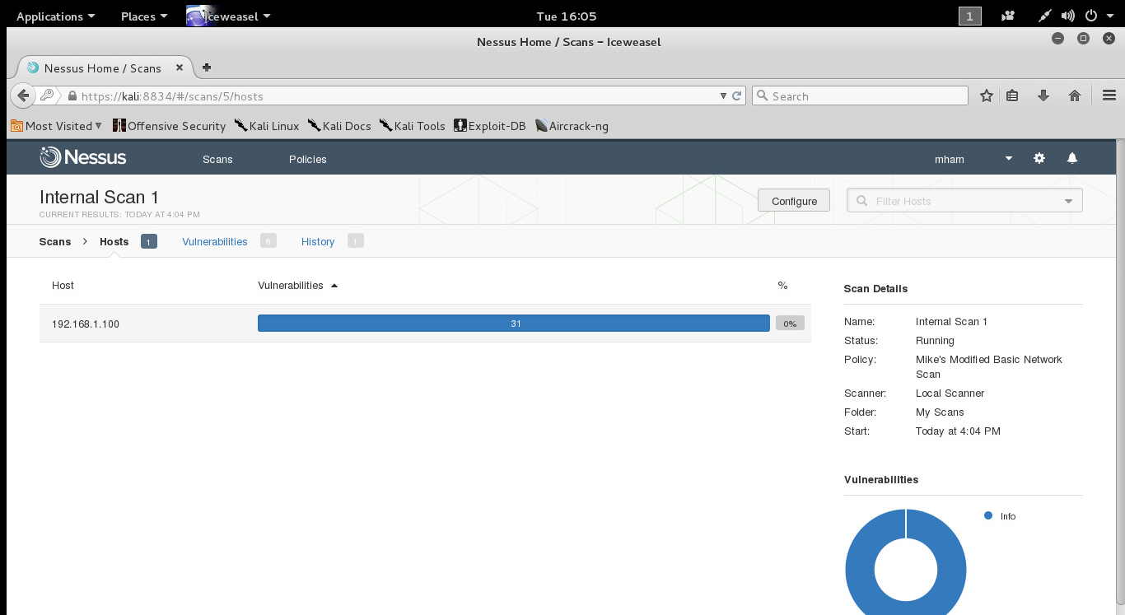
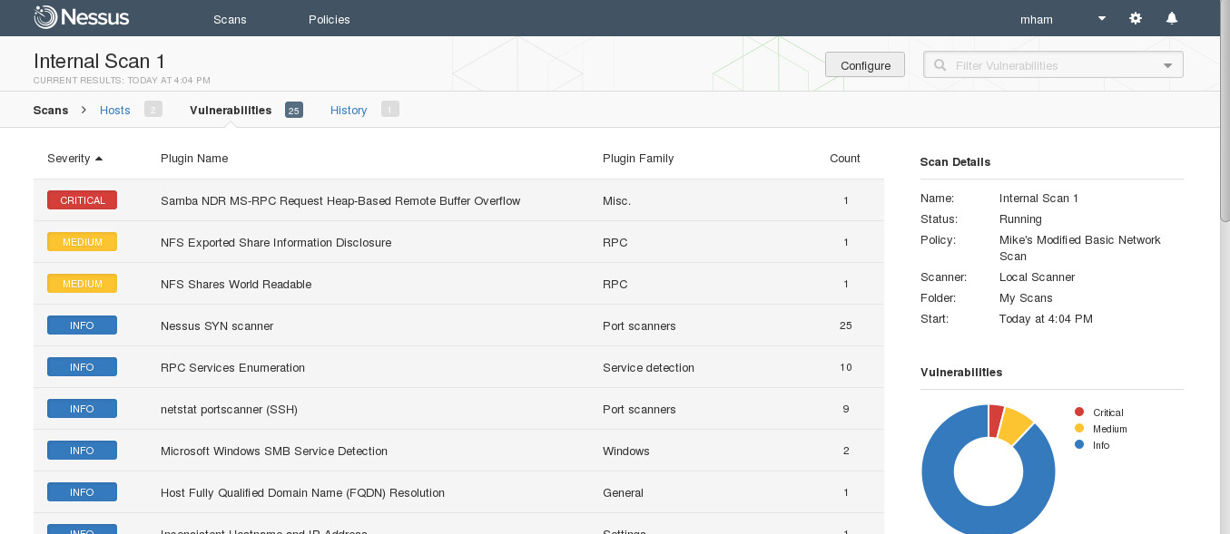
Notes:
Once you click submit it’s off!
Double click to check the status…

Slide 25
Nessus Results: Download Report
Finds services running on ports
Finds vulnerabilities associated with identified services
Notes:
Remember there are lots of options for the reports---and if you don’t like what’s there, check the web!
UNDERSTAND THIS REPORT WILL SAY ‘YOU ARE VULNERABLE TO….xxx’---this is the next step in which leads us to “exploitation”
‘You’re missing patch MS06-035…I go and find an exploit that matches MS06-035”

Slide 26
Parsing Scan Data
Import directly into Metasploit? Sweet!
Nmap’s XML files are directly readable
Nessus has a .nessus file that Metasploit can use
Sometimes you want a .csv file of the results, not XML
Use the Discover scripts that we have done in the past
There is a parsing engine that will take care of it for you

Slide 27
WARNING!! & Limitations
DANGEROUS SCANS!!!
Be very careful with DoS & Password Guessing
Some scans are simple
Some DoS scans will attempt DoS
Password Guessing can lock out actual users!
Limitations:
Only checks for known vulnerabilities
The checks are a static snapshot in time

Slide 28
Why do this?
As an attacker
You now have a list of vulnerabilities on the target system
Take list of vulnerabilities and search web for specific exploits (or use tools…more to come later!)
As a good guy
PATCH. YOUR. SYSTEMS.
Notes:
PAY ATTENTION TO WHY THE BAD GUYS DO THIS!!! THIS IS THE KEY TO MAKING YOUR ATTACK STEALTHY!!!
Are you just going to “keep attacking”? This is very loud!!
Vuln Scanning is the key to matching up your attacks! REMEMBER this report!!!

Slide 29
Vulnerability Scanning Defenses
CLOSE ALL PORTS THAT YOU DON’T NEED OPEN!
PATCH. PATCH. PATCH!!!
Have we mentioned this yet?
Run the tools against your own network on a periodic basis
Be careful with DoS & Password Guessing Tests

