Slide 1
Cyber Operations
Unit 09 – Password Auditing

Slide 2
Learning Outcomes
Upon completion of this unit, students will be able to:
Understand and explain what a rainbow table is
Determine the best way to crack a hash by choosing among password cracking methods

Slide 3
Rainbow Tables
Objective:
Overview of rainbow tables
Lab building and using RT
How to use RC Crack to Gen a Table
How to use RC Crack to Sort a table
How to use RC Crack to CRACK a password
History:
Notes:
History: The idea behind rainbow tables was proposed by Martin Hellman in 1980 in an article titled A Cryptanalytic Time-Memory Trade-Off[1]. It was further refined by Philippe Oechslin in 2003 in an article titled Making a Faster Cryptanalytic Time-Memory Trade-Off[2]

Slide 4
Rainbow Tables
Precomputed table for reversing cryptographic hash functions, usually for cracking password hashes
Using less computer processing time and more storage than a brute-force attack
More processing time and less storage than a simple lookup table with one entry per hash

Slide 5
Rainbow Crack
What IS a rainbow table?
What is Rainbow Crack?
Where to get it?
http://project-rainbowcrack.com
What platforms supported?
Notes:
RainbowCrack is a general propose implementation of Philippe Oechslin's faster time-memory trade-off technique. Function of this software is to crack hash.
The straightforward way to crack hash is brute force. In brute force approach, all candidate plaintexts and corresponding hashes are computed one by one. The computed hashes are compared with the target hash. If one of them matches, the plaintext is found. Otherwise the process continues until finish searching all candidate plaintexts.
In time-memory tradeoff approach, the task of hash computing is done in advance with the results stored in files called "rainbow table". After that, hashes can be looked up from the rainbow tables whenever needed. The pre-computation process needs several times the effort of full key space brute force. But once the one time pre-computation is complete, the table lookup performance can be hundreds or thousands times faster than brute force.

Slide 6
Rainbow Tables
To store every single 7 character password possible for the given example, it would require a least 417 TB of space - rainbow tables only need around 80 GB of storage space, depending on your generation options
Middle ground between brute force and dictionary attack
https://www.freerainbowtables.com
http://ophcrack.sourceforge.net/tables.php
http://project-rainbowcrack.com

Slide 7
How Rainbow Tables Work
Found a really nice article at http://kestas.kuliukas.com/RainbowTables/
I’m going to walk through this and point out the high-level pieces of how these things work

Slide 8
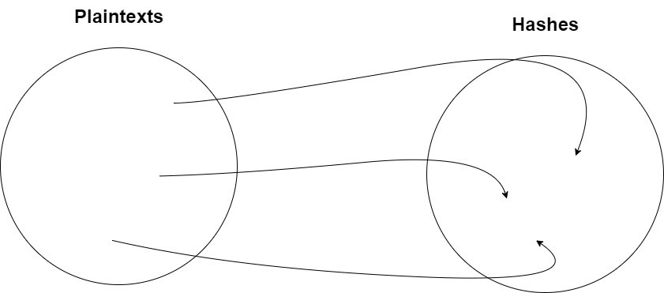
Hash Functions
We already know a hash maps plaintext to a “garbage” value and should not be reversible…that still holds true
To figure out the plaintext, you either do one of two things:
Hash each plaintext one at a time in realtime
Hash each plaintext one at a time ahead of time and store it
Notes:
Going one by one takes a very long time, and storing each hash takes an amount of memory which simply doesn't exist
Rainbow tables are a compromise between pre-computation and low memory usage.

Slide 9
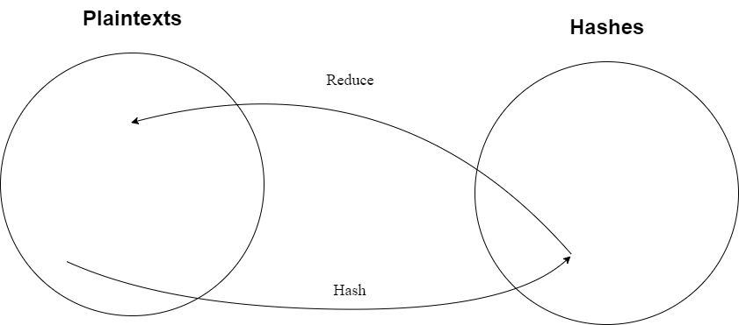
Reduction Function
This gets a little bit confusing
Does the reverse of a hash function (mapping hashes to plaintexts)
If you take the hash of a plaintext, and take the reduction of the hash, it will not give you the original plaintext; but some other plaintext
Notes:
Reduction can be anything. Maybe it’s taking the first 8 characters from the hash and hashing those.

Slide 10
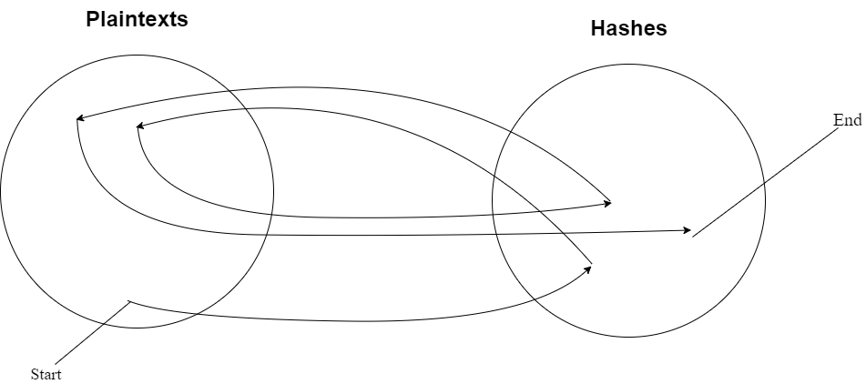
Reduction in Action
Suppose you want the first 8 characters because that’s what many passwords are and you want it in an MD5
hashMD5(12345678) = 25d55ad283aa400af464c76d713c07ad
hashMD5(25d55ad2) = 5c41c6b3958e798662d8853ece970f70
hashMD5(5c41c6b3) = 4e3d15bea09e7455aa362d3cf89838fc
hashMD5(4e3d15be) = f439b57135045b9d365dd867fca1e316

Slide 11
Reduction Explained
You pick a criteria to stop at (let’s say 100,000 hashes)
After the last reduction, you have a chain of 100,000 MD5 hashes
For example, the last one is 78ba340e23a492704f63e5239be65495
What the rainbow table stores is:
12345678 –> f439b57135045b9d365dd867fca1e316
Just the starting plaintext and the ending hash
This represents 100,000 hashes in a very small line of text

Slide 13
RC Continued
The RainbowCrack software includes three tools that must be used in sequence
Step 1: Use rtgen
Generates the rainbow tables
Step 2: Use rtsort
Sorts rainbow tables generated by rtgen
Step 3: Use rcrack
Table lookup process
“hash cracking process” (or equivalent)
rtgen, rtsort, rcrack are all command line programs
Notes:
rtgen will generate the tables, rtsort will sort them and rcrack will use the sorted tables to find the plaintext of any given hash.

Slide 14
Installing RainbowCrack
Pre-Installed in Kali
BackTrack:
Navigate to: http://project-rainbowcrack.com
Find downloads and download the appropriate version to BT (it’s a .zip file)
Unpack with the: unzip command
Make rtgen, rtsort, and rcrack executable:
chmod 755 rtgen
chmod 755 rtsort
chmod 755 rcrack
Notes:
On the previous slide we discussed where to get it… http://project-rainbowcrack.com
Specifically the downloads section: http://project-rainbowcrack.com/index.htm#download
Once you’ve got it…you need to install it.

Slide 15
Step 1: rtgen
Use rtgen program to generate rainbow tables
The rtgen program requires several parameters to generate a rainbow table, the syntax of the command line is:
rtgen [hash_algorithm] [charset] [plaintext_len_min] [plaintext_len_max] [table_index] [chain_len] [chain_num] [part_index]
/usr/share/rainbowcrack/charset.txt
Example:
rtgen lm alpha-numeric-symbol14-space 1 7 0 2400 33554432 0
Notes:
Hash_algorithm = what kind of table do you want to build?
Charset = characters to use (alpha, alpha-mixed, alphanumeric, etc…) --- see charset.txt for examples & names
Plaintext_len_min = min password length
Plaintext_len_max = max password length
The next are a bit more difficult to understand---not trying to gloss over these---they’re important but beyond the scope of our class…if you want more details you can read Phileppe Oechslin’s original paper…there are also online calculates to help you determine what to put here…BUT… probability of success rate and size of table…
Chain_len = higher numbers increase the probability success rate --- without increasing the table size much – but increase time to generate
Chain_len = The chain_len is the length of each "rainbow chain" in the rainbow table. A "rainbow chain" sized 16 bytes is the smallest unit in a rainbow table. A rainbow table contains lots of rainbow chains.
Chain_num = number of “chains in each table” is the chain count. larger numbers increase the size of the tables, but will also increase the success rate
Part_index = The last parameter is appended to the generated filename—used to prevent duplication of tables
rtgen - the soft
lm - type of hash
alpha - character set used
1 - minimum character word
3 - maximum character set
0 - number of the table
2400 = size of table
33554432 = number of hashes in a table
0 - The time-memory tradeoff algorithm is a probabilistic algorithm.
Before generating a table it is a good idea to check and see an
approximation of the amount of time the table is going to take to generate. To do
this you use the"-bench”

Slide 16
rtgen continued…
Well worth your time to do some investigating and benchmarking BEFORE spending months (or years)
longer chains will take more time generating,
too long chains == too many tables == will take to long cracking
http://www.onlinehashcrack.com/hash-generator.php#res
Notes:
Do some benchmarking, longer chains will take more time generating, to long chains/to many tables will take to long cracking.
The right values of all the parameters depend on what you need, to select good parameters require some understanding of the time-memory tradeoff algorithm.

Slide 17
rtgen in action:
Generate your tables!
Example (hint make a directory 1st):
rtgen ntlm numeric 1 3 0 2400 100000 0
Once complete you will have the 1st table:
The file name is simply all the command line parameters connected, with the "rt" extension.
DO NOT RENAME THE FILE!
Notes:
This command takes about 1 minute on a vm to complete on a Sandy Bridge i5 processor. It is safe to stop the computation any time by pressing Ctrl+C. Next time if the rtgen program is executed with exactly same command line parameters, it will resume from where the computation is stopped and continue the table generation.
When the command is finished, a file named "md5_loweralpha-numeric#1-7_0_3800x33554432_0.rt" sized 1.6 MB will be in place.

Slide 18
Create the remaining tables:
./rtgen ntlm numeric 1 3 1 2400 100000 0
./rtgen ntlm numeric 1 3 2 2400 100000 0
./rtgen ntlm numeric 1 3 3 2400 100000 0
./rtgen ntlm numeric 1 3 4 2400 100000 0
Notes:
We should now have 5 total tables created…
Now the rainbow table generation process complete.

Slide 19
Step 2: rtsort
rtsort: organizing the newly minted tables
rtsort is used to sort the chains in a rainbow table.
Each table is sorted individually
rtsort writes back to the original file name
DO NOT INTERUPT!
Notes:
Use rtsort program to sort rainbow tables
The rainbow tables generated by rtgen program need to be processed and sorted to make table lookup more efficient.
Each command above takes about 1 to 2 minutes to complete.
The rtsort program will write the sorted rainbow table to the original file.
Don't interrupt the rtsort program; otherwise the rainbow table being sorted will be damaged.
If the free memory size of your system is smaller than the size of the rainbow table being sorted, temporary hard disk space as large as the rainbow table size will be needed to store intermediate data.

Slide 20
rtsort in action:
Be sure to sort all of the tables (individually)
rtsort ntlm_numeric#1-3_0_2400x100000_0.rt
rtsort ntlm_numeric#1-3_1_2400x100000_0.rt
rtsort ntlm_numeric#1-3_2_2400x100000_0.rt
rtsort ntlm_numeric#1-3_3_2400x100000_0.rt
rtsort ntlm_numeric#1-3_4_2400x100000_0.rt
Or sort all tables at once:
rtsort *.rt
THIS ASSUMES YOU DO NOT HAVE ADDITIONAL TABLES IN THE SAME FOLDER!
Notes:
Each command above takes about 1 to 2 minutes to complete. The rtsort program will write the sorted rainbow table to the original file.
Don't interrupt the rtsort program; otherwise the rainbow table being sorted will be damaged.
If the free memory size of your system is smaller than the size of the rainbow table being sorted, temporary hard disk space as large as the rainbow table size will be needed to store intermediate data.

Slide 21
Step 3: rcrack
The rcrack program is used to lookup the rainbow tables
It only accepts sorted rainbow tables
With the sorted rainbow tables located in the /usr/share/rainbow/ directory:
to crack a single hash use the –h command followed by the hash
Syntax:
rcrack /usr/share/rainbow/*.rt -h your_hash
The first parameter specifies the path to the sorted tables
The "*” character is used to specify multiple files (all the tables)
Notes:
Rcrack is the heart---it’s the brains---it’s the program that does the comparison of your hash to your table…
TABLE MUST BE SORTED!!!
For demo – use the following website to create a ntlm hash: http://www.insidepro.com/rainbow.php?lang=eng
Normally it takes seconds or tens of seconds to finish, if the plaintext is within the selected charset and plaintext length range. Otherwise, it takes much longer time to search all the tables only to find nothing.

Slide 22
rcrack: extended edition
To crack multiple hashes
place all the hashes in a text file with each hash on a single line
Administrator:500:1c3a2b6d939a1021aad3b435b51404ee:e24106942bf38bcf57a6a4b29:::
Guest:501:a296c9e4267e9ba9aad3b435b51404ee:9d978dda95e5185bbeda9b3ae00f4b:::
2. Use the –l switch to specify the hash file
Example:
rcrack /usr/share/rb/*.rt -l hash_file
Notes:
rcrack c:\rt\*.rt -l hash_list_file
If the rainbow tables you generate use lm algorithm, the rcrack program has special support for it with the "-f" command switch. A hash dump file in pwdump format is required as input to rcrack program. The file will looks like this:
Administrator:500:1c3a2b6d939a1021aad3b435b51404ee:e24106942bf38bcf57a6a4b29016eff6:::
Guest:501:a296c9e4267e9ba9aad3b435b51404ee:9d978dda95e5185bbeda9b3ae00f84b4:::
The pwdump file is the output of pwdump2, pwdump3 or other utilities. It contains both the lm hash and the ntlm hash.

Slide 23
Rainbow Tables: Parting Shots
Very very powerful tool
You will need to dedicate a lot of resources to build a good tables
Hardware & time
Consider clustering / multiple machines
USE A UPS!
Do your homework!
Nothing worse than spending 18 months building BAD (inefficient) tables
The more you know! (hint: READ)
http://www.project-rainbowcrack.com/generate.pdf

Slide 24
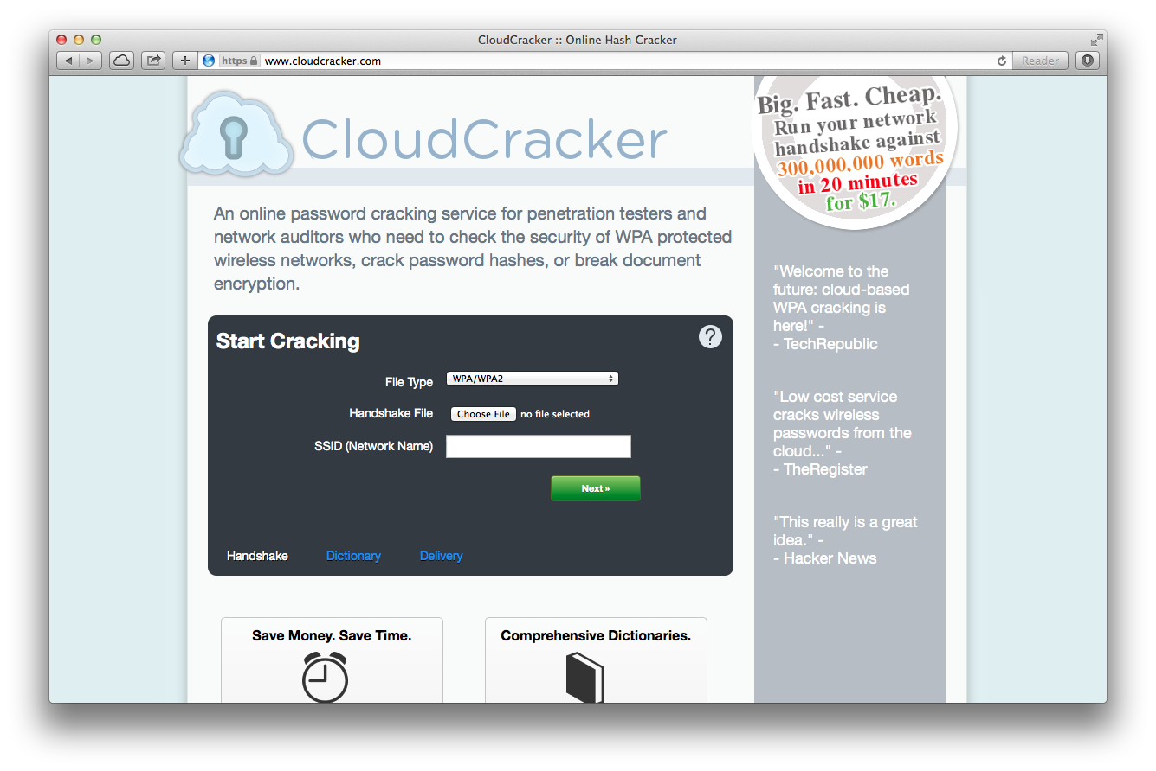
Easiest

Slide 25
GPU vs. CPU
What a GPU really does is alleviate some of the load of the CPU and handles some computation for the output on the screen

Slide 26
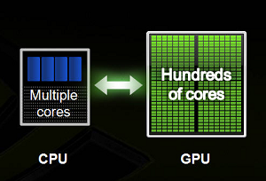
GPU vs. CPU
CPU has only few cores/multiple cores with lots of cache memory that can handle few software threads at a time
GPU has hundreds of cores that can handle thousand of threads simultaneously

Slide 27
GPU vs. CPU
GPUs are highly specialized in number crunching, something that graphics processing desperately needs
Multiple GPUs can also be employed to achieve a single goal
TL;DR; GPUs are really fast, but designed for very specific types of applications

Slide 28
Not all GPUs are created equally…
Some graphics cards are more capable than others
Look at how many cores they have
How much memory
Before you go buy a password cracking machine, do your due diligence!

Slide 29
Hurdles
What about non-English passwords?
Those that use special character sets
Wingdings anybody?
Wingding’s anybody?
Change frequency
Locking accounts out

Slide 30
More Iterations
Running a hash through the hashing algorithms multiple times
Running a password through SHA256, for instance, and then feeding the hashed output back through the algorithm another 500 times would certainly make wordlist and brute force attacks slower

Slide 31
Salting
Salting attempts to defeat table lookup attacks by adding several characters to the password before passing it through the hashing algorithm
Characters don't have to remain secret
Salting also thwarts cracking techniques that rely on rainbow tables

Slide 32
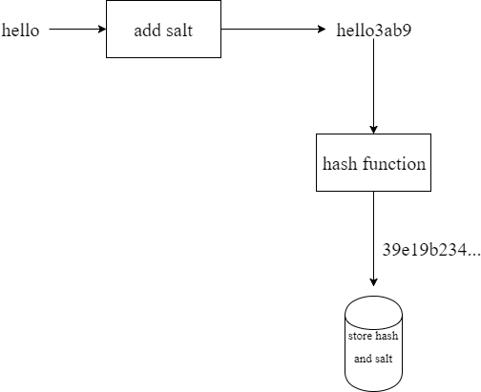
Salting

Slide 33
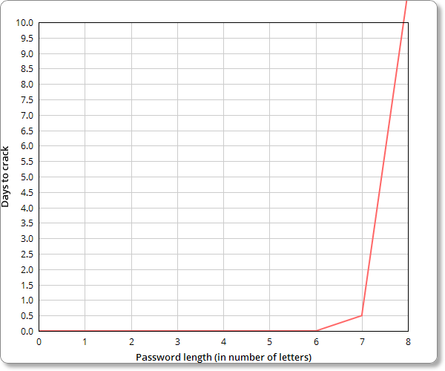
Length

Slide 34
Multifactor Authentication
Something you know
Something you have
Something you are

Slide 35
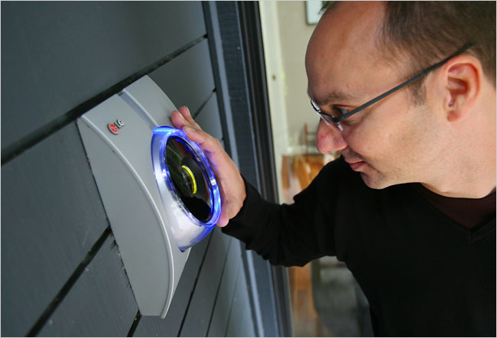
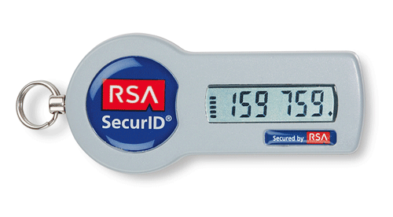
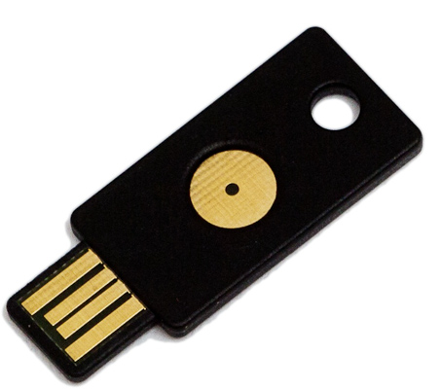
Multifactor Authentication

Slide 36
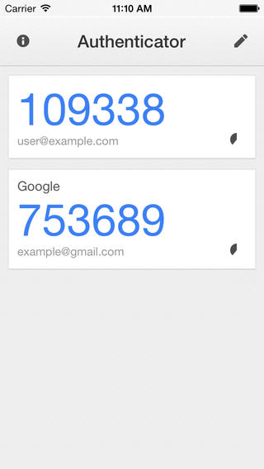
Google Authenticator

