Slide 1
Cyber Operations
Unit 10 – Meterpreter

Slide 2
Learning Outcomes
Upon completion of this unit, students will be able to:
Determine the most useful commands to use in meterpreter when presented with a target system
Explain the functionality of a meterpreter command shell

Slide 3
Getting a Meterpreter Shell
Notes:
Ok---so this lecture is basically a series of demos on Meterpreter.
Meterpreter ROCKS --- you NEED to spend time with Meterpreter. Understand it. Love it. Get cozy with it. It will become your BEST FRIEND.

Slide 4
sysinfo
Provides information about the target system
meterpreter > sysinfo
Notes:
So you’ve got a Meterpreter shell… now what???
Can you find it on the victim? (how do you see the current processes?) Netstat…view processes…
Gets the sysinfo for the system that you are currently sitting on (probably already have this info by now, at least most of it)
Ran just by typing in sysinfo

Slide 5
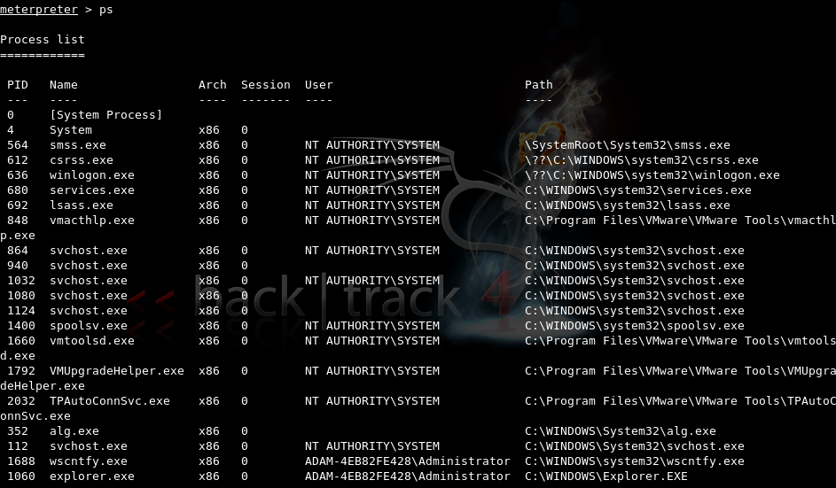
ps
List all running processes (on the target)
Notes:
This command is used to get the list of processes running on the target machine.
The different columns are as follows:
PID: The process ID of the item on that line, used with other commands
Name: The name of the process, explorer.exe for example
Arch: The architecture that the service is running on (32 or 64 bit)
Session: The session on the victim that the service is running on
User: The user level the service is running as
Path: The path to the actual executable that was used to start that service
This is going to be KEY for what? MIGRATION! Remember---we usually want to quickly migrate to a more stable environment

Slide 6
kill
This command kills a process, specified by a PID.
meterpreter > kill <pid>
Notes:
To use the command, just type in kill (PID), obviously substituting the appropriate PID in that you want.
Where do we get the PID! (previous slide!)

Slide 7
migrate
This command is used to migrate to other process ids (PIDs).
meterpreter > migrate <pid>
Notes:
Probably one of the most popular and most useful features --- migrate! Move your shell to another process!

Slide 8
getpid
Grabs the PID of the process you are currently attached to.
meterpreter > getpid
Notes:
Pretty self explanatory, this command ---displays the current PID (of the processes you’re running)

Slide 9
getuid
Obtain the username responsible for the current process
meterpreter > getuid
Notes:
This command gets the username, or UID, that is associated with the current Meterpreter session.
This command is used by just typing in getuid

Slide 10
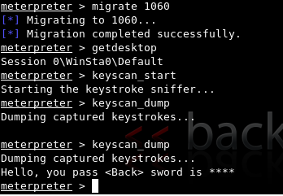
Keyscan
meterpreter > keyscan_start
Starts keystroke recording
meterpreter > keyscan_dump
Dumps the current users keystrokes
meterpreter > keyscan_stop
Stops recording user keystrokes
Notes:
Keystroke recording!
To use this command set, you must first migrate your process over to the explorer.exe process. The process you are attached to must be explorer.exe (find with ps)
Keyscan_start can then be used to start the capture
Keyscan_dump can be used to dump the currently captured keystrokes
Keyscan_stop can be used to stop the capture

Slide 11
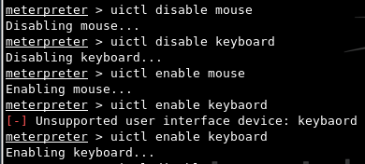
uictl
Provides the ability to disable / enable input (keyboard and mouse)
meterpreter > uictl disable mouse
meterpreter > uitcl enable mouse
Notes:
The setup for this command is the same as the keyscanner. (migrate to explorer.exe)
Control some of the user interface components
Once connected to this you can type in any of the variations of the command uictl disable/enable mouse/keyboard

Slide 12
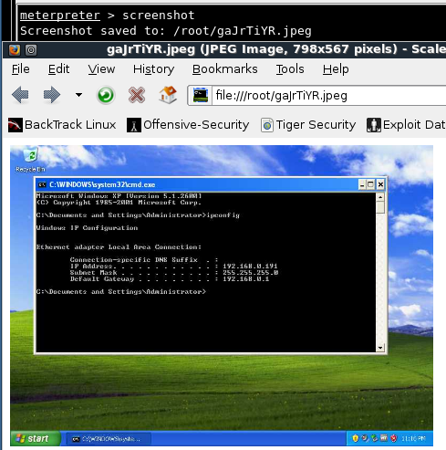
screenshot
Takes a screenshot of the target machine
meterpreter > screenshot
Notes:
To use, just type screenshot at the meterpreter prompt, and a screenshot will be taken and a window will open with the result.

Slide 13
hashdump
Grabs and displays the native hashes
meterpreter > hashdump
Notes:
This is another rather self explanatory command, it dumps the hashes for the system.
To use, just type in “hashdump”
This will output the hashes, which can then be fed into JTR or a similar program, or even a rainbow table

Slide 14
getsystem
Attempts to elevate privileges to system level
meterpreter > getsystem
Notes:
This command is used to attempt to get to a system level user
It is used by just typing in getsystem
System is the highest you can get on a windows box

Slide 15
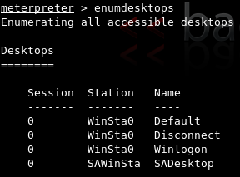
enumdesktops
Allows attacker to interact with all available desktops on the system
meterpreter > enumdesktops
Notes:
This command is used to enumerate all available desktops on the system. This can be just the console (session 0) or remote connections
Default would be the logged in screen where the user could interact with various apps
Disconnect is the screensaver, or locked window
Winlogon is the screen that the user logs on at

Slide 16
getdesktop
Displays the desktop that is currently active
meterpreter > getdesktop
Notes:
enumdesktops can be used in conjunction with “getdesktop”
Getdesktop finds the desktop that is associated with the current session
A majority of the time, this will default to the Default desktop on session 0
The point here is that each desktop has it’s own keyboard buffer….so if you want to sniff normal stuff the user does on the desktop you have to be in the right desktop
If you want to sniff the logon password you need to change the active desktop to 0\WinSta0\WinLogon

Slide 17
idletime
Displays how much time the user has been inactive
meterpreter > idletime
Notes:
This command finds the amount of time the user on the target machine has been idle
This could be extremely useful for finding if the user is sitting there, or if it just an idle machine.

Slide 18
run
Allows the execution of ruby scripts (pre-packaged or self developed)
checkvm
credcollect
getcountermeasures
getgui
killav
scheduleme
meterpreter > run <script>
Notes:
This command is used to run scripts that are pre included with Metasploit, or ones that you create yourself
A much more advanced one is called getgui which can create a new user with a password and enable a remote desktop connection (RDP)
Just stop to think about some things you could do here---without even getting too crazy…kill av, schedule a service to open every 5 minutes or 1 hour or month…call it “backup”, etc…add a user and a rdesktop connection
LOADS of fun here

Slide 19
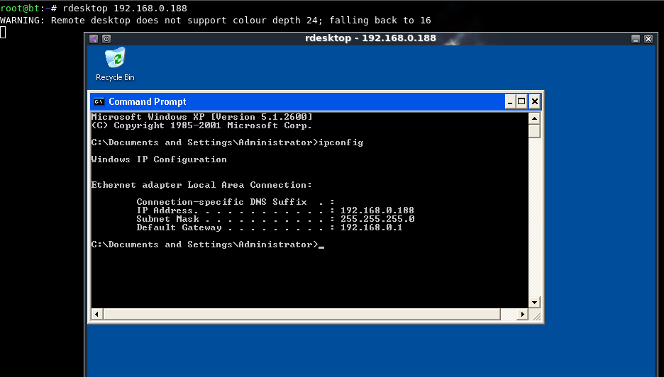
run getgui
Notes:
After running that script, you could then go in and connect with the rdesktop command in the regular bash shell

Slide 20
shell
Provides an interactive Windows OS shell
meterpreter > shell
Notes:
Running the shell command in the meterpreter will drop you into a cmd prompt on the target machine based on the user level you are currently sitting at

Slide 21
clearev
Clears event and security logs
meterpreter > clearev
Notes:
This command clears out the event log of the machine so no previous activity would be shown in the logs
NOTE! Not very stealthy…

Slide 22
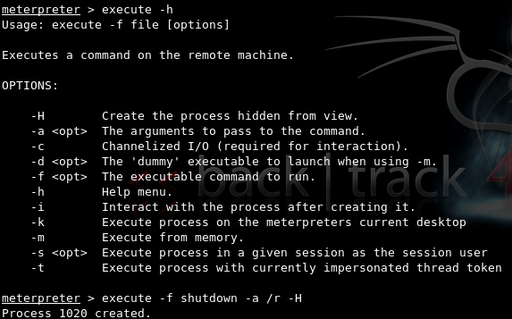
execute
Executes the specified file on the target
-H creates the process as hidden from view
-a allows you to pass required arguments
-i interact with the process after starting it
meterpreter > execute –f <file> <options>
Notes:
This command executes an exe file on the target machine
This can be used to do a large variety of things, such as start an FTP server, FTP client, create a backdoor using netcat, and many other things.
The processes created can additionally be hidden from the user on the target machine
meterpreter> execute –f calc.exe

Slide 23
Webcams
Webcam_list
meterpreter > webcam_list
Webcam_snap
meterpreter > webcam_snap
Record_mic
meterpreter > record_mic
Notes:
Webcam_list Lists the webcams available on the target machine to snap pictures from
Webcam_snap takes a snapshot from the webcam itself and displays it to the attacker
Record_mic records audio for a specified amount of time
All of these obviously require a webcam and/or microphone to be usable

Slide 24
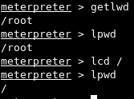
Local Directory traversal
lcd: changes the local working directory
lpwd: gets the local working directory
getlwd: identical to lpwd
Notes:
This is LOCAL people---local (so you need to upload a file? Move into it locally)
lcd: changes the local working directory, works exactly like regular cd
Lpwd: gets the local working directory, exactly like pwd
Getlwd: identical to lpwd

Slide 25
Remote File System Commands
cd
changes directory on the remote machine
del
deletes a file specified in command
rm
identical to del
rmdir
removes a specified directory
mkdir
creates a new directory

Slide 26
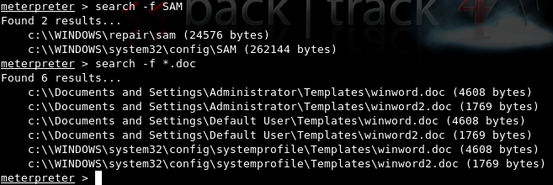
search
Allows you to search remote machine for specific files
meterpreter > search –f <file_name or wildcard>
Notes:
Can be used to search for files on the target machine
Wildcard characters can be used to search for file types or other
meterpreter> search –f SAM

Slide 27
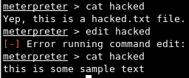
Remote file management
cat
prints the contents of a specified file to the screen
edit:
Allows you to edit text using an editor similar to vi
Notes:
Edit in VI: --- “i” to insert
Make your changes
Esc key to escape, then “:” “wq” to write and quit

Slide 28
download
Download a file from the target to the host
meterpreter > download <src file> <dest file>
Notes:
Downloads any file or directory on the target system.
Syntax is just “download [source] [destination]”, but the destination is not needed; it defaults to the current location

Slide 29
upload
Upload a file to the target host
meterpreter > upload <scr file> <dest file>
Notes:
Can be used to upload files from your local machine running the meterpreter console on up to the target machine
Location can be chosen with the directory commands previous found as well as specifying location in the command

Slide 30
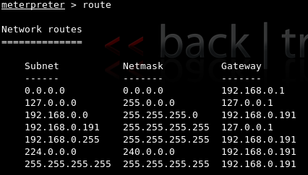
route
View and modify the networking routing table of the target
meterpreter > route
Notes:
Shows the routing tables on the target machine.

Slide 31
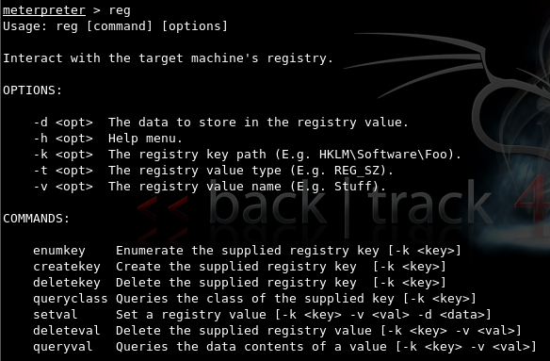
reg
Remotely edit the registry
meterpreter > reg <command> <option>

Slide 32
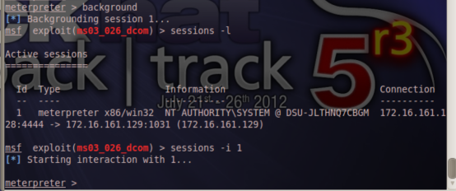
Background
Puts the meterpreter session in background mode
meterpreter > background
sessions –l
used to ID the current sessions
sessions –I <session_id>
used to move back into the session
Notes:
Puts the meterpreter session into background mode and allows you to come back for more later!

Slide 33
Reboot/shutdown
reboot: reboots the machine with no warning to the user
meterpreter > reboot
shutdown: Shuts the machine down with no warning to the user
meterpreter > shutdown
Notes:
If shutdown doesn’t work --- migrate to svchost.exe

