Slide 1
Vulnerabilities
10. Local & Remote Access

Slide 2
Learning Outcomes
Upon completion of this unit, students will be able to:
Students will possess a thorough understanding of the various types of vulnerabilities (design and/or implementation weaknesses), their underlying causes, their identifying characteristics, the ways in which they are exploited, and potential mitigation strategies. They will also know how to apply fundamental security design principles during system design, development and implementation to minimize vulnerabilities.
Students will understand how a vulnerability in a given context may be applied to alternative contexts and to adapt vulnerabilities so that lessons from them can be applied to alternative contexts.

Slide 3
Local Access
Being physically at a system to gain access
Also called “privilege escalation attacks”
Two types:
Horizontal – doesn’t gain more privileges (i.e. bank account users)
Vertical – gains more privileges (bypassing the lock screen on a smartphone)

Slide 4
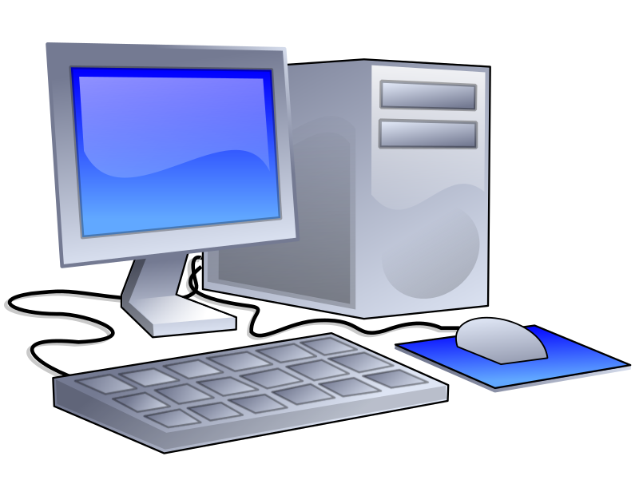
Local Access
Logs in while the user is still on the lock screen, either through a backdoor or getting the password, but being physically at the target system
Web Apps
Remote Access
Local Access
Target

Slide 5
Remote Access
Gaining authorization on a system without being physically present
Usually used in corporate facilities and with servers
LAN file sharing on a home network is not considered remote access
Different aspects of remote access:
Passive attacks (sniffing)
Identity spoofing
Social engineering (can also be local)
Administrator fault

Slide 6
Remote Access Activity
Allow remote connections to this computer
Find PC name
Connect through Remote Desktop Connection

