Slide 1
History of Cellular
Unit: 0
Intro to Wireless

Slide 2
Objectives
Define how frequencies are allocated
Explain how near channel interference occurs
Apply principles of guard bands to allocate frequencies

Slide 3
There was a time…
…in which we used our phones to call people…

Slide 4
How far we’ve come
1880, first realistic radio communications
1879, transmission reached 18+ mile mark
1934, FCC formed
1946, First phone that didn’t need wires pops up
1983, Cellular communications sort of appear in the US

Slide 6
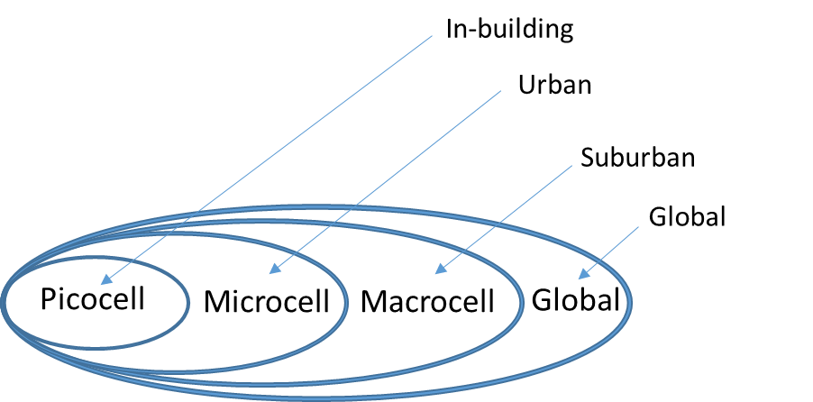
Terms
Base Station (BS)
Transmitter of radio waves
Mobile Station (MS)
Receiver of the radio waves
Cell
The area covered by a base station

Slide 7
Cells
Cells need to be different sizes
In rural regions, cells are very large
More farming = less people
Less people = less devices on the network
Metro regions, smaller cells exist
Less farming = more people
More people = more devices on the network

Slide 8
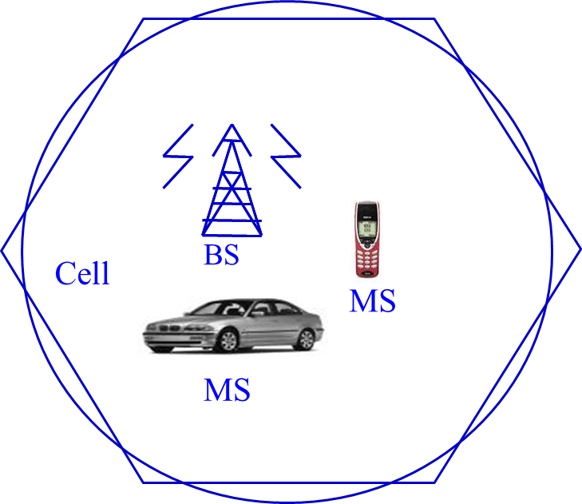

Slide 9
Other Cell Considerations
Data transmission hates mobility
Every base station handoff disrupts transmission
The faster we’re moving, the less data we can transmit
OR
The faster we’re moving, the more expensive data transmission is

Slide 10
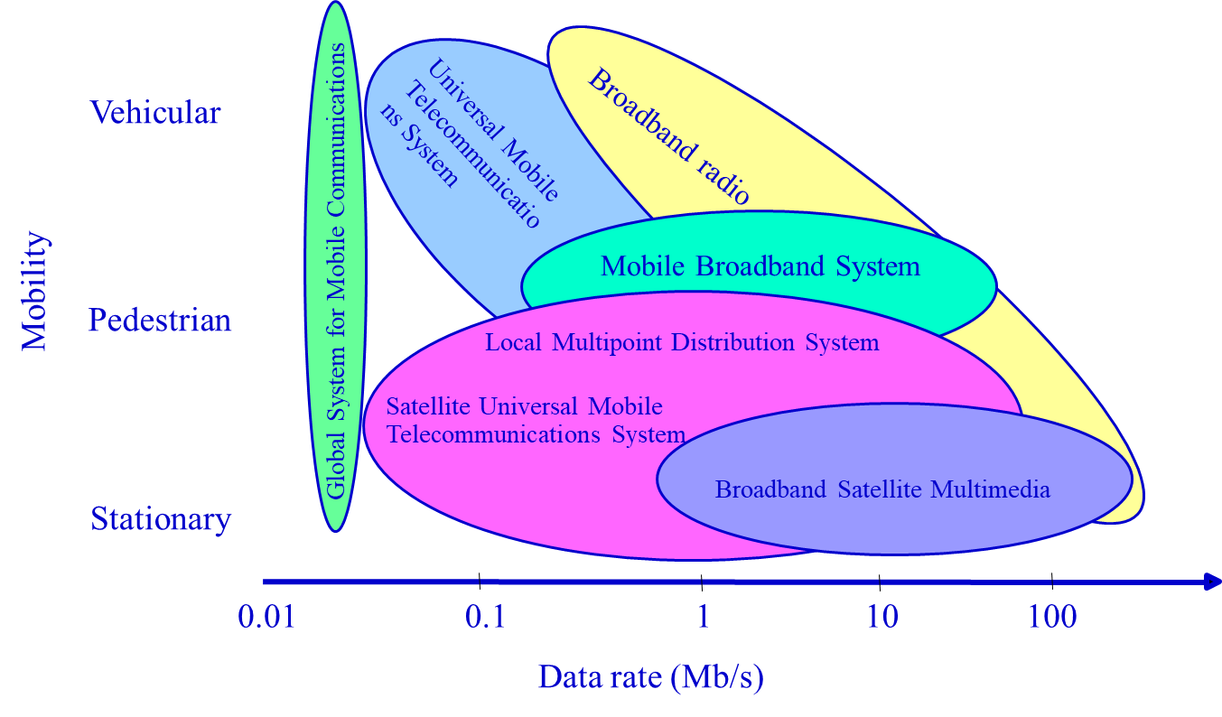

Slide 11
Frequencies
We measure these in hertz…
We don’t want to overlap
Try it: get a bunch of 900Mhz cordless phones in one place
You’ll eventually run into troubles
The good part: the base stations in everyone’s house is low power
…or at least it’s supposed to be…
Bandwidth is important!

Slide 12
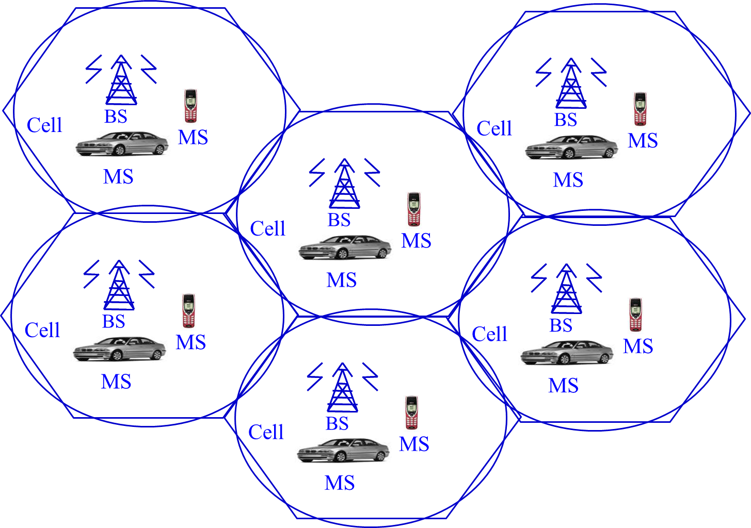

Slide 13
FM Radio Stations
104.7 <- is this a legit station?
98.8 <- is this a legit station?

Slide 14
FM Radio Overlap
We can’t have overlapping use of frequencies
Signals would become confused
FM Radio is given a 200kHz width (bandwidth!)
Ideally they should be spot on in the center
This helps prevent overlap

Slide 15
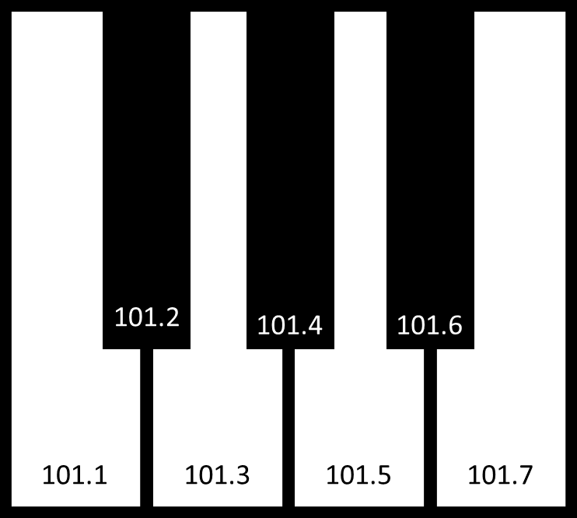
It’s like the white keys on a piano!

Slide 16
Bandwidth
Difference in the upper/lower frequencies
For us, we’ll focus on a single channel
The same bandwidth can carry equal data
Example: 3kHz for a phone conversation
So, the band 1kHz-4kHz can be the same as 100002 kHz – 100005 kHz

Slide 17
Other Common Radio Frequencies
535-1705 kHz AM Radio
174.0-216.0 TV Channel 7-13
978 Mhz Low flying aircraft
1090 MHz High Flying aircraft
47.0-47.2 Ghz Armature satellites
20-20000 Hz Human Ear
Is 20,000 loud?

