Slide 1
Waves and Channels
Unit: 1
Signaling

Slide 2
Review
What are guard bands?
Types of multi access:
  FDMA
  TDMA
  CDMA -> “secret sauce”
ISL- intersymbol interference

Slide 3
Objectives
Define how different waves propagate differently.
Establish the foundation for forward and reverse channels & duplex communications
Calculate the propagation of various types of radio waves

Slide 4
Cellular Channels- Their Uses
Typically 4 channels dedicated
  Simplex Channels ← What’s this?
2 Exchange Metadata
  Authentications
  Subscriber info
  Call parameters
2 Exchange real data
Control data needs to be exchanged before we can do data
Kind of like how FTP works

Slide 5
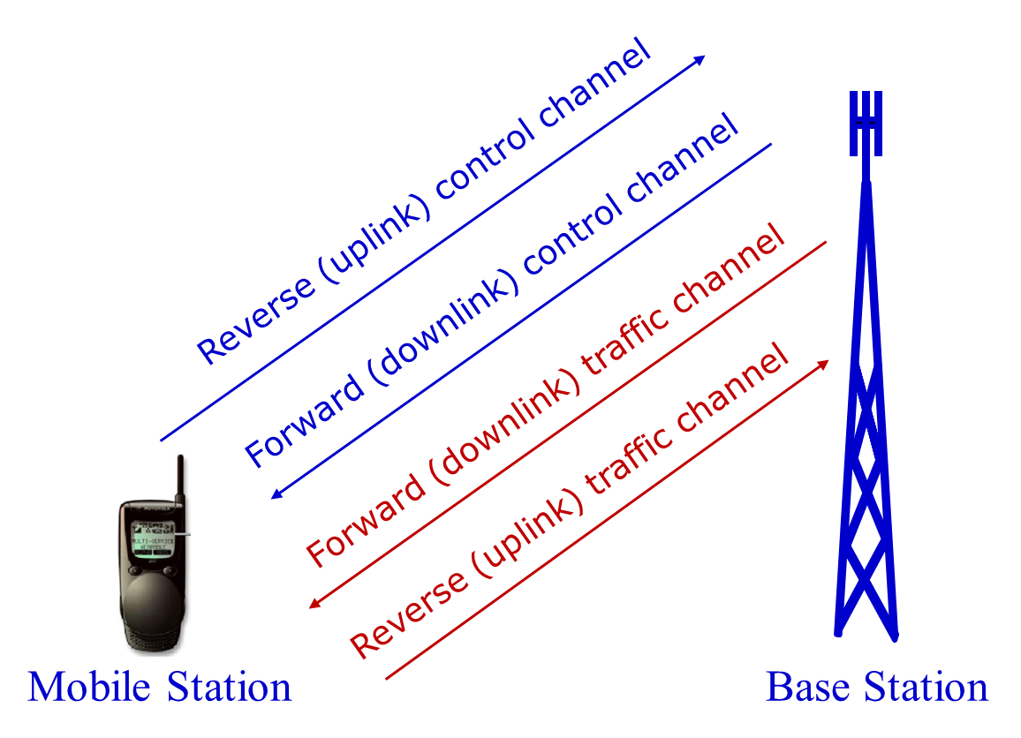

Slide 6
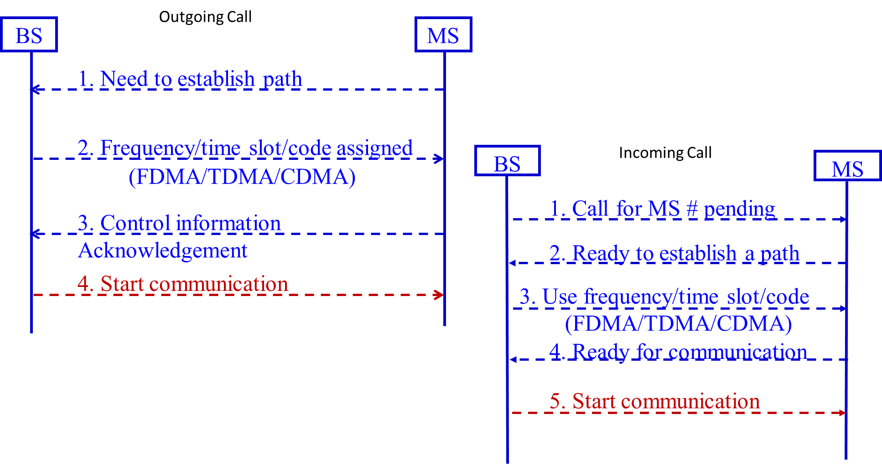

Slide 7
Lifespans
Control channels are used very differently
How many channels do we assign to each?
  Depends on what we’re doing

Slide 8
Back to Bandwidth
If I have the same bandwidth (say 3kHz) can I transfer the same amount of data?
What impacts this?
Are all protocols equally efficient?

Slide 9
Examples
2G GSM .030 MHz .104mb/s 0.52
3G CDMA 1.2288MHz 3.072mb/s 0.125
4G LTE 20MHz 81.6mb/s 4.08
V.92 .004MHz 0.056mb/s 14.0
802.11g 20MHz 54mb/s 2.7
802.11ad 2160MHz 6756mb/s 3
mb/s vs MB/s

Slide 10
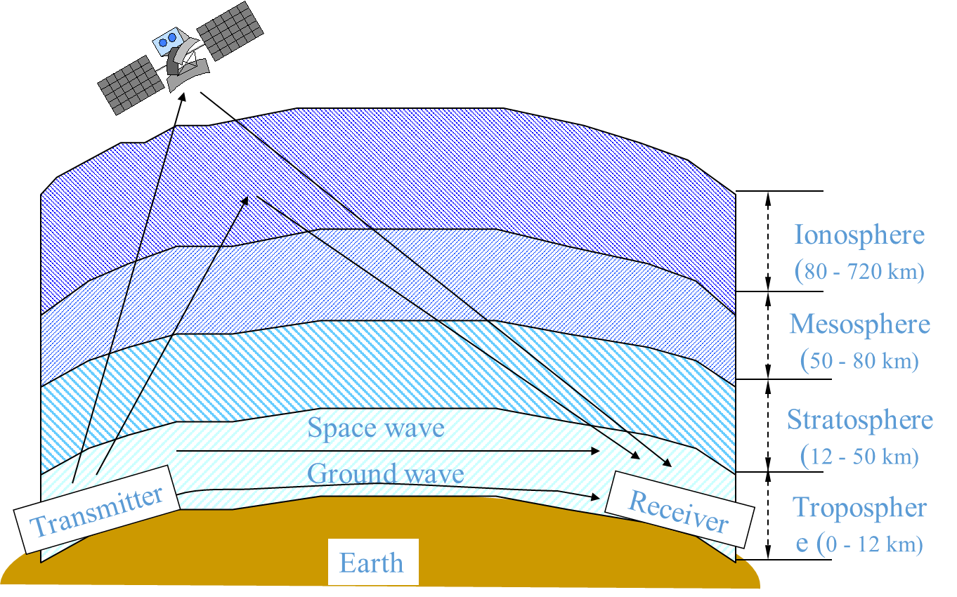
Properties of Waves
Distance of the tower can impact things
Various frequencies act differently when transmitted

Slide 11
How fast do waves travel?

Slide 12
All waves travel at 300,000km/s
*technically -> 299,792,458 m/s
We can predict wavelength based on the frequency
So:
  300000 = frequency(Hz) x wavelength
  Cellphones – 800 MHz
  What’s the wavelength?

Slide 13
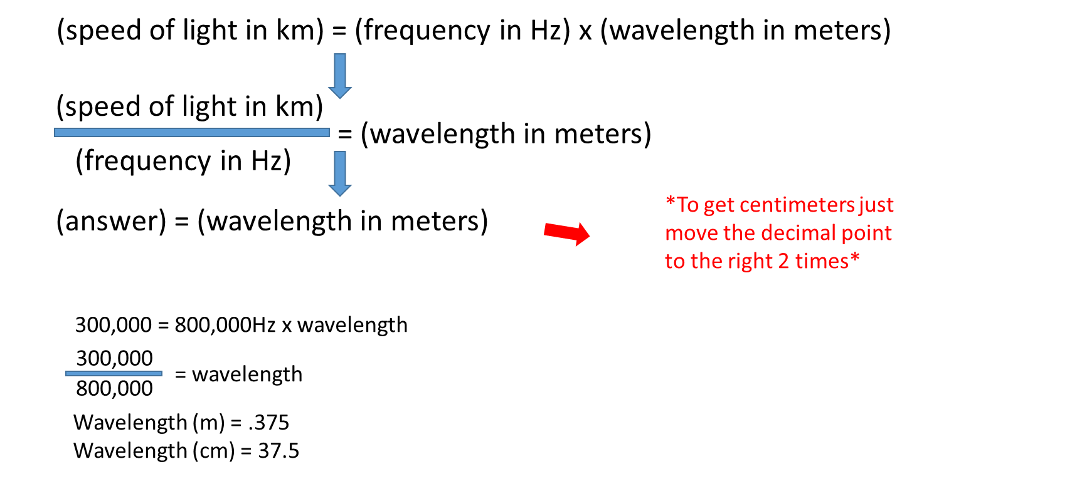
Math!

Slide 14
Wavelengths
FM Radio – 100Mhz, 3 m
Ka band satellite – 20GHz, 15mm
The frequencies are divided into various bands

Slide 15
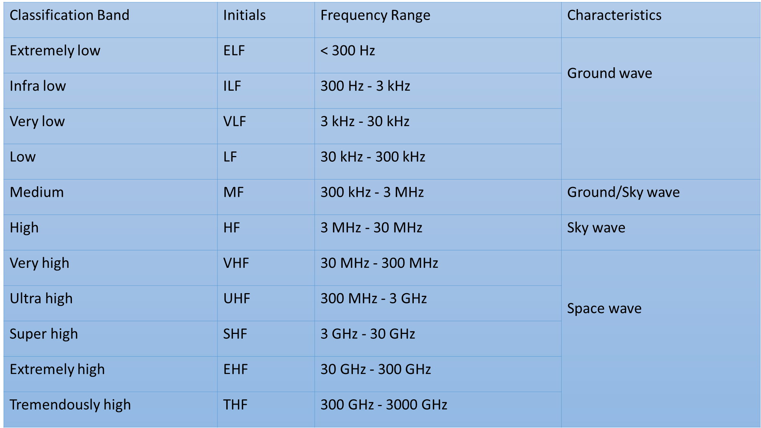

Slide 16
Signal Propagation
Free Space
  Basically, line of sight
  “Ideal” method of communicating
  Space ships, satellites, transmissions in “nothing”
Land
  This annoying planet gets in the way
  Antennas don’t broadcast in a ball

Slide 17
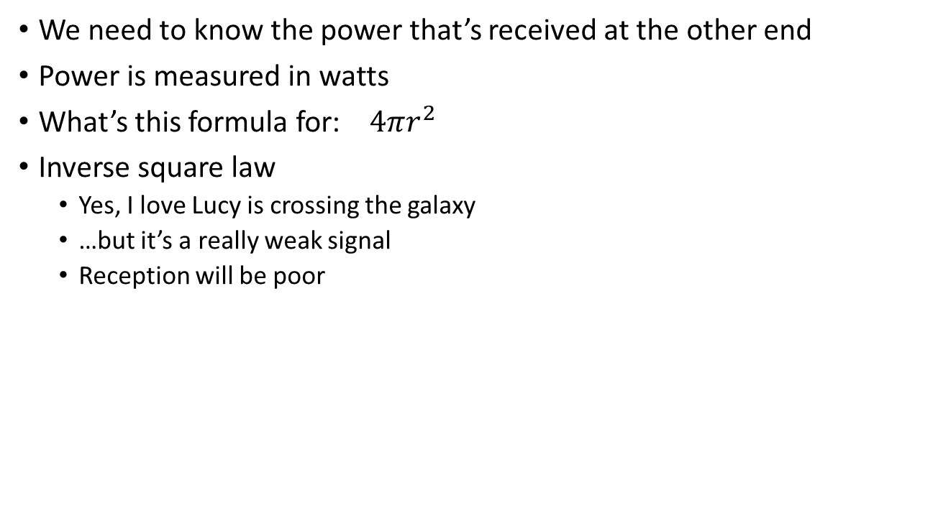
How far can my wave theoretically go?
We need to know the power that’s received at the other end
Power is measured in watts
What’s this formula for: $4πr^{2}$
Inverse square law
  Yes, I love Lucy is crossing the galaxy
  …but it’s a really weak signal
  Reception will be poor

Slide 18
How far can my wave go?
*In an ideal world
P_{r} = Power received
d = distance from the source (radius)
P_{t} = power transmitted
G_{t} = gain of the antenna
A_{e}= area covered by the transmitter

Slide 19
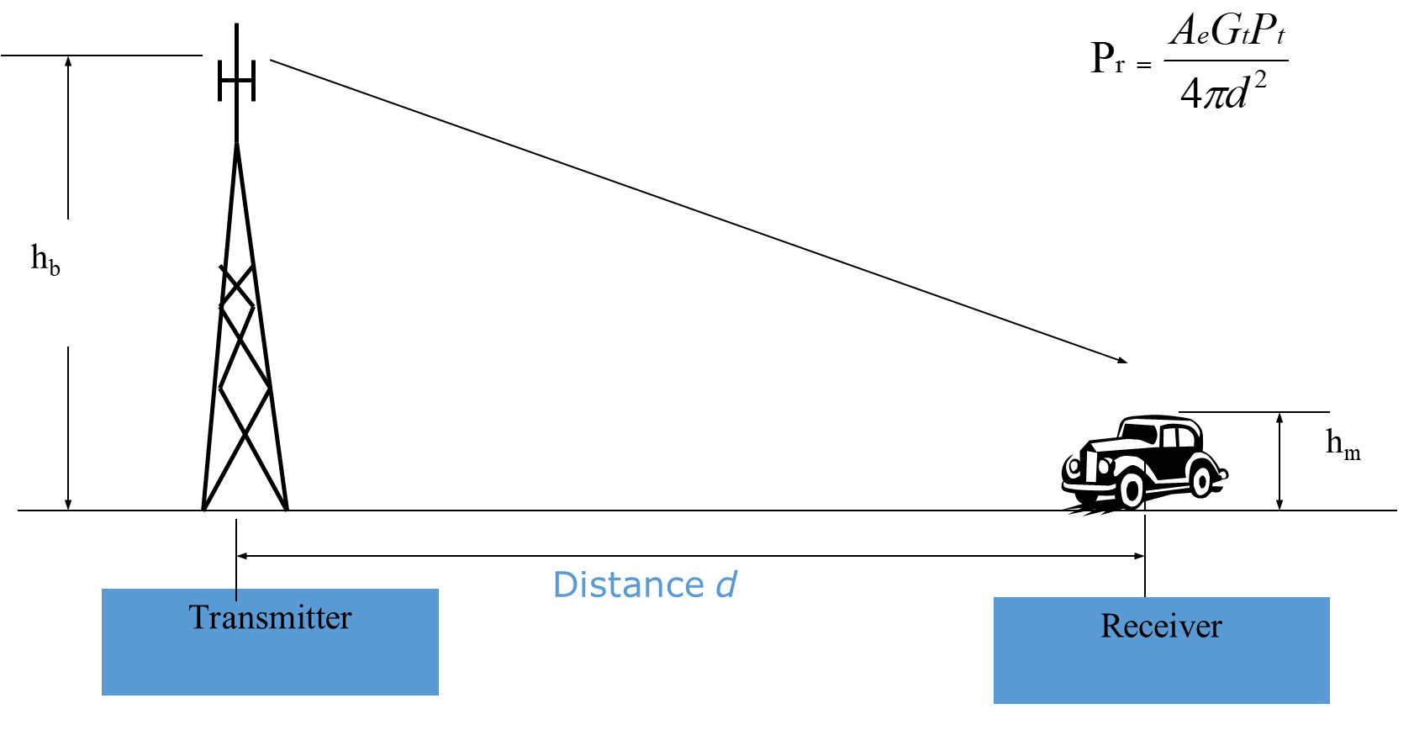

Slide 20
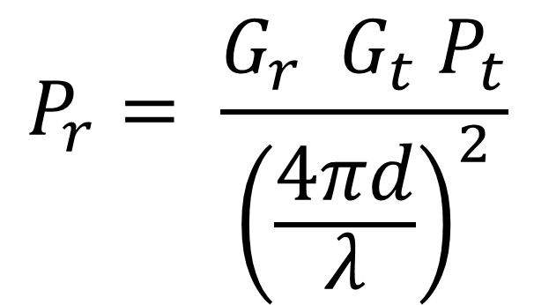
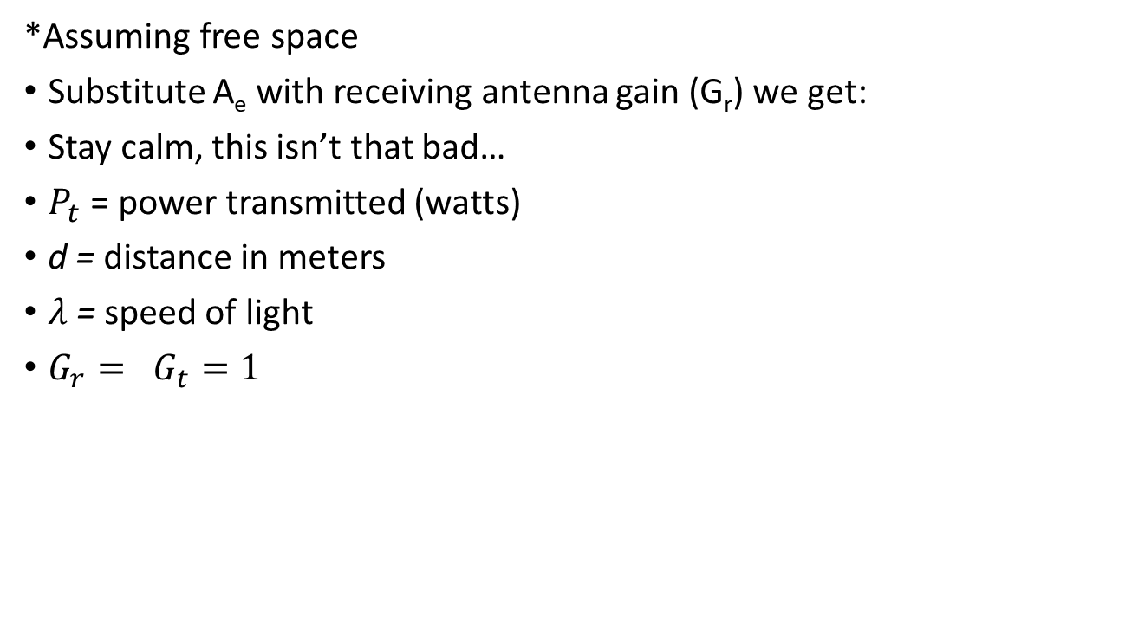
Going Further
*Assuming free space
Substitute A_{e} with receiving antenna gain (G_{r}) we get:
Stay calm, this isn’t that bad…
$P_{t}$ = power transmitted (watts)
d = distance in meters
$λ$ = speed of light
$G_{r}= G_{t}=1$

Slide 21
Propagation
I hope that I have line of sight LoS (or free space)
Reflection
  The radio wave bounces off something larger than the wave
  Like a planet or a building or the atmosphere
Diffraction
  A sharp edge bends the wave
  Edge of a wall
Scattering
  Something smaller than the wave gets in the way
  Like a tree

Slide 22
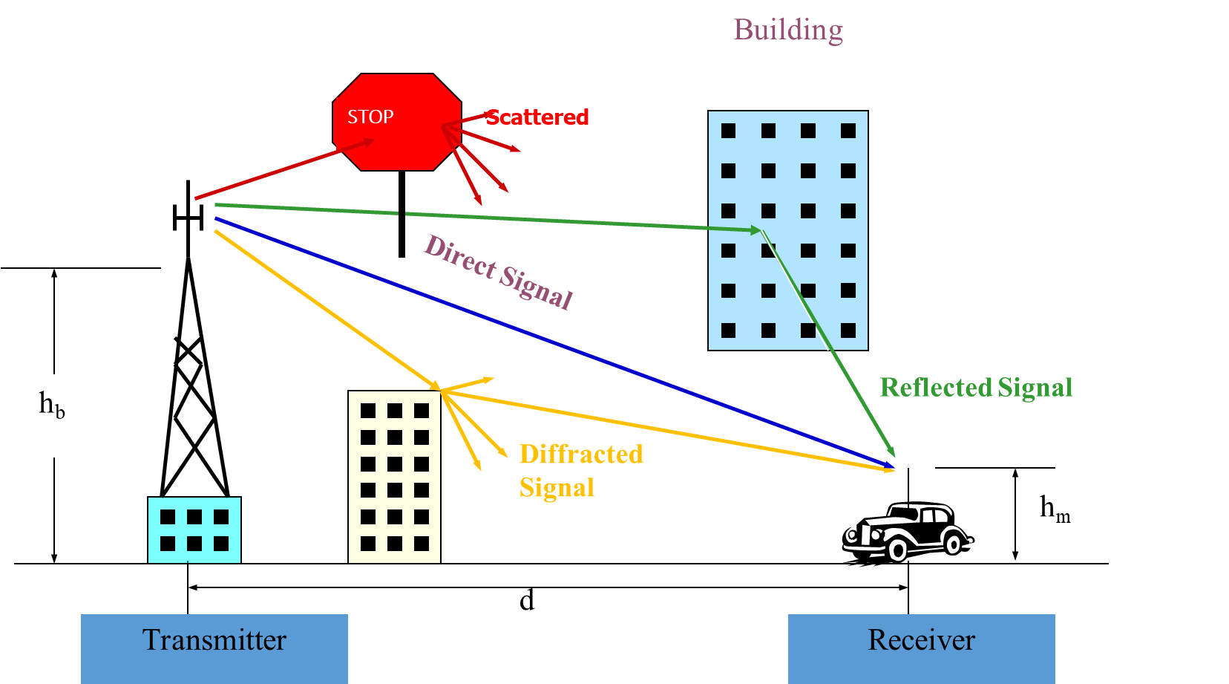

Slide 23
Signal Processing
Hugely important concept
What’s the shortest/fastest distance between two points?
How many copies of a wave do I receive?
What if the signal reflects?
Flightradar24.com

Slide 25
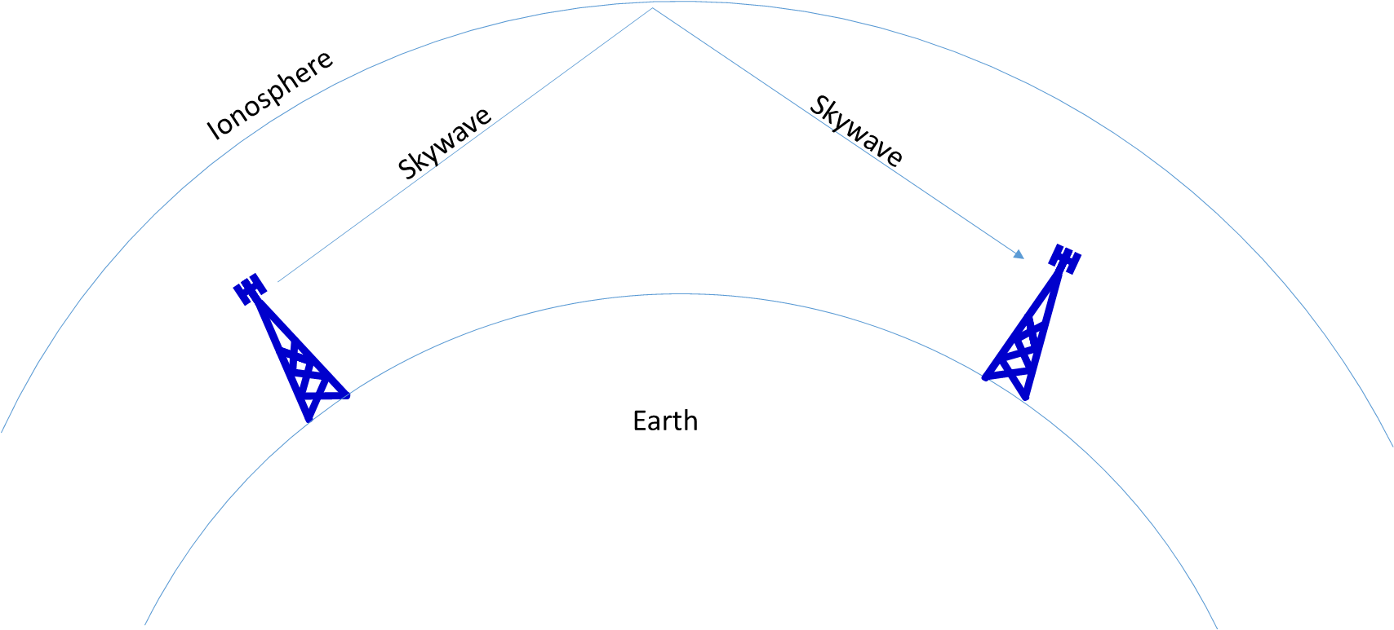
Waves have properties
Skywaves for example, love to reflect

Slide 26
Ride the Waves
How far can you go?
FM vs AM are great examples
  AM: 535-1705kHz
  FM: 88 – 108 MHz
Basically: AM = big waves
      FM = little waves

Slide 27
Ionosphere Reflection
AM Radio waves refract from the ionosphere
FM waves blast right through
Where do they go?
  AM: China
  FM: Mars
FM -> height is key, AM -> not really
Ionosphere is really good at refracting at night
AM
  Reduces power, directional antennas, shutdown

Slide 28
Scales
Small-scale
  Signal variation/fading over a short distance
Large scale
  Signal variation/fading over a long distance
Diffraction & scattering -> small scale
Reflection -> large scale

