Slide 1
Signal Degradation
Unit: 1
Signaling

Slide 2
Review
Waves travel at the speed of?
Based on this we can calculate wavelength
Waves propagate differently
Large wavelengths create skywaves (AM)
Ground waves travel in a straight line (FM)

Slide 3
Objectives
Define common antenna types
Calculate how speed impacts radio waves

Slide 4
Antenna Types
Isotropic
Equal in all directions
Are antennas isotropic?

Slide 5
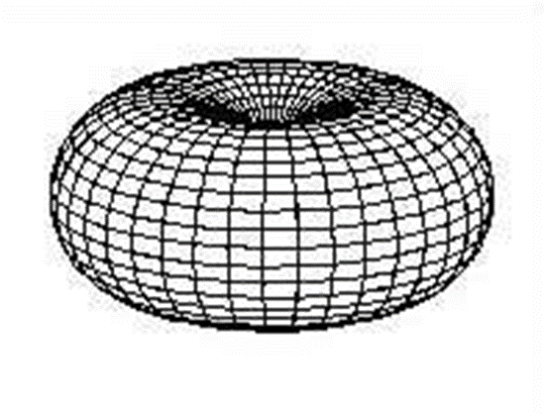
Antennas
Omnidirectional
Waves propagate evenly in all directions
Poor levels directly above/below the plane
Cell phones, FM Radio, wifi (usually)
Di-pole
Directional/point to point

Slide 6
Power Gain (or just gain)
Measurement of antenna’s electrical efficiency
How well do I transfer electrical signal to waves
Or vice versa
Ratio of power to theoretical perfection
Perfection == lossless isotropic antenna
Usually measured in decibels isotropic (dBi)
(Can also be dBd, lossless half-wave dipole antenna)
Dipole antennas are more common
dBd = dBi – 2.15

Slide 7
Our radio transmissions degrade
Path Loss L_{p}
Reduction in “power density” over wide areas
Factors- distance, frequency, land
Slow Fading L_{s}
Small area problems
Building, road, etc
Fast Fading L_{F}
Caused by motion of MS
Things near transmitter, like raindrops

Slide 8
Path Loss
Talked briefly before
Urban areas make signal propagation problematic
Thus, better signal in open areas

Slide 9
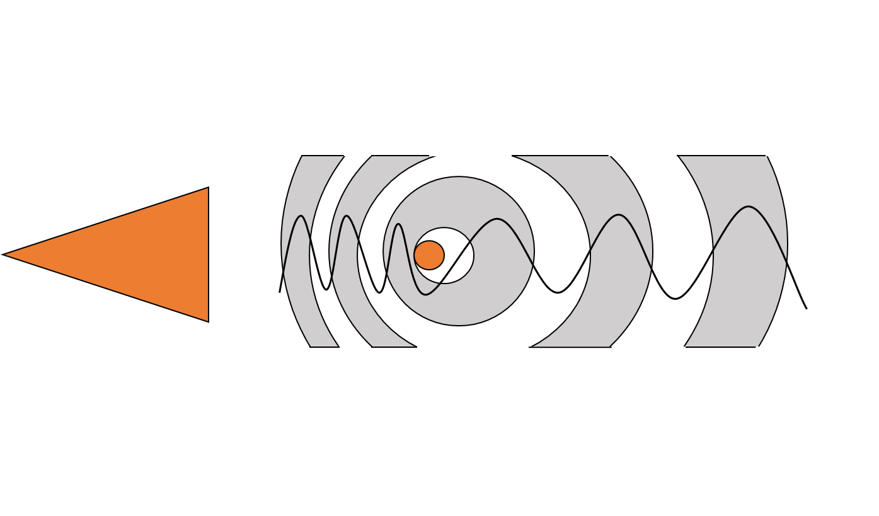
Doppler Effect
If you’re moving, your frequency changes
This is called Doppler shift

Slide 10
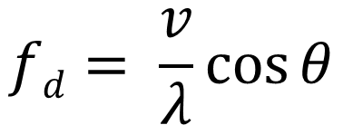
Doppler Shift
If you’re a new-age goat with a cellphone, things get messy
f_{d} = Doppler shift
f_{c} = frequency of source carrier
f_{r} = frequency of received signal
v = velocity (m/s)
$λ$ = carrier wavelength
$θ$ = Radians

Slide 11
Where is the Doppler effect a big deal?
Walking?
Driving?
Driving really fast?
Flying?

Slide 12
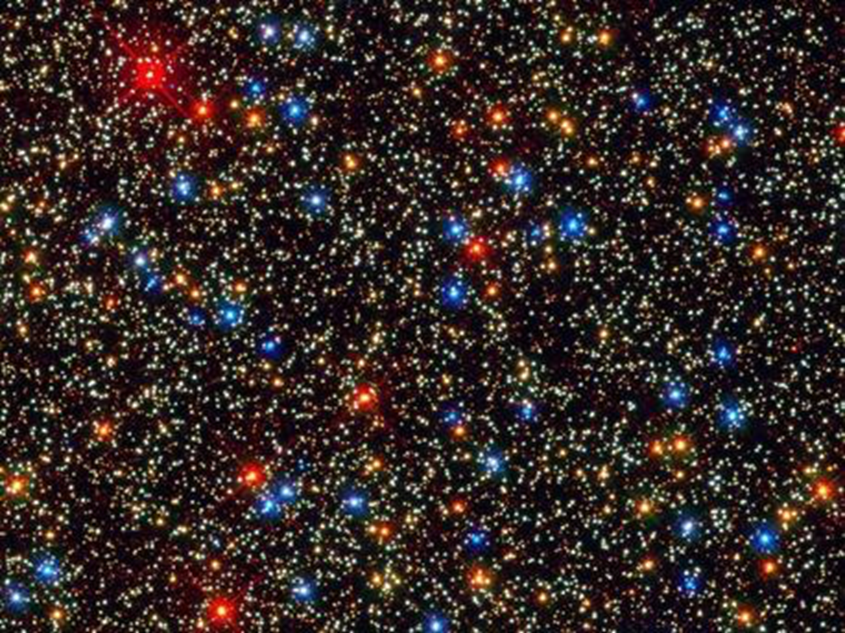
Doppler Shift Impacting Images in Space

Slide 13
What about really fast?
http://io9.gizmodo.com/5786083/what-are-the-fastest-spacecrafts-ever-built
http://descanso.jpl.nasa.gov/DPSummary/Descanso4--Voyager_new.pdf

Slide 14
Spacecraft!
Spacecraft tend to move rather quickly
Their speeds need to be accounted for in signal processing
Redshift vs blueshift?
Visible light exhibits the Doppler effect

Slide 15
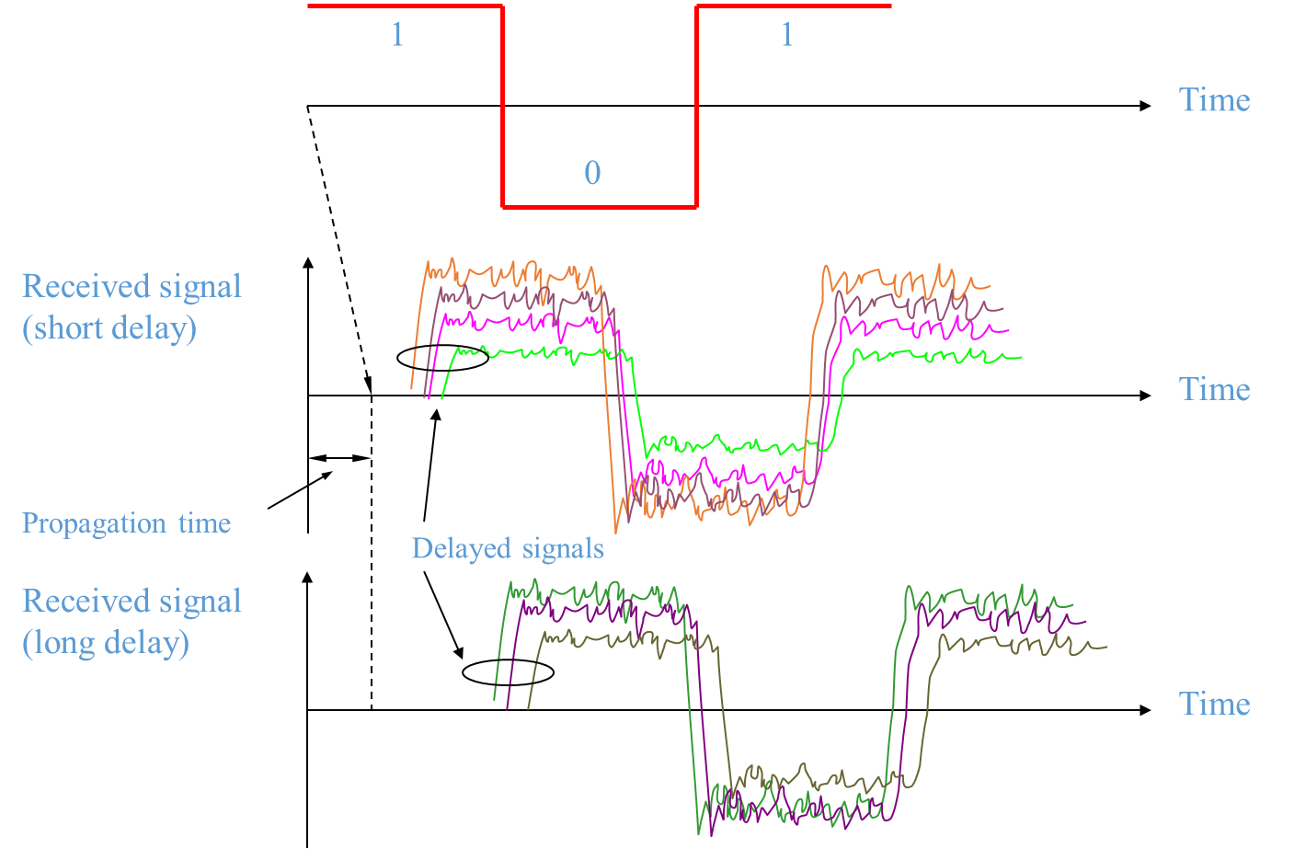
Intersymbol Interference
Radio waves reflect off as they travel
This can cause multiple copies of a wave to be received
Much like an echo
This is called:
Intersymbol Interference

Slide 16
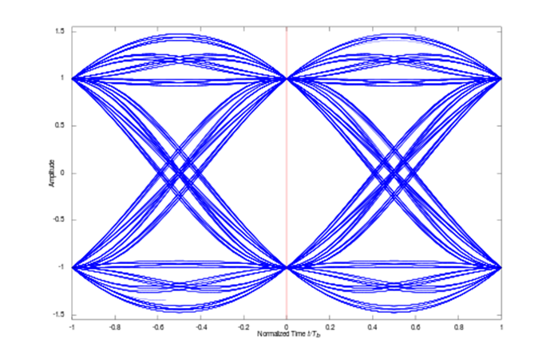
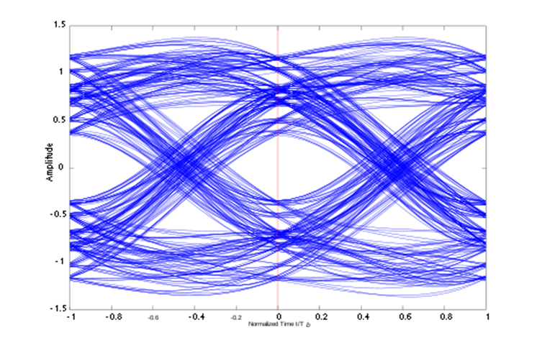
Intersymbol Interference
Problem we run into: the world isn’t flat
People put up buildings
Radio waves bounce off buildings, can’t
take a straight path
Data arrives out of order
Called Intersymbol Interference

