Slide 1
WIRELESS SPECTRUM REGULATION
Module: 2
Lesson: 1

Slide 2
Objectives
Understand what “Wireless Spectrum” is.
Learn who regulates “Wireless Spectrum”.
Discuss why a central regulatory body is necessary.

Slide 3
What is “Wireless Spectrum”?

Slide 4
Understanding Wireless/Radio Spectrum
Wireless Spectrum
More often referred to as Radio Spectrum.
Is the range of radio frequencies (RF) on the electromagnetic spectrum, who’s purpose is to be used for wireless communication.
This typically ranges from the 3kHz band to the 300GHz band.
The process of managing the numerous radio frequencies and its corresponding spectrum is, Spectrum Management.
Notes:
Sources:
https://www.fcc.gov/engineering-technology/policy-and-rules-division/general/radio-spectrum-allocation

Slide 5
Understanding Wireless/Radio Spectrum
Wireless Spectrum
You probably use it everyday!
FM radio in the car (KJAM): 101.3 MHz
Two way walkie talkies: 462 – 467 MHz
Cellular phone (GSM): 850 MHz & 1900MHz
WiFi: 2.4 GHz & 5GHz
Notes:
Sources:
https://www.fcc.gov/engineering-technology/policy-and-rules-division/general/radio-spectrum-allocation

Slide 6
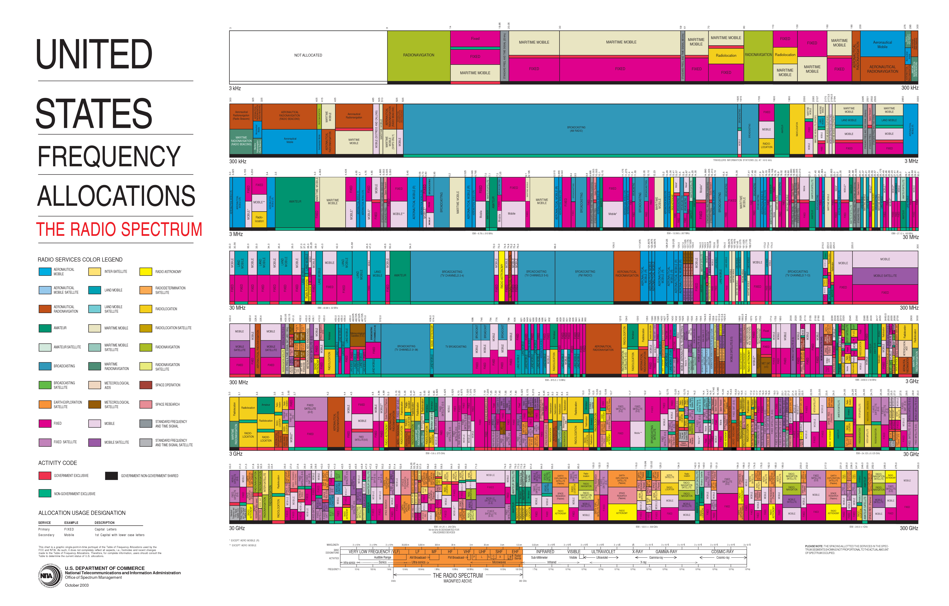
Understanding Wireless/Radio Spectrum
Wireless Spectrum
Notes:
Sources:
https://www.ntia.doc.gov/files/ntia/publications/january_2016_spectrum_wall_chart.pdf

Slide 7
Who’s responsible for Spectrum Management in the U.S.?

Slide 8
Regulation of Wireless Spectrum
FCC
Federal Communications Commission
Is the regulatory body for administering wireless spectrum to non Federal entities such as; individuals, businesses, state and local governments.
NTIA
National Telecommunications and Information Administration
Is the regulatory body for administering wireless spectrum to Federal entities such as; Military, FBI, and even the White House.
Notes:
Sources:
https://www.fcc.gov/engineering-technology/policy-and-rules-division/general/radio-spectrum-allocation
https://www.ntia.doc.gov/category/spectrum-management

Slide 9
Why do we need regulation?

Slide 10
Regulation of Wireless Spectrum
FCC
Wireless Spectrum is a shared finite space that exists within nature, and is not physically owned.
Since everyone wants a fair slice of it, it is necessary to have a non bias central regulatory body tasked with both allocating and policing the limited spectrum.
The FCC ensures that all of the spectrum is being used efficiently, and that participants follow the same rules and protocols to keep everything cohesive.
Notes:
Sources:
https://www.fcc.gov/engineering-technology/policy-and-rules-division/general/radio-spectrum-allocation

Slide 11
Regulation of Wireless Spectrum
Licensed
The FCC requires that in order to utilize certain spectrum, a user must attain a license and pay a supporting fee.
This is to keep those who aren’t trained and don’t have permission to access the spectrum away.
Unlicensed
The FCC maintains a specified amount of unlicensed spectrum that a user may use. This is for many reasons including personal devices like wireless access points / routers, and cordless phones. These fall into the ISM category or Industry, Scientific, and Medical.
Notes:
Sources:
https://www.fcc.gov/engineering-technology/policy-and-rules-division/general/radio-spectrum-allocation

Slide 12
Regulation of Wireless Spectrum
Examples
The FCC ensures that specified spectrum for emergency and law enforcement radio communications are not hindered and being used by unauthorized personal. Allowing us to stay safe.
Ensures that all HAM radio operators use proper etiquette to create a useable and understanding space for all.
Ensures companies comply with wireless safety standards in home electronics, protecting us.
Notes:
Sources:
https://www.fcc.gov/engineering-technology/policy-and-rules-division/general/radio-spectrum-allocation

Slide 13
Conclusion
We now understand what “Wireless Spectrum” is.
We know who regulates “Wireless Spectrum”.
And understand why a central regulatory body is necessary.

