Slide 1
We all need to talk
Unit: 4
Signaling

Slide 2
Recap
Cells are the radius covered by a BS
Size vs capacity is important
Spectrum -> frequencies used to carry data
Bandwidth -> range of frequencies used
FM radio, example, 200kHz band
Bandwidth can carry the same amount of data
No matter its frequency
The protocol’s efficiency makes a difference
FCC regulates spectrum, etc.

Slide 3
Objectives
Identify various methods of allowing multiple devices to communicate simultaneously
Define TDMA, FDMA, SDMA, and CDMA
Discuss strengths and weaknesses of each multi-access mechanism

Slide 4
New Issue:
So we separate stuff out, that’s great…
We have lots of cell phones
How can we all use them at the same time?
Consider a walky-talky:
Can you carry on multiple conversations at once?
Enter the need: multiplexing
Let’s us carry multiple signals over a single shared medium
Can be a cable or a radio wave

Slide 5
Multiplexing: FDMA
And oldie but a goodie!!
Frequency Division Multiple Access
Basically: divide up our frequency into small pieces for each user
These are called channels
Pros: easy and works great!
Cons: Crosstalk
1st Generation technology
Original analog cell phones

Slide 6
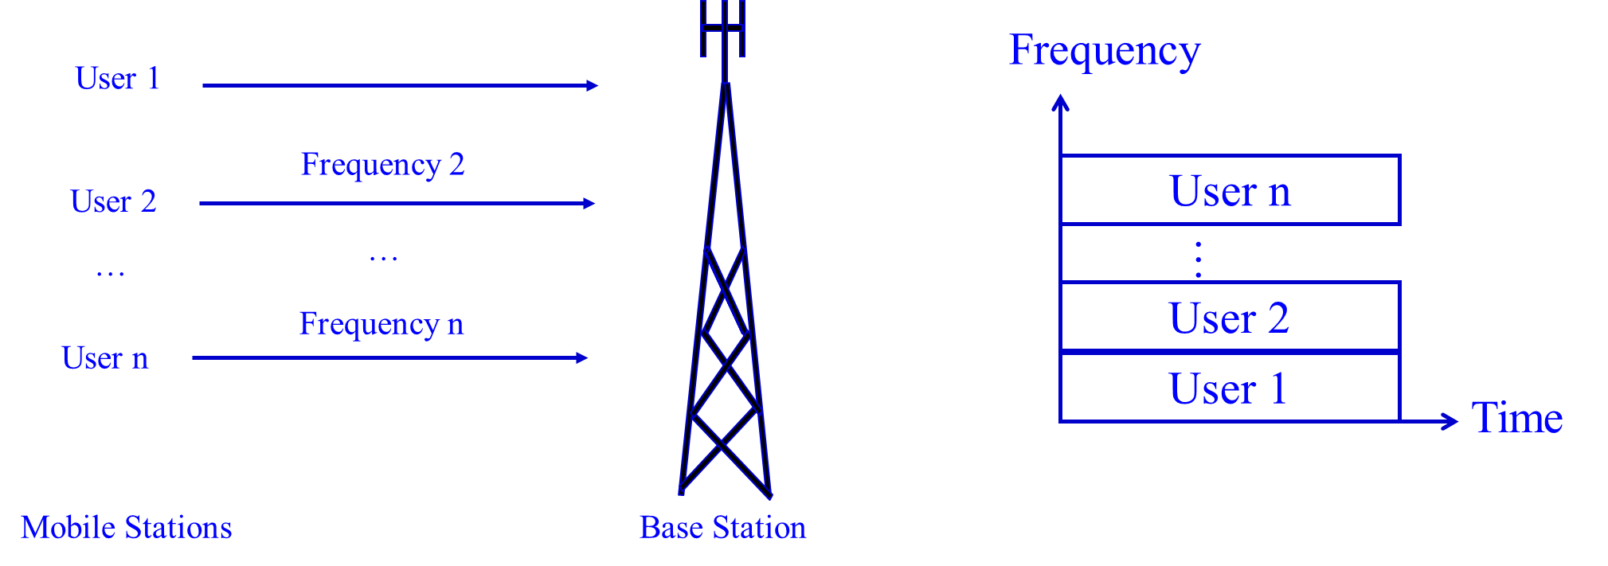

Slide 7
Multiplexing: TDMA
FDMA sucks… One user can hog the signal
Solution: put them on a timer!
Time Division Multiple Access
2G technology here
Essentially: digital voice
Examples: GSM
Used a lot in satellites
Sync Overhead
Collisions

Slide 8
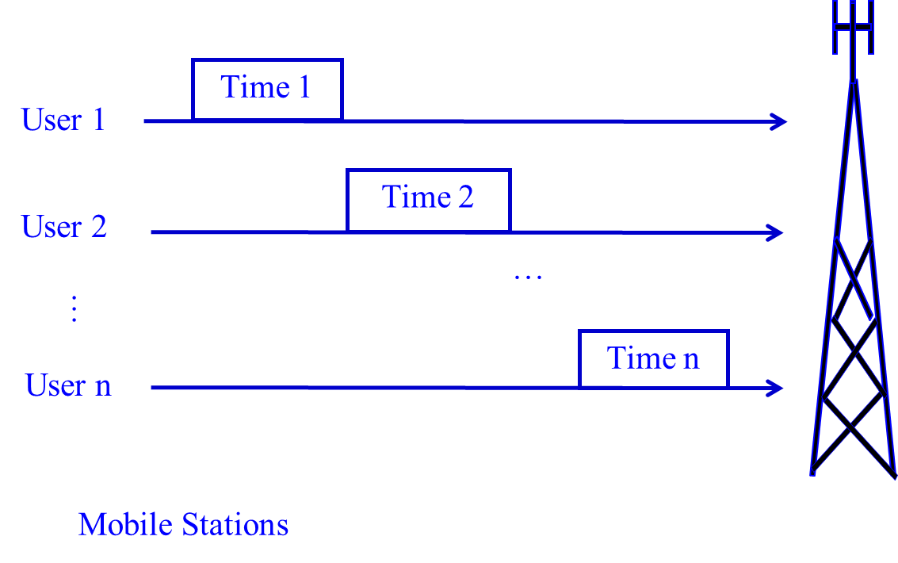

Slide 9
CDMA- Sound Familiar?
Code Division Multiple Access
Mix a not-so-secret code in for each user
Encodes raw data with code
Transmits, removes code at other end
Uses a wider frequency
Now we’re talking 3G technology
Scalability
Limited by the number of codes you can come up with
How fast can you code/decode your data
Near/Far

Slide 10
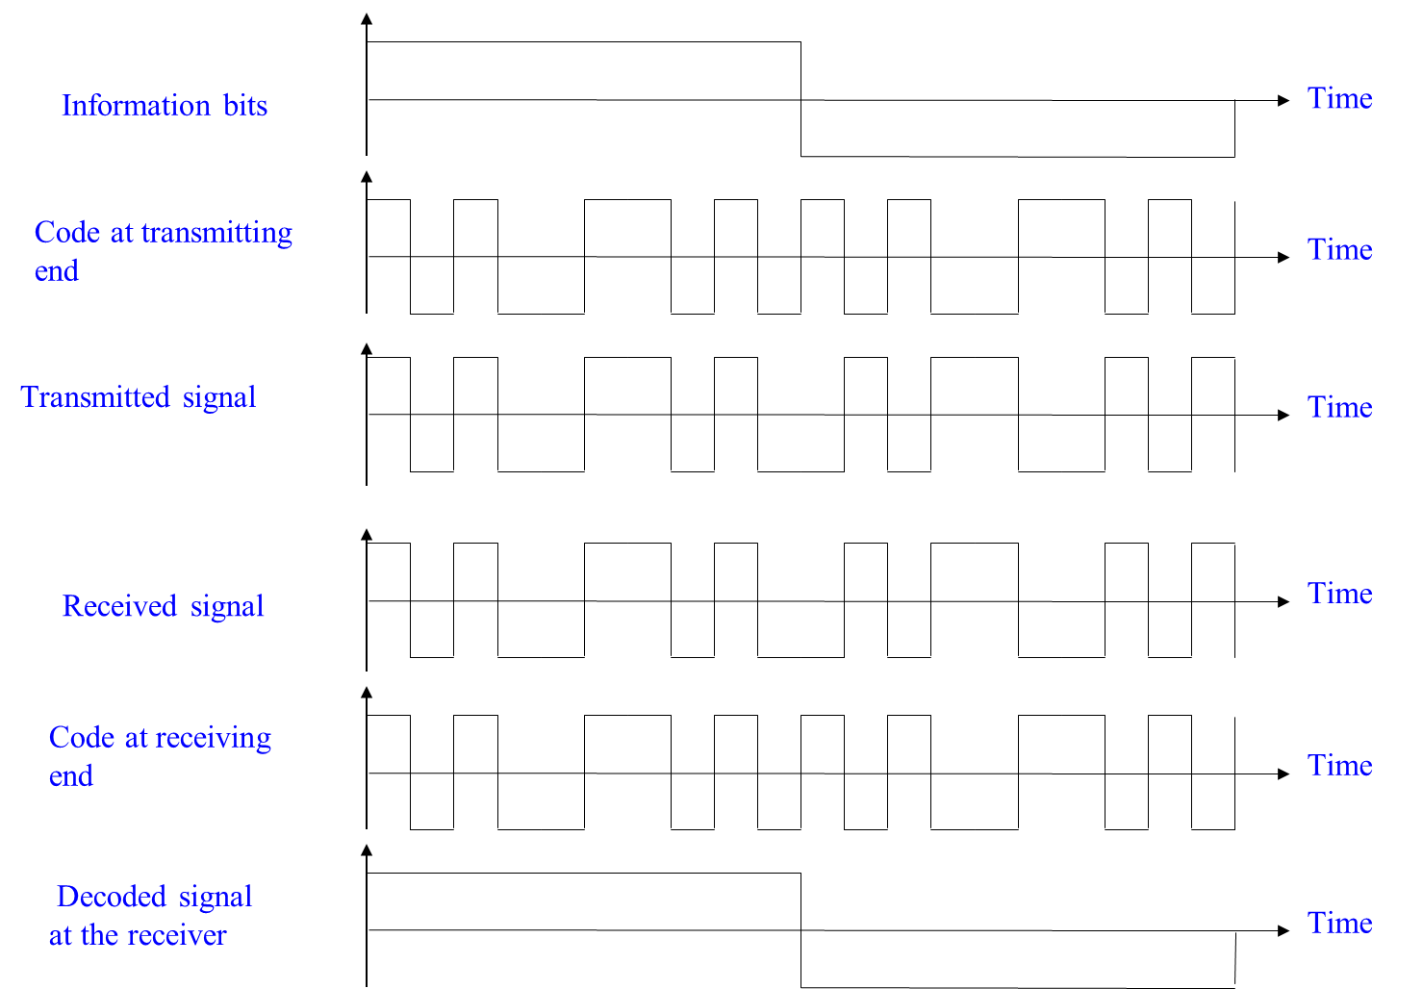

Slide 11
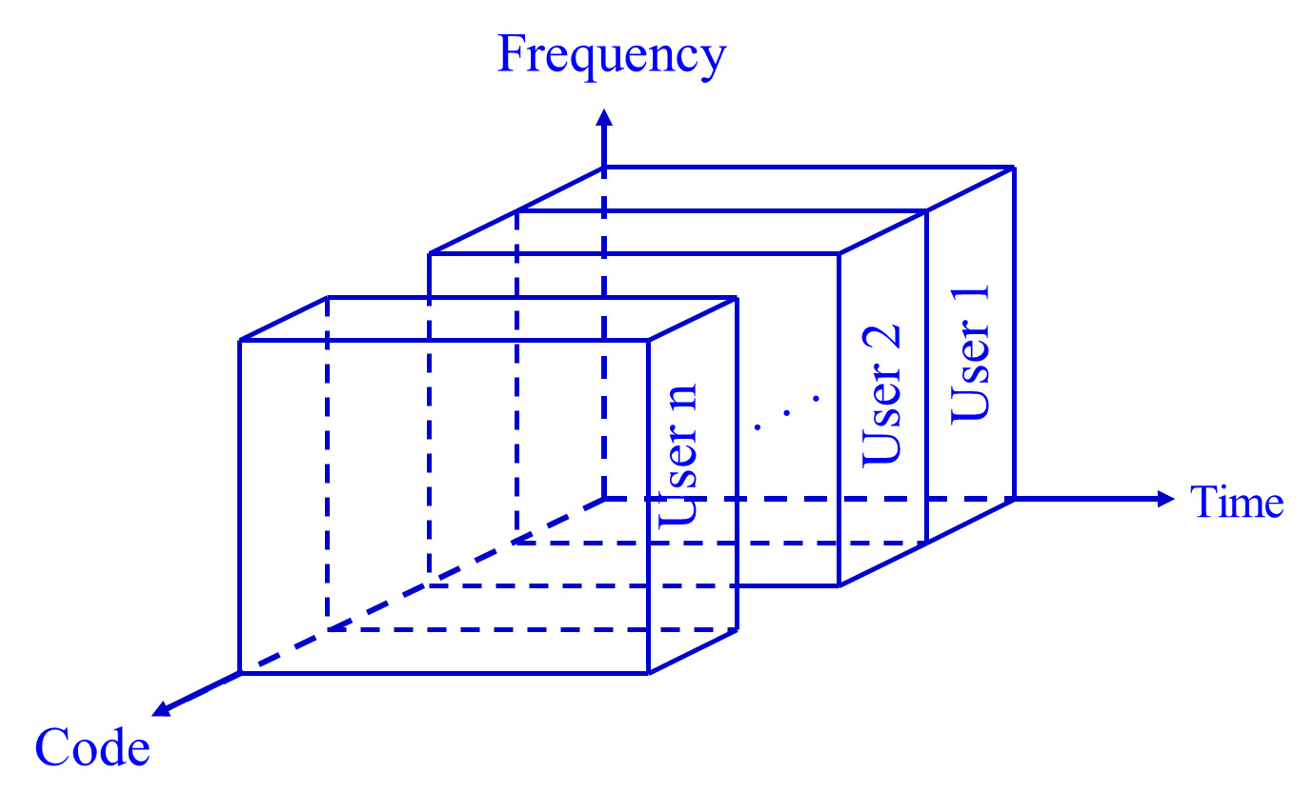

Slide 12
Space Division Multiple Access
I’m pointing my signal at YOU
And only you…
Basically, directional antennas on BS and MS
Can reuse channels
No interference
High quality signal
Problems
Tech is fairly new
How many antennas can you hang from a tower?

Slide 13
Beam 1
Beam 2
Beam 3
MS₂
BS
MS₃
MS₁

Slide 14
Big Advantages of each:
FDMA
Really easy
TDMA
Flexible growth
CDMA
Nearly unlimited growth?
SDMA
Infinite capacity, pair with CDMA for extra goodness

Slide 15
Problems
FDMA
Wastes spectrum, guard bands, no changing frequencies
TDMA
Needs guard space + time sync issues
CDMA
Requires signal processing + power levels
SDMA
Mobile clients are tough to handle

Slide 16
Where do we use them?
FDMA
Radio & TV
TDMA
Mostly GSM, 2G & 3G
CDMA
2.5 and 3G Communications
OFDM
The 4G’s
SDMA
Satellites

