Slide 1
Sinusodes
Unit: 3
Modulations

Slide 2
Objectives
Define what modulation is.
Compare signal modulation to common applications, such as an aircraft marshal
Explore how AM and FM actually delivers signals

Slide 3
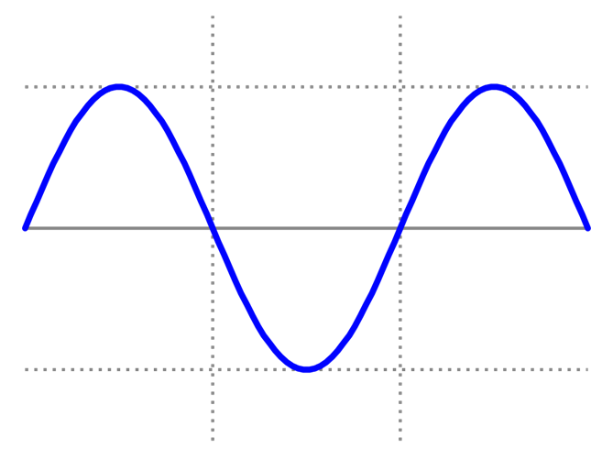
The Sine Wave
Mathematical curve
Describes a constant oscillation
“Sinusoidal”
Used in tons of stuff, math, chemistry, physics
And radios!
Through math, we can change properties of the wave
Amplitude
Frequency
Phase

Slide 4
How much data does the marshal send?
All they have are two sticks, but how many types of messages can they send?

Slide 5
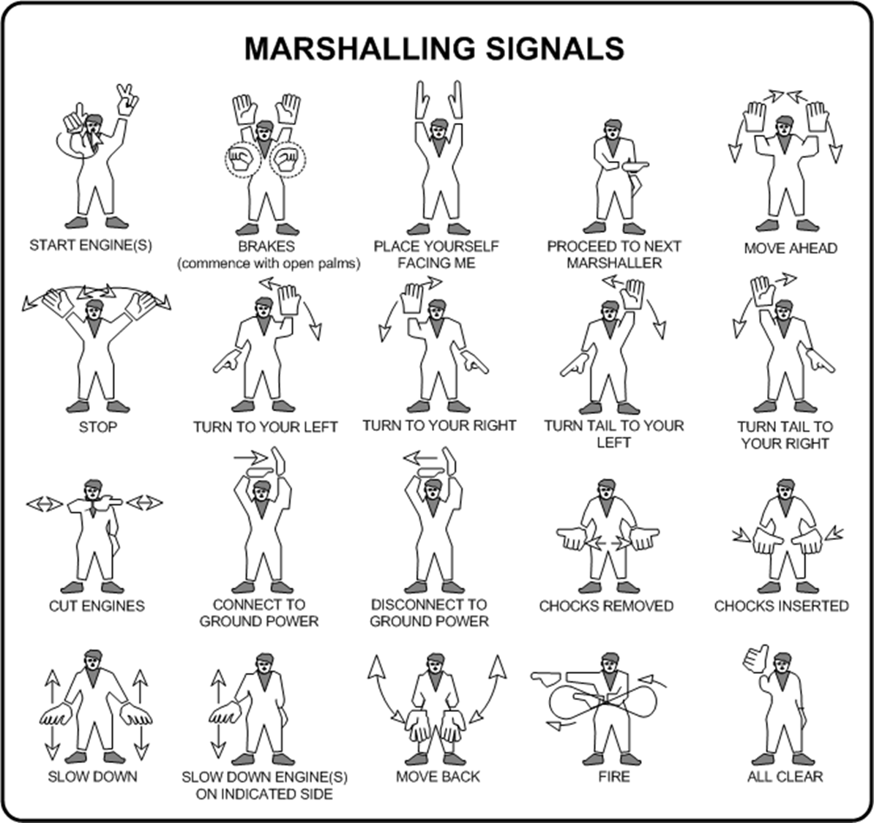

Slide 6
GNU Radio
We’ve made a sine wave before
Question: Does a basic sinusoid carry data?

Slide 7
Signals are tricky
We have to modify the wave to transmit data
The base wave is a carrier wave
We need to maintain a oscillation
What does the oscillation of a wave tell us?

Slide 8
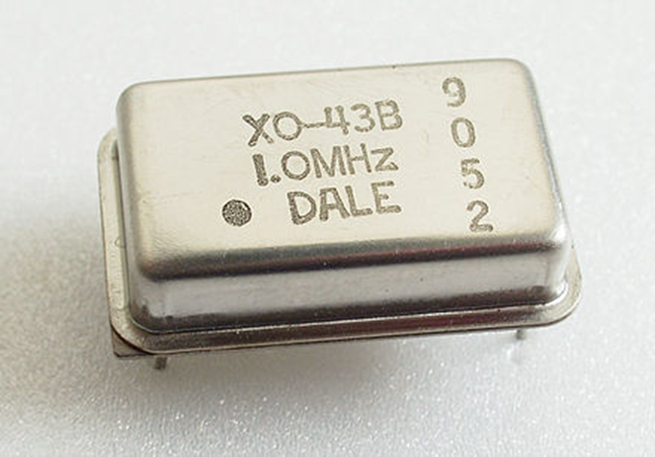
Oscillation = frequency
Cuts out the other stuff
Hardware: enter an oscillator!
Fun computer parts!
Circuit that creates a wave
Also can convert DC to AC power
Can also make noise
Below 20 Hz, audio synthesizer
16 Hz to 20 kHz- what we hear
RF Oscillator- 100 kHz to 100gHz

Slide 9
What do you do here?
Listens for (or produces) specific math
Once we have the wave, we decode its data
But again, how did we get it there?
We modulate the wave in some way

Slide 10
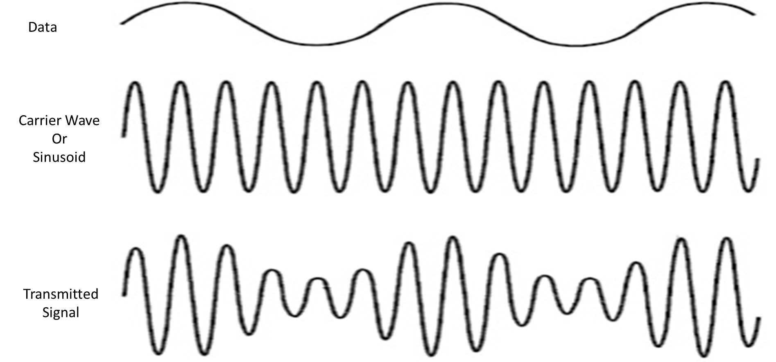
1st Method: Amplitude

Slide 11
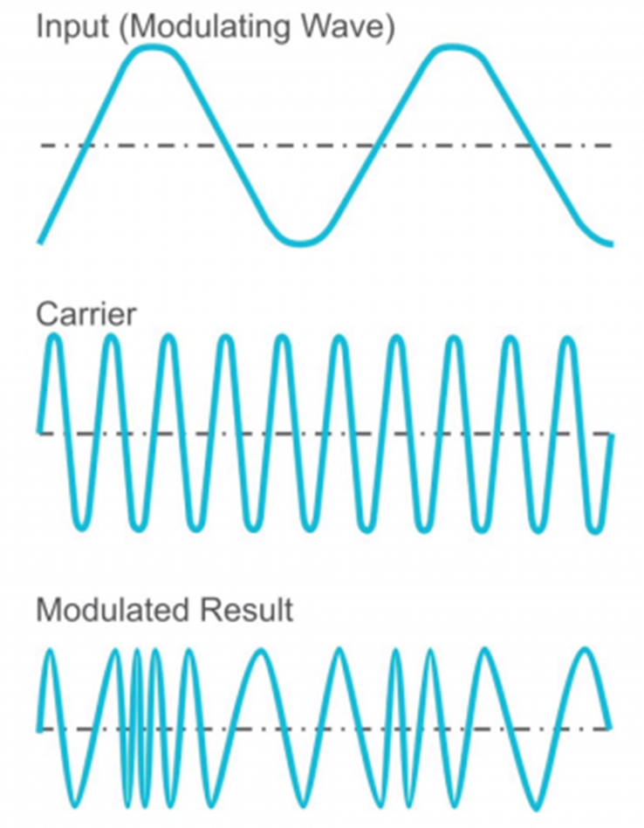
2nd Method- Frequency!

Slide 12
So, AM vs FM? Yep!
Amplitude Modulation
Usually limited to 50 kilowatts
Actually changes strength to work
Long Range
Can get lost of low amplitude signal
Only 10 kHz
More interference
AM occurs naturally, from our sun
Frequency Modulation
Usually up to 100
Short Range
More bandwidth! 200 kHz

Slide 13
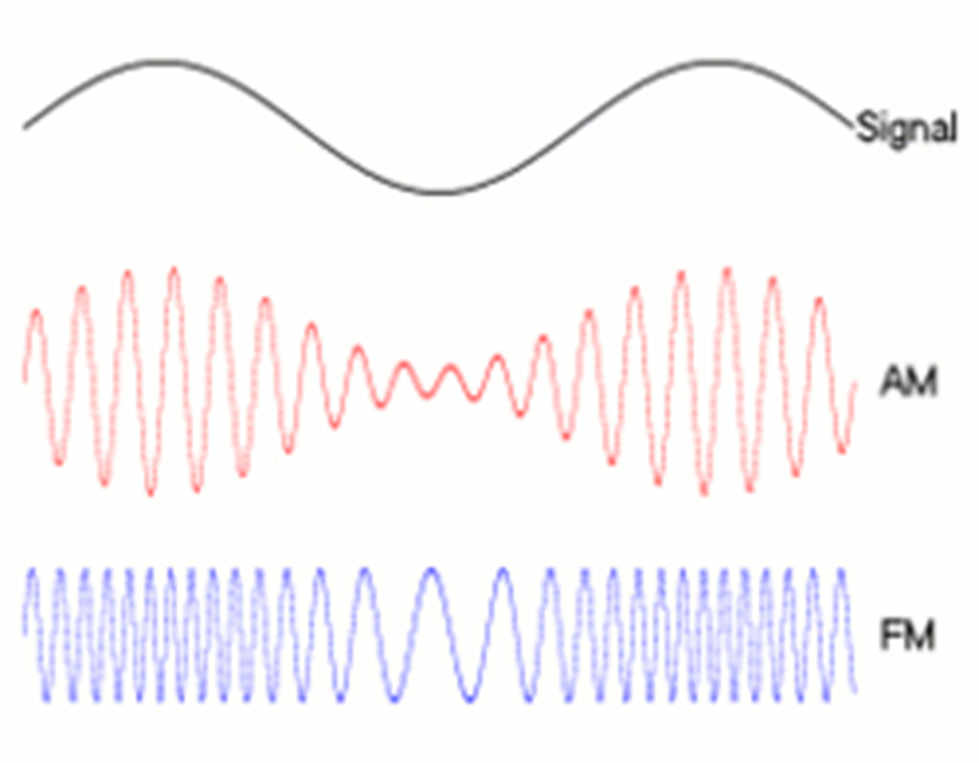

Slide 14
So…
Who does Doppler shift bother more?
Who is more susceptible to interference?
Who is cheaper/easier to build? (generally)

