Slide 1
Cellphone Stuff!
Unit: 0
Intro

Slide 2
Where are we going?
Working towards a working BTS
Base Transceiver Station
Start out small, work our way up to it
Primarily GSM stuff
Zero CDMA (Like Verizon and Sprint)
GSM- Global System for Mobile

Slide 3
What will we have?
OpenBTS- software implementation of cell infrastructure
Most of The Big Guys have really complicated infrastructure
OpenBTS tries to standardize it as much as possible
Talk the talk?
We’ll have a 2G network
GSM
Voice and SMS
OpenBTS can also do “2.5G”
GPRS Data
Tough to do in a VM

Slide 4
ARFCN
Absolute Radio-Frequency Channel Number
How is cellular spectrum actually divided up?
Kind of like 802.11 -> they overlap
Each cellular band is divided up
Don’t want to overlap
Licensed by FCC

Slide 5
Duplex Communication
Up/Down at the same time: FDMA
Multiple phones -> TDMA
We need two different frequencies!
And technically, licenses for each

Slide 6
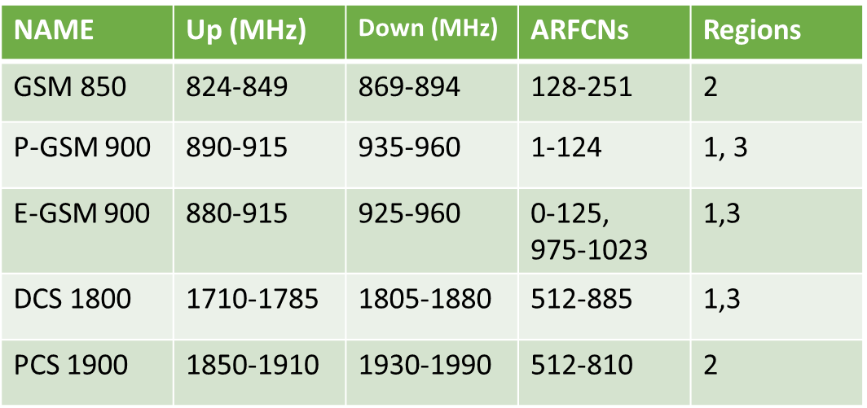
Frequency Bands
Three primary regions
1 Europe and Africa
2 Americas
3 Asia
Quad Band Handsets?
”World Phones”
Support 850, 900, 1800, 1900 mHz

Slide 7
ARFCN’s
Adjacent ARFCN’s overlap frequencies
Each band (channel) is 270.833kHz of bandwidth
Each pair has fixed up/down link frequencies

Slide 8
What ARFCN are you using?
iOS, dial: *3001 # 12345 # *
Android dial *#0011#

