Slide 1
Cellphone Stuff!
Unit: 1
GSM

Slide 2
Review
What are the units of cellular RF divided up into?
Frequency bands
What frequencies do cellular devices tend to live on?
850 MHz - US

Slide 3
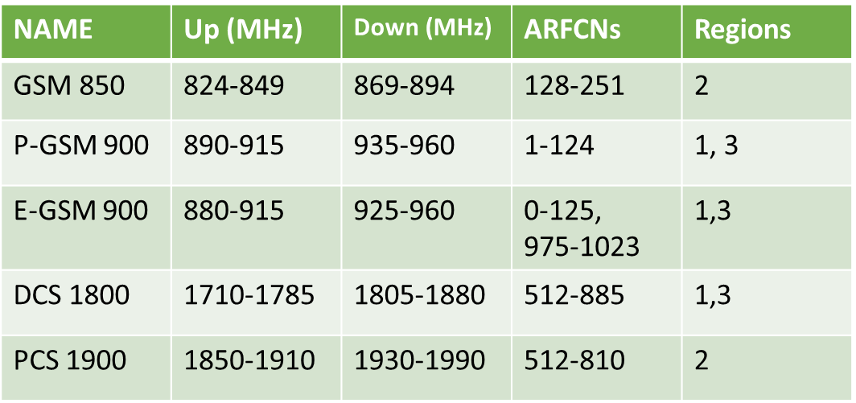
Frequency Bands
Three primary regions
1 Europe and Africa
2 Americas
3 Asia
Quad Band Handsets?
”World Phones”
Support 850, 900, 1800, 1900 MHz

Slide 4
Data Loss
We usually lose around 3% of voice data
5-7% isn’t too bad
10% <- sounds funny
SMS solves many problems for us!
Why??
It’s just text

Slide 5
Short Message Service (SMS)
GSM allows SMS messages to use unused bandwidth.
Tough to max out system capacity
Around 1800 messages per ARFCN per minute
SMS doesn’t care about data loss so much
Retransmission!

Slide 6
What’s inside GSM
Essentially an OSI Model…
Only 3 layers of fun
L3- communication Management Layer
L2- Data Link Layer
L1- Physical Layer

Slide 7
Layer 1: Timing is Everything
We’re using 8-way TDMA
Time slots are actually called ‘physical channels’
How many “full-rate” calls can we handle over 8 physical channels?
Question: How much voice data do you lose?
What would half-rate do for us?

Slide 8
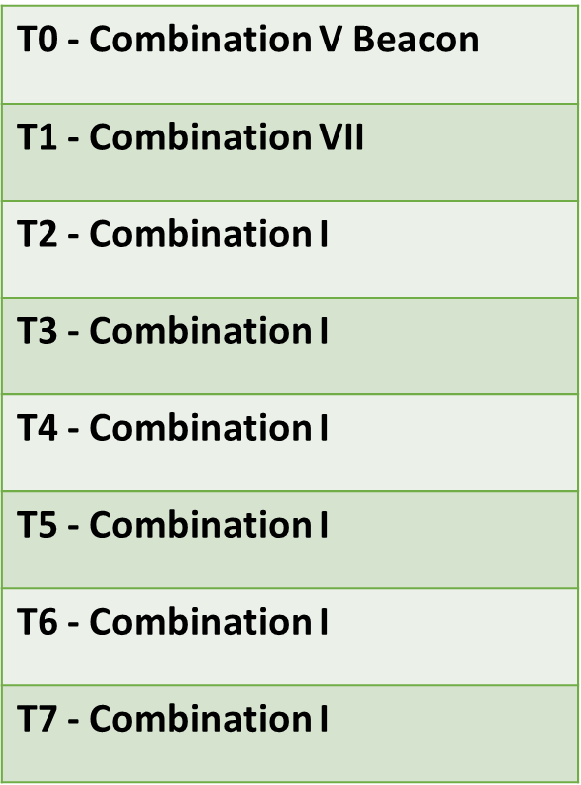
Physical Channels
What can we do on a channel?
Remember: T0 through T7 = 8 channels
Restricted to certain things… called Combinations
Combination V: The Beacon
Reserved and always sent at T0
Combination I: full rate traffic
Used for voice or GPRS (slow data)
Combination VII: SMS
(and management sort of stuff)

Slide 9
Combinations: The Breakdown
Combinations are broken down into “logical channels”
Logical vs Physical channel?
Physical channel = single time slot
Logical Channel = data carried in physical channel
It takes about 4.62ms to send a burst on all 8 physical channels
Every physical channel is divided into 50 burst periods
What’s a burst?
Lasts for about 15/26 ms

Slide 10
Bursts
Basically raw packets, sort of
Fast flying, remember: 1 burst every 576.9μs
Contain 148 bits
Only 57 bits of actual data b/c of encoding
What exists here?
2X 8.25 bits of guard band (kind of)
2X 3 tail bits (used for your encoder to sync up, basically)
2X 1 bit stealing flags (indicators of a FACCH… this comes later)
26 bits of training sequence
8 different nuber combos, keeps our BTS identified seperate from others
Also helps estimate problems, time delays, jitter, ISL

Slide 11
That’s enough burst talk
That’s as “deep” as we’ll go into a GSM packet
Which… is pretty deep actually...
Fun fact, with the guard bands, the margin of timing error is about:
31μs (.031ms)

Slide 12
Things are tricky
Some data is too big for a burst
They become interleaved over multiple burst periods

Slide 13
Logical Channels
We’ve gone down to the burst…
Let’s go up a bit
Still living at L1 of GSM

Slide 14
Identity is important
Your MS needs to know it’s locking onto the right BTS
Some things are unique to T0 & Combination V
FCCH: Frequency Correction Channel
Transmit all zeros!
Makes a solid tone when demodulated
MS uses this to lock on its oscillator
SCH: Synchronization Control Channel
Tells us where we are in this whole timing mess
Eg: T0 C1
BCCH: Broadcast Control Channel
Important info! Cell identity, how to access it, what ARFCNs to use, how to register, and:
Do you take emergency calls?

