Slide 1
Identifying a Network
Unit: 2
Networking

Slide 2
Review
What does your phone spend life doing?
RACH- Random Access Channel
What problems can occur with randomly sending data?
Does everything we talk about only apply to GSM?

Slide 3
How to pick your network!
Task at hand:
You’ve picked up a BCCH
It’s full of information
Now what?

Slide 4
Identity Stuff: MCC
Mobile Country Code
3 digit number assigned by ITU
International Telecommunication Union
Actually multiple parts
USA -> 310 primarily
A few things on 311
A couple on 316
Test -> 001
!!!This is different from E.164 (Phone numbers)
0- Test Networks
2- Europe
3- North America
4- Asia & Middle East
5- Oceania
6- Africa
7- South & Central America
9- Other stuff

Slide 5
Identity Stuff: MNC
Mobile Network Code
2 or 3 digits
Assigned by national regulator
01 -> Test Networks
Weirdness:
The US uses 3 digit MNC’s
The rest of the world uses 2 digits
Therefore: International US MNC’s end with 0 (roaming)
The US has 7 MCC’s
Potential for 7 duplicate MNC’s in the US

Slide 6
Examples
United States, 310
150, 170, 560 AT&T + more
026, 260, 580 T-Mobile
Verizon has like 40
Lookup your network IDs:
mcc-mnc.com
Some CDMA networks don’t use MCC/MNC’s

Slide 7
LAC
Location Area Codes
16 bits of goodness (0xFFxx are “reserved”)
Number to ID the paging area of the BTS
Whenever your MS moves, it updates its LAC
Aka: hands off to another BTS

Slide 8
CI
Cell ID
16 more bits of fun!
Unique for every BTS in the network

Slide 9
More fun! BSIC
Base Station Identity Code
6 bits, broken into two pieces
NCC- Network Color Code
Unique for each network
Values of 0 to 7
Assigned by a regulator of some sort
BCC- Base Station Color Code
Unique to adjacent BTS
This is really just important for folks using the same ARFCN

Slide 10
Where do we find MCC + MNCs?

Slide 11
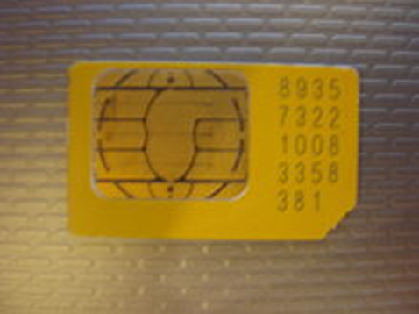
SIM Cards!
Subscriber Identity Module
Circuit that stores many things!
For now, it stores an IMSI
International Mobile Subscriber Identity
14-15 digit number that ID’s the subscriber
Basically, your username

Slide 12
IMSI
They’re a big deal
You don’t want to disclose your IMSI
You can’t <usually> “look up” your IMSI
Made up of: MCC + MNC + MSIN
MSIN: Mobile Subscription Identification Number
So:
310150123456789 would be: 310 150 123456789
MCC MNC MSIN
You don’t want others to know your IMSI…

Slide 13
GSM’s Fix
You don’t want others to know your IMSI…
So, you usually use a TMSI
Temporary Mobile Subscriber Identity
32 bit number to ID you on the network
Helps you to be sort of anonymous <- LOL

Slide 14
Other ID’s: IMEI
International Mobile Equipment Identity
15 digit that ID’s the handset
Sort of a MAC address
GSM doesn’t really use IMEI’s
Except for theft
CDMA uses a similar thing: MEID, Mobile Equipment Identifier
You may also see ESN
We’re getting rid of these, not big enough

Slide 15
Last One: MSISDN
Mobile Subscriber Integrated Services Digital Number
Any idea what this is?

Slide 16
MSISDN
It’s the handset’s phone number! (per E.164)
Fun Fact:
Handsets are mostly unaware of their MSISDN
MSISDN to IMSI association is only on the network/BTS
Note: MSISDN to IMSI… Not TMSIS!
Never: MSISDN to IMEI

