Slide 1
WiFi
Unit: 5
Wireless

Slide 2
Review
802.11
Section of IEEE standards document
Uses ISM bands (industrial scientific medical)
Common: B, A, G, N, AC
Adaptive Rate Selection
What does it do?
Why?

Slide 3
802.11 ABC’s
A, B, and G
Very closely related
B -> baseline technology
A -> frequency + new tech
G -> hybrid
N, AC
New age tech

Slide 4
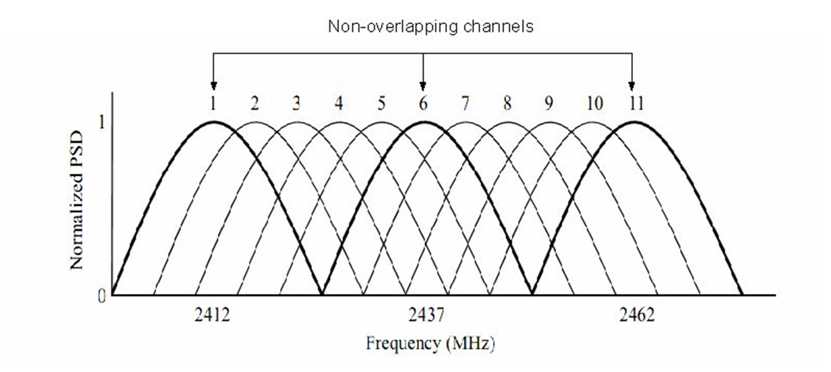
Channel Diagram

Slide 5
Wireless Spectrum
9-100 Khz- Aircraft, ship navigation
100Khz-1Mhz: AM Radio
Around 10 Mhz: Shortwave Radio
Around 100 Mhz: FM Radio
Between FM and 1Ghz: TV
1Ghz: Cell Phones
10 Ghz + WiMax and Satellite

Slide 6
WiFi Components
Hardware makes a difference
Chipset
Vendor
Antenna

Slide 7
Chipset
Tons of options
Generally -> strength vs power use
Most physical network adapters
Realtek and Intel
Intel makes a lot of chips <- this makes sense
Ralink makes them too
Power/signal/other factors
Features!

Slide 8
802.11 Adapter Modes
Requires hardware and OS support
Various potential modes
Access Point (ExtAP)
Station (ExtSTA)
Network Monitor (NetMon)
Ad Hoc

Slide 9
Alfa AWUS051NH
Chipset supports monitor mode
This is helpful…
...for sketchy stuff
Kali already has drivers
Please don’t use 64 bit Kali…

Slide 10
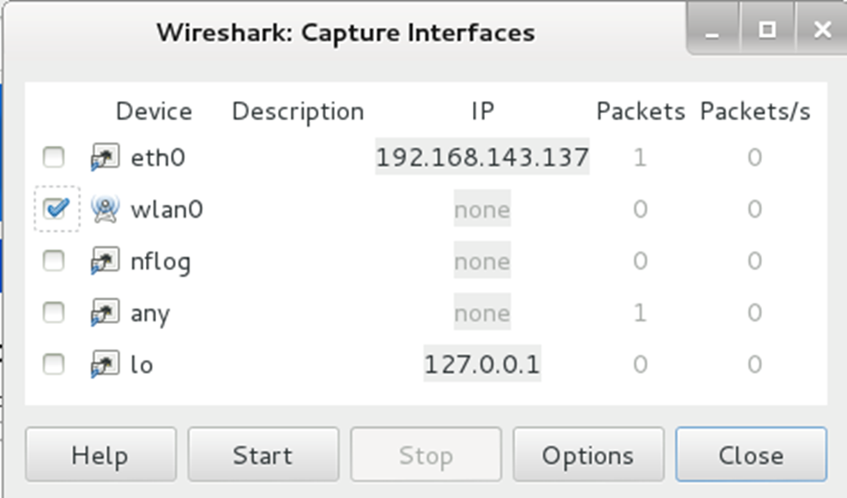
Watch wireless connect
Open Wireshark
Applications>Internet>Wireshark
Select wlan0, click Start

Slide 11
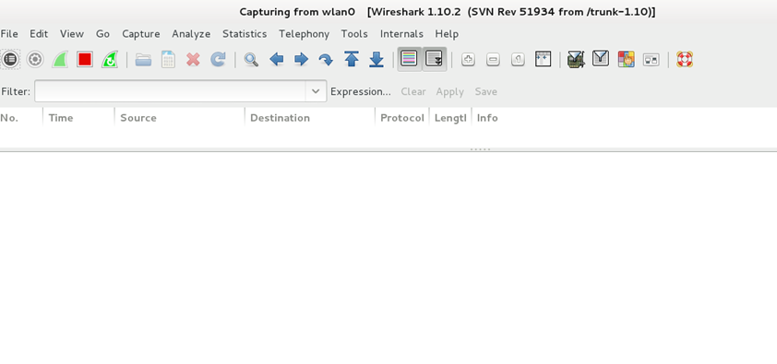
And…. Nothing Happens…

Slide 12
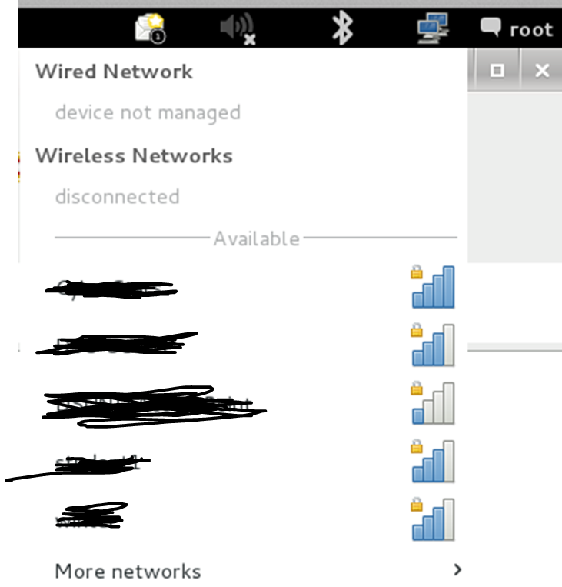
Connect to a Network
Network Manager >
Select your network

Slide 13
airmon-ng
Enables monitoring of wireless interfaces
Forces your adapter into “monitor” mode
Basically: creeper mode

Slide 14
airmon-ng
airmon-ng <- will list adapters
Also tells you if NetMon is supported
airmon-ng start wlan#
Puts specified adapter into monitor mode
Creates new ‘interface’ in interface list
airmon-ng check kill
Kill off all PID’s that are associated with the adapter

Slide 15
Interesting Stuff
Channel can be important
Adapter can only listen to 1 channel at a time
Getting stuck on a channel can be a problem
Moving channel to channel can be a problem
*It’s not supposed to be a problem

Slide 16
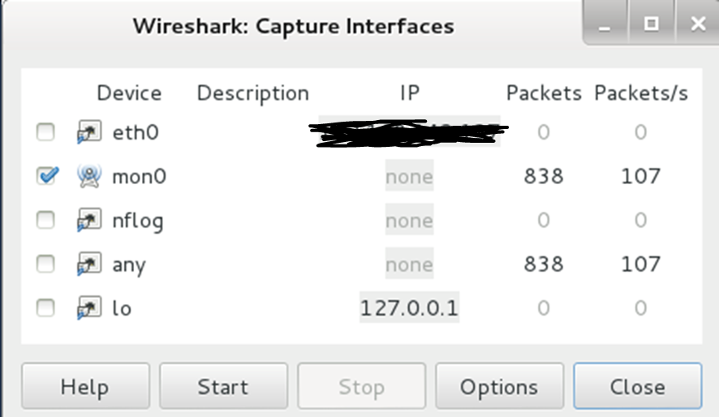
Watch wireless connect
Open Wireshark
Applications>Internet>Wireshark
Select mon0, click Start

Slide 17
Problem
Your Routers/APs spill all of their details...
Broadcast TONS of info that we LOVE to have!
BSSID: Basic service set identification
Contains: SSID and MAC Address
SSID: Service Set Identifier
MAC: Your hardware address
What if we hide this info??

