Slide 1
Cellphone Stuff!

Slide 2
Where are we going?
Working towards a working BTS
Base Transceiver Station
Start out small, work our way up to it
Primarily GSM stuff
Zero CDMA (Like Verizon and Sprint)
GSM- Global System for Mobile

Slide 3
What will we have?
OpenBTS- software implementation of cell infrastructure
Most of The Big Guys have really complicated infrastructure
OpenBTS tries to standardize it as much as possible
Talk the talk?
We’ll have a 2G network
GSM
Voice and SMS
OpenBTS can also do “2.5G”
GPRS Data
Tough to do in a VM

Slide 4
ARFCN
Absolute Radio-Frequency Channel Number
How is cellular spectrum actually divided up?
Kind of like 802.11 -> they overlap
Each cellular band is divided up
Don’t want to overlap
Licensed by FCC

Slide 5
ARFCN’s
Adjacent ARFCN’s overlap frequencies ^^ This is wifi, but still…
Each band (channel) is 270.833kHz of bandwidth
Each pair has fixed up/down link frequencies

Slide 6
Legality?
So technically this isn’t legal to do
Spectrum
850,900, 1800, and 1900MHz is where GSM lives
Not really supposed to use those
Rules of engagement:
Not connecting antennas
No amplifiers
Total network range will be about 10 feet

Slide 7
Duplex Communication
Up/Down at the same time: FDMA
Multiple phones -> TDMA
We need two different frequencies!
And technically, licenses for each

Slide 8
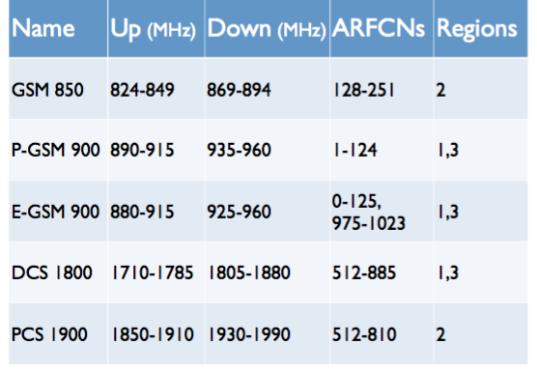
Frequency Bands
Three primary regions
1 Europe and Africa
2 Americas
3 Asia
Quad Band Handsets?
”World Phones”
Support 850, 900, 1800, 1900 mHz

Slide 9
What ARFCN are you using?
iOS, dial: *3001 # 12345 # *
Android dial *#0011#

Slide 10
SMS FTW
Tough to max out system capacity
Around 1800 per ARFCN per minute
SMS doesn’t care about data loss so much
Retransmission!

Slide 11
What’s inside GSM
Essentially an OSI Model…
Only 3 layers of fun
L3- communication Management Layer
L2- Data Link Layer
L1- Physical Layer

Slide 12
Layer 1: Timing is Everything
We’re using 8-way TDMA
Time slots are actually called ‘physical channels’
How many “full-rate” calls can we handle over 8 physical channels?
Question: How much voice data do you lose?
What would half-rate do for us?

