Slide 1
Cellphone Stuff!

Slide 2
Review
What are the units of cellular RF divided up into?
What frequencies do cellular devices tend to live on?

Slide 3
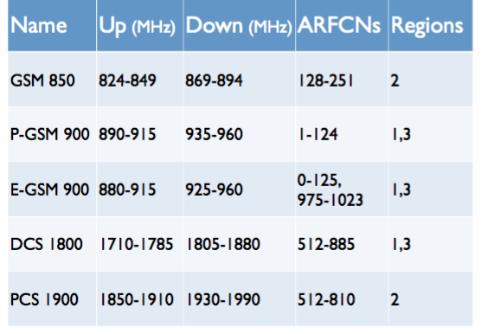
Frequency Bands
Three primary regions
1 Europe and Africa
2 Americas
3 Asia
Quad Band Handsets?
”World Phones”
Support 850, 900, 1800, 1900 mHz

Slide 4
Layer 1: Timing is Everything
We’re using 8-way TDMA
Time slots are actually called ‘physical channels’
How many “full-rate” calls can we handle over 8 physical channels?
Question: How much voice data do you lose?
What would half-rate do for us?

Slide 5
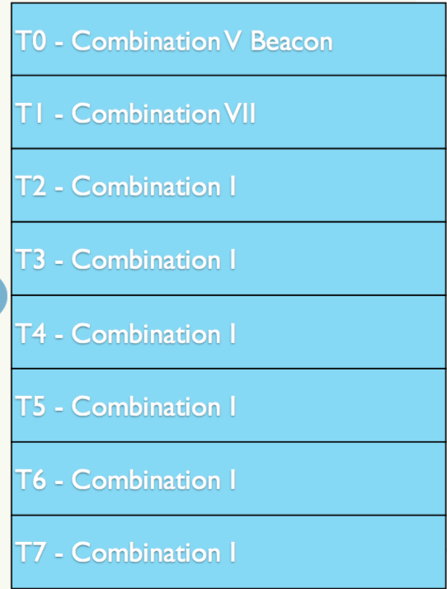
Physical Channels
What can we do on a channel?
Remember: T0 through T7 = 8 channels
Restricted to certain things… called Combinations
Combination V: The Beacon
Reserved and always sent at T0
Combination I: full rate traffic
Used for voice or GPRS (slow data)
Combination VII: SMS
(and management sort of stuff)

Slide 6
Combinations: The Breakdown
Combinations are broken down into “logical channels”
Logical vs Physical channel?
Physical channel = single time slot
Logical Channel = data carried in physical channel
It takes about 4.62ms to send a burst on all 8 physical channels
Every physical channel is divided into 50 burst periods
What’s a burst?
Lasts for about 15/26 ms

Slide 7
Regular Bursts
We’re going deep
Likely deeper than you’ve gone in networking…
We’re going to the bit level

Slide 8
Regular Bursts
Basically raw packets, sort of
Fast flying: 1 burst every 576.9μs
What exists here?
164.5 bits of data

Slide 9
Regular Bursts
What exists here?
2X 3 tail bits
True start of the burst (the guard really isn’t a start, 8.25 bits??)
Tail bits:
Electronics need a bit of time to come alive
These bits are literally for your transmitter to have time to power up

Slide 10
Regular Bursts
What exists here?
57 bits of data
Usually going to be… voice??
Can also be a FAACH
Fast Associated Control Channel – we’ll come back to a FAACH

Slide 11
Regular Bursts
Basically raw packets, sort of
Fast flying, remember: 1 burst every 576.9μs
What exists here?
1 bit of signage
Stealing Flag
Indicates what type of data we just received in the previous 57 bits
Tells us if this is a Traffic Channel or a FACCH.

Slide 12
Regular Bursts
Basically raw packets, sort of
Fast flying, remember: 1 burst every 576.9μs
What exists here?
26 bits for the Training Sequence
Clock synchronization & differentiation!
There’s 8 different options that can fit here
This is how your MS differs BTS’s– the TS is different for each BTS

Slide 13
Regular Bursts
Basically raw packets, sort of
Fast flying, remember: 1 burst every 576.9μs
What exists here?
Another data indicator- SF
57 bits of data
3 bits– give time to turn down the transmitter
”wait for 8.25 bits”

Slide 14
That’s enough burst talk
That’s as “deep” as we’ll go into a GSM packet today…
Which… is pretty deep actually...
Fun fact, with the guard bands, the margin of timing error is about:
31μs (.031ms)

Slide 15
Things are tricky
Some data is too big for a burst
They become interleaved over multiple burst periods

Slide 16
Logical Channels
We’ve gone down to the burst…
Let’s go up a bit
Still living at L1 of GSM

Slide 17
Identity is important
Your MS needs to know it’s locking onto the right BTS
Some things are unique to T0 & Combination V
FCCH: Frequency Correction Channel
Transmit all zeros!
Makes a solid tone when demodulated- 67.7 kHz above center
MS uses this to lock on its oscillator
SCH: Synchronization Control Channel
Tells us where we are in this whole timing mess
Eg: T0 C1
BCCH: Broadcast Control Channel
Important info! Cell identity, how to access it, what ARFCNs to use, how to register, and:
Do you take emergency calls?
MNC, LAC, neighbor ARFCNs

