Slide 1
GSM Frames

Slide 2
Review
What are the units of cellular RF divided up into?
What are the individual time slots of GSM’s TDMA called?
How many are there?
What’s the first time slot used for?
What were combinations?

Slide 3
Combination V
FCCH: Frequency Correction Channel
Zeros!
SCCH: Synchronization Control Channel
Timing
BCCH: Broadcast Control Channel
What’s here?

Slide 4
New Channels
FCCH
SCCH
CCCH- Common Control Channel
Basically… paging your phone
Your phone lives a boring life...
Just listens to CCCH
Waits for specific things to be sent out here
Replies from the phone: RACH- Random Access CHannel
Phones reply to a CCCH request
Phones can also initiate connections with a RACH

Slide 5
Order of Operations
Phone turns on (or leaves airplane mode)
FCCH – finds a seemingly usable frequency
SCH- Where is the network currently at, timing wise?
BCCH- Are you my mother?
Boom, you’re connected
Sit and contemplate life
CCCH- Hey, wake up and do something!
Mobile to BTS: RACH

Slide 6
Last Piece of Combo V
SDCCH- Standalone Dedicated Control Channel
Also exists in Combo VII
CCCH’s really just wake up the device
SDCCH’s set stuff up
Sync channels for:
Call
SMS
Location Updates
More stuff
Basically prepares us for a TCH

Slide 7
TCH- Traffic Channel
Not exceptionally fast…
Roughly 13kb/s
Uses GSM codec though, not IP
Primarily for voice or GPRS data
Can also do a FACCH- Fast Associated Control Channel
Used for call metadata: caller hung up
Uses the Stealing Flags

Slide 8
Others… SACCH
Slow Associated Control Channel
Handles real time radio management stuff
Timing information/corrections
Power commands
Receives/reports power info
Takes place during a call

Slide 9
Layer 3 goodies
Pieces inside of Layer 3:
Radio Resource- Manages dedicated channels
Handle physical/logical channels
Paging handsets
Create the beacon
Basically describe the physical layout of the network
Mobility Management- Handling MS
Call Control or Short Message Service- Processing Calls

Slide 10
Layer 3 goodies
Pieces inside of Layer 3:
Radio Resource- Manages dedicated channels
Mobility Management- Handling MS
Who on our network deals with that MS?
Authenticate users
Basically: user identities/authentication
Call Control or Short Message Service- Processing Calls

Slide 11
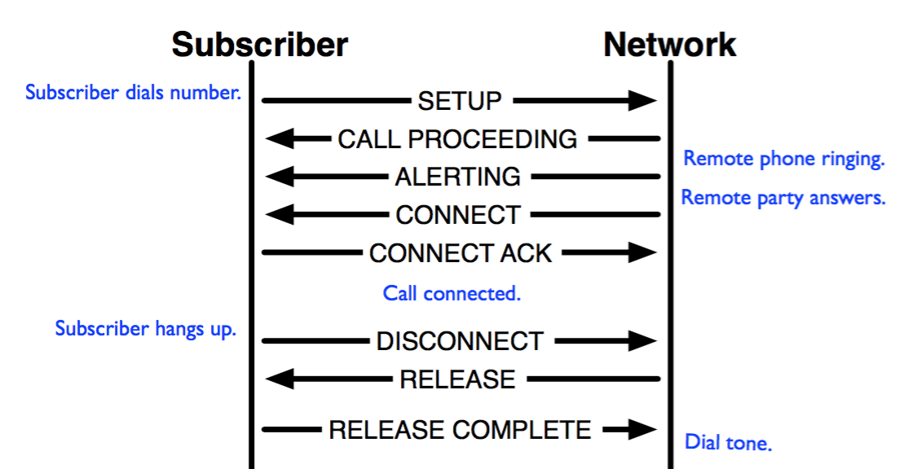
Layer 3 goodies
Pieces inside of Layer 3:
Radio Resource- Manages dedicated channels
Mobility Management- Handling MS
Call Control or Short Message Service- Processing Calls
Bridge handset to phone service

Slide 12
What kind of channels can we play with?
Really, phone/data types
LUR- Location Update Request
MOC- Mobile Originated Call
MTC- Mobile Terminated Call
MO-SMS- Mobile Originated SMS
MT-SMS- Mobile Terminated SMS
EmergencyCall- Emergency MOC

