Slide 1
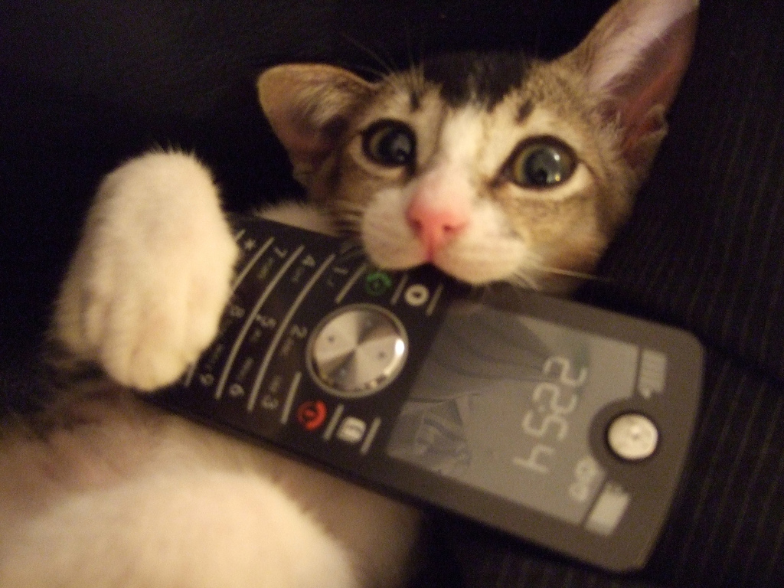
CSC420 Cellular/Mobile

Slide 2
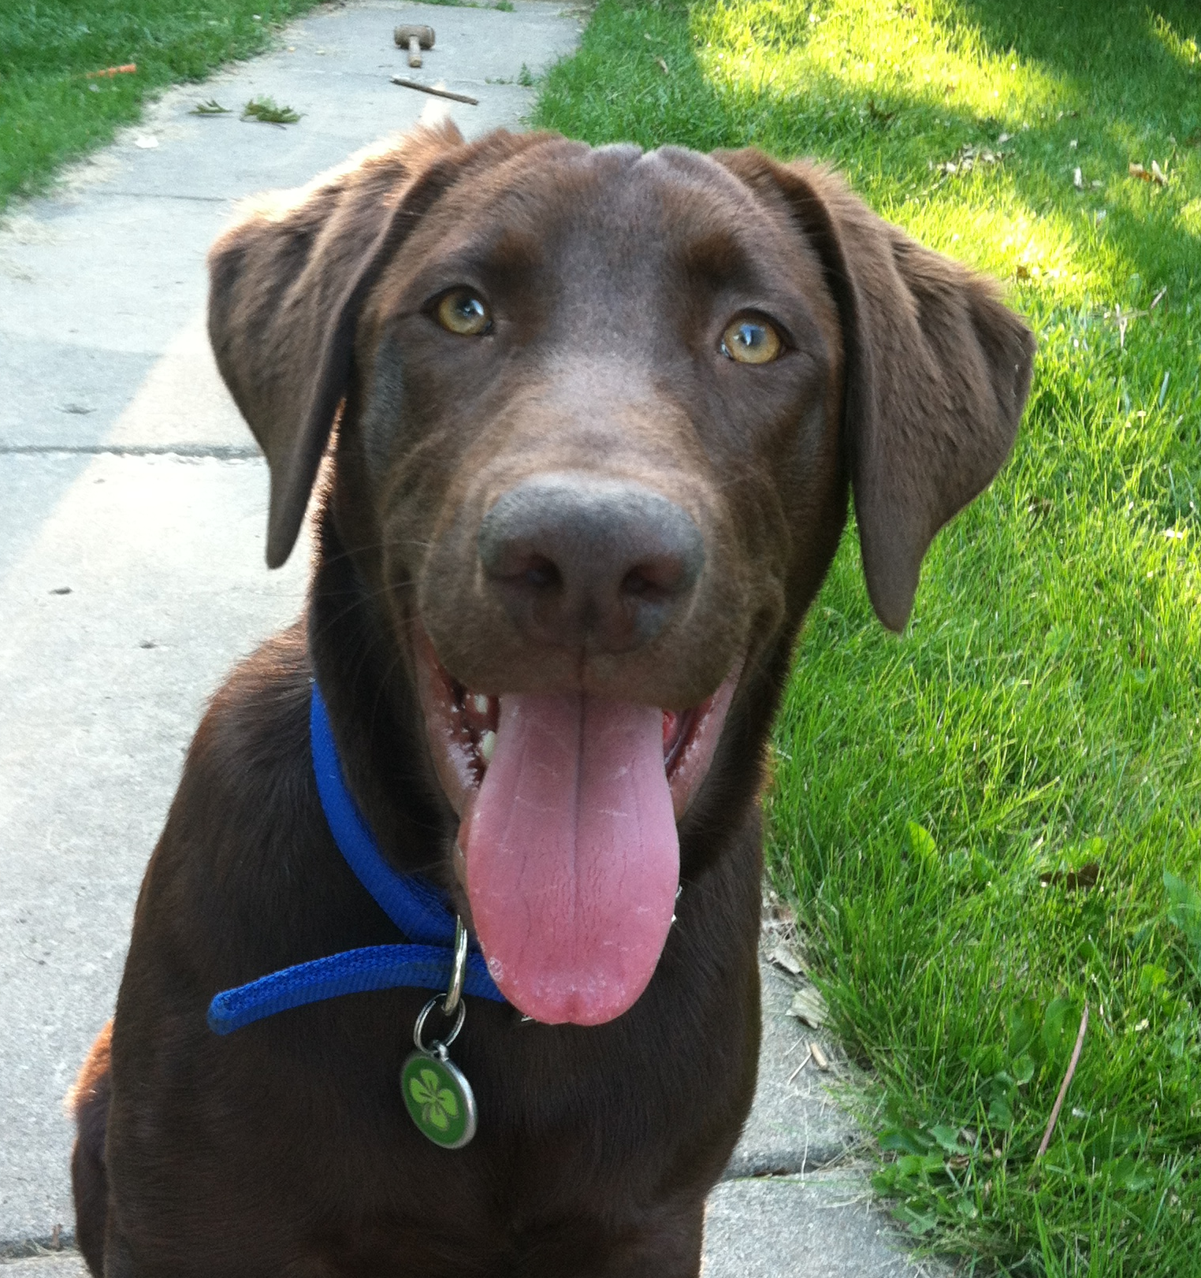
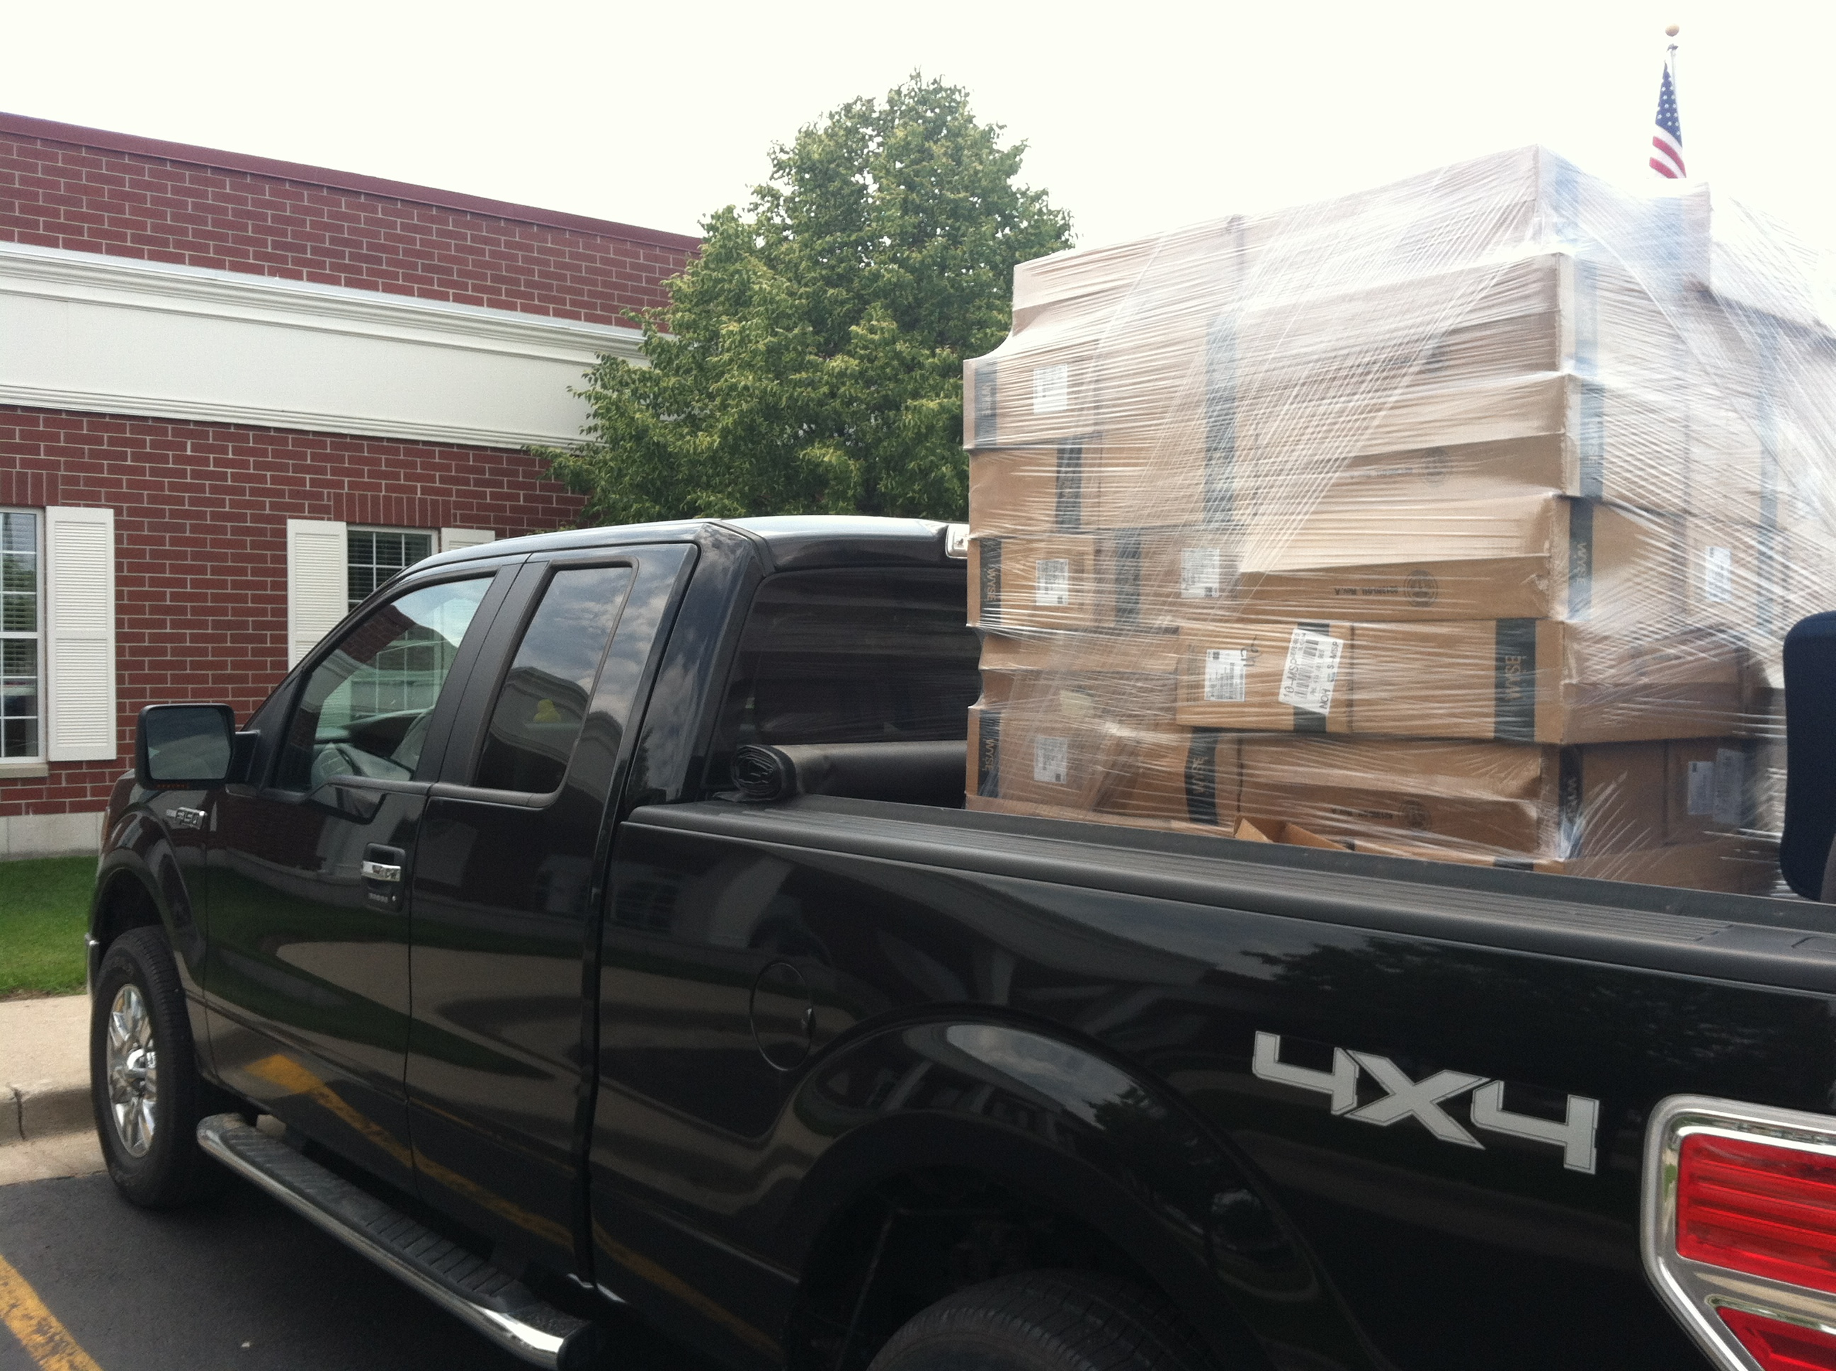
Who Am I?

Slide 3
Topics
Radio waves
How do they actually work?
How do so many talk at once?
Mobile device things!
802.11 wireless networking
Antennas
Standards
Security
Cellular technologies
Base station stuff
CDMA, LTE, GSM
Association/Roaming
Phone tech
How a phone call works
VoIP
Other Mobile Things
GPS
Software defined radio

Slide 4
This is a fairly new class
We will have some growing pains of a new class
Entirely new concepts for DSU courses
and some of it is new to me too
How do we do this hands-on?
This is our class, let’s learn together

Slide 5
Labs will be interesting
Love virtual machines
Tough to do a virtual iPhone
Or a virtual wireless adapter
Illegal to plug and play

Slide 6
Be Prepared For:
Using things you’ve learned in other classes
In depth and hands on networking things!
Real world networking things
We’ll break stuff from time to time
Some math
Cat pics

Slide 7
What to expect from me
Timely responses
Helpful to questions
Fairness for the class

Slide 8
But you need to…
Ask questions
Have timely responses
Be fair to your classmates

Slide 9
Email: Do’s vs Don’ts
Do:
Email me, often as you like
Swing by my office
Send a message at 2 am and be delighted that I instantly respond
Proof read messages
Don’ts:
Email me with a high priority email
Email me with no subject
Send useless messages:
“IT JUST DOESN’T WORK I HATE IT SO MUCH ARRRRGH”
Send a message at 2 am and get angry when I don’t instantly respond

Slide 10
Possibly Weird Schedule
Friday “lab day”

Slide 11
Go through syllabus

