Slide 1
History of Cellular

Slide 2
There was a time…
…in which we used our phones to call people…

Slide 3
How far we’ve come
1880, first realistic radio communications
1879, transmission reached 18+ mile mark
1934, FCC formed
1946, First phone that didn’t need wires pops up
1983, Cellular communications sort of appear in the US

Slide 5
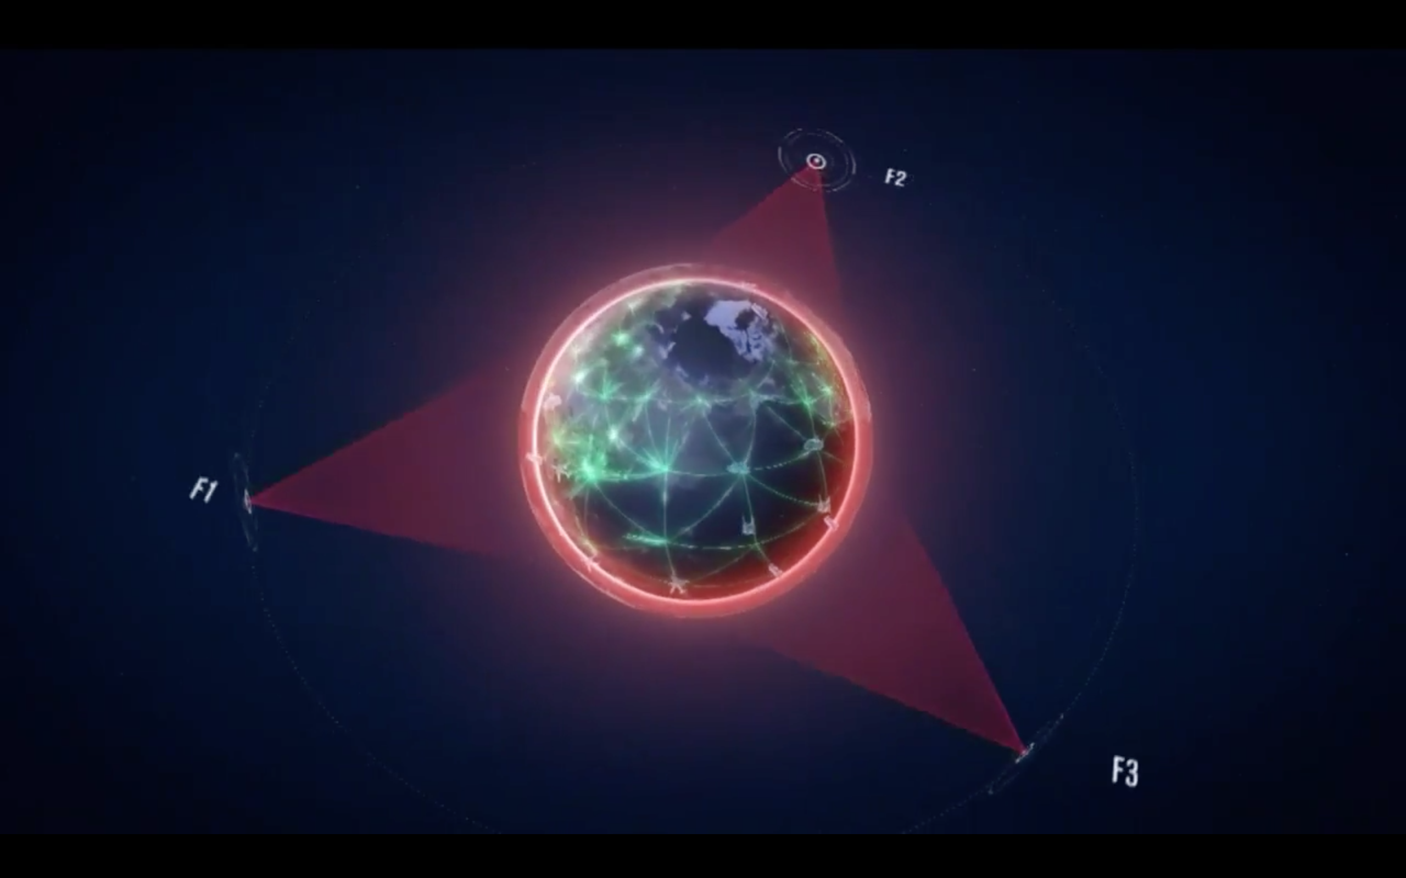
Cool Happenings 1 Year Ago
Boeing
Cisco
Inmarsat

Slide 6
Terms
Base Station… BS
  Transmitter of radio waves
Mobile Station… MS
  Receiver of the radio waves
Cell
  The area covered by a base station

Slide 7
Cells
Cells need to be different sizes
In our region, cells are very large
  More cows, less devices on the network
Metro regions, more smaller cells exist
  Less cows, more devices

Slide 8


Cell
BS
MS
MS

Slide 9
Satellite
In-building
Urban
Suburban
Global
Picocell
Microcell
Macrocell
Global

Slide 10
Other Cell Considerations
Data transmission hates mobility
Every base station handoff disrupts transmission
The faster we’re moving, the less data we can transmit
  OR
The faster we’re moving, the more expensive data transmission is

Slide 11
Vehicular
Universal Mobile Telecommunications System
Broadband radio
Mobility
Global System for Mobile Communications
Mobile Broadband System
Pedestrian
Local Multipoint Distribution System
Satellite Universal Mobile Telecommunications System
Broadband Satellite Multimedia
Stationary
0.01
0.1
1
10
100
Data rate (Mb/s)

Slide 12
Frequencies
We measure these in hertz…
We don’t want to overlap
  Try it: get a bunch of 900Mhz cordless phones in one place
  You’ll eventually run into troubles
  The good part: the base stations in everyone’s house is low power
    …or at least it’s supposed to be…
Bandwidth is important!

Slide 13
Cell
BS
BS
Cell
MS
MS
MS
MS
Cell
BS
MS
MS
Cell
BS
BS
Cell
MS
MS
MS
MS
Cell
BS
MS
MS

Slide 14
FM Radio Stations
104.7 <- is this a legit station?
98.8 <- is this a legit station?

Slide 15

FM Radio Overlap
We can’t have overlapping use of frequencies
Signals would become confused
FM Radio is given a 200kHz width (bandwidth!)
  Ideally they should be spot on in the center
  This helps prevent overlap

Slide 16
Bandwidth
Difference in the upper/lower frequencies
  For us, we’ll focus on a single channel
The same bandwidth can carry equal data
Example: 3kHz for a phone conversation
  So, the band 1kHz-4kHz can be the same as 100002 kHz – 100005 kHz

Slide 17
Other Common Radio Frequencies
535-1705 kHz AM Radio
174.0-216.0 TV Channel 7-13
978 Mhz Low flying aircraft
1090 MHz High Flying aircraft
47.0-47.2 Ghz Armature satellites
20-20000 Hz Human Ear
  Is 20,000 loud?

Slide 18
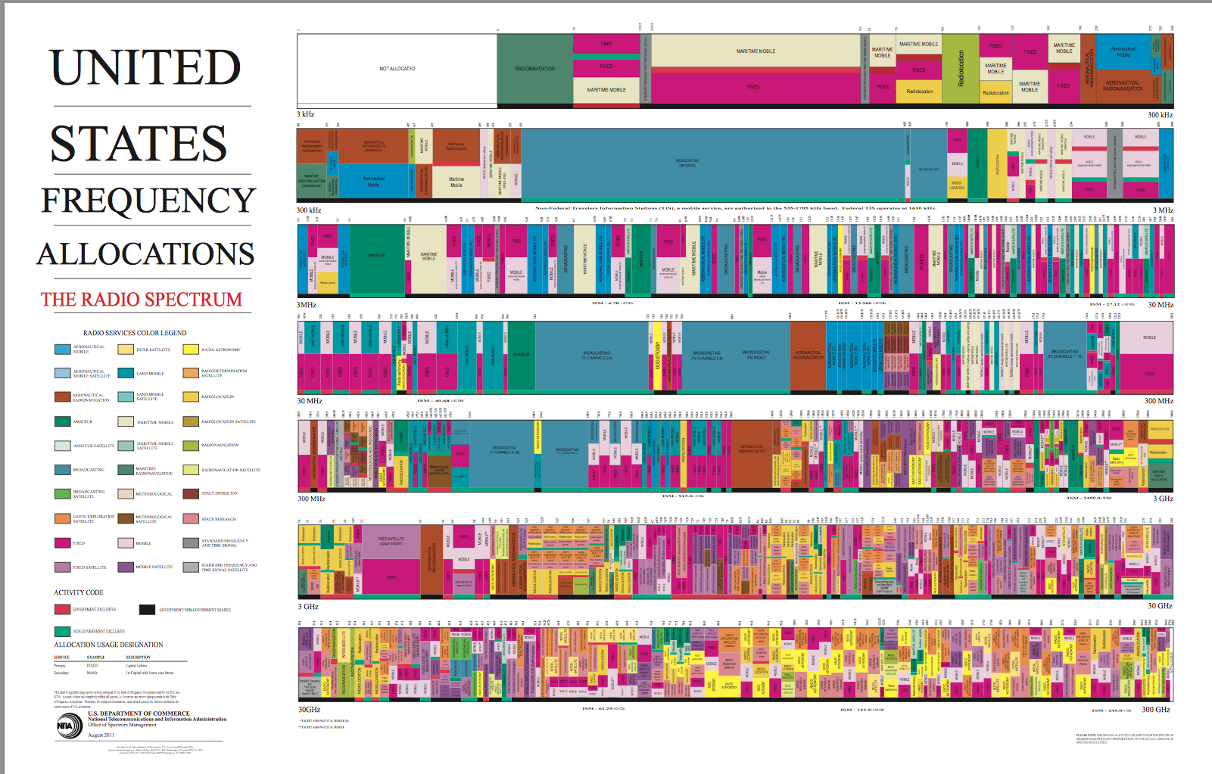

Slide 19
Problem
We have tons of high powered devices
If we could listen to the spectrum, it’d be very noisy
We need to keep different devices separated
  Put them on different frequencies
There’s a reason you don’t hear cell phone calls with an FM radio
  FM operates on different frequencies 87.5-108.0 MHz
If only there was a government agency to save the day!

Slide 20
The FCC
Make word-wide wire and radio communications available at reasonable charge
Six Objectives:
  Promote broadband
  Foster competition
  Regulate spectrum
  Media -> wardrobe malfunction?
  Public and Homeland Safety -> Emergency response
  Modernize themselves

Slide 21
FCC- Radio Regulation
Regulates: broadcasting, amateur radio, radar, repeaters
Basically: if it broadcasts a signal, they regulate it
Antennas! http://wireless2.fcc.gov/UlsApp/AsrSearch/asrRegistrationSearch.jsp
The FCC sells spectrum
  Electromagnetic spectrum

Slide 22
Question: Do the frequencies we use on devices change?

Slide 23
Auction 73
Remember the switch to digital TV??
Around 2008, broadcast TV had to become digital
Left 700MHz band open for use, FCC sold it
  TV Channels 52 through 69
It’s happened before, channels 70-83 for analog cell phones
Total price for sale: wee bit over $10 billion
Bidders: US Cellular, Verizon, AT&T, EchoStar

