Slide 1
Waves and Channels

Slide 2
Review
Multiplexing
  Allowing multiple entities to talk
  Share one piece of spectrum
Types of multi access:
  FDMA
  TDMA
  CDMA
ISL- intersymbol interference

Slide 3
Cellular Channels- Their Uses
Typically 4 channels dedicated
  Simplex Channels ← What’s this?
2 Exchange Metadata
  Authentications
  Subscriber info
  Call parameters
2 Exchange real data
Control data needs to be exchanged before we can do data
Kind of like how FTP works

Slide 4
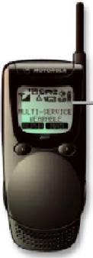
Reverse (uplink) control channel
Forward (downlink) control channel
Forward (downlink) traffic channel
Reverse (uplink) traffic channel
Mobile Station
Base Station

Slide 5
Outgoing Call
BS
MS
1. Need to establish path
2. Frequency/time slot/code assigned
BS
Incoming Call
MS
(FDMA/TDMA/CDMA)
1. Call for MS # pending
3. Control information Acknowledgement
2. Ready to establish a path
4. Start communication
3. Use frequency/time slot/code
(FDMA/TDMA/CDMA)
4. Ready for communication
5. Start communication

Slide 6
Lifespans
Control channels are used very differently
How many channels do we assign to each?
  Depends on what we’re doing

Slide 7
Back to Bandwidth
If I have the same bandwidth (say 3kHz) can I transfer the same amount of data?
What impacts this?
Are all protocols equally efficient?

Slide 8
Examples
2G GSM .030 MHz .104mb/s 0.52
3G CDMA 1.2288MHz 3.072mb/s 0.125
4G LTE 20MHz 81.6mb/s 4.08
V.92 .004MHz 0.056mb/s 14.0
802.11g 20MHz 54mb/s 2.7
802.11ad 2160MHz 6756mb/s 3
mb/s vs MB/s

Slide 9
Properties of Waves
Distance of the tower can impact things
Various frequencies act differently when transmitted
Ionosphere (80 - 720 km)
Mesosphere (50 - 80 km)
Space wave
Stratosphere (12 - 50 km)
Ground wave
Transmitter
Receiver
Troposphere (0 - 12 km)
Earth

Slide 10
How fast do waves travel?

Slide 11
All waves travel at 300,000km/s
*technically -> 299,792,458 m/s
We can predict wavelength based on the frequency
So:
  300000 = frequency x wavelength
  Cellphones – 800 MHz
  What’s the wavelength?

Slide 12
All waves travel at 300,000km/s
We can predict wavelength based on the frequency
So:
  300000 = frequency x wavelength
  Cellphones – 800 MHz
  What’s the wavelength?
  800 MHz = 800,000,000 Hz

Slide 13
All waves travel at 300,000km/s
We can predict wavelength based on the frequency
So:
  300000 = frequency x wavelength
  Cellphones – 800 MHz
  What’s the wavelength?
  800 MHz = 800,000,000 Hz
  300,000 = 800,000,000 x ?

Slide 14
All waves travel at 300,000km/s
We can predict wavelength based on the frequency
So:
  300000 = frequency x wavelength
  Cellphones – 800 MHz
  What’s the wavelength?
  800 MHz = 800,000,000 Hz
  300,000 = 800,000,000 x ?
  300,000/800,000,000 = ?
  = 37.5cm

Slide 15
Wavelengths
FM Radio – 100Mhz, 3 m
Ka band satellite – 20GHz, 15mm
The frequencies are divided into various bands

Slide 16
Classification Band | Initials | Frequency Range | Characteristics
Extremely low | ELF | < 300 Hz | Ground wave
Infra low | ILF | 300 Hz - 3 kHz
Very low | VLF | 3 kHz - 30 kHz
Low | LF | 30 kHz - 300 kHz
Medium | MF | 300 kHz - 3 MHz | Ground/Sky wave
High | HF | 3 MHz - 30 MHz | Sky wave
Very high | VHF | 30 MHz - 300 MHz | Space wave
Ultra high | UHF | 300 MHz - 3 GHz
Super high | SHF | 3 GHz - 30 GHz
Extremely high | EHF | 30 GHz - 300 GHz
Tremendously high | THF | 300 GHz - 3000 GHz

Slide 17
Signal Propagation
Free Space
  Basically, line of sight
  “Ideal” method of communicating
  Space ships, satellites, transmissions in “nothing”
Land
  This annoying planet gets in the way
  Antennas don’t broadcast in a ball

Slide 18
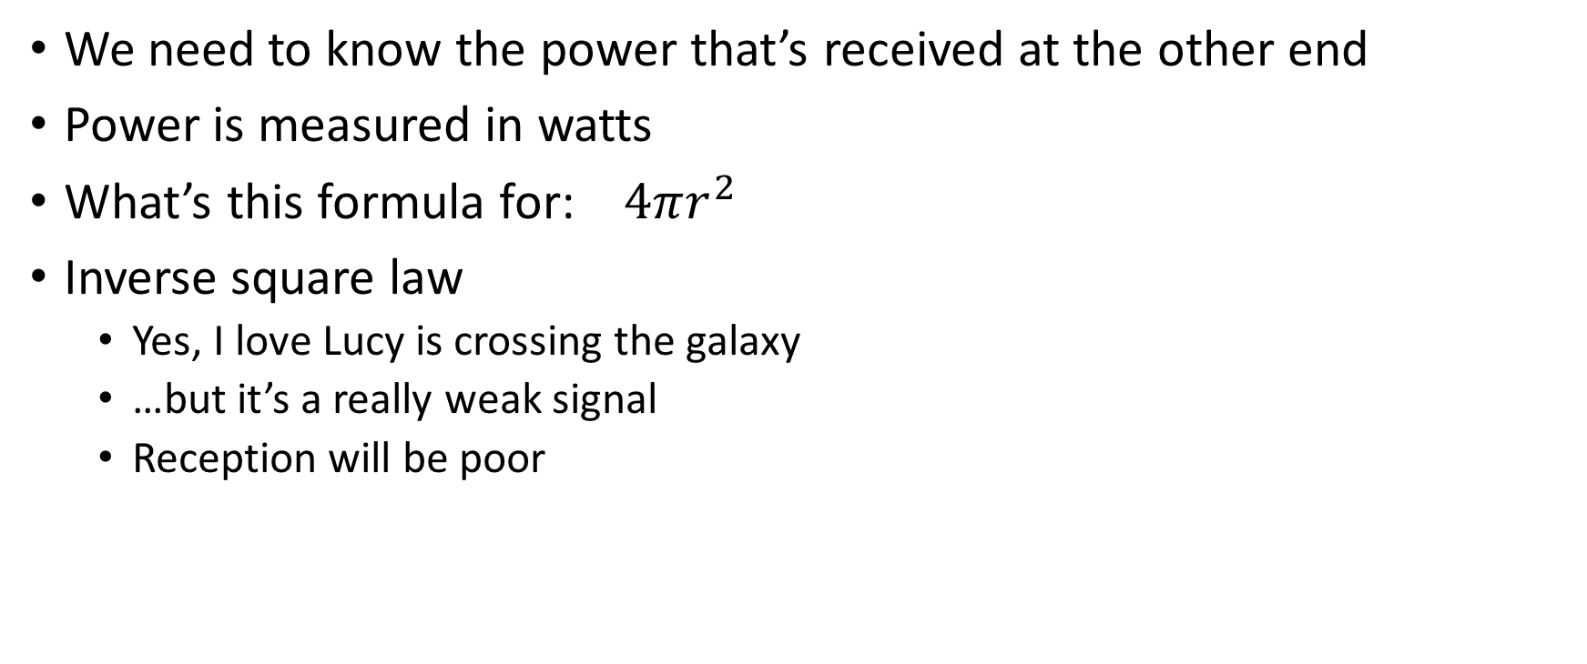
How far can my wave theoretically go?
We need to know the power that’s received at the other end
Power is measured in watts
What’s this formula for: $4πr^{2}$
Inverse square law
  Yes, I love Lucy is crossing the galaxy
  …but it’s a really weak signal
  Reception will be poor

Slide 19
How far can my wave go?
*In an ideal world
P_{r} = Power received
d = distance from the source (radius)
P_{t} = power transmitted
G_{t} = gain of the antenna
A_{e}= area covered by the transmitter

Slide 20
h_{b}
h_{m}
Distance d
Transmitter
Receiver

Slide 21
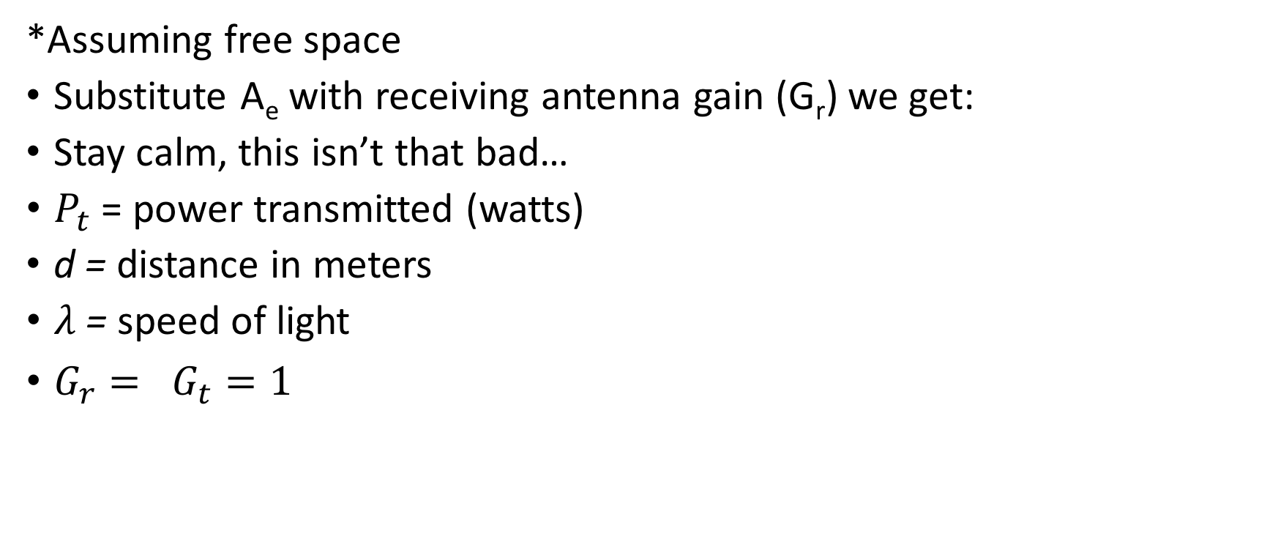

Going Further
*Assuming free space
Substitute A_{e} with receiving antenna gain (G_{r}) we get:
Stay calm, this isn’t that bad…
$P_{t}$ = power transmitted (watts)
d = distance in meters
$λ$ = speed of light
$G_{r}= G_{t}=1$
$$P_{r}= \frac{G_{r} G_{t} P_{t}}{{\left(\frac{4πd}{λ}\right)}^{2}}$$

Slide 22
Propagation
I hope that I have line of sight LoS (or free space)
Reflection
  The radio wave bounces off something larger than the wave
  Like a planet or a building or the atmosphere
Diffraction
  A sharp edge bends the wave
  Edge of a wall
Scattering
  Something smaller than the wave gets in the way
  Like a tree

Slide 23
Building
STOP
Scattered
Direct Signal
h_{b}
Reflected Signal
Diffracted Signal
h_{m}
d
Transmitter
Receiver

Slide 24
Signal Processing
Hugely important concept
What’s the shortest/fastest distance between two points?
How many copies of a wave do I receive?
What if the signal reflects?
Flightradar24.com

Slide 25
Classification Band | Initials | Frequency Range | Characteristics
Extremely low | ELF | < 300 Hz | Ground wave
Infra low | ILF | 300 Hz - 3 kHz
Very low | VLF | 3 kHz - 30 kHz
Low | LF | 30 kHz - 300 kHz
Medium | MF | 300 kHz - 3 MHz | Ground/Sky wave
High | HF | 3 MHz - 30 MHz | Sky wave
Very high | VHF | 30 MHz - 300 MHz | Space wave
Ultra high | UHF | 300 MHz - 3 GHz
Super high | SHF | 3 GHz - 30 GHz
Extremely high | EHF | 30 GHz - 300 GHz
Tremendously high | THF | 300 GHz - 3000 GHz

Slide 26
Waves have properties
Skywaves for example, love to reflect
Different kind of skywave-->

Slide 27
Ride the Waves
How far can you go?
FM vs AM are great examples
  AM: 535-1705kHz
  FM: 88 – 108 MHz
Basically: AM = big waves
      FM = little waves

Slide 28
Ionosphere Reflection
AM Radio waves refract from the ionosphere
FM waves blast right through
Where do they go?
  AM: China
  FM: Mars
FM -> height is key, AM -> not really
Ionosphere is really good at refracting at night
AM
  Reduces power, directional antennas, shutdown

Slide 30
Scales
Small-scale
  Signal variation/fading over a short distance
Large scale
  Signal variation/fading over a long distance
Diffraction & scattering -> small scale
Reflection -> large scale

