Slide 1
WiFi

Slide 2
Review
802.11
Section of IEEE standards document
Uses ISM bands (industrial scientific medical)
Common: B, A, G, N, AC
Adaptive Rate Selection
What does it do?
Why?

Slide 3
802.11 ABC’s
A, B, and G
Very closely related
B -> baseline technology
A -> frequency + new tech
G -> hybrid
N, AC
New age tech

Slide 4
Channel Diagram

Slide 5
Wireless Spectrum
9-100 Khz- Aircraft, ship navigation
100Khz-1Mhz: AM Radio
Around 10 Mhz: Shortwave Radio
Around 100 Mhz: FM Radio
Between FM and 1Ghz: TV
1Ghz: Cell Phones
10 Ghz + WiMax and Satellite

Slide 6
WiFi Components
Hardware makes a difference
Chipset
Vendor
Antenna

Slide 7
Chipset
Tons of options
Generally -> strength vs power use
Most physical network adapters
Realtek and Intel
Intel makes a lot of chips <- this makes sense
Ralink makes them too
Power/signal/other factors
Features!

Slide 8
802.11 Adapter Modes
Requires hardware and OS support
Various potential modes
Access Point (ExtAP)
Station (ExtSTA)
Network Monitor (NetMon)
Ad Hoc

Slide 9
Alfa AWUS051NH
Chipset supports monitor mode
This is helpful…
...for sketchy stuff
Kali already has drivers
Please don’t use 64 bit Kali…

Slide 10
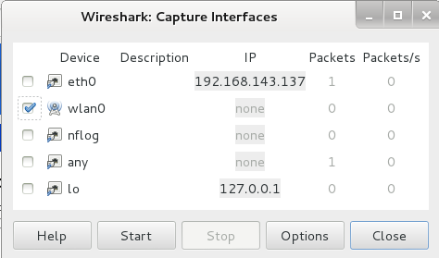
Watch wireless connect
Open Wireshark
Applications>Internet>Wireshark
Select wlan0, click Start

Slide 11
And…. Nothing Happens…

Slide 12
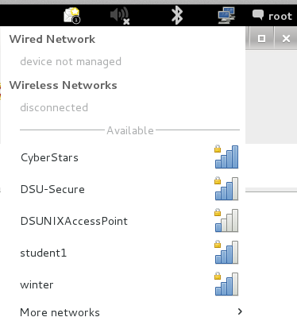
Connect to a Network
Network Manager >
Select your network

Slide 13
airmon-ng
Enables monitoring of wireless interfaces
Forces your adapter into “monitor” mode
Basically: creeper mode

Slide 14
airmon-ng
airmon-ng <- will list adapters
Also tells you if NetMon is supported
airmon-ng start wlan#
Puts specified adapter into monitor mode
Creates new ‘interface’ in interface list
airmon-ng check kill
Kill off all PID’s that are associated with the adapter
Notes:
Running airmon-ng by itself will list all of the current wifi adapters and tell you if any monitors exist
Airmon-ng check kill will find all of the programs that are using the wireless adapter and kill them off

Slide 15
Interesting Stuff
Channel can be important
Adapter can only listen to 1 channel at a time
Getting stuck on a channel can be a problem
Moving channel to channel can be a problem
*It’s not supposed to be a problem

Slide 16
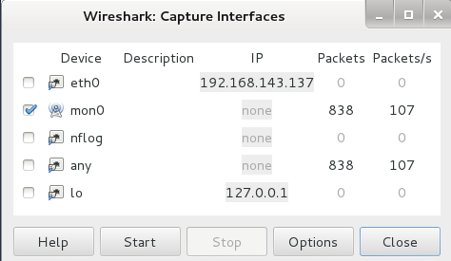
Watch wireless connect
Open Wireshark
Applications>Internet>Wireshark
Select mon0, click Start

Slide 17
Problem
Your Routers/APs spill all of their details...
Broadcast TONS of info that we LOVE to have!
BSSID: Basic service set identification
Contains: SSID and MAC Address
SSID: Service Set Identifier
MAC: Your hardware address
What if we hide this info??

