Slide 1
Wireless Attacks

Slide 2

Set up the APs
Computer IP: 192.168.11.50
Subnet Mask: 255.255.255.0
Router IP address:
  http://192.168.11.100
  http://192.168.11.1
Username: root
Password: <blank>
  Don’t actually type “<blank>”, there is no password

Slide 3
Passive Sniffing
Monitor mode
Watch a connection take place
Wireshark goodness

Slide 4
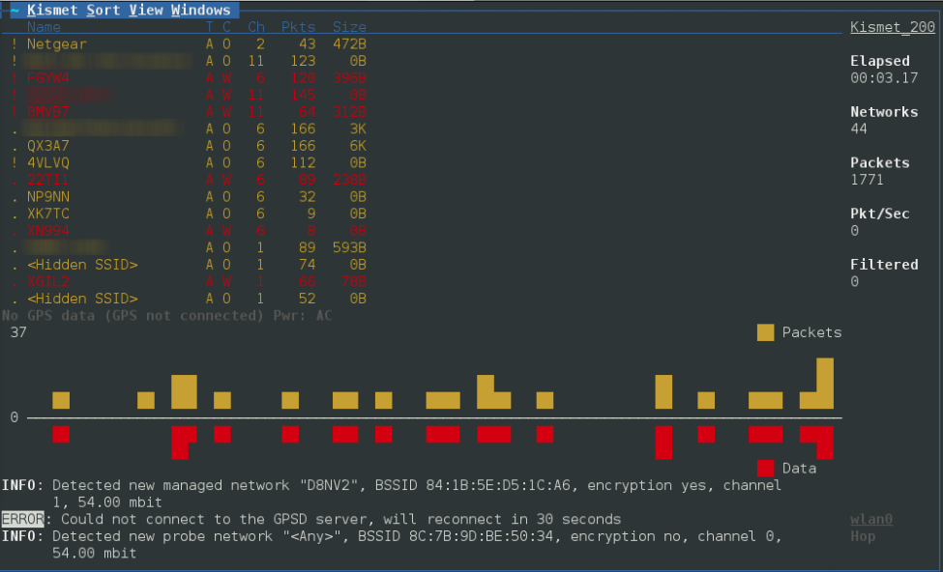
kismet

Slide 5

How do you defend?
No wrong answers…err we’ll show you why it’s wrong
Encryption
Hide SSID
Client filter
Turn down radios

Slide 6

2/4 Aren’t Bad
Effective
Encryption
  WEP (not really)/WPA/WPA2
Turn down your wireless antennas so people have to be in your space to connect
Rubbish
Hiding your SSID
Client MAC filter

Slide 7
Wireless MAC Filter
We’re going to specify which clients are allowed and limit the connection to only them
Any benefits?
  White-list approach, you know exactly who you’re allowing
Drawbacks?
  Takes forever – think of a company with 500 users
  Management nightmare
  More of a hassle than it’s worth, we’ll show you…

Slide 8
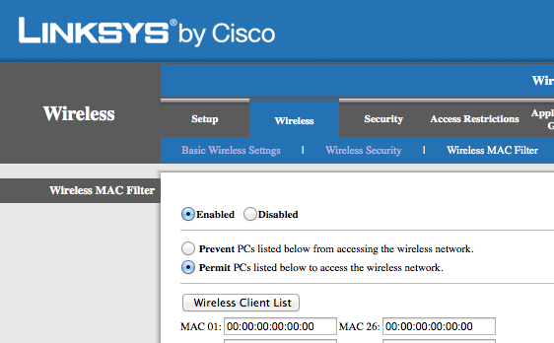
How do you go set one?

Slide 9

So, you put up a MAC filter, huh?

Slide 10
Spoof your MAC
Let’s look for some connected clients
Find your wireless adapter
Start up airmon-ng
3. Start up airodump-ng

Slide 11
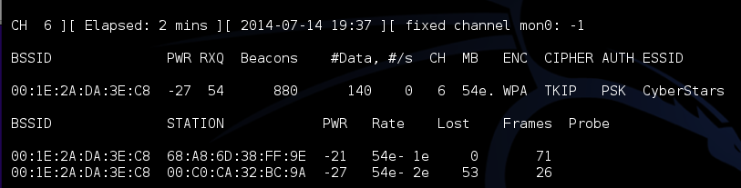
Look at those clients:

Slide 12
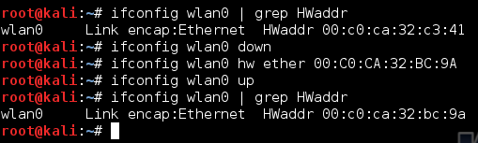
Spoof your MAC
Find your current MAC address
Turn the wireless interface off
Change the MAC address
Turn the interface back on

Slide 13
~Break Time~

Slide 14
SSID
Just a quick recap
SSID = Service Set Identification
  Really just the name of your wireless network
We’re not all this clever:
  Bill Wi the Science Fi
  Get off my LAN
  The LAN Before Time
  Use this one mom
  That’s what she SSID

Slide 15
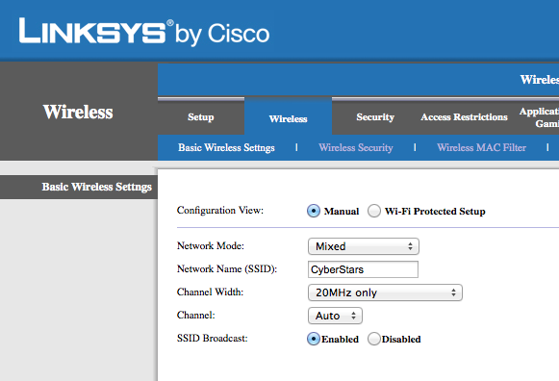
How do we hide it?

Slide 16
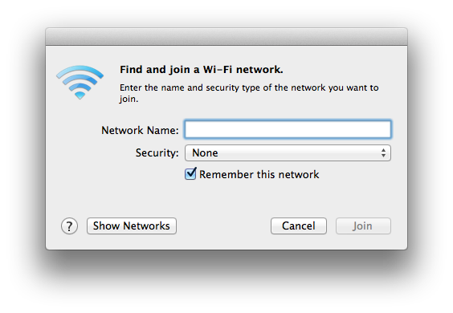
SSID
On a hidden network, the idea is that users/attackers have to know what you named it
  No name, no Wi-Fi
  …supposedly

Slide 17


Slide 18
Find the SSID
We can find that SSID
Find your wireless adapter
Start up airmon-ng
3. Start up airodump-ng

Slide 19
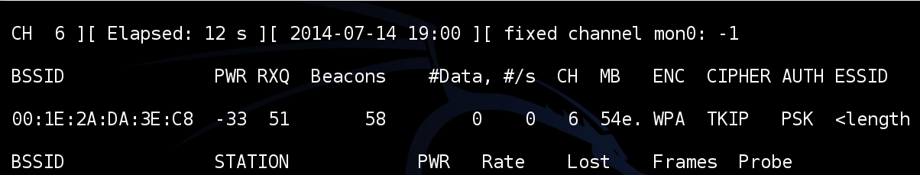
Find the SSID
We found it…now what?
Two options:
  Wait
  Deauthenticate a client (more on this later)

Slide 20
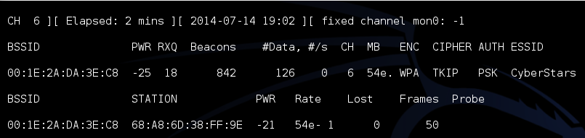
Got lucky and a client connected:

Slide 21
TL;DR;
Hiding your SSID will only thwart noobs
  It makes it a little more difficult for your own users to find
  Small speed bump
MAC filters
  Huge investment of time to set up
  Really not worth doing

Slide 22
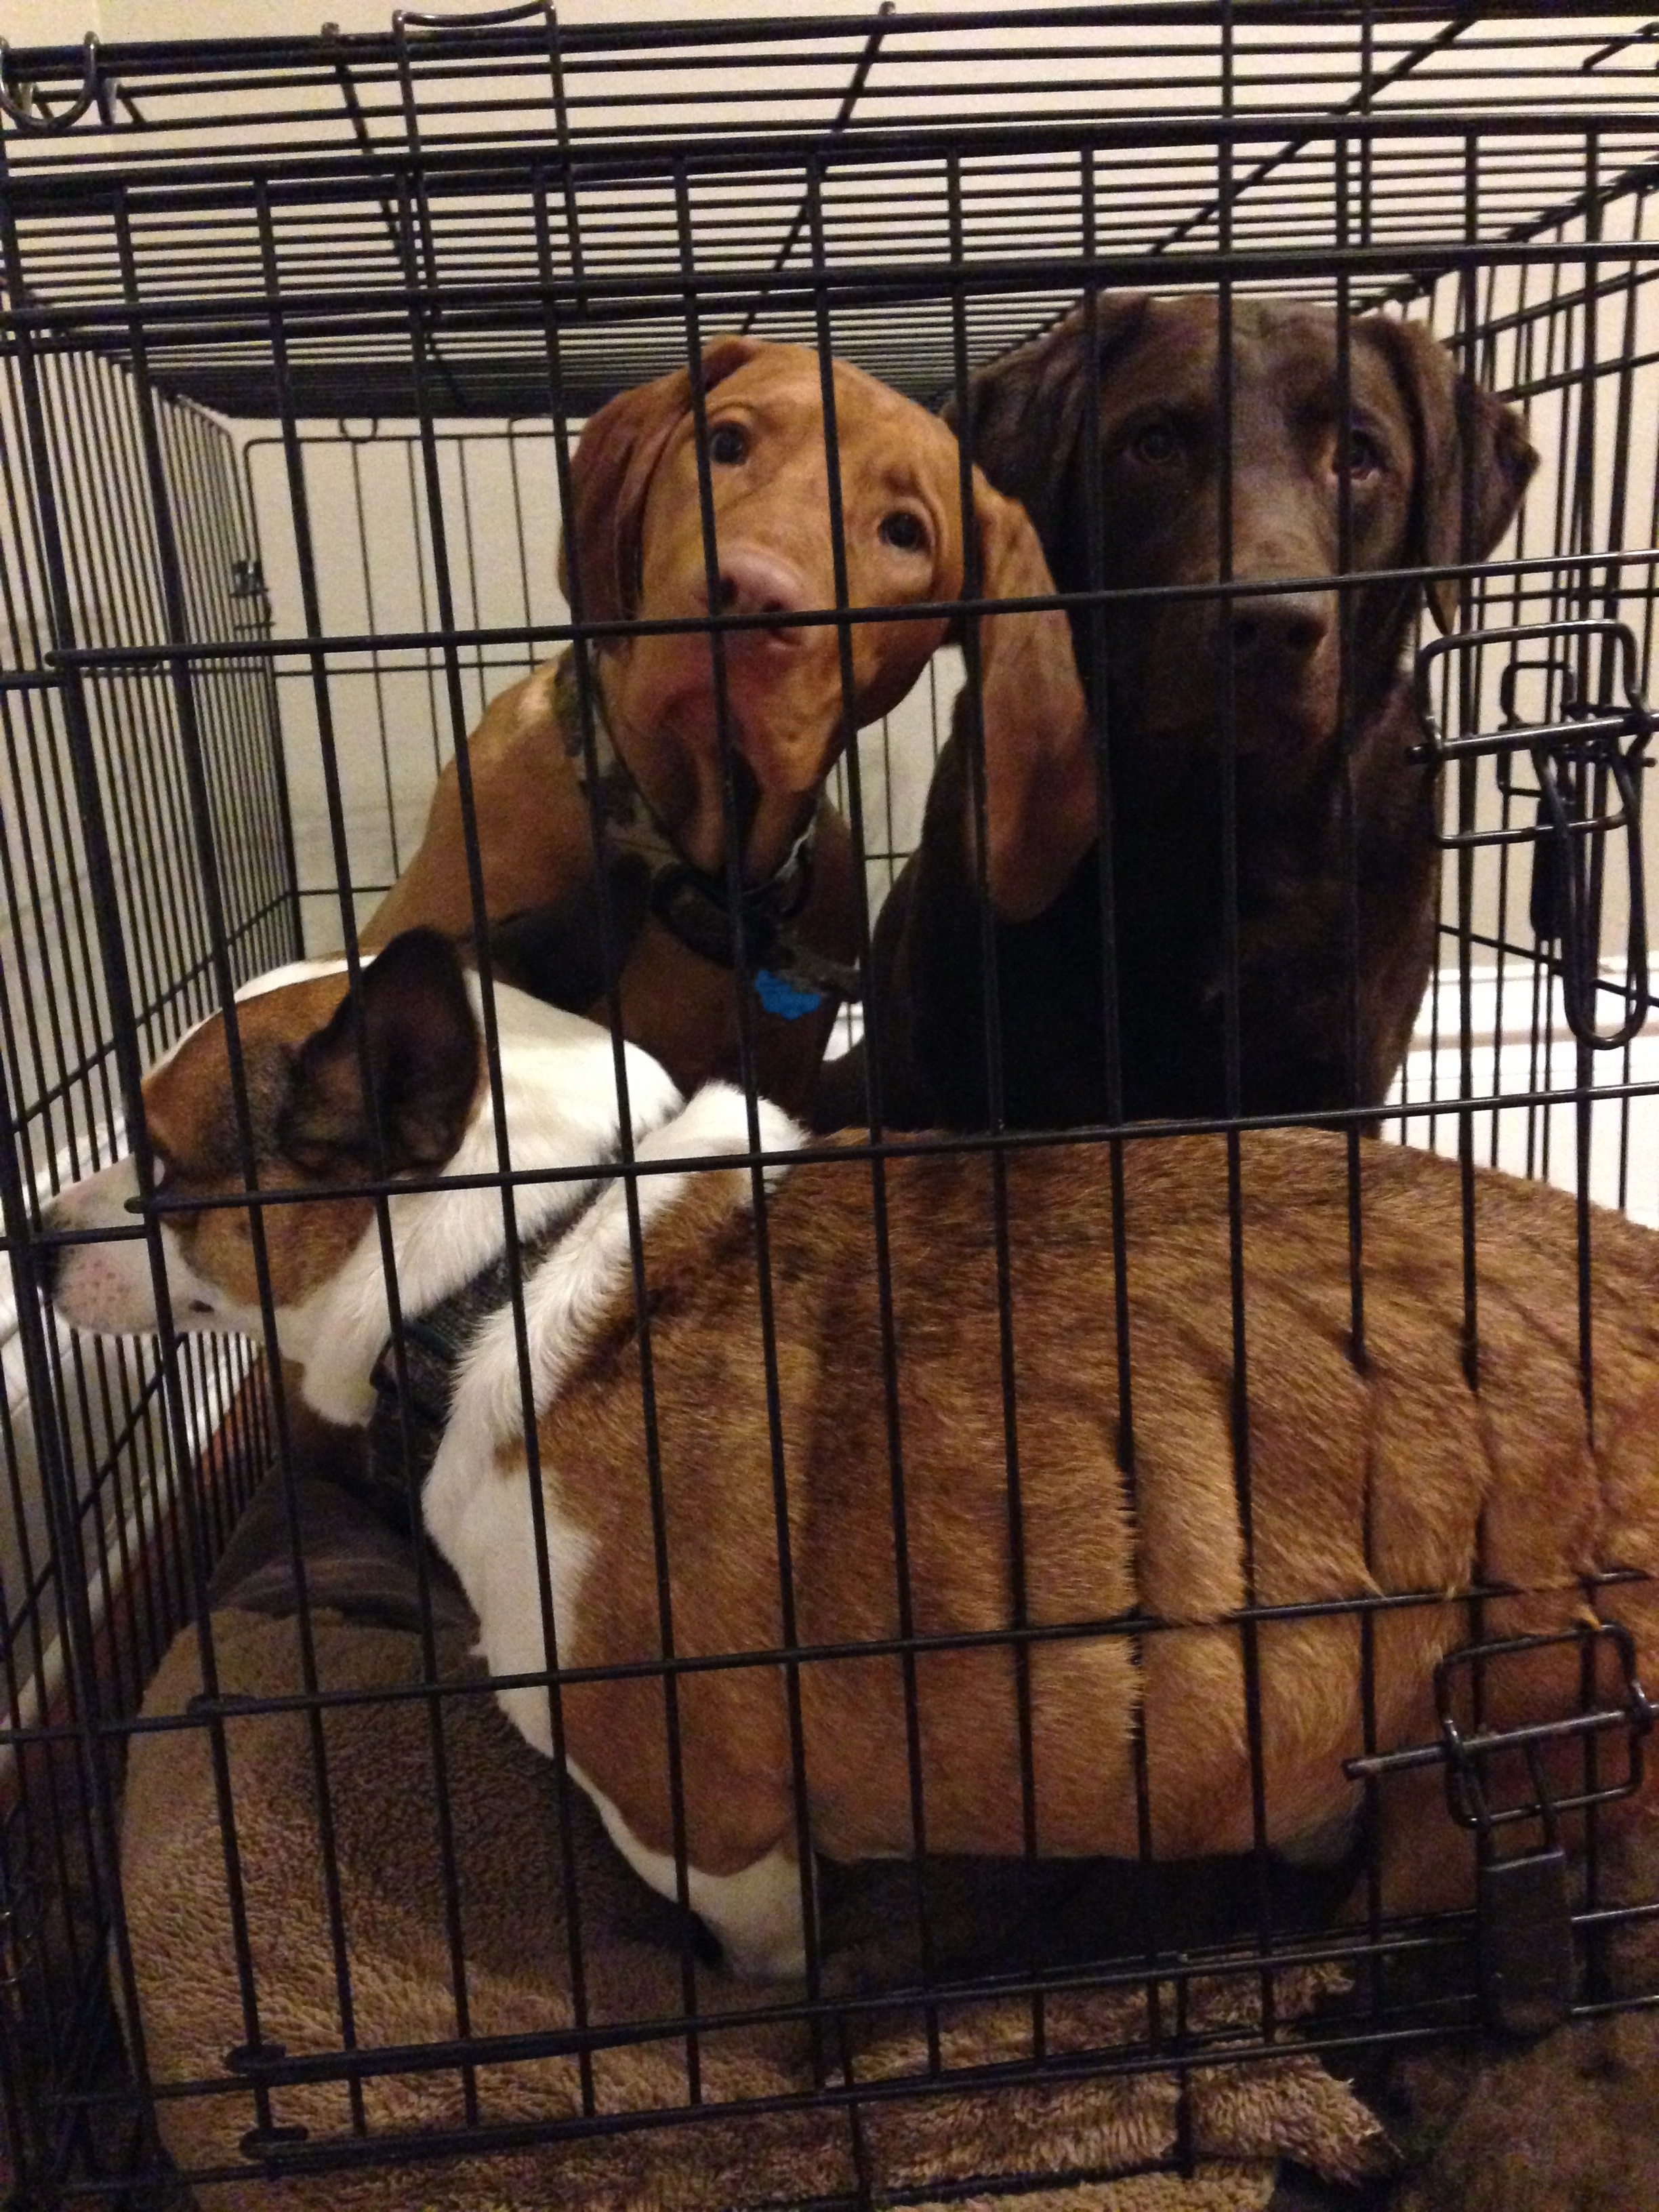
Let’s talk encryption
Wrapping your important data in a secure container

Slide 23


Slide 24
WEP
Standard ratified in September 1999
Wired Equivalent Privacy
  LOL not really, WEP as it turns out is actually pretty bad
Deprecated in 2004 and is documented in the current standard
  5 years of glory…or at least it should have only been 5

Slide 25
How does it work?
10,000 foot view
Encryption occurs between the client and an access point (AP)
Using a pre-shared key, users are able to connect to the access point
Flaws in the cipher/encryption method make WEP pretty terrible

Slide 26
Encryption Levels
Off
64-bit WEP – for a little bit of security
  The keys used end up only being 40 bits
  24 bits are reserved for an Initialization Vector (IV)
128-bit keys – ehh, it’s a good try, but still not exactly bullet-proof
  104-bit key size
  Still have 24 bits for the IV

Slide 27
A closer look at the keys:
A 64-bit WEP key is usually entered as a string of 10 hexadecimal characters (0-9 and A-F)
  Each character represents four bits
10 digits of four bits each gives 40 bits
Adding the 24-bit IV produces the complete 64-bit WEP key
(4 bits × 10 + 24 bits IV = 64 bit WEP key)

Slide 28
WEP Authentication
Two methods of authentication can be used with WEP
  Open System – user doesn’t authenticate to the access point
  Shared Key – all users have the same key

Slide 29
Shared Key
WEP key is used for authentication in a four step challenge-response handshake
Pre-shared WEP key is also used for encrypting the data frames using RC4 (more on this later)
The client sends an authentication request to the Access Point.
The Access Point replies with a clear-text challenge

Slide 30
Shared Key
Client encrypts the challenge-text using the configured WEP key, and sends it back in another authentication request
The Access Point decrypts the response. If this matches the challenge-text the Access Point sends back a positive reply

Slide 31
RC4 Cipher
Stream Cipher - operates on a byte-at-a-time basis using an input stream
RC4 Cipher (Stream Cipher)
Clear Text (No Encryption)
Key
Client
Bit
Bit
Encrypted
Bit
Key
AP

Slide 32
Stream Ciphers
They only way they will remain secure is the same traffic key must never be used twice
The purpose of an IV (Initialization Vector), which is transmitted as plain text, is to prevent any repetition
24-bit IV is not long enough to ensure this on a busy network
50% probability the same IV will repeat after 5000 packets

Slide 33
Bringing it all Together
WEP is used to encrypt traffic between the client and an access point
Each bit of data is encrypted and transmitted
The keys are 64 bits, and 24 of those bits are used for the IV
By gathering enough IVs, we can easily reverse the remaining 40 bits of keys
We sign in, and they get pwned

Slide 34
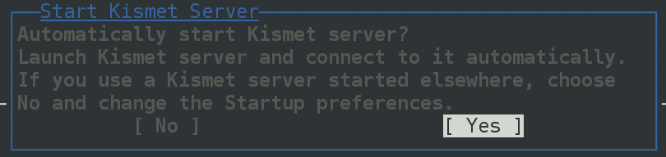
Let’s do this!
Find your wireless adapter:
Start up Kismet and look for networks

Slide 35
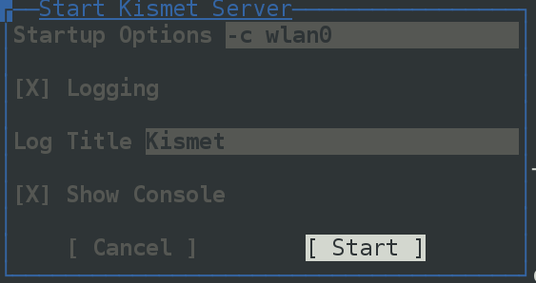
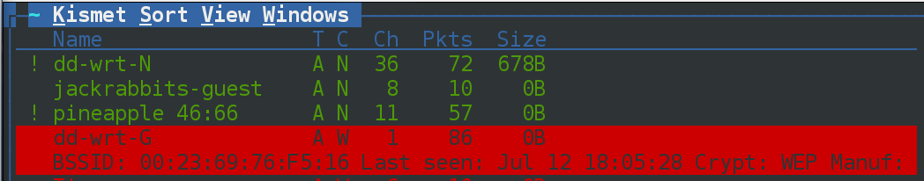
Once the service is started, you should start seeing a list of networks. Pick out a target!

Slide 36
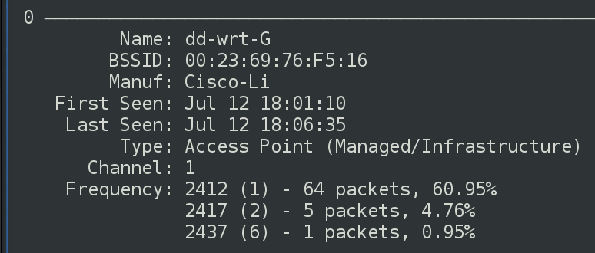
Write down the following (put them in a text file):
  Name/SSID, BSSID, Channel

Slide 37
Close down Kismet, unplug, and re-plug in your USB adapter
Put the wireless adapter in monitor mode:
  airmon-ng start <interface>
Start airodump to capture against the target network:
  airodump-ng --channel <channel>
  --bssid <bssid> --write <pcap file name> <monitor adapter>

Slide 38
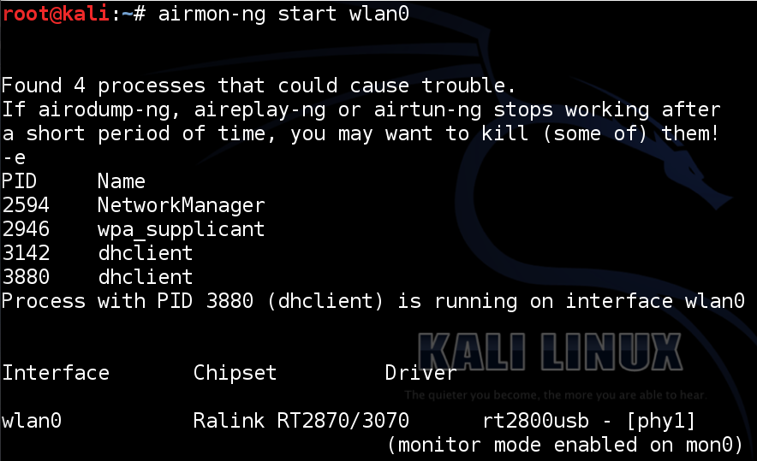

Slide 39
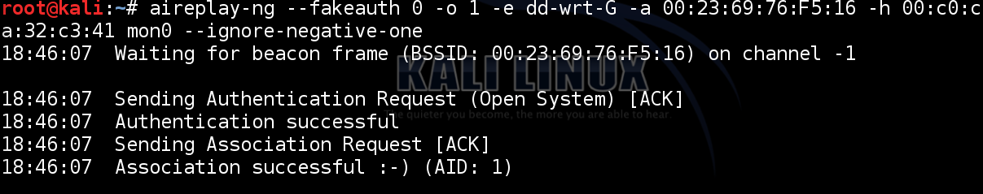
Fake your association with the AP
  aireplay-ng –fakeauth 0 –o 1 –e <SSID>
  -a <BSSID> -h <Monitor MAC> <interface>

Slide 40
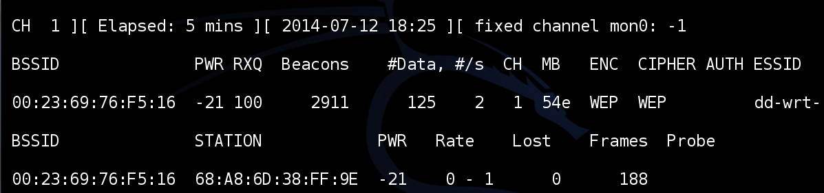
Find the MAC address of your wireless adapter and write it down
  ifconfig wlan0 | grep Hwaddr

Slide 41
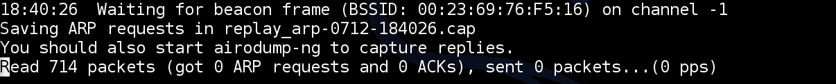
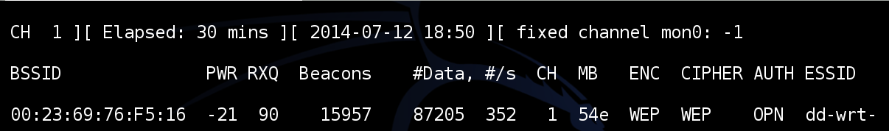
Open a new terminal window, start the ARP replay:
  aireplay-ng --arpreplay -h <associated client MAC> -b <BSSID> <monitor interface>
Wait for a bunch of IV packets (try every 5,000)

Slide 42
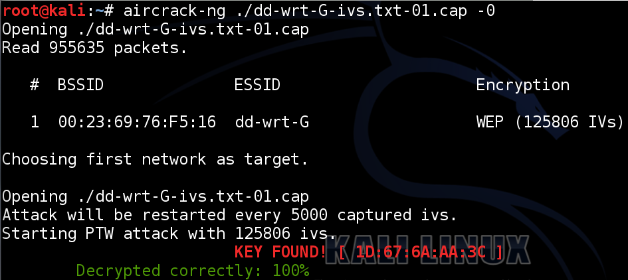
Once you have your IVs, open a third terminal window and try to crack it!
  aircrack-ng ./<pcap file name> -0

Slide 43
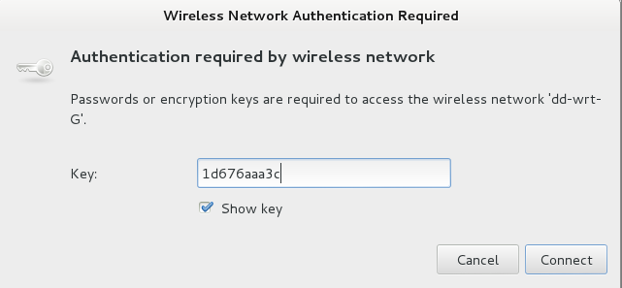
Try to connect:

Slide 44
WPA Personal

Slide 45
WPA
Wi-Fi Protected Access
Came about in 2003
Temporal Key Integrity Protocol (TKIP)
  Employs a per-packet key
  Dynamically generates a new 128-bit key for each packet and thus prevents the types of attacks that compromised WEP

Slide 46
WPA
WPA also includes a message integrity check
  Replaces the cyclic redundancy check (CRC) in WEP
  WPA uses a message integrity check algorithm called Michael
PSK is between 8 and 63 characters long

Slide 47
Authentication
Relies on a pairwise master key which is computed based on SSID and PSK
Once the client has the PMK, it and the AP negotiate a new temporary key
  Called the pairwise transient key (PTK)
Every time client connects, the keys are changed periodically

Slide 48
Authentication
Keys are a function of the:
PMK
A random number
  Supplied by the AP called a A-nonce
Another random number
  Supplied by the client, called a C-nonce
MAC Address of client and AP
TL;DR; many variables = unique and nonrepeating

Slide 49
Authentication
AP verifies the client has the PMK by checking the Message Integrity Code (MIC) field during authentication Exchange
  MIC is cryptographic hash of packet
  If MIC is incorrect, PTK and PMK are incorrect

Slide 50
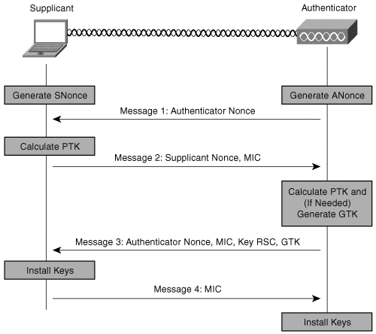

Slide 51
Four-Way Handshake
To crack a key, you’re going to need:
  SSID (not in four-way handshake)
  ANonce sent by AP
  SNonce sent by client
  Client’s MAC
  The AP’s MAC address
  MIC
Don’t actually need all four frames

Slide 52
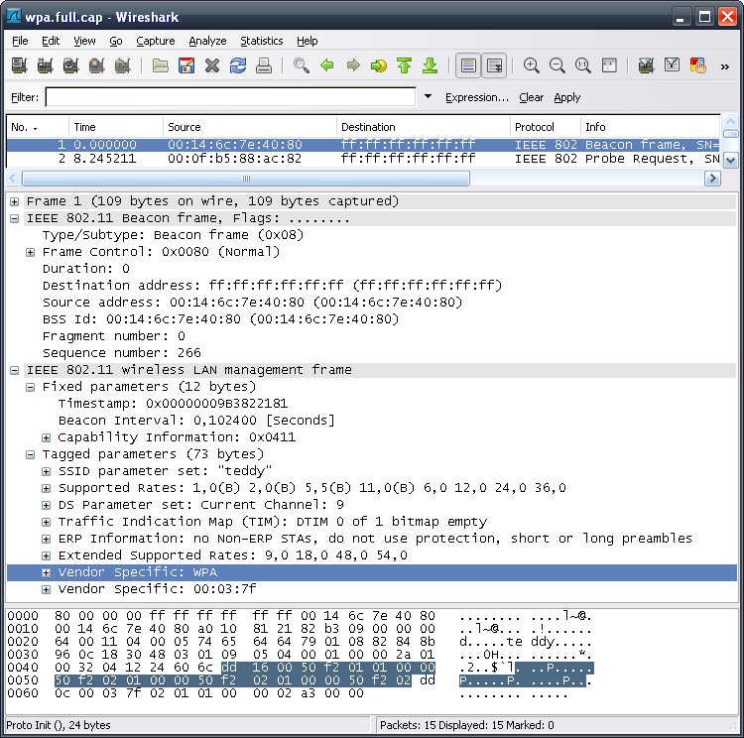

Slide 53
Passive Sniffing
Obtaining the handshake passively requires not interaction with the target network
  Very stealthy
Think of how often clients join/leave
Fire up airmon-ng and airodump-ng

Slide 54
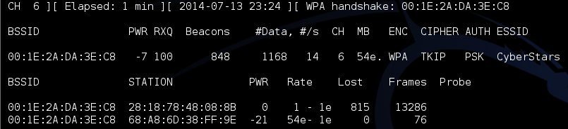
Passive Sniffing
# airmon-ng start wlan0
# airodump-ng --channel <channel> --bssid <MAC> --write <file> <monitor interface>

Slide 55
Active Attacks
Sometimes we don’t want to wait
Deauthenticate a user, watch them reconnect
Use 802.11 DoS attack
Launch a new window and fire up aireplay-ng

Slide 56
aireplay-ng
# aireplay-ng –deauth 10 –a <AP MAC> -c <client MAC> <monitor interface>

Slide 57
Cracking the PSK
Pretty much boils down to an offline brute-force attack
Pretty tough, the key is 8-63 ASCII characters
Passphrase is hased 4096 times before use within the PMK
Let’s try it out…

Slide 58
aircrack-ng
Needs a minimum of two of the four frames in the four-way handshake
Use a dictionary file and cross your fingers
You may have to specify your target BSSID

Slide 59
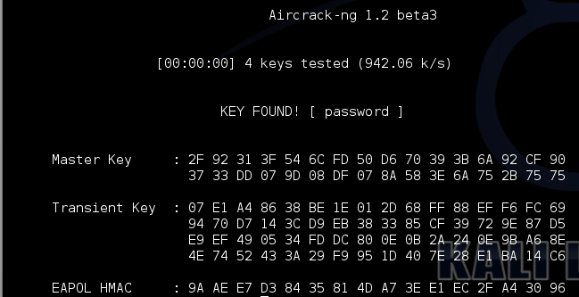
aircrack-ng
# aircrack-ng –w <wordlist> <capture>

Slide 60
coWPAtty
Another pretty useful tool
  aircrack-ng is good, but has some limitations
Needs a minimum of frames one and two or two and three
Again, use a dictionary attack

Slide 61
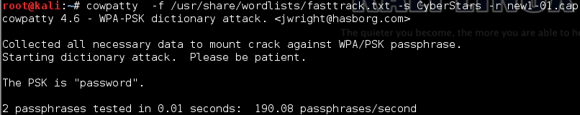
coWPAtty
# cowpatty –f <wordlist> -s <SSID> -r <capture file>

Slide 62
Questions? or
Lunch Time!

Slide 63
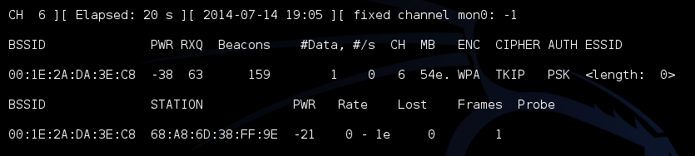
What if we’re impatient?
Let’s boot somebody that is already connected (don’t need to do this often):
Write down the BSSID, channel, and STATION

Slide 64
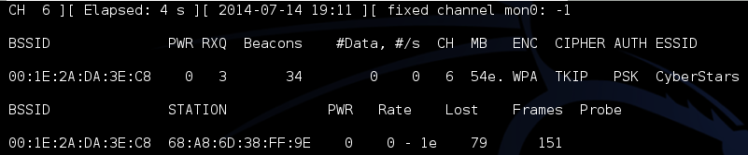
Deauth
Open up a second terminal and run:
  # aireplay-ng -- deauth 10 –a <AP MAC> -c <client MAC> <monitor interface>
Check back with airmon-ng

