Slide 1
Cells Cont

Slide 2
Review
Cells have varying shape based on terrain, etc
A handoff zone is needed for devices to roam
Horizontal vs vertical handoffs
  Tough problems to solve
  Leverage software

Slide 3
Cochannel Interference
We know cells are next to each other
We need to reuse frequencies
Distance can be calculated
Interference can’t always be eliminated

Slide 4
Cell Splitting
Beating the dead horse- cells aren’t all the same size
Service providers split cells into smaller pieces for higher density
Some cells are on-demand
  Turn them on during high loads

Slide 5
Large cell (low density)
Small cell (high density)
Smaller cell (higher density)
Depending on traffic patterns the smaller cells may be activated/deactivated in order to efficiently use cell resources.

Slide 6
Direction is important
We’ve been referring to omnidirectional antennas in the cells
Sometimes that’s the case, often it’s not
Typically directional antennas are used
  Frequently 60, 90, or 120 degrees
Probably mounted in the center of the cell regardless
Capacity control
  Mount several directional antennas instead of one onmidirectional

Slide 7
c
120º
a
b
Omni
120º sector
d
90º
a
c
b
90º sector

Slide 8
Sectoring Advantages
Borrow channels
  Take from low density directions
Decreasing co-channel interference
Quad-sectors
  Higher efficiency/capacity

Slide 9
Other Sectoring Methods
Place BS where cells intersect
Has some advantages
  Direct towards populations
  Avoid geography problems
B
C
X
A

Slide 10
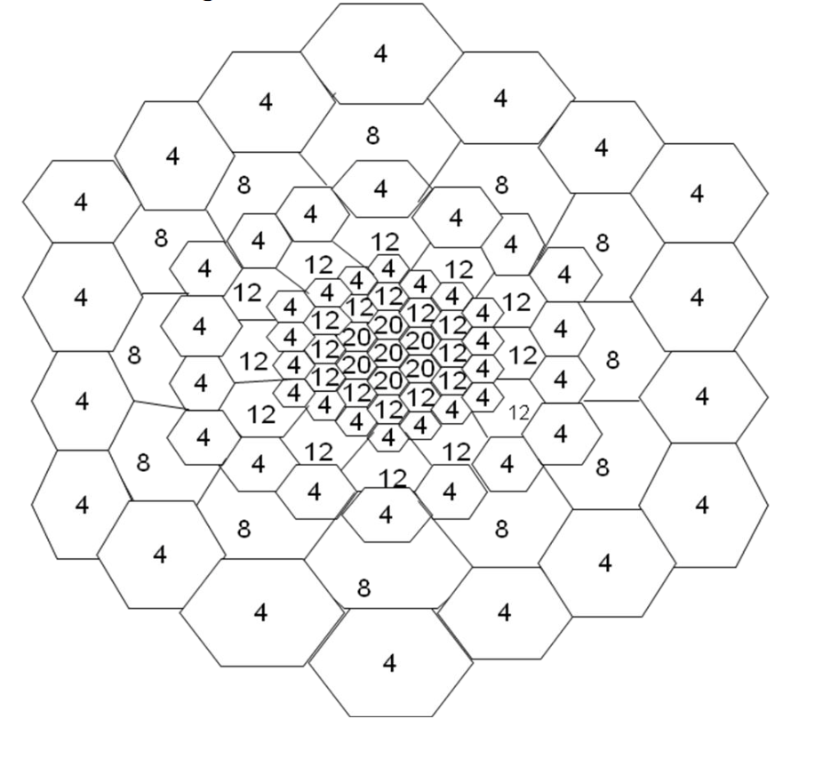
Why would we use this layout?

Slide 11
Interference Types
Co-channel interference
Adjacent Channel Interference

Slide 12
Presentations
Choose a topic of interest relating to cellular/mobile/wireless tech
  Other things we’ll be talking about:
    802.11 stuff
    Software defined radio
    Embedded operating systems
    Backhaul carriers
    VoIP
    Other stuff?
10 minute presentation at end of semester

