Slide 1
Reducing Complexity Principles
1. Modularity and Abstraction

Slide 2
Learning Outcomes
Upon completion of this unit, students will be able to:
Point out different modules.
Utilize modularity in their programming.
Identify abstractions.

Slide 3
Modularity – What is it?
Modularity refers to the logical dividing and organizing that allows complex software to be manageable for the purpose of implementation and maintenance.
This can be done by related functions, implementation considerations, data links, etc.

Slide 4
Why use Modular Design?
Modules can be developed, tested, and/or deployed independently. By doing this it allows the following:
You can independently version modules
You can develop and test modules by themselves
You can have modules developed by different teams
Minimizes download time
Minimizes application start-up time
Helps keep the software organized and readable

Slide 5
Example of a Modular System
An online banking program
The user can access a variety of functions
Transferring money between accounts
Paying bills
Updating personal information
Behind the scenes, each of these is a separate module designed to do its own function.

Slide 6
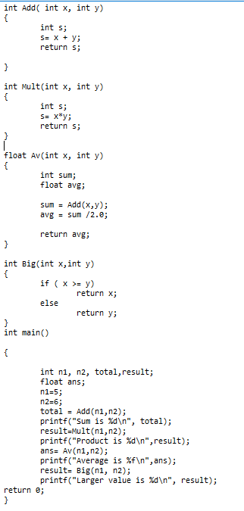
Modularity in Programming
Functions are one example of how modularity can be implemented in programming
Libraries can also be used to make a program more modular
Here is an example of a program that implements the Modularity Principle using functions:

Slide 7
Abstraction
In simplest terms:
The abstraction principle is the idea of reducing repetition of code in your program.
In terms of software engineering:
The abstraction principle is a technique that establishes how much complexity the user will have to deal with.
The idea is that by using abstractions, the design becomes more efficient for complex systems so that the interface is more user friendly.

Slide 8
Types of Abstraction
Control/procedural
Data
Abstraction of actions
Uses subroutines and control flow
Subroutine = set of instructions that perform a frequently used task (AKA a function)
Control flow = the order in which the statements of the program are executed (i.e. top to bottom processing)
Abstraction of data structures
Handles data in meaningful ways
These lists provide ways to access the data without knowing the specific value of that data
Linked list
Stack
Queue

Slide 9
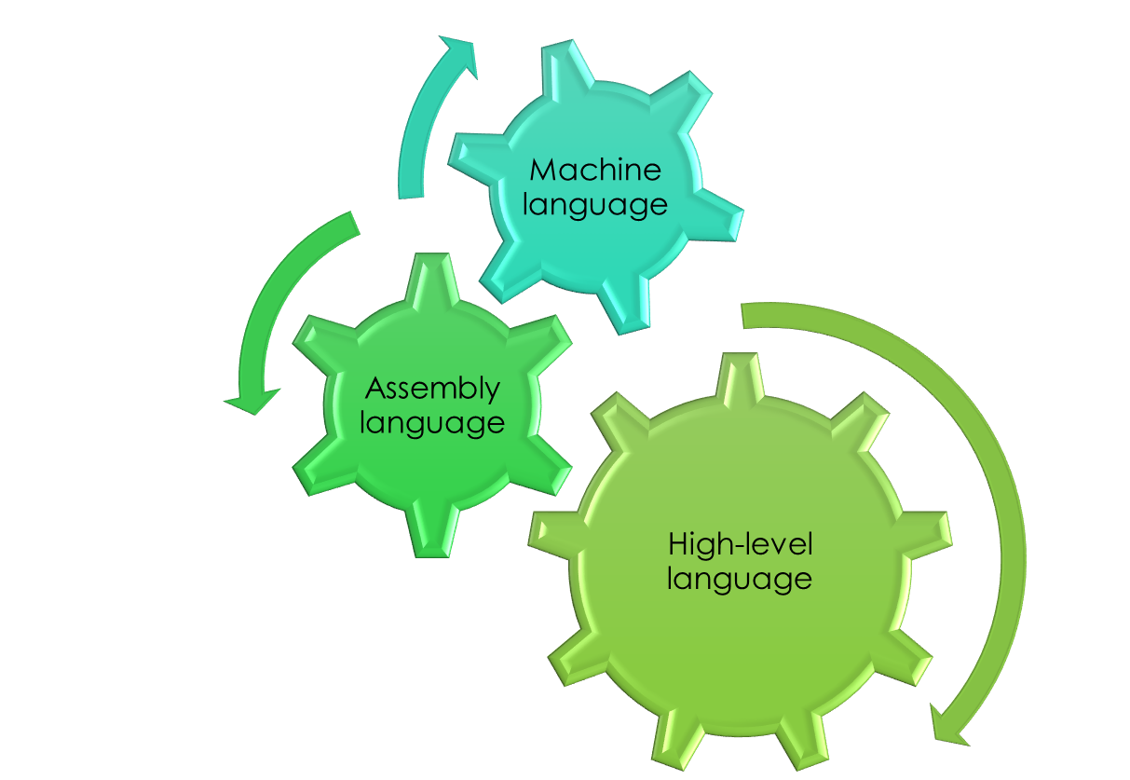
Programming Languages

Slide 10
Example
Because of abstractions, this is easy to write into a high-level language and expect the correct answer to pop out.
Without abstraction, the numbers need to be converted to binary and the calculation part decomposed into assembly instructions. Also, the steps taken to assign the value to ‘X’.
High-level languages are programmed to automatically do specific machine language steps when they come across a symbol such as * or +.
Since you’re probably going to use these more than once in your code, it’s beneficial for the high-level languages to already have written those steps into one simple call.
X =(3-2) * 10

Slide 11
How to implement abstraction
No duplicate code
If you find yourself writing the same code over and over again, script it
An abstraction will generalize functionality with input parameters that allow software reuse (think functions)
Software is developed using abstractions such as constants, expressions, statements, procedures, and libraries. Basically stuff that can be reused.

Slide 12
So how does this relate to security?
We can apply abstraction to the code in order to separate design from implementation
So, what the user sees and what the code actually does will be two different things
In this way, we protect the intellectual property of the company
Others can’t steal your code if they can’t see the code

