Slide 1
Reducing Complexity Principles
2. Layering

Slide 2
Learning Outcomes
Upon completion of this unit, students will be able to:
Identify different layers of security.

Slide 3
What is Layering?
Integrating multiple security defenses to patch possible gaps in a different layer of security
For example, Norton’s Internet Security Suite provides:
Antivirus
Firewall
Anti-spam
Parental controls
Privacy controls
Layering is only useful when used with a range of different types of defenses, rather than redundancy of a single type.

Slide 4
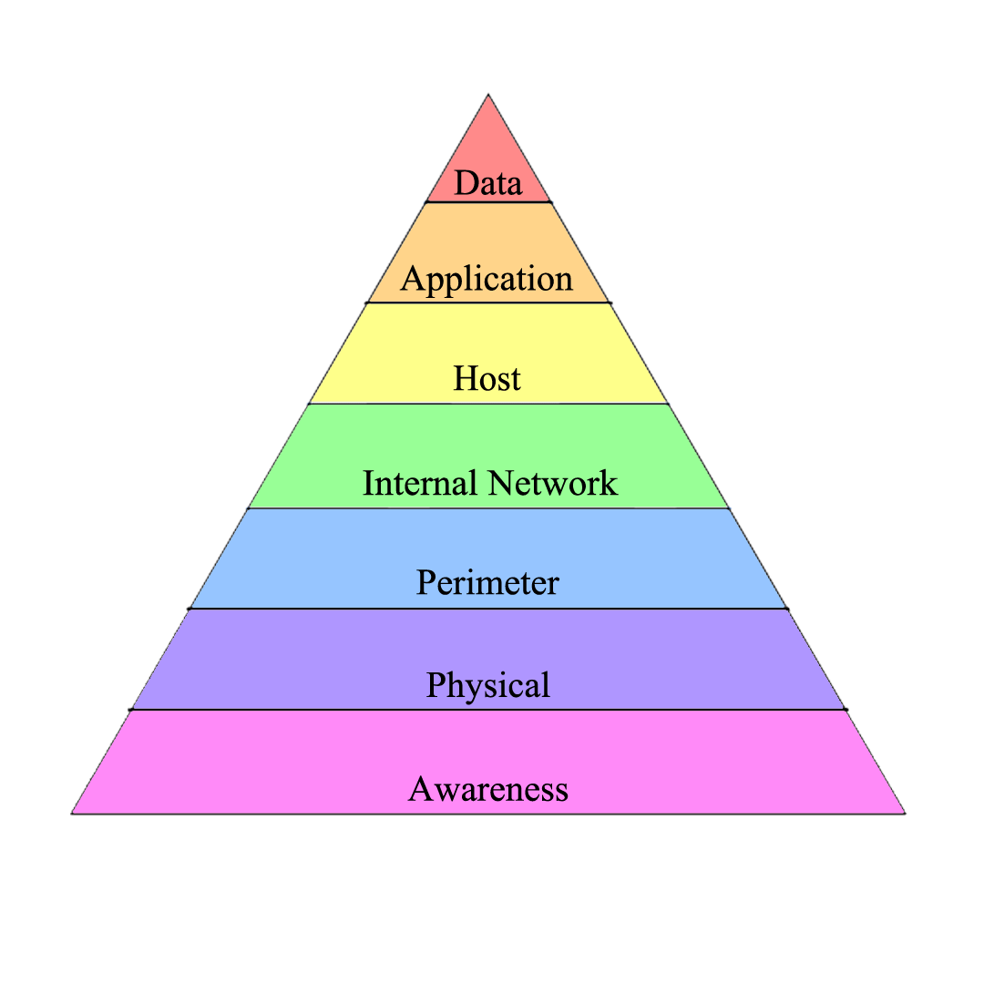
The Layering Hierarchy
Database Security (online backup)
AAA, Security Assurance (coding)
Vulnerability Management (patches)
Encryption, Firewalls
DoS Prevention, Message Parsing
Fences, Keys, Badges
Password Strengths, Usage Policies

