Slide 1
Principle of Hierarchy

Slide 2
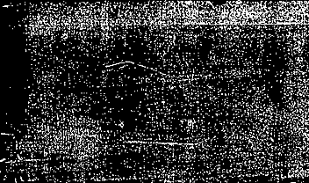
What is it?
Things are grouped into different levels
A variety of different levels
Allows work with little or no knowledge
Every level is an abstraction of some idea

Slide 3
Why use it?
Easier to write
Easier to read, modify, and extend.
Build more complicated structures
Reduces errors

Slide 4
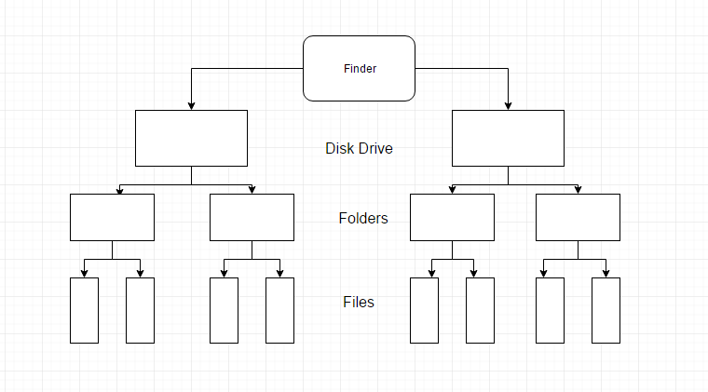

An Example of a file hierarchy system:

Slide 5
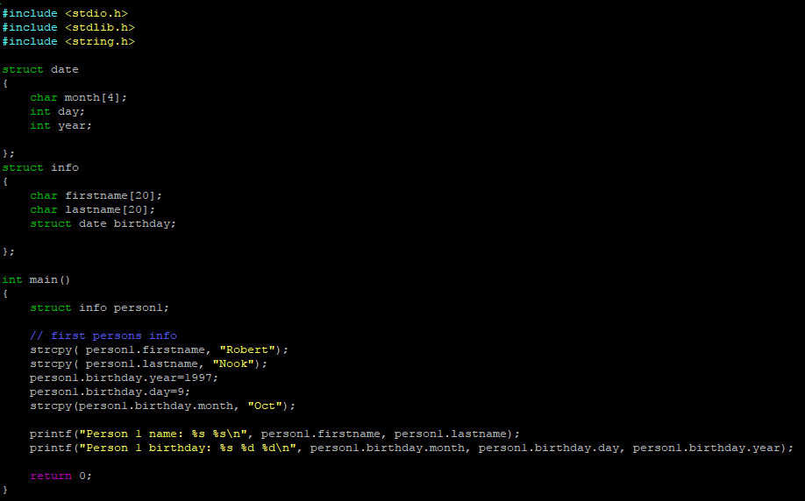

Slide 6

Your output should look Something like this:

