Slide 1
Reducing Complexity Principles
3. Hierarchy

Slide 2
Learning Outcomes
Upon completion of this unit, students will be able to:
Know what a hierarchal structure is and how to implement it
Explain how using hierarchal structures makes software more secure

Slide 3
What is it?
In a hierarchical structure, things are grouped into different levels
There is a “top” level and then lower levels underneath of it.
This allows you to work in any one level with little or even no knowledge of any other level
Every level is an abstraction of some idea, concept, or classification.

Slide 4
Why use it?
It makes programs easier to write
Programs written in a clear, hierarchical manner are easier to read, modify, and extend.
It lets you build more and more complicated structures on top of each other.
This helps secure your program by reducing the amount of possible errors

Slide 5
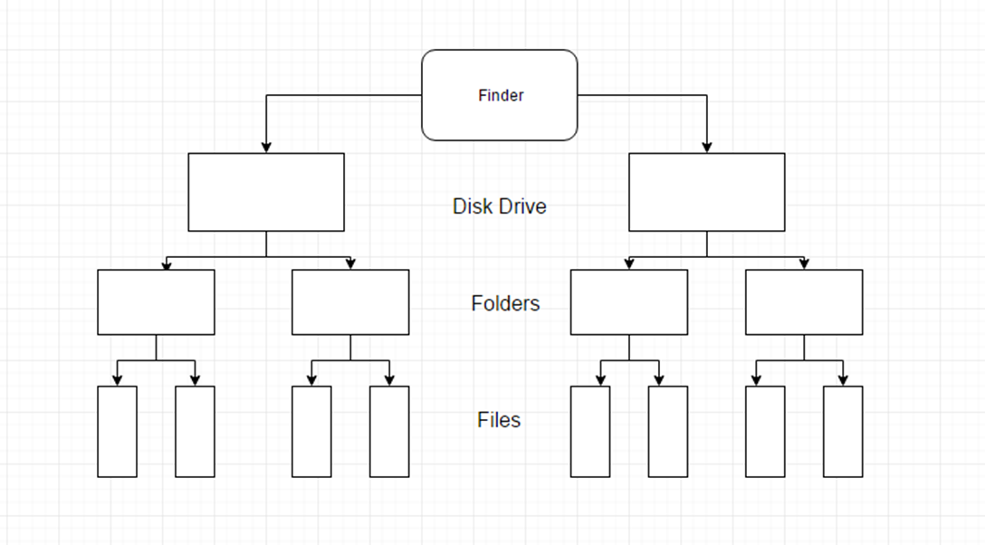
An example of a file hierarchy system:

Slide 6
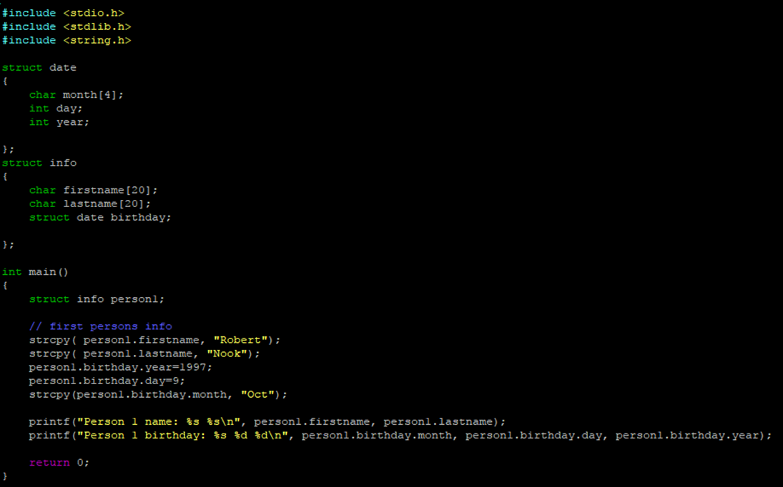
An example using layered structures in C programming:

