Slide 1
Social Engineering

Slide 2
What is it?
By definition social engineering is the use of deception to manipulate individuals into divulging confidential or personal information that may be used for fraudulent purposes

Slide 3
Common Social Engineering techniques
Baiting
Phishing
Water holing
Quid pro quo
Tailgating

Slide 4
Phishing
What is it?

Slide 5
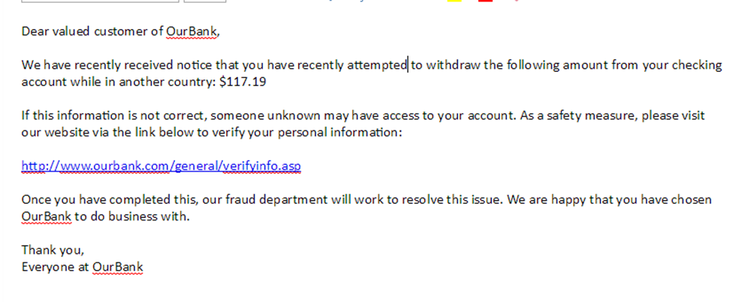
Example of a Phishing email

Slide 6


Baiting
Attackers leave malware-infected software in locations people will find them with curiosity-piquing labels such as “Salary Info 2017” and wait for people to open or install them

Slide 7
Water Holing
Water holing is a targeted strategy that capitalizes on the trust that users have in websites that they regularly visit
The attacker looks for vulnerabilities in the websites that are most often visited by these employees
Uncommon but dangerous

Slide 8
Quid Pro Quo
Claims to be technical support
Walks through steps to “fix problem”
Installs malware instead

Slide 9
Tailgating
Attacker follows person into restricted area
The attacker could be holding a box or something that requires both hands

Slide 10
How to prevent it
Slow down
Research
Delete any request for financial information or passwords
Don’t click on links; search for the site yourself

