Slide 1
User Experience /Human Computer Interface Security
3. Social Engineering

Slide 2
Learning Outcomes (Calibri, 33, Black)
Upon completion of this unit, students will be able to:
Know what social engineering is
Describe the different kinds of social engineering
Know how to spot phishing emails and other social engineering tactics

Slide 3
What is it?
By definition social engineering is the use of deception to manipulate individuals into divulging confidential or personal information that may be used for fraudulent purposes
Criminals use social engineering tactics because it is usually easier to exploit your natural instinct rather than hack your software
For example, it is much easier to fool someone into giving you their password than to try to hack it

Slide 4
Common Social Engineering techniques
Baiting
Phishing
Water holing
Quid pro quo
Tailgating

Slide 5
How to prevent it
Slow down
Hackers want you to act first and think later
Research
Be suspicious of any messages from companies you use
Delete any request for financial information or passwords
Don’t click on links; search for the site yourself

Slide 6
Phishing
What is it?
The fraudulent practice of sending emails pretending to be reputable companies to induce individuals to reveal private information

Slide 7
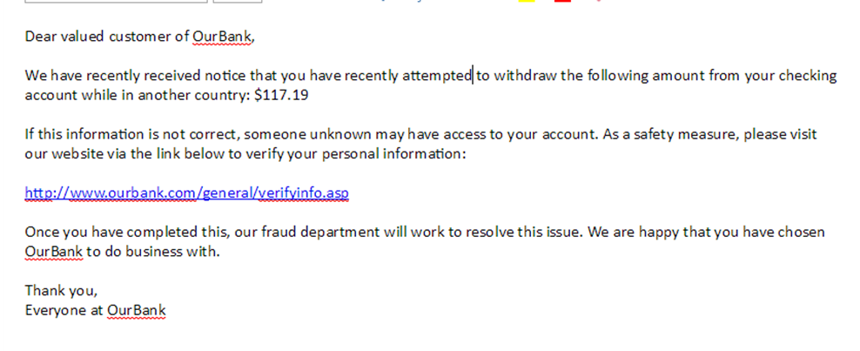
An example of a Phishing email

Slide 8
Baiting
This attack relies on the curiosity or greed of the victim
Attackers leave malware-infected software in locations people will find them with curiosity-piquing labels such as “Salary Info 2017” and wait for people to open or install them

Slide 9
Water Holing
Water holing is a targeted strategy that capitalizes on the trust that users have in websites that they regularly visit
Targets are typically employees of large enterprises or government offices
The attacker looks for vulnerabilities in the websites that are most often visited by these employees and injects malicious code that redirects the target to a separate site that malware is hosted.
Watering hole attacks are uncommon, but they are very dangerous because they are difficult to detect

Slide 10
Quid Pro Quo
Means “something for something”
Attacker calls company numbers claiming to be technical support
The attacker then walks the worker through the steps that they believe is helping, but instead is steps to install malware

Slide 11
Tailgating
An attacker seeking entry into a restricted area follows behind someone who has legitimate access
The attacker could be holding a box or something that requires both hands
The legitimate person will typically hold the door open for the tailgater out of common curtesy (instead of slamming the door in their face, right?)

