Slide 1
Vulnerabilities
1. Vulnerability Taxonomies

Slide 2
Learning Outcomes
Upon completion of this unit, students will be able to:
  Understand what CVE does.
  Understand what CWE does.
  Understand what OSVDB does.
  Understand what CAPEC does.

Slide 3
Topics covered
CVE
  Common Vulnerabilities and Exposures
CWE
  Common Weakness Enumeration
OSVDB
  Open Source Vulnerability Database
CAPEC
  Common Attack Pattern Enumeration and Classification

Slide 4
CVE – Common Vulnerabilities and Exposures
Vulnerability Taxonomies

Slide 5
CVE – Common Vulnerabilities and Exposures
A list of standard terms (CVE identifiers) for publicly known security threats
  Basically, a naming standard for security threats
Sponsored by the US Department of Homeland Security
Free to use
  Maintained by MITRE, a nonprofit company
Is an international effort
  Organizations around the world are actively involved in making their products CVE-compatible
If everyone follows CVE as the naming standard, it’s easier to identify information about a single problem from multiple resources

Slide 6
CVE – History
Most information security tools used their own database that uses their own naming system for security vulnerabilities
Each vendor used different measurement methods to state the number of vulnerabilities or exposures they detected
Consequences:
  Possible gaps in security coverage
  No effective interoperability among the databases and tools
Launched in 1999
  CVE was the solution to unify information security tools

Slide 7
CVE – How does this work?
When a threat is discovered and disclosed, CVE Numbering Authorities assign the threat a CVE ID then post it on the CVE list
Before it can be posted, the Vulnerability Disclosure Policy must be obeyed
  The affected vendor will be contacted about the found threat with Proof of Concept
  The vendor should correct the threat within 90 days
  After the threat is corrected, it will be disclosed to the public
  The vulnerability is then assigned a CVE and put on the CVE list

Slide 8
CVE – Security Threats
The security threats are divided into 2 categories:
  Vulnerability
    Mistake in software that a hacker can use to gain DIRECT access to a system or network
  Exposure
    Mistake in software that a hacker can use to gain INDIRECT access to a system or network

Slide 9
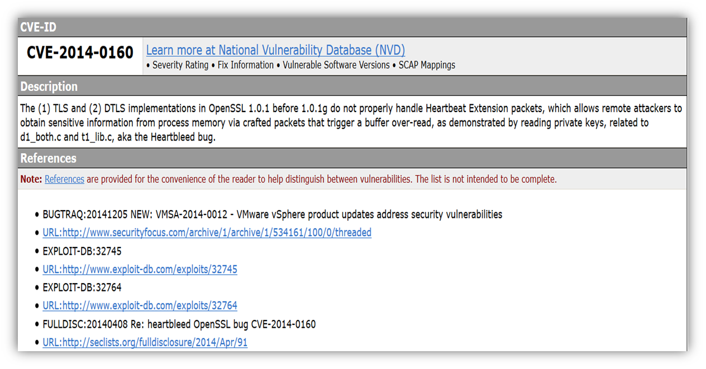


CVE identifier
The identifier includes:
  A CVE Identifier Number
    Basic syntax is “CVE-Year-Arbitrary Digits”
    Looks like “CVE-2013-1002”
  Brief description of the security vulnerability or exposure
  Any relevant references
    Vulnerability reports and advisories
cve.mitre.org

Slide 10
CVE – Who can make CVE Identifiers?
CVE Numbering Authorities (CNAs)
  Trusted major OS vendors, security researchers, and research organizations
  These people are allowed to assign CVE Identifiers to newly discovered issues
Reasons for having CNAs?
  They don’t have to go through MITRE to release an identifier to the public
  Puts the burden on the community to keep it updated instead of MITRE having to use man power to keep it updated
    Less work on MITRE to manage and maintain the CVE

Slide 11
CVE – Won’t this help hackers?
Any discussion involving vulnerabilities can help hackers
So why do the benefits of having CVE outweigh the risks?
  It takes a lot more work for an organization to protect its networks and fix all possible holes than it takes for a hacker to find a single vulnerability to exploit
    The organization can use the CVE to identify the problem and easily find the solution
  Sharing information within the information security community is much harder than it is for hackers to share information
    CVE provides a sharing platform for information security organizations to communicate security threats

Slide 12
To search for CVE Identifiers
This will provide a comprehensive evaluation of the CVE Identifier
  http://www.cvedetails.com/
Official site
  https://cve.mitre.org/cve/cve.html

Slide 13
CWE – Common Weakness Enumeration
Vulnerability Taxonomies

Slide 14
CWE – Common Weakness Enumeration
Online list of software weaknesses
  Serves as a common language, a measuring stick for software, and a baseline for weakness identification, mitigation, and prevention efforts
Free
  Also maintained by MITRE
Compiled and updated by a group of experts from business academic institutions and government agencies
The software weaknesses will be named in a similar fashion to the CVE identifiers
  Example: CWE-493
    Note: CWEs do not include the year

Slide 15
CWE – Tiers
The CWE is assembled into 3 tiers
  Top tier
    Divides known weaknesses into a few large, general classes
      Used by enterprise management people, academics, researchers, and vendors
  Middle tier
    Divides into several dozen categorized groups of definitions
      Used by security experts, system administrators, and software developers
  Lower tier
    Full list of weaknesses
      Used by people at all levels including PC users

Slide 16
CWE – What’s the purpose?
Allows service providers to inform users of weaknesses and possible solutions
Allows software buyers to have a good comparison of similar products offered by different vendors
Allows legal personnel to formalize contracts, terms, and conditions of a certain software’s usage
Organizations want assurance that the software products they buy or develop are free of known security flaws

Slide 17
To search the CWE
http://cwe.mitre.org/data/index.html

Slide 18
OSVDB – Open Source Vulnerability Database
Vulnerability Taxonomies

Slide 19
OSVDB – Open Source Vulnerability Database
Independent, open-sourced database of vulnerabilities
Started in 2002 at the Blackhat and DEFCON conferences
  The database was officially open to the public in 2004
Why did they create this?
  To provide accurate, non-biased technical information on security vulnerabilities
The open source nature of the database promoted greater collaboration between companies and individuals
  The idea was to eliminate redundant work and reduce expenses from the development and maintenance of running a vulnerability database

Slide 20
OSVDB – Open Source Vulnerability Database
The database was shutdown on April 5th, 2016
  The creators couldn’t get the security community to support the database and contribute to it
  Thus, the creators were straining themselves keeping this database updated and maintained

Slide 21
OSVDB
While the database can no longer be accessed, the blog they created is still active
https://blog.osvdb.org/
  This blog provides commentary on things related to vulnerabilities

Slide 22
CAPEC – Common Attack Pattern Enumeration and Classification
Vulnerability Taxonomies

Slide 23
CAPEC – Common Attack Pattern Enumeration and Classification
Comprehensive dictionary and classification taxonomy of known attacks
  Complex taxonomy of hundreds of attack classes showing textual, categorical, and referential data
  These are common methods for exploiting software systems
Free
  Maintained by MITRE
Released in 2007
Naming is same as CWE but uses CAPEC
  Example: CAPEC-66

Slide 24
CAPEC – Common Attack Pattern Enumeration and Classification
Why is this useful?
  Advance community understanding of these attacks and enhance defenses
  Able to communicate with others about a specific attack and have them understand exactly what you’re referring to
  Used mainly by analysts, developers, testers, and educators
Public participation and contributions continue to develop the list
  CAPEC provides the means for identifying, collecting, and sharing attack patterns among the information security community

Slide 25
CAPEC – Classification taxonomy
Uses a hierarchy; can be classified in two ways
  Top of hierarchy is a set of categories called Mechanisms of Attack
    Collect and Analyze Information
    Inject Unexpected Items
    Engage in Deceptive Interactions
    Manipulate Timing and State
    Abuse Existing Functionality
    Employ Probabilistic Techniques
    Subvert Access Control
    Manipulate Data Structures
    Manipulate System Resources

Slide 26
CAPEC – Classification taxonomy
  2. Top of hierarchy is a set of categories called Domains of Attack
    Social Engineering
    Supply Chain
    Communications
    Software
    Physical Security
    Hardware
  Within those categories are meta-level patterns
    These meta-level patterns are parents to standard patterns
      These standard patterns may be parents to detailed patterns

Slide 27
CAPEC – Attack Patterns
Each attack pattern shows a few things:
  How a specific part of the attack is designed and how it will execute
  General aspects of the attack that are used frequently
  The attacker’s challenges and how they would solve them
  Guidance on how to mitigate the attack
These attack patterns are researched extensively using real-world exploits as examples
Examples of attack patterns
  HTTP Response Splitting (CAPEC-34)
  SQL Injection (CAPEC-66)
  Buffer Overflow (CAPEC-100)
  Clickjacking (CAPEC-103)

Slide 28
Search CAPEC
https://capec.mitre.org/data/definitions/1000.html

Slide 29
Conclusion
These vulnerability taxonomies have forever impacted the way we communicate security threats
CVE, CWE, OSVDB, and CAPEC were all created to provide a standard for security threats that would unify the information security community
  better communication about security threats
  produced a world-wide collaboration
  Platform to share information
  Helps developers debug their software

