Slide 1
Vulnerabilities
2. Buffer Overflow & Number Over/Underflows

Slide 2
Learning Outcomes
Upon completion of this unit, students will be able to:
  List different types of buffer overflows.
  Perform a buffer overflow.
  Point out vulnerable C code.

Slide 3
Buffer Overflow
A buffer overflow occurs when a program or process attempts to write in more data to a block of memory than the buffer can actually hold
Buffers contain a defined amount of data
  Extra data can overwrite values in memory addresses
  Bounds checking or discarding data can help prevent this
Allows an attacker to control, modify, or crash a process
  Attacker can gain partial or total control of the host
  Gain the ability to access other files, manipulate programming, or delete important data
    Do this by injecting shell code into the buffer so they can have a root shell

Slide 4
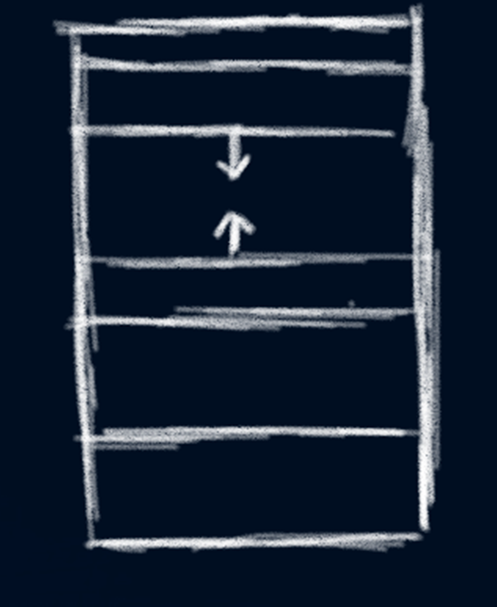
Memory address space of a process
Kernel
Stack
Empty
Heap
Data
Text

Slide 5
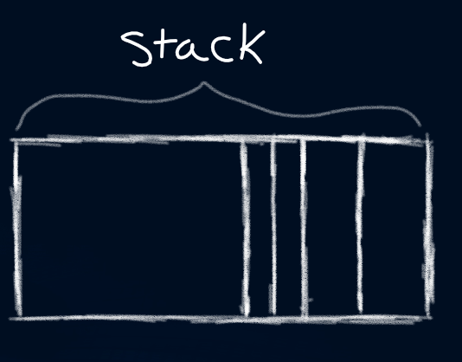
Components of stack memory
Buffer
Instructions
Parameters
Base pointer
Return address

Slide 6
Way it works – Example
Allocate memory in a program – say 500 bytes
We need to know how big our malicious code is – say 100 bytes
So, we need a little over 400 bytes of NOP code (no operation) – say 410 bytes
  This ensures the malicious code goes into the base point of the stack
The first 410 bytes are in the buffer area. The 100 bytes of malicious code fills the rest of the buffer and the base point
Add on the address of our malicious code to the return address in the stack
Now we have exploited buffer overflow

Slide 7
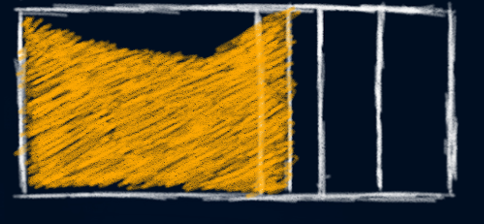
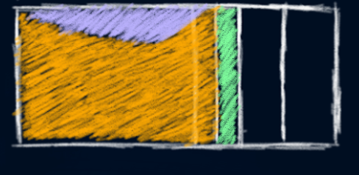

Way it works – Example
Malicious code (100 bytes)
NOP code (410 bytes)
Address of Malicious code (10 bytes)
buffer overflow (>500 bytes)
User input

Slide 8
Types of buffer overflows
Stack based
  Most common type
  Exploits a memory spaced reserved for an object in a program
Heap based
  Difficult to do; rare
  Flood memory space reserved for a program

Slide 9
Integer Overflow
Occurs when a program using a number in a mathematical operation will result in a larger number that ends up not fitting in the integer type used to store it
You can’t exploit an integer overflow to add arbitrary malicious code to the program
So how is this a dangerous exploit?
  The system cannot detect that the calculation is incorrect and will operate under the assumption that it is
    The result is unexpected behavior from the system
  Bad calculations can wreak havoc on programs that are used for sensitive things like rockets or money calculations

Slide 10
Integer Underflow
Underflow occurs when a resulting value is too small for the program’s precision
Example:
  Computer supports up to 10 decimals
  The resulting value ends up being 0.0000000000001
    13 decimals > 10 decimals
  Underflow will occur
There are a few different ways a computer will handle an underflow
  Error
  Use an approximation instead

Slide 11
Format String attack
Alter the flow of an application by exploiting certain functions like printf or sprint to access other memory space
Used to crash a program or execute harmful code
  Attacker can overwrite control access privileges
  Attacker can overwrite return addresses
What is a format string?
  Example: printf(“My house number is: %d\n”, 404);
Occurs when the format string is requesting more arguments (%d, %s, etc) than you give to it
  Example: printf(“My house number is: %d %d %s %s\n”, 404);
  The program will fetch numbers from the stack which will be treated as memory locations

Slide 12
Why this exploit works so well
Applications fail to manage their memory allocations or validate input
Applications developed in C or C++ use library functions that are not bound checked
  gets, scanf, strcpy
No bounds checking on user input and data

Slide 13
Avoiding exploitation
Use strong type languages that will detect buffer overflows
  Java, C#, etc.
  Avoid these : gets, strcpy, strcat, sprint, scanf
  Replace with these: fgets, strncpy, strncat, snprintf
Use bounds checking
  Make sure input is of correct length
  Make sure input does not contain unwanted character types
Test code
  Try to break it in every way possible before a hacker has the chance
Use Address Space Layout Randomization (ASLR)
  Randomizes the base address of items in the process’s address space
  The addresses change with each system boot, making the locations unpredictable

Slide 14
The Morris Worm – 1988
One of the first computer worms, Morris worm used a buffer overflow in vulnerable version of fingerd on VAX systems to spread from machine to machine
  VAX is a discontinued line of mid-range server computers (some old systems are still in use)
  Fingerd is a daemon that provides interface to the “finger” program at most network sites (it’s supposed to return a status report on either the system or a person
Written by a grad student at Cornell University
  He wanted to gauge the size of the internet but the worm turned into a denial of service attack
  If the worm got into a computer it had already infected, it made a copy of itself to infect it again

Slide 15
The Morris Worm continued ~
Infected more than 60,000 machines and shut down the internet for several days
Exploited the gets() function in fingerd
  finger daemon declared 512-byte buffer without any bounds checking
  The code contained 400 bytes of NOP instructions (also called NOP sled) then instruction for execve(“/bin/sh”,0,0) system call (shell code)
Resulted in the first felony conviction in the US under 1986 Computer Fraud and Abuse Act
  Sentenced to 3 years probation, 400 hours of community service, and a $10,050 fine
  Morris would’ve stayed anonymous but his father convinced him to confess
This worm changed the perception of technology as we know it. Not only did it slow computers to a crawl and cause drastic system downtime, but also psychologically impacted our perception of security and reliability of the Internet

Slide 16
Blaster Worm – 2003
In July, Microsoft declared a buffer overrun in the Windows RPC interface
  Allowed attack to run arbitrary virus code on systems
In August, Blaster worm attacked a known buffer overflow in Microsoft Remote procedure call (RPC) process using TCP port 135
Also called “MS Blast” or “Lovesan”
Affected operating systems Windows XP, Windows NT 4.0, and Windows 2000
Once installed, blaster attempted to find other vulnerable computers through email and other methods
  When found, blaster would instruct the computer to create a process on the target computer and cause the worm to be downloaded to it

Slide 17
Blaster Worm continued ~
Blast worm downloaded MSBlast.exe to the windows directory and then executed it
Worm caused systems to reboot every 60 seconds due to a flaw in the worm’s code which caused the computers to crash and reboot
The worm was programmed to start a SYN flood against port 80 of windowsupdate.com
  This created a distributed denial of service attack
  Intended to target Bill Gates
  MSBlast.exe contains the following messages:
    “I just want to say LOVE YOU SAN!!”
    “billy gates why do you make this possible ? St0p making money and fix your software !!”

Slide 18
Heartbleed – 2012-2014
Introduced into OpenSSL in 2012, publicly disclosed in 2014
  Not a buffer overflow but classified as a “buffer over-read”
    Buffer overflow is sending the server too much data, buffer over-read is receiving more data than you’re allowed
Exploits a memory safety bug in OpenSSL
  Exploits the use of memcpy()
  OpenSSL is an open source cryptography library that implements the Secure Sockets Layer (SSL) and Transport Layer Security (TLS) protocols
    It generates keys and certificate signing requests, checksums, performs encryption and decryption

Slide 19
Heartbleed continued ~
Someone sends data to the server and wants it echoed back
    They have to send both the length of it and the data itself
An attacker can send OpenSSL some small data but say they’re sending 64KiB (the max)
OpenSSl would then say “okay I’ll send you back this small data and some other stuff to make up 64KiB”
    The attacker can’t choose what data is sent back to them, but if done enough times, eventually they’ll get something interesting and sensitive

Slide 20
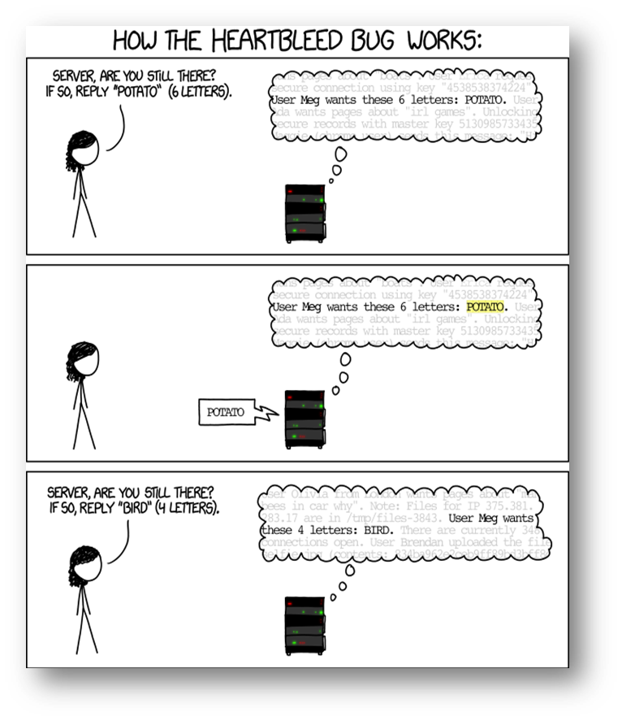
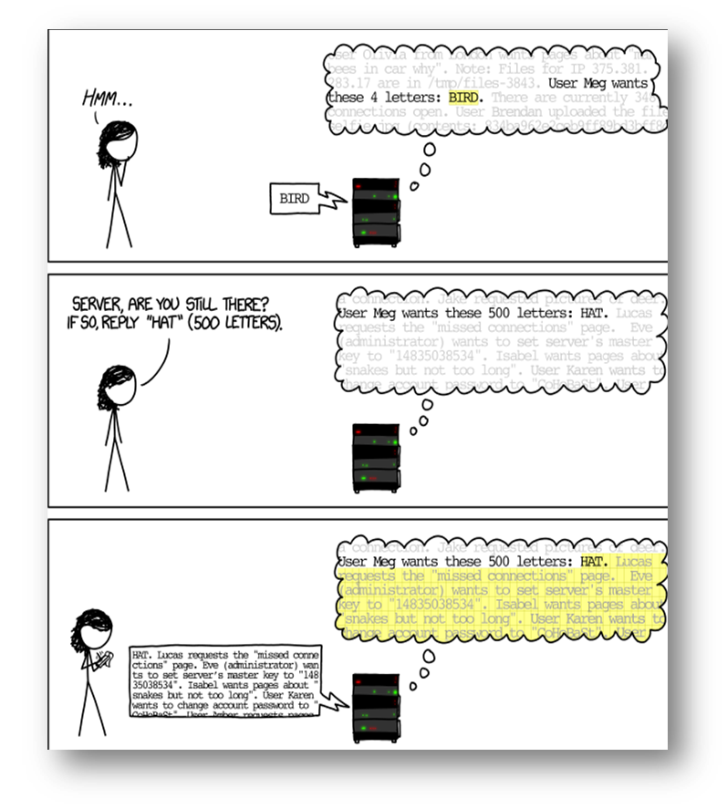
Heartbleed continued ~
Property of xkcd

Slide 21
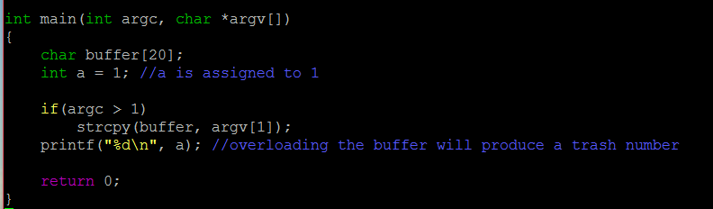
Demo – code
Written in C
Vulnerable code:
  strcpy()
Takes an argument from the command line and copies it into buffer
Prints out the value of “a”

Slide 22
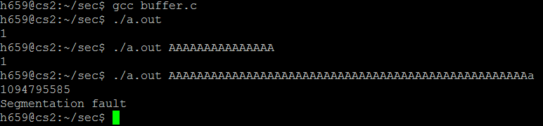
Demo – output
Running ./a.out produces normal results
Adding command line values
  ./a.out AAAAAAAAAAA will run normal
  Running ./a.out AAAAAAAAAAAAAAAAAAAAAAAAAAAAAAAAAA produced a junk value and segmentation fault
    Thus, we have overflowed the buffer

