Slide 1
Input Validation

Slide 2
What is input validation?
All applications require input of some kind
Input validation is the correct testing for any input that is supplied by something else
User input could come from:
An end user
Another application
Malicious user
Or any number of sources
Because of this, all input entered should be tested and validated in order to protect against a potential attack

Slide 3
Whitelists vs blacklists
A black list is testing a desired input against a list of negative inputs
Allow everything EXCEPT…
A white list is testing a desire input against a list of positive inputs
Disallow everything EXCEPT …
So which is better?

Slide 4
Whitelisting vs. blacklisting
Commonly, black list validation tries to detect possible dangerous characters and patterns like the apostrophe, the string “1=1”, or the <script> tag
This does not work because these are easy to work around
Instead of 1=1, doesn’t 2=2? Or 5 > 1 ??
White list validation defines exactly what IS authorized
Length
Patterns (such as email addresses)
Numbers (for date options or social security etc.)

Slide 5
vulnerabilities resulting from incorrect input validation
Buffer overflows
Injection attacks (SQL and more)
DoS attacks
Memory leakage
Information disclosure
Compromised systems
….and more

Slide 6
Buffer Overflow
A buffer overflow occurs when a program or process attempts to write in more data to a block of memory than the buffer can actually hold
Allows an attacker to control, modify, or crash programs
Attackers may gain total or partial control over the hosts
Here is an example of a simple buffer overflow that is often cause when the code relies on external data to control its behavior
The code also uses gets() function to read arbitrary amounts of data into a stack buffer
Because there is no way to limit he amount of data read, the safety of this code depends on the user to always enter fewer than BUFSIZE characters

Slide 7
Denial of Service
A Denial of Service attack happens when a machine or network resource is made unavailable to its intended users by temporarily or indefinitely disrupting services of a host connected to the Internet
This is typically achieved by flooding the targeted machine with superfluous requests in an attempt to overload systems
There are many different ways to help prevent this from happening:
IPS based prevention (intrusion prevention systems)
Blackhole and sinking (all the traffic sent to the IP address is sent to a “black hole”)
DDS based defense (blocks connection-based DoS attacks with bad intent)
Firewalls
Routers and Switches

Slide 8
Memory Leakage
Memory leakage occurs when a program incorrectly manages memory allocations by not releasing memory that is no longer needed
Memory leaks slow down the performance of an application by reducing the amount of available memory
If the leakage is serious enough, it could cause the application to crash
This problem can be solved by freeing memory after it is no longer needed

Slide 9
SQL Injection
If there is nothing preventing the user from entering invalid input, they may exploit it using SQL Injection
For example:
If you type in something like this:
The server will include this information in in the SQL statement:
The SQL above will return ALL rows from the “Users” table, since OR 1=1 is always true
This can be especially dangerous if the “Users” table also includes passwords and other account information

Slide 10
SQL injection demo
1) Open the Kali-linux 2 and Metasploitable 2
2) Open Iceweasel; Browse to the IP address 192.168.78.129 in the Kali VM
3) log in using the username: “user” and the password: “password”
4) change the security level to “low”
5) Travel to the “SQL Injection” tab on the left side of the page. You should come to a user ID page
6) This web application is vulnerable to SQL injection because their input validation conditions are not protected. This can be shown by simply typing in:
Name’
7) Once you push submit, an error message will appear. This crash proves that this application is vulnerable to SQL injection

Slide 11
8) Now, we will bypass the authentication by typing this into the User ID: text box:
Rellk’ or ‘1’=‘1
9) Once you push submit, a list of first names and last names should appear
10) Now we need to gather more useful information. In order to do that, we are going use Union statements. Type this into the UserID box:
Rellk’ or 1=1 union select null, database() #
11) It will show the list as it was shown previously, except at the end of the list you will see this:
This happened because we set the first string to show “null” and the second one to show the database (which is the dvwa)
12) Let’s try to get more useful information by asking for all of the table names
Rellk’ and 1=1 union select null, table_name from information_schema.tables #

Slide 12
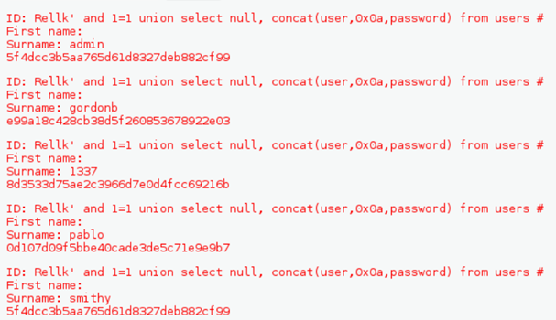
13) Once you push submit, it should show you the complete list of table names that are in the Web application. We are the most interested in the users table. We are going to retrieve all of the column names from this table by typing this into the text box:
Rellk’ and 1=1 union select null, concat (table_name, 0x0a, column_name) from information_schema.columns where table_name = ‘users’ #
14) A list of column names should appear. Among these are the user and password columns, which we are the most interested in seeing. To retrieve this information:
Rellk’ and 1=1 union select null, concat(user,0x0a,password) from users #
You now have the username and password hash of every user on the system

