Slide 1
Password Weakness

Slide 2
What makes a password “weak” ??
Predictability
A password that is easy to predict is easy to crack
Including a mix of:
  Lower case letters
  Upper case letters
  Numbers
  Symbols

Slide 3
Hashing vs Encryption
Encryption is a two-way function
Hashing is a one-way function

Slide 4
Password Storage
Passwords used to be stored in the clear on UNIX systems
In the next attempt to increase security, passwords were hashed
To see if the password supplied was correct…

Slide 5
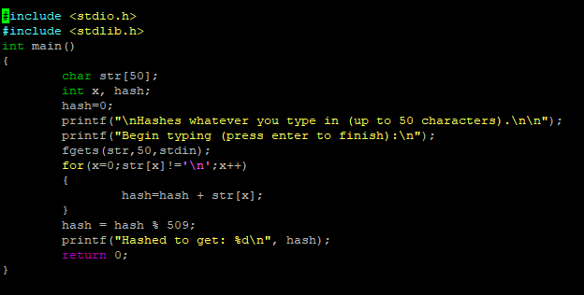
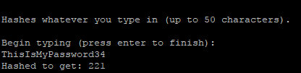
An example of an easily-cracked hash (CRC)
This is the output:

Slide 6
The Next Step:
“Rainbow tables”
  Rainbow tables were a database of passwords and their hash values for a given algorithm
If the table of hashed passwords was available, the cracker just had to look up the hashed value in the rainbow table to reveal the original password.

Slide 7
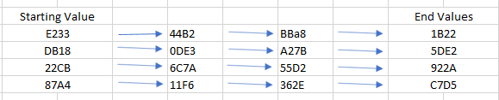
The Next Step:
Salt was created
This made the rainbow tables virtually useless
Example of a rainbow table

Slide 8
More Problems:
Users are in the habit of choosing standard dictionary words, names, and dates
Uppercase is likely to be at the beginning of the dictionary word and a number at the end
Password crackers study lists of released passwords
Of course, this can easily be avoided with a secure, unique password
There are multiple lists of leaked passwords on this page:
https://wiki.skullsecurity.org/Passwords

Slide 9
In This Lab:
“guess and check” method
You will run simple md5 hashes through a program that will check to see if the hash matches any of the passwords in a specified list of passwords
This is how it works:

Slide 10
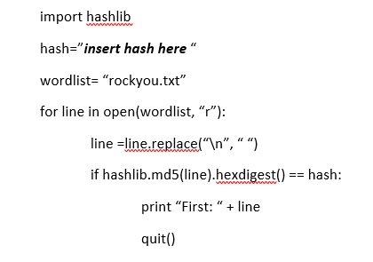

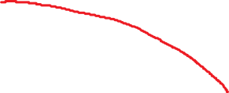


This code takes each of the words in the list and hashes them using the md5 hash.
It then checks the new hash with the hash that you previously provided for the “hash” variable.

Slide 11
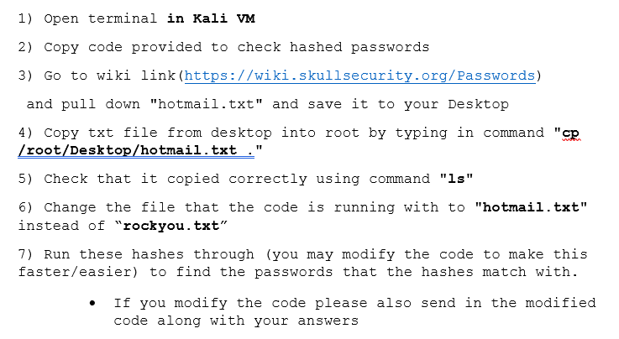

Slide 12

Here is the code you should use to begin (remember you can modify it)

Slide 13
