Slide 1
Password Weakness

Slide 2
What makes a password “weak” ??
Password strength is usually determined by predictability
A password that is easy to predict is easy to crack
Including a mix of:
Lower case letters
Upper case letters
Numbers
Symbols
All of this contributes to making a password more secure

Slide 3
Hashing vs Encryption
Encryption is a two-way function; encrypted messages can be decrypted using the proper key
Hashing is a one-way function that scrambles text to produce a unique message. With a properly written algorithm, there is no way to reverse the hashing process

Slide 4
Password Storage
Passwords used to be stored in the clear on UNIX systems; in order to get passwords you just had to know where they were stored
In the next attempt to increase security, passwords were hashed using well-known hashing algorithms ( such as MD5) and then stored
To check if a correct password had been supplied, the supplied password would be hashed using the same algorithm and compared to the original hashed value. If the values were the same, the passwords must have matched.

Slide 5
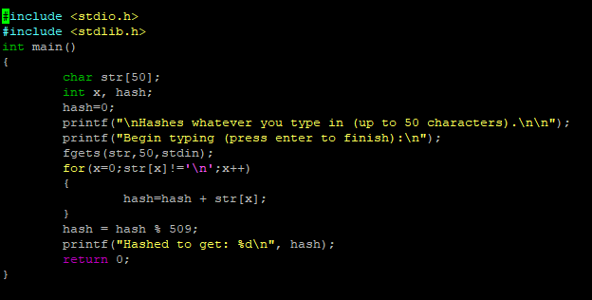
An example of an easily-cracked hash (CRC)
This is the output:

Slide 6
The Next Step:
While most hashes used were not as simple as the CRC hash, hackers were still able to break the passwords by creating “rainbow tables”
Rainbow tables were a database of passwords and their hash values for a given algorithm
If the table of hashed passwords was available (most of the time it was), the cracker just had to look up the hashed value in the rainbow table to reveal the original password.

Slide 7
The Next Step:
In order to fix this problem, “salt” was created. Salt is a value (unique to the machine being used) that is combined with the password to create new hash values for passwords
This made the rainbow tables virtually useless
Example of a rainbow table

Slide 8
More Problems:
However, hackers are very aware of how people come up with their passwords.
Users are in the habit of choosing standard dictionary words, names, and dates. They also know that if there are complexity requirements, the uppercase is likely to be at the beginning of the dictionary word and a number at the end
Password crackers study lists of released passwords and try the most popular ones first
Of course, this can easily be avoided with a secure, unique password
There are multiple lists of leaked passwords on this page:
https://wiki.skullsecurity.org/Passwords

Slide 9
In This Lab:
You will see how the “guess and check” method works using the leaked lists that are found online and some simple python code.
You will run simple md5 hashes through a program that will check to see if the hash matches any of the passwords in a specified list of passwords
This is how it works:

Slide 10
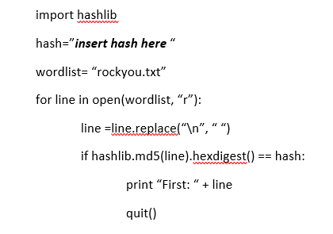
This code takes each of the words in the list and hashes them using the md5 hash.
It then checks the new hash with the hash that you previously provided for the “hash” variable.

Slide 11
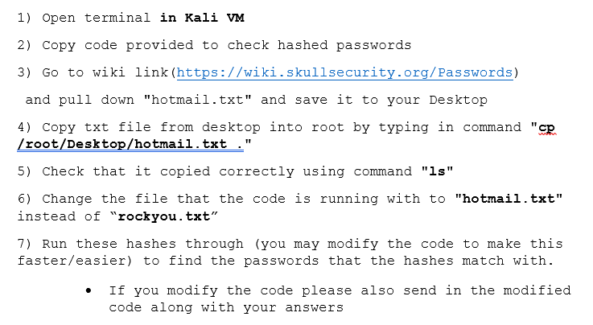

Slide 12
Here is the code you should use to begin (remember you can modify it)

Slide 13
