Slide 1
Race Conditions

Slide 2
What is a race condition?
A race condition occurs when two threads access a shared variable at the same time
If a program has a race-condition vulnerability, attackers can run a parallel process to race against the program to change the behaviors of the program

Slide 3
Causes of race conditions
The most common cause of a race-condition is unpredictable values of shared variables between multiple threads
Sometimes it works; Sometimes it doesn’t
If each thread is executed separately, the variable value will behave as expected

Slide 4
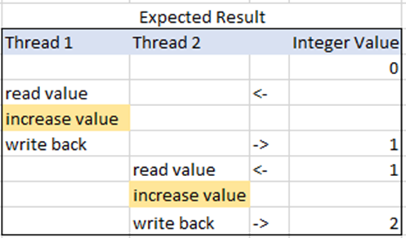


How to fix race condition errors
The best solution to fix a race condition is to put “locks” into place
This will ensure you get the correct result every time the program is run

Slide 5
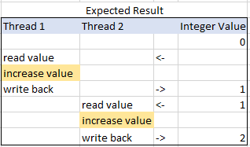
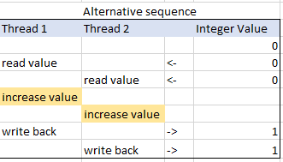
Example:

Slide 6
Thread 1
Add 1 then return
Thread 2
Add 1 then return
Variable
5

Slide 7
Thread 1
Add 1 then return
Thread 2
Add 1 then return
6
Variable

Slide 8
Thread 1
Add 1 then return
Thread 2
Add 1 then return
Variable
6

Slide 9
Thread 1
Add 1 then return
Thread 2
Add 1 then return
7
Variable

Slide 10
Thread 1
Add 1 then return
Thread 2
Add 1 then return
Variable
7
7

Slide 11
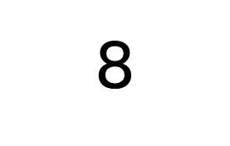
Thread 1
Add 1 then return
Thread 2
Add 1 then return
8
Variable

Slide 12
So…
Instead of Thread 1 and Thread 2 alternating through their processes, they end up trying to grab the same variable at the same time, resulting in the final answer being 8 instead of 9.
If you put locks into place, however, it works as it was expected to:

Slide 13
Thread 1
Add 1 then return
Thread 2
Add 1 then return
LOCK
Variable
5

Slide 14
Thread 1
Add 1 then return
Thread 2
Add 1 then return
6
LOCK
Variable

Slide 15
Thread 1
Add 1 then return
Thread 2
Add 1 then return
LOCK
Variable
6

Slide 16

Thread 1
Add 1 then return
Thread 2
Add 1 then return
7
Variable

Slide 17
Thread 1
Add 1 then return
Thread 2
Add 1 then return
Variable
7

Slide 18

Thread 1
Add 1 then return
Thread 2
Add 1 then return
Variable

Slide 19
Thread 1
Add 1 then return
Thread 2
Add 1 then return
LOCK
Variable
8

Slide 20
Thread 1
Add 1 then return
Thread 2
Add 1 then return
9
Variable

